Slide 1
IGW Contextual Bandits

Slide 2
Motivation
I want to create a custom contextual bandit
I have existing data, do I need to do anything fancy to train my bandit offline?
Is there any limit on the kinds of models I can use?
After deploying how can I do exploration effectively?
IGW techniques makes CB as easy as regression
Off-policy training becomes supervised regression
You can use any function class you want for regression
Optimal exploration follows a simple IGW rule

Slide 3

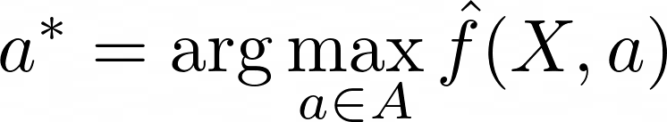
What is IGW?
IGW is an exploration rule that needs two things:
A reward model
The max of your reward model

Slide 4
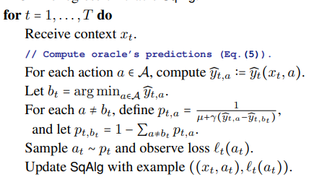
What does IGW Look Like
Foster, Dylan, and Alexander Rakhlin. "Beyond ucb: Optimal and efficient contextual bandits with regression oracles." International Conference on Machine Learning. PMLR, 2020.

Slide 5

How Does It Work?
Foster, Dylan, and Alexander Rakhlin. "Beyond ucb: Optimal and efficient contextual bandits with regression oracles." International Conference on Machine Learning. PMLR, 2020.

Slide 6
How Does It Work?
Foster, Dylan, and Alexander Rakhlin. "Beyond ucb: Optimal and efficient contextual bandits with regression oracles." International Conference on Machine Learning. PMLR, 2020.
Regret

Slide 7
How Does It Work?
Foster, Dylan, and Alexander Rakhlin. "Beyond ucb: Optimal and efficient contextual bandits with regression oracles." International Conference on Machine Learning. PMLR, 2020.
MSE

Slide 8

How Does It Work?
Foster, Dylan, and Alexander Rakhlin. "Beyond ucb: Optimal and efficient contextual bandits with regression oracles." International Conference on Machine Learning. PMLR, 2020.

Slide 9

How Does It Work?
Foster, Dylan, and Alexander Rakhlin. "Beyond ucb: Optimal and efficient contextual bandits with regression oracles." International Conference on Machine Learning. PMLR, 2020.

Slide 10
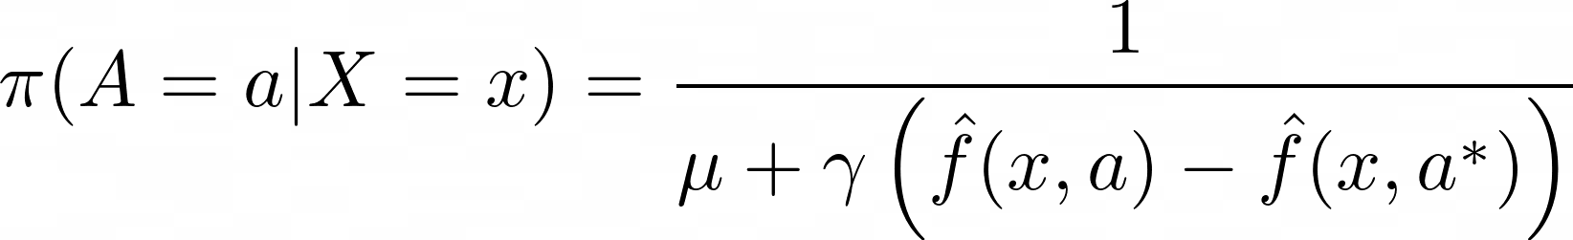
One More Time (IGW Exploration Policy)

Slide 11
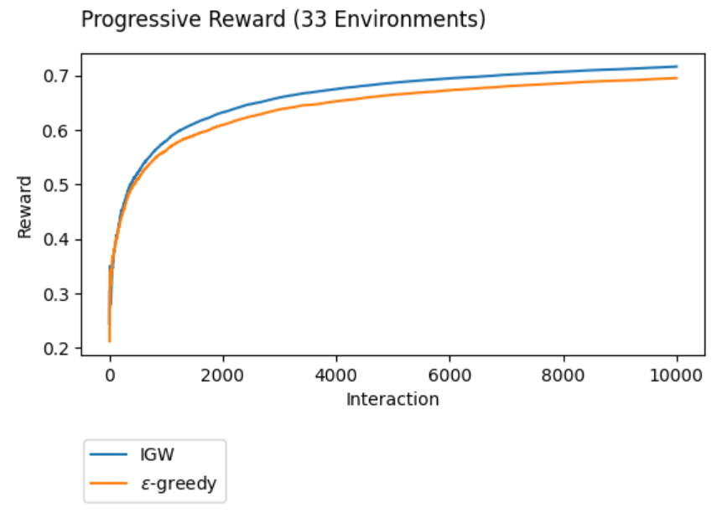
Experimental Results
IGW beats Epsilon-Greedy while still being model class agnostic

Slide 12
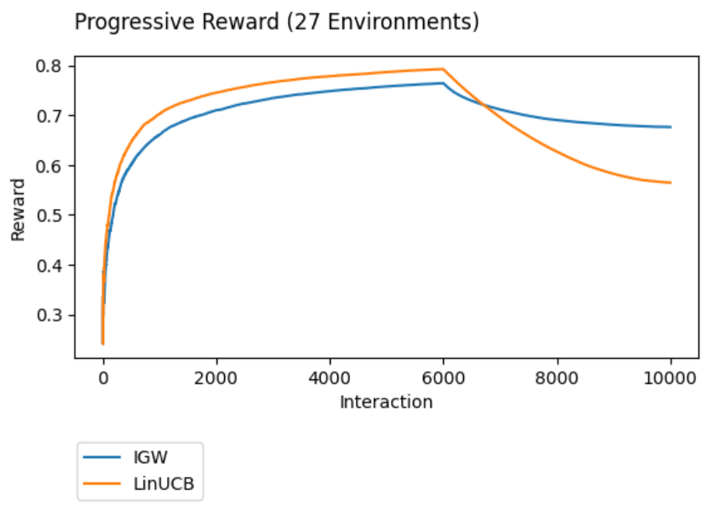
Experimental Results
IGW beats LinUCB when the very strict assumptions of LinUCB are violated.

Slide 13
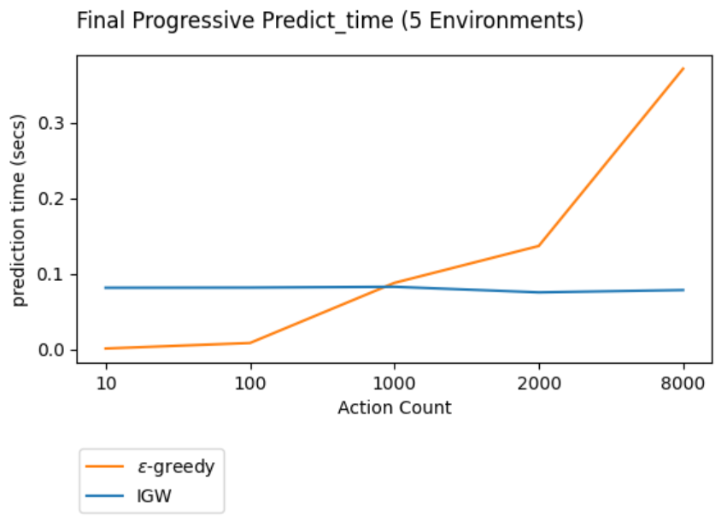
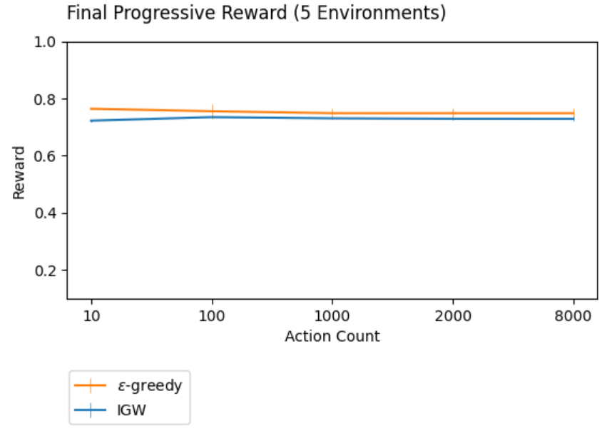
Experimental Results
CappedIGW* substantially beats epsilon-greedy in prediction time as the number of actions increases while losing only slightly in terms of total reward.
* Rucker, Mark, Yinglun Zhu, and Paul Mineiro. "Infinite Action Contextual Bandits with Reusable Data Exhaust." arXiv preprint arXiv:2302.08551 (2023).

