Slide 1
Capstone Presentation
Customer Churn Analysis
- Mrudhulaa PV

Slide 2
Business Problem Understanding
The E-commerce company is currently facing difficulties in retaining customers due to the intense competition in the market
Loss of customers implies loss in revenue
Broadcasters' profitability are impacted by high customer acquisition costs and fixed content fees
Five times the cost of client retention equals the cost of customer acquisition
Profits rise from 25-95% when client retention is increased by 5%
OBJECTIVE:
To overcome this challenge, the company plans to create a model that can predict customer churn and provide customized offers to potential churners.

Slide 3
SCOPE:
The most effective model for predicting churn
Significant insights and recommendations from the model and EDA
CONSTRAINTS:
Prior retention initiatives may have included cashbacks or discounts, but this is unknown
Unknown campaign budget

Slide 4
Data Ingestion
The given data has 19 variables (including target variable) and 11260 observations
Variables are of integer, string and float data types and few are also categorical in nature
Data does not show any duplication
Variables have presence of null values in data
Numerical variables are not normally distributed and are skewed in nature
Numeric variables also shows presence if outliers
Targe variable (Churn) shows that data is imbalance in nature

Slide 5
Modelling Approach Used
Visual inspection
Observe rows & columns, data attributes, datatypes, null values, duplicates
Perform data cleaning
Statistical description
EDA
Perform univariate and bivariate analysis
Perform univariate analysis for categorical variables
Correlations between variables
Data preparation
Remove unwanted variables (Account ID)
Missing value treatment
Outlier treatment
Variable transformation (Encoding)
Pre-processing
Train-test split in 70:30 ratio
Scaling
Modelling
Test several algorithms and measure performance on the train and test
Hyperparameters tuning on data
Depending on evaluation metrics, choose the best model

Slide 6
Comparison of model performance
Model | Training dataset |  |  |  | Testing dataset
 | Accuracy | Recall | Precision | F1-Score | Accuracy | Recall | Precision | F1-Score
Gradient Boosting tuned | 1.00 | 0.98 | 1.00 | 0.92 | 1.00 | 0.97 | 1.00 | 0.95
Bagging with Decision tree | 1.00 | 0.97 | 1.00 | 0.87 | 1.00 | 0.95 | 1.00 | 0.91
Random Forest | 1.00 | 0.97 | 1.00 | 0.86 | 1.00 | 0.95 | 1.00 | 0.91
XGBoost | 1.00 | 0.97 | 1.00 | 0.89 | 1.00 | 0.92 | 1.00 | 0.90
XGBoost Tuned | 1.00 | 0.97 | 1.00 | 0.91 | 1.00 | 0.92 | 1.00 | 0.91
Random Forest Tuned | 0.96 | 0.93 | 0.78 | 0.67 | 0.98 | 0.91 | 0.87 | 0.77
ANN Tuned | 0.98 | 0.88 | 0.96 | 0.87 | 0.99 | 0.90 | 0.98 | 0.88
KNN | 0.98 | 0.95 | 0.90 | 0.80 | 0.97 | 0.90 | 0.93 | 0.85

Slide 7
Comparison of model performance
Model | Training dataset |  |  |  | Testing dataset
 | Accuracy | Recall | Precision | F1-Score | Accuracy | Recall | Precision | F1-Score
KNN Tuned | 0.99 | 0.96 | 0.94 | 0.89 | 0.97 | 0.90 | 0.96 | 0.90
ANN | 0.95 | 0.93 | 0.78 | 0.72 | 0.90 | 0.83 | 0.83 | 0.77
AdaBoost Tuned | 1.00 | 0.94 | 1.00 | 0.86 | 1.00 | 0.81 | 1.00 | 0.83
Gradient boosting with default parameters | 0.92 | 0.90 | 0.62 | 0.58 | 0.85 | 0.79 | 0.72 | 0.67
Logistic Regression | 0.88 | 0.88 | 0.43 | 0.45 | 0.75 | 0.74 | 0.55 | 0.56
LDA | 0.88 | 0.88 | 0.41 | 0.44 | 0.74 | 0.74 | 0.53 | 0.55
AdaBoost with default parameters | 0.90 | 0.89 | 0.58 | 0.59 | 0.74 | 0.73 | 0.65 | 0.65
Logistic Regression Tuned | 0.88 | 0.88 | 0.45 | 0.46 | 0.74 | 0.73 | 0.56 | 0.57
Logistic Regression with Smote | 0.79 | 0.77 | 0.82 | 0.81 | 0.43 | 0.41 | 0.56 | 0.55

Slide 8
Modelling Approach Used & Why
When predicting customer churn, consider the cost of false positives and false negatives.
The best model balances precision (predicted positives that are actually positive) and recall (actual positives correctly predicted)
To assess the trade-off between these two criteria and determine which model is the best, the F1-score is a helpful metric
While the goal is to reduce FN, recall is particularly important in this situation
Recall values should be used to determine the ideal model

Slide 9
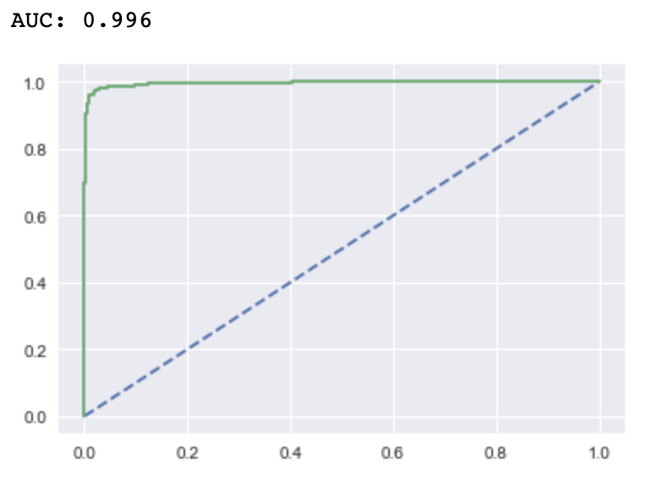
Gradient boosting tuned model is the best!
Model | Testing dataset
 | Accuracy | Recall | Precision | F1-Score
Gradient Boosting tuned | 1.00 | 0.97 | 1.00 | 0.95
Recall
is the highest value here among all models
Precision
is the highest value here among all models
Accuracy
is the highest value here comparatively
F1-Score
is the highest here among all models
AUC and ROC curve of the test data of Gradient boost tuned model

Slide 10
Why this modelling approach?
For Gradient boosting tuned model, overall performance metrics are the best
High AUC indicates that the model is able to distinguish between positive and negative instances with a high degree of accuracy
Due to this, the model is able to make accurate predictions and avoid false positives and false negatives

Slide 11
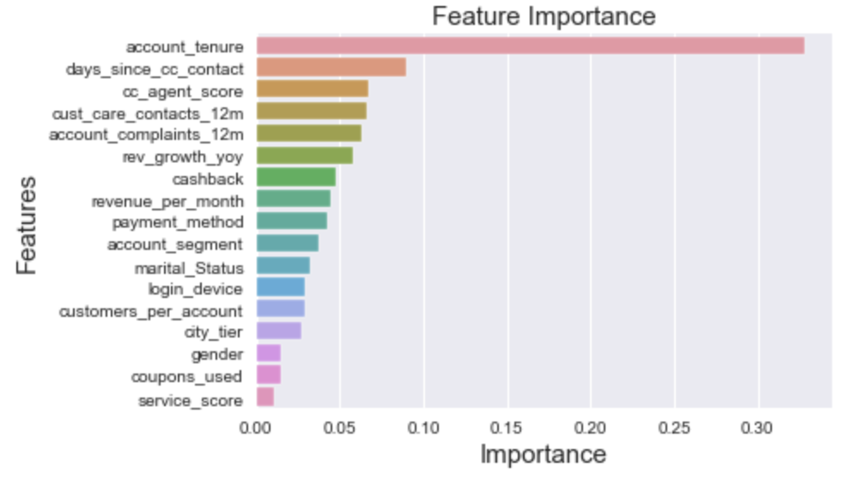
Top predictors of the best model
The model is most influenced by tenure, which accounts for 35% of the relevance of each attribute variable. Most churn is found in low tenure
The next four features add up to nearly 30% of relevance.
  Days since last contacting customer service: 9%
  agent for customer service: 7%
  Contacts with customer service: 7%
  If a complaint was filed or not last year - 6%
  Each of these relates to providing excellent customer service. Things that might be improved
Revenue per month attribute contributes to 6% of all feature importance. The churn in high revenue customers is more than in low revenue customers
Cashback and other features all have individual contributions of less than 5% each

Slide 12
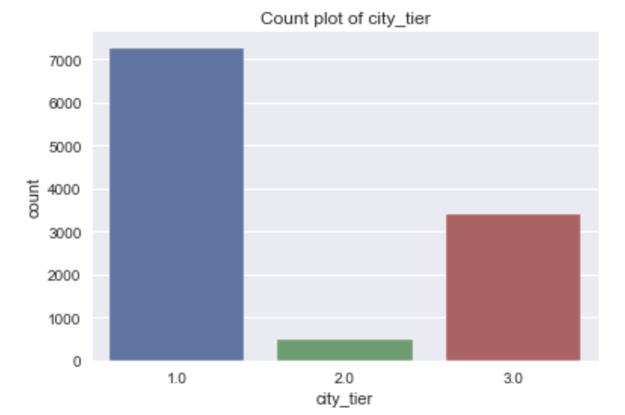
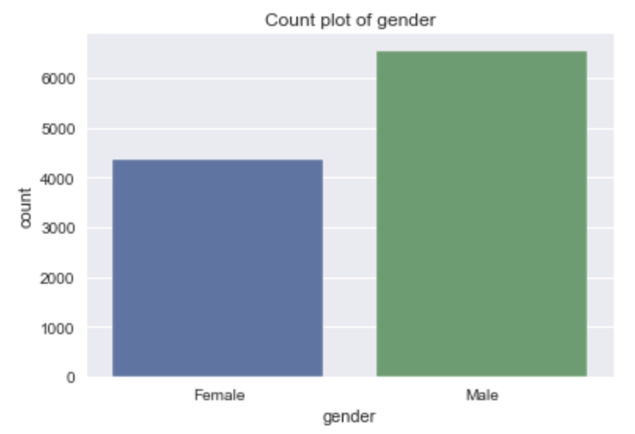
EDA
Assumptions:
account_tenure is considered in months
revenue_per_month is average revenue per month which is considered in Rupees
rev_growth_yoy is considered in percentage (%)
cashback is considered in Rupees
Majority of the customers are from tier 1 cities
Majority of the clients are male

Slide 13
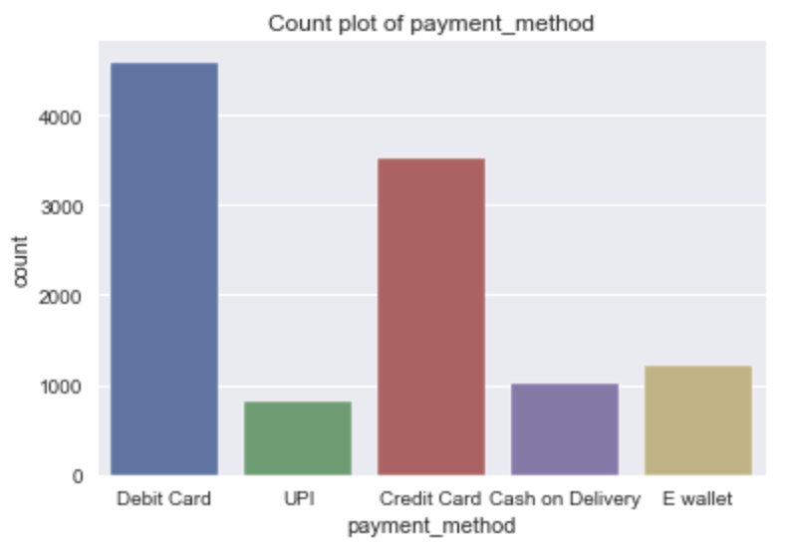
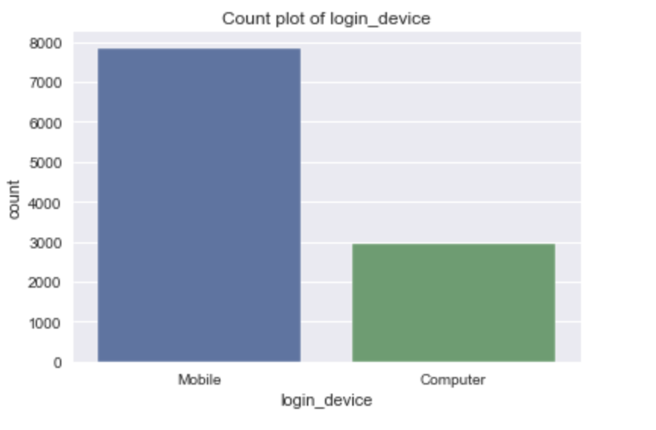
EDA
Majority customers prefers debit and credit card as their mode of payment
Majority of the clients use mobiles

Slide 14
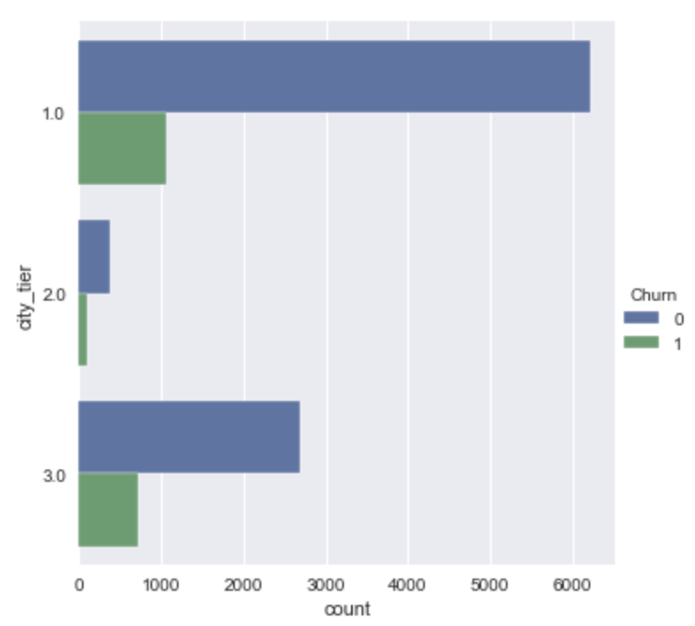
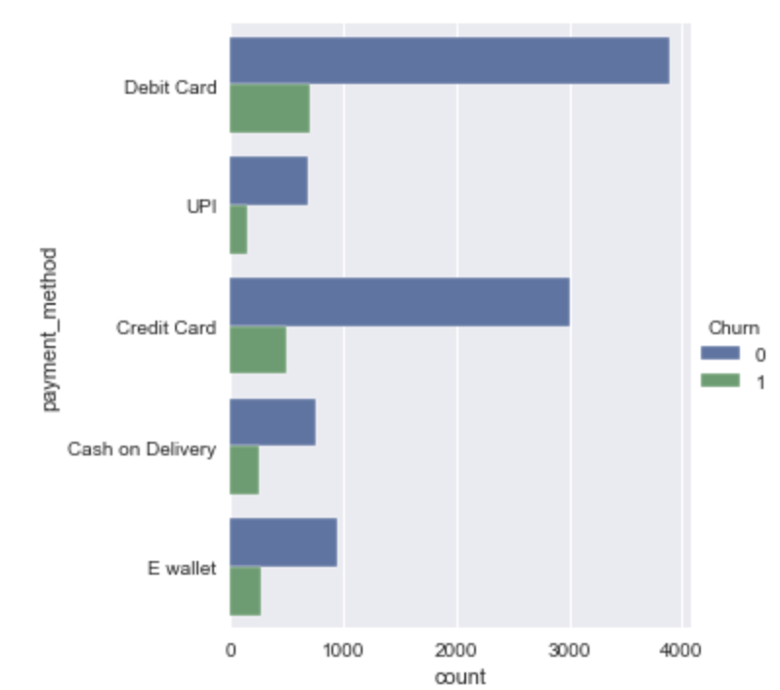
EDA
Customers from Tier-1 and Tier-3 exhibit a significant churn rate.
High churn rates for payments made using debit and credit cards.

Slide 15
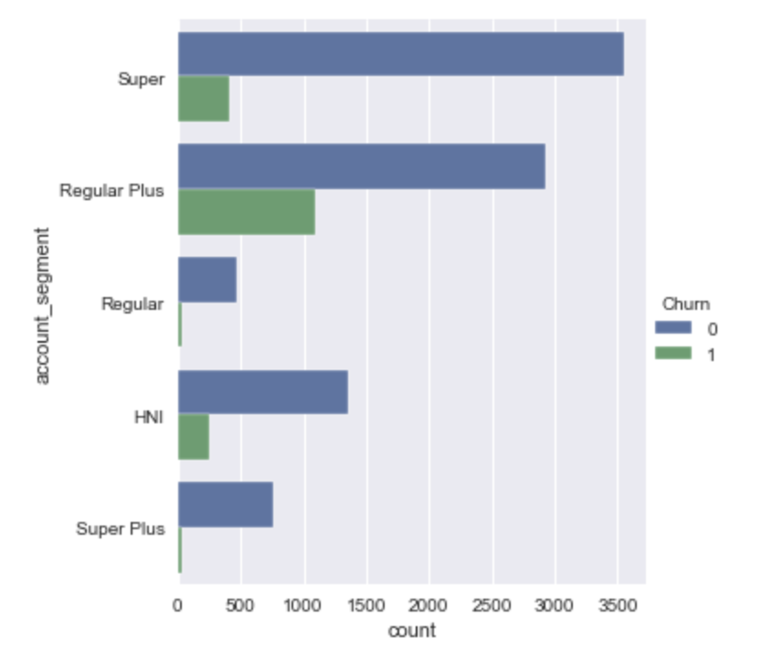
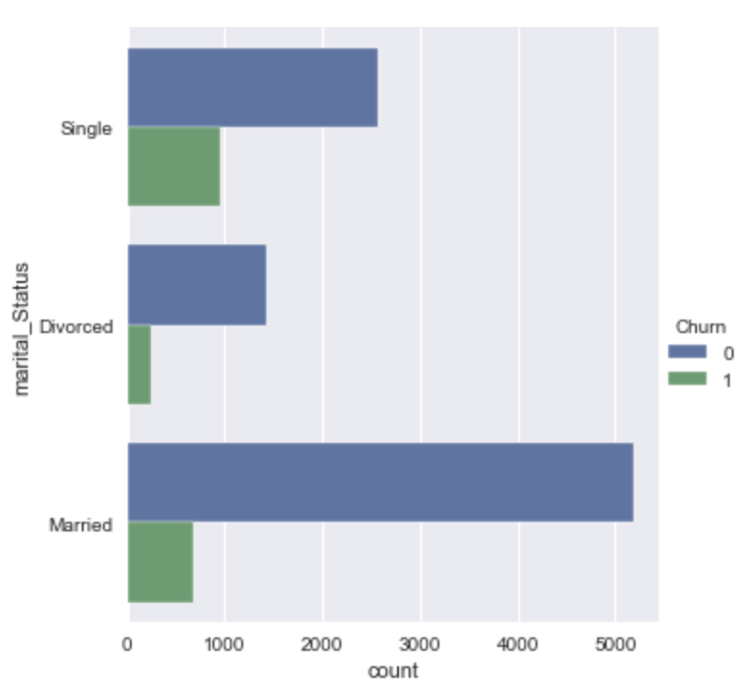
EDA
Customers into “Regular Plus” segment shows high trend towards Churn
Customers with marital status as “Single” shows high volume of Churn

Slide 16
Insights from Analysis
City tier type 1 shows the highest rate of churn compared to city tier types 2 and 3
Customers who prefer debit cards or credit cards as their mode of payment are more likely to churn
Male customers have a higher churn rate compared to female customers
Customers in the "Regular Plus" segment are showing a higher churn rate
Single customers are more prone to churning compared to divorced or married customers
Customers who use the service over a mobile device show a higher rate of churn
Any complaints raised in last 12 months doesn’t show any impact toward churn
Tenure and cashback are directly proportional to each other

Slide 17
Recommendations
Increase visibility in tier 2 cities to acquire new customers
Promote hassle-free and secure payment methods like standing instructions in bank accounts or UPI
Conduct a survey to better understand customer expectations and improve service scores
Train customer care executives to deliver better service and provide them with necessary tools
Offer customized plans based on customer spend and tenure to improve customer loyalty and retention
Offer family floater plans for married customers to increase customer satisfaction and loyalty
Tailor services and marketing efforts to meet the needs and preferences of target audience to improve customer satisfaction and drive business growth

Slide 18
Recommendations
Analyse customer churning pattern based on gender and address the reasons why male customers are more likely to churn
Focus on improving customer experience for the "Regular Plus" segment, as they have shown a higher churn rate
Offer tailored packages with added benefits or discounts to reduce churn rates among single customers
Conduct a detailed study of mobile user preferences and address pain points to reduce churn rates among mobile users
Develop loyalty programs or rewards for repeat business to increase customer retention and loyalty
Offer financial incentives or flexible payment options to reduce churn among customers who prefer debit or credit cards
Invest in technology to streamline customer service processes and provide faster and more efficient service to improve customer satisfaction and reduce churn

Slide 19
Recommendations
One potential method of categorizing customers involves dividing them into four groups based on their spending habits and loyalty.
The first group consists of high-spending customers who have been loyal to the company for a long time. These customers may receive exclusive rewards and benefits.
The second group consists of high-spending customers who have not been loyal to the company for a long time. They may need additional incentives to continue shopping with the company.
The third group consists of low-spending customers who have been loyal to the company for a long time. These customers may appreciate rewards and incentives to encourage them to spend more.
The fourth group consists of low-spending customers who have not been loyal to the company for a long time. These customers may require more attention and engagement to maintain their interest in the company.

Slide 20
Thank you!

