Slide 1
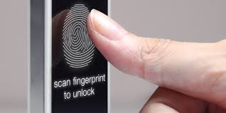
FINGERPRINT LIVENESS DETECTION USING CONVOLUTIONAL NEURAL NETWORK AND FINGERPRINT IMAGE ENHANCEMENT
PRESENTED BY,
MRUDHULA M NAIR
ROLL NO : 28

Slide 2
CONTENTS
INTRODUCTION
CONVOLUTIONAL NEURAL NETWORK
LITERATURE REVIEW
PROPOSED METHOD
CONCLUSION

Slide 3
INTRODUCTION
Use of fingerprint authentication system is growing recently.
Nowadays fingerprint spoofing occurs in various ways.
Effective liveness detection is required to distinguish spoof.
It determines whether the fingerprint being captured is the
actual measurement from an authorised person.
Fig 1 : Finger Play- Doh mold and silicon model

Slide 4
INTRODUCTION
Fingerprint liveness detection algorithms are mainly classified into two groups.
- Hardware : consists of a specified device attached to the sensor to detect
particular features of living traits.
- Software : detects fake traits once the fingerprint sample is obtained from
a standard sensor.
Features used to distinguish between real and fake fingers are extracted from the image of the fingerprint.
Some techniques uses features such as ridge strength, continuity and clarity of fingerprint.

Slide 5
CONVOLUTIONAL NEURAL NETWORK
A class of deep feed forward artificial neural networks, mostly applied to analysing visual imagery.
Relatively little pre-processing compared to other image classification algorithms.
These systems are basic devices for profound learning which are particularly for picture acknowledgement.
We can separate elements from a pre-trained system, and utilize these elements to prepare a straight classifier

Slide 6
CONVOLUTIONAL NEURAL NETWORK
Utilizes pictures straightforwardly as information.
Arranges the components of the picture in a way similar to visual cortex.
These system comprises of convolutional layers.
Each phase is made out of a channel bank and highlight pooling layers.
Applications involves common dialect preparing, picture and example acknowledgment and video examination.

Slide 7
LITERATURE REVIEW
The existing liveness detection techniques are :
CNN Random.
Uses only random filter weights drawn from a Gaussian distribution.
Although the filter weights can be learned, filters with random weights can perform well and they do not need to be learned.
Uses a convolutional network with random weights as the feature extractor.

Slide 8
LITERATURE REVIEW
Local Binary Patterns.
Local texture descriptor that have performed well in various computer vision applications.
In its original version, the LBP operator assigns a label to every pixel of an image by thresholding each of the 8 neighbors of the 3x3-neighborhood with the center pixel value and considering the result as a unique 8-bit code representing the 256 possible neighborhood combinations.
And the proposed system provides about 98% accurate result.

Slide 9
PROPOSED METHOD
Structure of the liveness detection technique :
FIG
Fig 2 : Structure of liveness detection technique

Slide 10
PROPOSED METHOD
Two techniques are used:
Convolutional Neural Network
Fingerprint Image Enhancement
Convolutional Neural Network
State of art technique in image recognition.
Classical CNN comprises of alternating layers of convolution and
local pooling.
Common patterns within local regions of an inputted image are extracted by the first convolution layer with a filter.

Slide 11
PROPOSED METHOD
For each position in filter inner products are computed and output it
as feature map c .
Nonlinear function f() is applied elementwise to each feature map c.
Resulting activations are passed to the pooling layer.
Information within a local region R, is aggregated and outputs the
pooled feature map.
pool() is the aggregated function.

Slide 12
PROPOSED METHOD
For each feature map :
Sj = pool(f(ci)) vi ɛ Rj
where Rj is the pooling region in and i is the index of each
element within it.
In a multi-layer model, pooled maps are inputted to the
convolutional layer and features invariant to local transformations
of an input image are extracted.

Slide 13
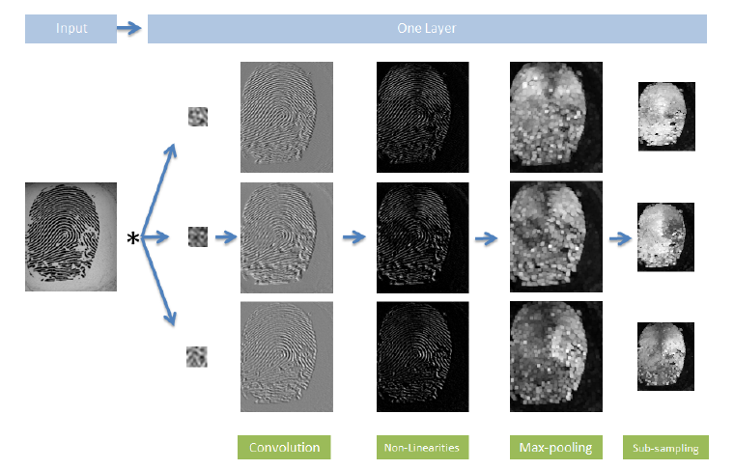
PROPOSED METHOD
Fig 3 : Sequence of operations performed by a single layer convolutional network.

Slide 14
PROPOSED METHOD
CONVOLUTION
Convolution filters receives the input signals.
Convolution is the process where the network labels the input signal by referring to the things it has learned in the past.
Convolution has the property of being translational invariant.
The output signal strength is independent on the location of the features.

Slide 15
PROPOSED METHOD
SUBSAMPLING
Subsampling-Inputs after passing through the convolution layer can be "smoothened" to reduce the sensitivity of the filters against noise and variations.
Obtained by taking average or taking the maximum over a sample of the signals.
Examples include reducing the size of the image or reducing the color contrast across RGB channels.
Downsampling is used here.

Slide 16
PROPOSED METHOD
POOLING
3 types of pooling are: average, max and stochastic pooling.
Average Pooling outputs the average of the activations units in each patch.
Max Pooling outputs the maximum value of each patch.
Stochastic Pooling randomly draws a value from each patch based on a distribution where higher pixel values have higher probabilities of being chosen.
The patches obtained from the previous convolutional layer are used for pooling process.
Fig 4 : Pictorial representation

Slide 17
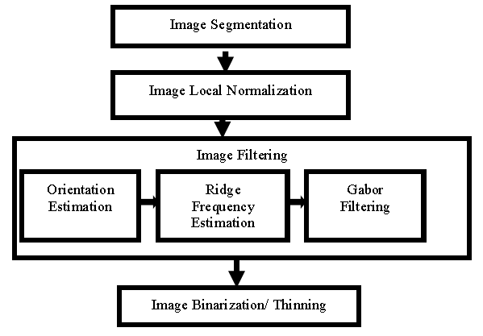
PROPOSED METHOD
Fingerprint Image Enhancement
Fig 5 : The notional diagram of the fingerprint enhancement algorithm

Slide 18
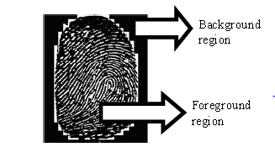
PROPOSED METHOD
IMAGE SEGMENTATION
Pre-processing step in an Automatic Fingerprint Identification System is the fingerprint segmentation.
It separates a fingerprint area (foreground) from the image background.
The two regions that represents a fingerprint image are the foreground region (Region of Interest) and the background region.
Accurate segmentation of a fingerprint greatly reduces the computation time.
Fig 6 : Fingerprint image

Slide 19
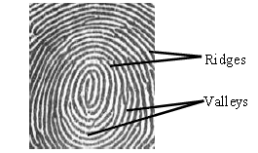
PROPOSED METHOD
The regions having the ridges and valleys are the foreground regions.
The ridges are darker, raised regions of a fingerprint image and the valleys are the white, lower regions between the ridges.
The background regions are the outside regions, where the noises injected into the image during enrollment are found.
The essence of segmentation is to reduce the burden associated with image enhancement by ensuring that focus is only on the foreground regions while the background regions are ignored.
Fig 7 : Ridges and valleys

Slide 20
PROPOSED METHOD
IMAGE LOCAL NORMALIZATION
Performed in order to standardize the level of variations in the image grey-level values.
As a result of normalization, we can make fall the grey-level values to improve the image contrast and brightness.
The first task is the division of the segmented image into blocks of size S × S .
For each pixel, grey-level value is compared with the average greylevel value for the host block.
The result of the comparison produced a normalized grey-level value N(i , j) , for a pixel I(i , j)belonging to a block having average grey-level value of M

Slide 21
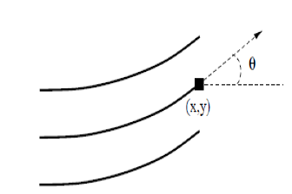
PROPOSED METHOD
ORIENTATION ESTIMATION
The ridges form patterns in each image flow in different directions.
The orientation of a ridge is the direction of its flow over a range of pixels.
At a location the orientation (x , j), the orientation is shown in
Fig 8 : The orientation of a ridge pixel in a fingerprint.

Slide 22
PROPOSED METHOD
The algorithm has the following steps:
STEP 1: Firstly, blocks of size S×S were formed from the normalized fingerprint image.
STEP 2: The gradients (p, q) were computed for each pixel, (p,q) in each block, as the gradient magnitudes in the x and y directions, respectively.
STEP 3: By using its S×S neighbourhood, the local orientation of a pixel was computed for a fingerprint image.
STEP 4: This is slightly modified by dividing the image into S×S blocks and then computing the local orientation of each block centered at the pixel I(i , j) .
STEP 5: Then this orientation image is converted into a continuous vector field.
STEP 6: Then the Gaussian smoothing is performed on a vector field.

Slide 23
PROPOSED METHOD
RIDGE FREQUENCY ESTIMATION
The ridge frequency image is the sum total of the local frequency of the ridges.
The ridge frequency is obtained from the extraction of the ridge map from the image.
This extraction involves the following steps:
The consistency of the orientation field obtained from the first prerequisite
in the local neighbourhood of a pixel (p , q) is computed.
If the consistency level < fixed threshold Fc, then until the consistency > Fc,
the local orientations are re-estimated.
After the orientation field is obtained, two adaptive filters are applied to the image.

Slide 24
PROPOSED METHOD
GABOR FILTERING
After obtaining the prerequisites, Gabor filtering is used to improve or enhance the fingerprint image to a finer structure.
It involves the removal of noise and artifacts .
IMAGE BINARIZATION/THINNING
The image is binarized and thinned to make it more suitable for feature extraction.
The Method sets the threshold (T) for making each and every cluster in the image as tight as possible, thereby minimizing their overlap. Here T is taken as zero(0).

Slide 25
CONCLUSION
Convolution neural networks are one of the essential tools for deep learning, and are suitable for image recognition.
Neural Network Toolbox also enables us to perform a transfer learning.
A Convolutional Neural Network is used for classifying live fingerprints from the fake ones.
An efficient fingerprint liveness detection technique is designed and implemented along with a fingerprint image enhancement technique in order to increase the accuracy of the system.

Slide 26

REFERENCES
R. F. Nogueira, R. de Alencar Lotufo, and R. C. Machado, “Fingerprint liveness detection using convolutional neural networks,” IEEE Transactions on Information Forensics and Security, vol. 11, no. 6, pp.1206–1213, 2016.
Babatunde, Iwasokun Gabriel, et al. "Fingerprint image enhancement: Segmentation to thinning." (2012).
R. F. Nogueira, R. de Alencar Lotufo, and R. C. Machado, “Evaluating software-based fingerprint liveness detection using convolutional networks and local binary patterns,” in Biometric Measurements and Systems for Security and Medical Applications (BIOMS) Proceedings,2014 IEEE Workshop on. IEEE, 2014, pp. 22–29.

Slide 27


