Slide 1
Recognition & Retrieval of Mathematical Expressions
Mrudhula
Rajitha

Slide 2
Introduction:
This project primarily focuses on recognizing the mathematical expressions followed by the retrieval process. The end goal of the project is to retrieve the available sources for a given mathematical expression.
As the data falls under image category we will be using image classification such as CNN.

Slide 3
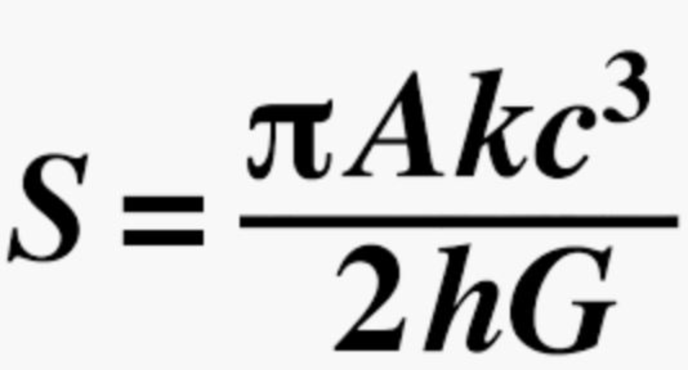
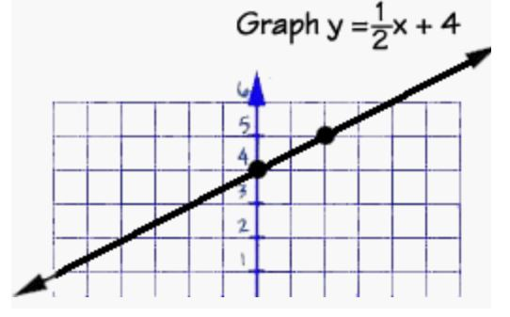
Few Expressions:

Slide 4
Need for the project:
A college student may want to search textbooks and course notes to find math notation that has similar structure or semantics to a given expression.
A researcher may wish to find technical papers that use or define a given function.
Math recognition also finds application in tutoring systems. For example, when middle school and high school students tested a math tutoring prototype (based on FFES/DRACULAE)

Slide 5
Level1:Offline Handwritten images
Achieved to classify offline handwritten images using CNN

Slide 6
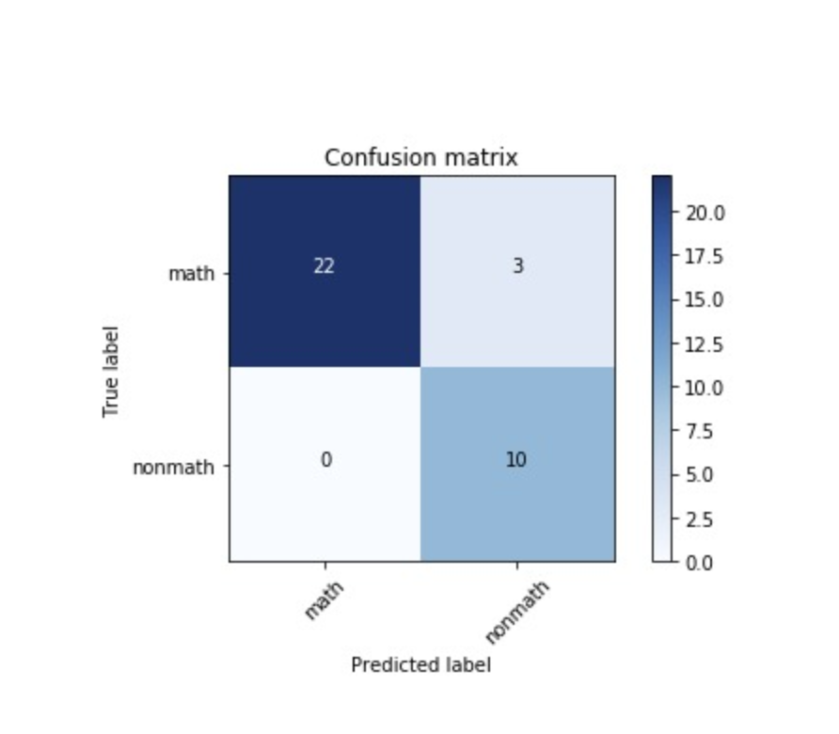
Level1 Metric:

Slide 7
Level2:Online Handwritten images
The central pattern recognition problems – segmentation, classification,parsing and machine learning (i.e. opti-mizing recognition model parameters) – all come into play when recognizing mathematics.

Slide 8
Level2:Online Handwritten images
The input to a math recognition system can take three forms: vector graphics (such as PDF) and strokes (such as pen strokes on a data tablet).

Slide 9
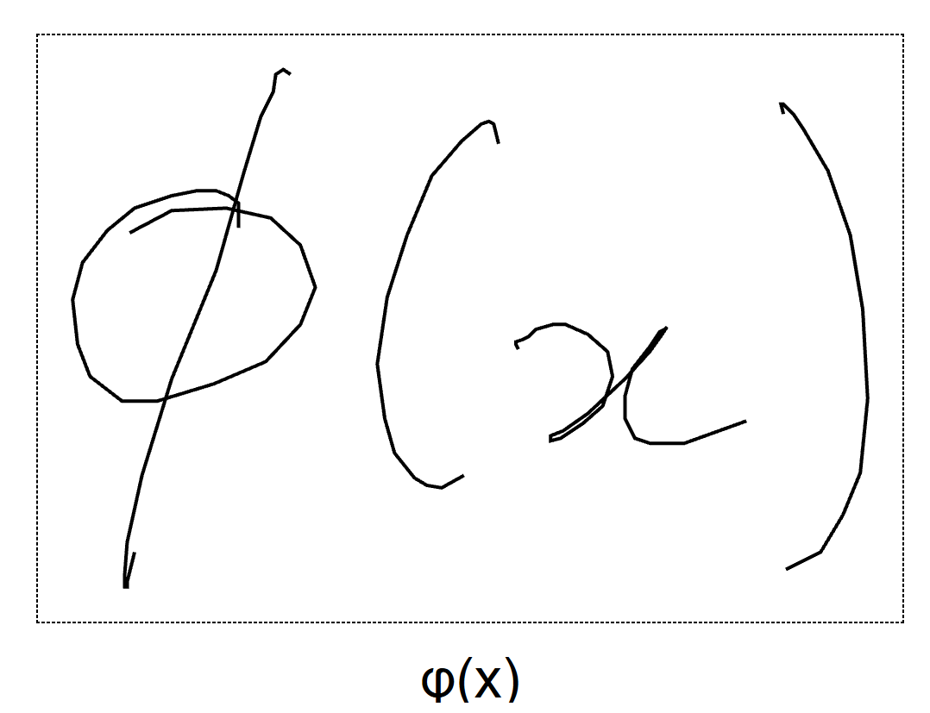
Inkml Equation:

Slide 10
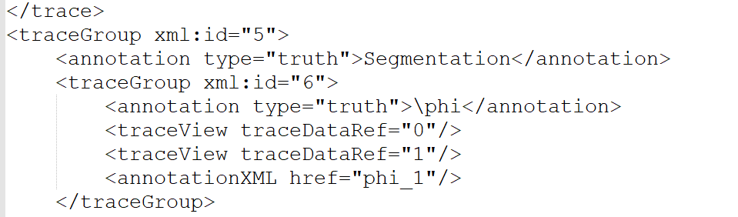
Inkml Format:

Slide 11
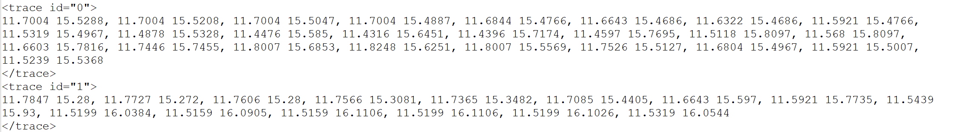
Inkml Format:

Slide 12
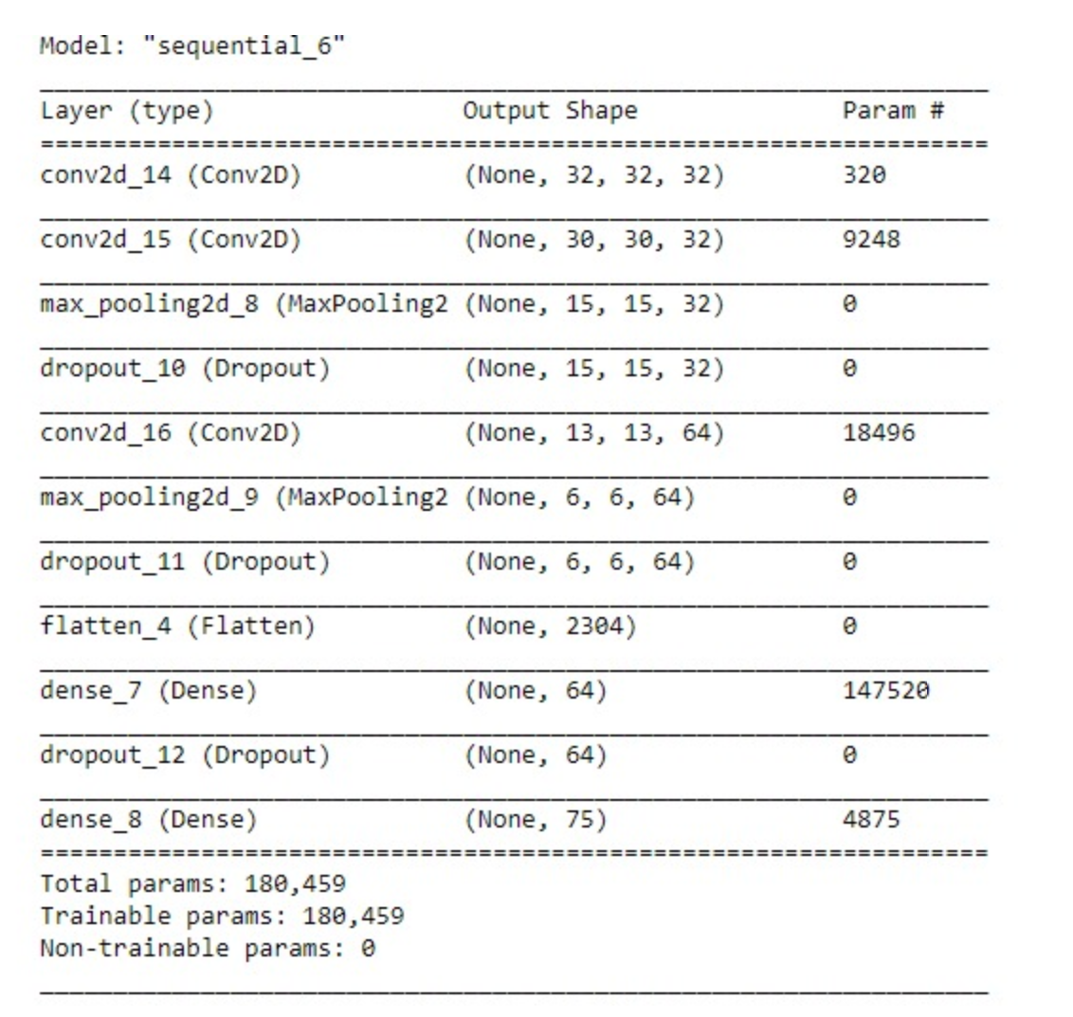
CNN:

Slide 13
Metrics:
InkML Size | Symbols | UniqueSymbols | Loss(%) | Accuracy(%)
921 | 11224 | 56 | 33 | 90
1338 | 16970 | 75 | 34 | 91

Slide 14
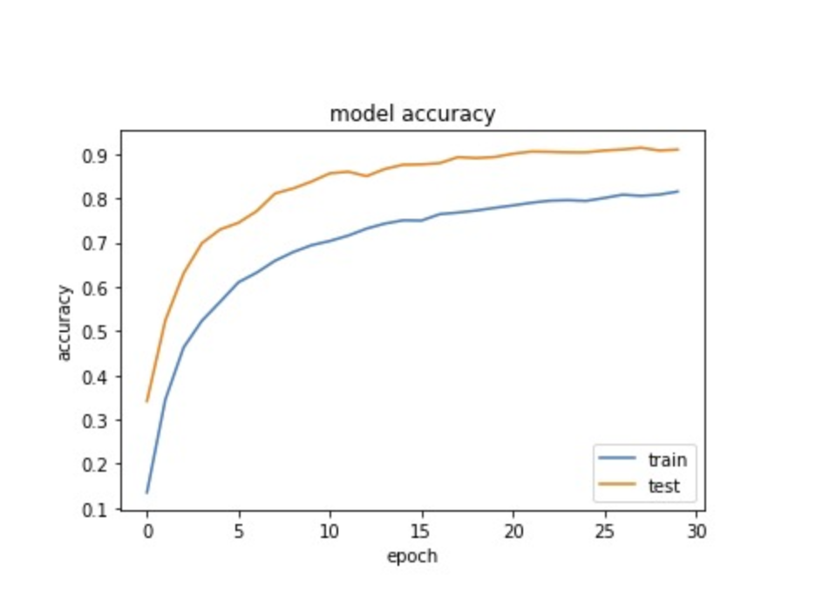
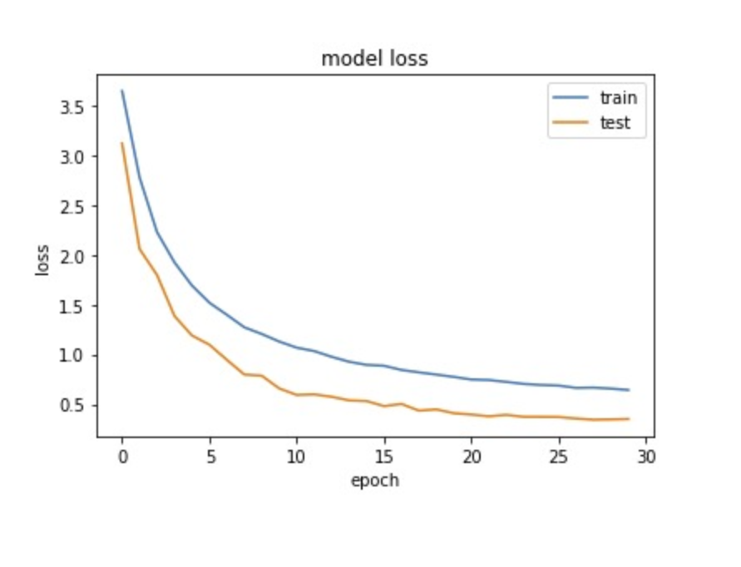
Plots:

Slide 15
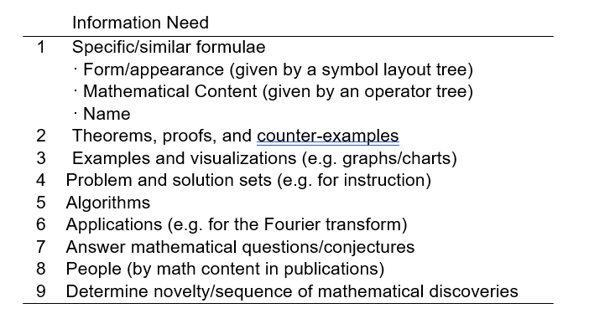
Project usefulness:

Slide 16
Challenges:
Expression detection
Symbol extraction or symbol recognition
Layout analysis
Mathematical content interpretation

Slide 17
What have we learnt?
Effect on model performance with various model tweaking
Read an InkML image
Image segmentation
Creation of Symbol dataset
Image pre-processing

Slide 18
Future Scope
Level3 - Expression level classification
Level 4 - Detection of Formulas in Document Pages

Slide 19
Thank you!!

