Slide 1

Lucene
Search Engine Programming
MRUDHULA MURALI
UNIVERSITY OF SOUTH FLORIDA

Slide 2
Lucene is an open source Java based search library
Generic framework with a java library where we can create a inverted index
It is scalable. This high performance library is used to index and search virtually any kind of text
Provides advanced search options like synonyms, stop words, based on similarity, proximity
2 Types: Indexing and Searching.
Document Indexing
Document retrieval

Slide 3
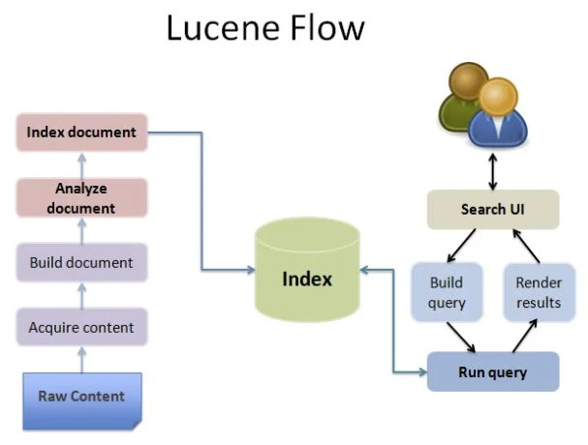

Slide 4
ENVIRONMENT SETUP
Step 1
Java Development Kit (JDK) Setup
Oracle's Java site: Java SE Downloads.
Step 2
Eclipse IDE Setup
http://www.eclipse.org/downloads/
eclipse.exe
Step 3
Setup Lucene Framework Libraries
http://archive.apache.org/dist/lucene/java/
Environment Setup

Slide 5
Lucene: Create Your First Application
List of indexes created during this process
Print the number of search results found
Steps:
Step 1: Create Java Project
Step 2: Add Required Libraries
lucene-core-3.6.2
Step 3: Create Source Files
Create a package called com.usf.lucene
Simple Search Application
Create java classes under the com.usf.lucene package.
Environment Setup

Slide 6

Thank You

