Slide 1

Integrated Hotel Booking And Guest Experience Management System
Presented By:
K . Mrudhula [192372290]
P . Harika [192311243]
C . Sri Lakshmi [192311342]
N . Vishnu sai sri [192372039]
Supervisor:
DR.SUDHAGAR
CSA4305– Internet Programming
Date : 25-11-2025

Slide 2
AGENDA
Project Demo
Result & Analysis
Conclusion
Future Work
References
Introduction
Problem Statement
Literature Review
Architecture
Techniques used

Slide 3
Introduction:
Manual hotel booking involves phone calls, paperwork, and delays.
Guests face difficulty checking room availability in real-time.
An online reservation system simplifies the booking process.
Allows users to browse rooms, check availability, and book instantly.
Reduces administrative load for hotel staff.
Enhances guest experience through automation & web-based access.

Slide 4
Problem Statement:
Traditional hotel booking is time-consuming and involves manual effort.
Lack of a centralized system for real-time room availability.
Manual record-keeping increases the chances of double booking.
Data inconsistency occurs due to outdated or incorrect booking logs.
Guests do not have an easy, self-service online platform to make bookings.
Hotels require a secure, efficient, user-friendly online reservation portal

Slide 5
Literature Review :
S.NO | DETAILS OF THE JOURNAL | ALGORITHM / METHODOLOGY USED | ADVANTAGES | DIS ADVANTAGES
1 | Basheer et al. (2025). Online Hotel Reservations & Guest Satisfaction in Kashmir. | Survey analysis; UX evaluation | Provides user satisfaction insights; helps improve UI/UX | Region-specific; not technical
2 | Nguyen (2025). Web-based Hotel Booking System. | PHP–MySQL; CRUD operations; session login | Simple, scalable; reduces manual work | Limited automation; basic features
3 | Gunjal (2025). Hotel Booking App using MERN. | MERN stack; REST APIs; JWT auth | Fast, modern UI; scalable system | Complex setup; requires higher skills

Slide 6
MODULE 1 :Admin Panel
(Hotel and Booking Control)

Slide 7


Architecture : (Admin side)
Login Page
(User / Admin)
Admin Homepage
PHP
Application
My SQL Database
Email Notification
Manage Hotels
Cancel Booking
Hotels
Rooms
Manage Users
Reports
Bookings
Customers

Slide 8
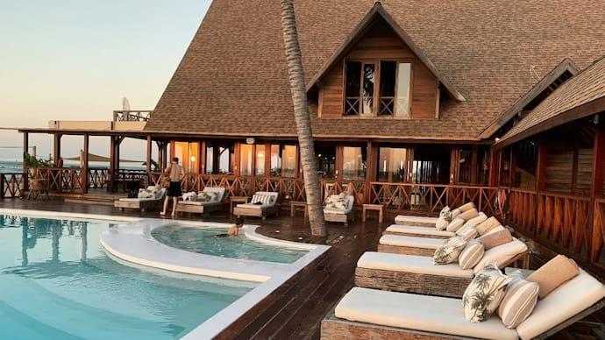
TECHNIQUES USED

Slide 9
PHP
Handles Server side Logic for hotels, rooms, and booking management
Ensures structured navigation and modular admin workflows
CRUD Operations
Admin can Create, Read, Update, Delete entries in all tables Ensures data integrity and real-time updates in the system
Admin Authentication
Secure login maintains admin session across pages Prevents unauthorized access to admin-only operations

Slide 10

Table Wise Data Management (MYSQL)
Separate tables for hotels, rooms, bookings, customers
Ensures organized storage and easy relational queries
Backend Validation & Error Handling
Prevents duplicate entries, missing fields, or invalid operations Maintains cleanliness and accuracy of the database

Slide 11
MODULE 2 : User Portal
(Booking & Guest Experience)

Slide 12
Architecture : (User Side)
Login Page
(User / Admin)
User Homepage
PHP
Application
My SQL Database
Email Notification
Browse Cities
View Details
Customers
Hotels
Payment
View bookings
Rooms
Bookings

Slide 13
PHP
Displays cities, hotels, rooms Dynamically from the database
Handles booking form submission and stores bookings securely
MYSQL for database Storage
Stores user Account, hotels details, room data, and bookings. Ensures smooth retrieval using optimized SELECT queries.
HTML/CSS/ Bootstrap
Provides responsive, user-friendly layout on all devices. Enhances user experience with clean components like cards and forms.

Slide 14
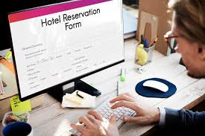
Sessions for authentication
Keeps the user Logged in across pages like Home, Book Room, My bookings.
SQL queries for data retrieval & booking logic
Fetches hotels based on selected city, room availability, and pricing. Prevents double booking by checking room status before confirming.
Ensures Personalized experience and secure access

Slide 15
TECHNIQUES
Frontend
HTML5, CSS3, Bootstrap5
Responsive Card Layouts for hotels & rooms
Backend
Core PHP for Business Logic, MYSQL
SQL JOIN Queries for room hotel mapping
Server
XAMPP (Apache + MYSQL)
Browser based UI testing
Dynamic Hero images and Room Galleries
Session Based Login System
Infinity Free for Deployment

Slide 16
MODULE-3 Payment & Billing System

Slide 17
PROJECT DEMO

Slide 18
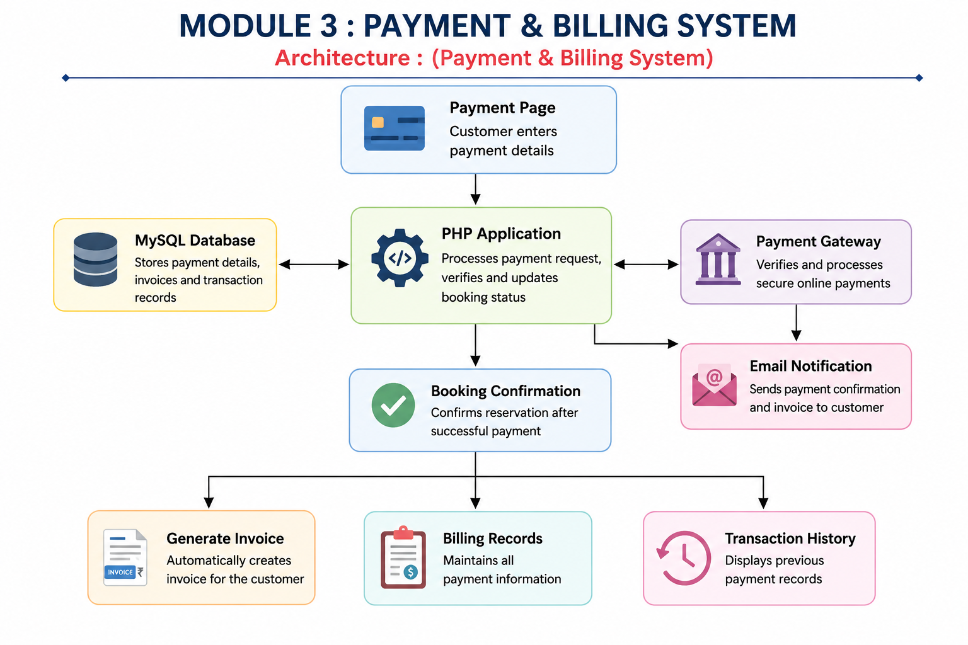

Slide 19
MODULE-4 Review system

Slide 20
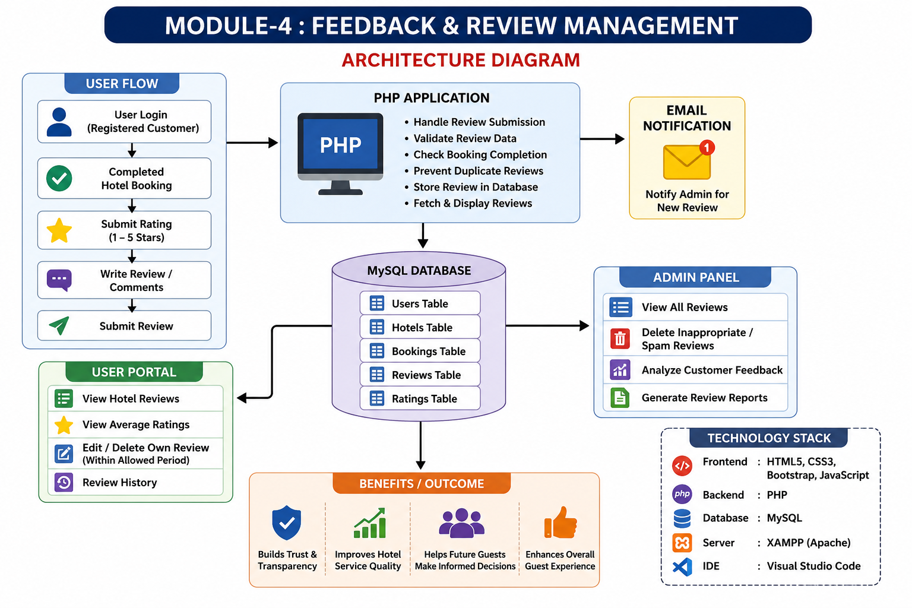

Slide 21
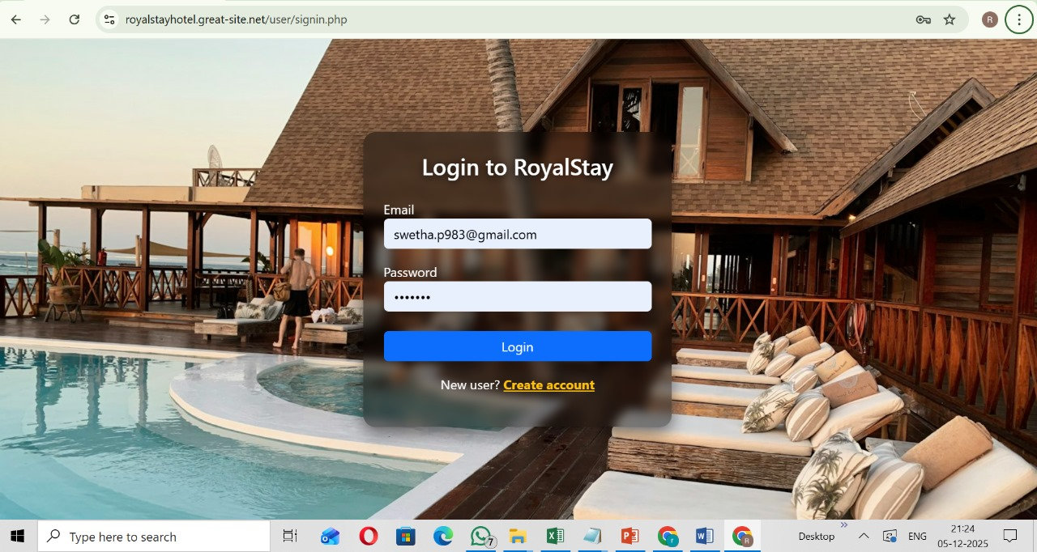
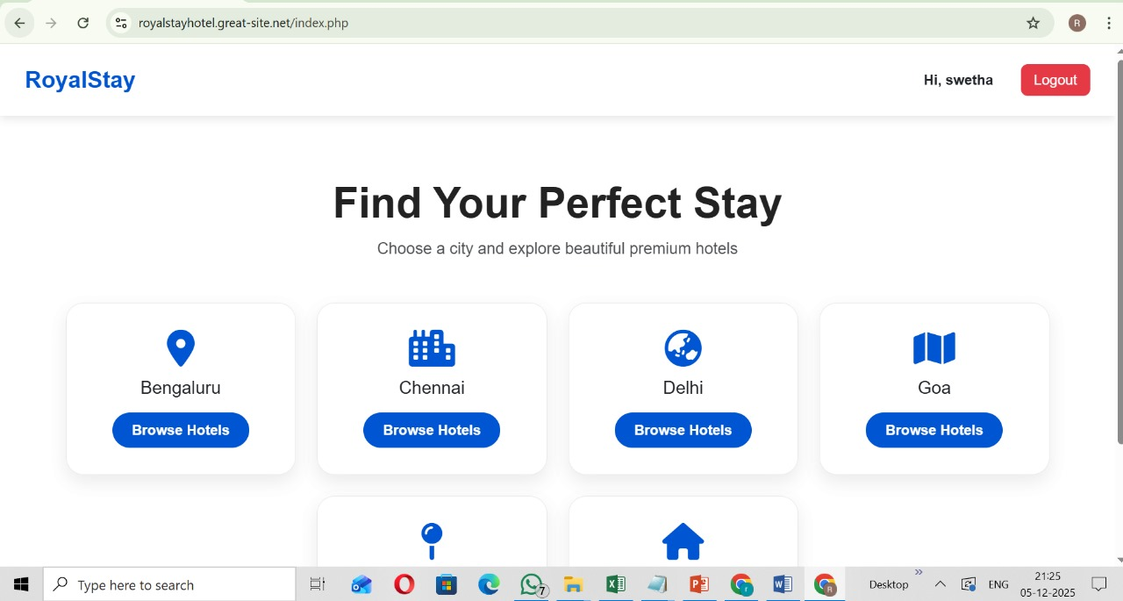
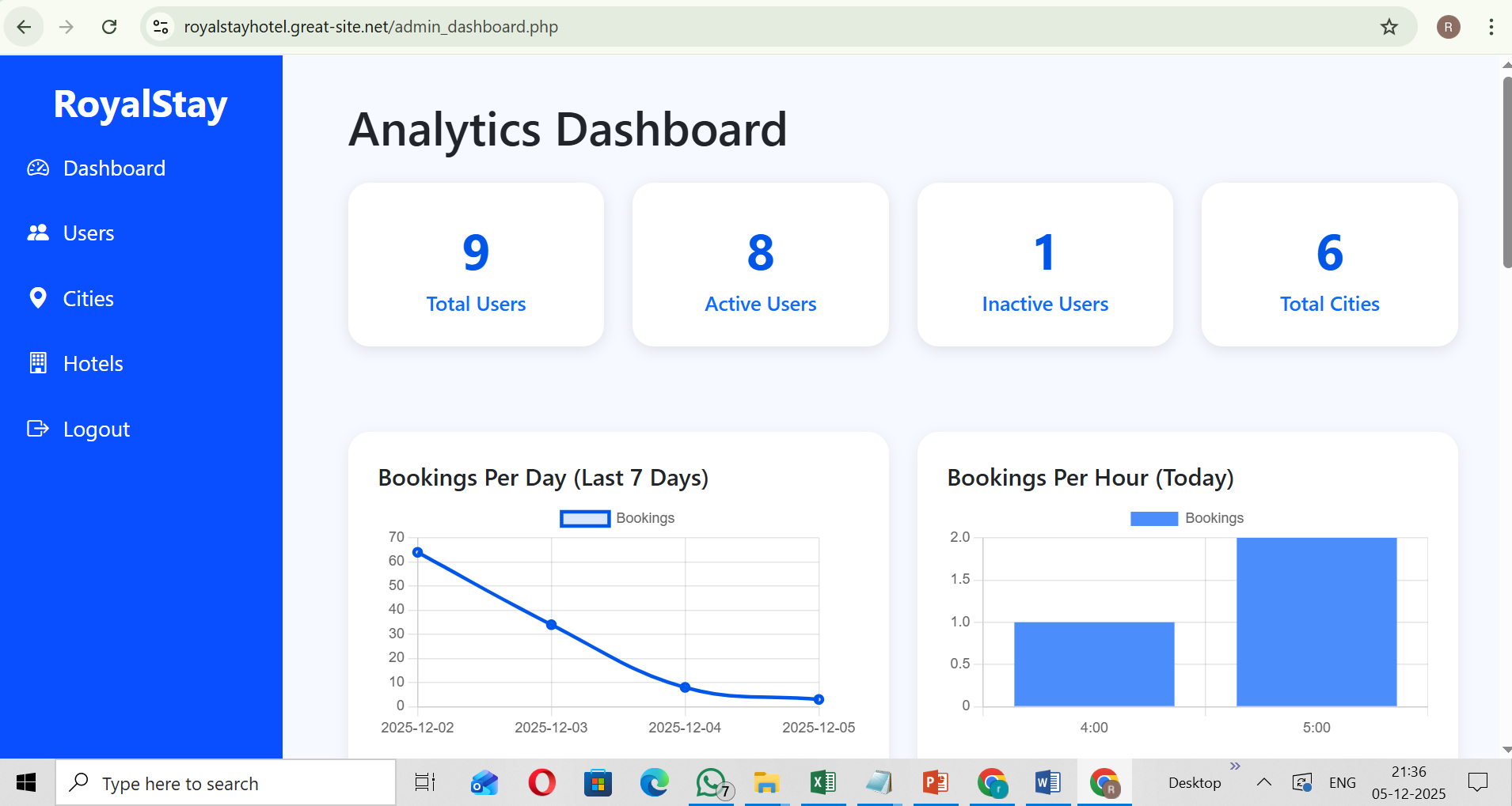
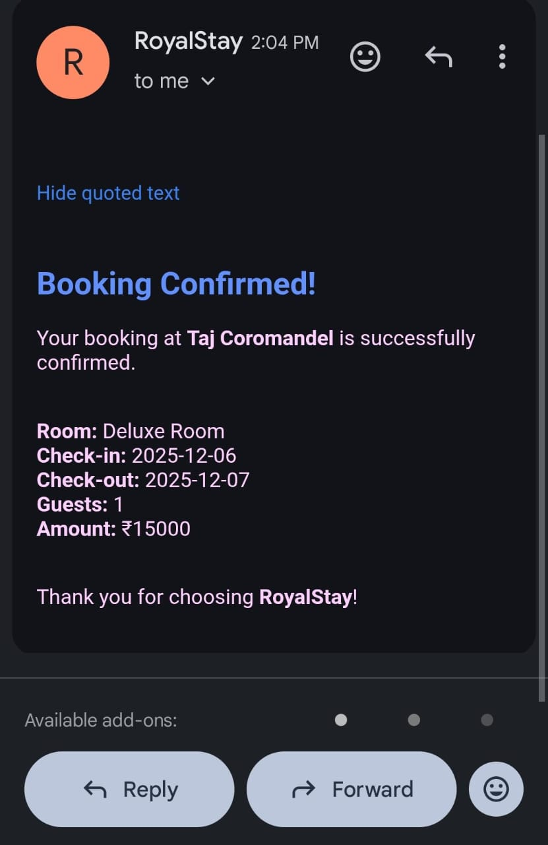
Admin and User Interface
Authentication
User Portal
Admin Portal
Mail Notification
Link : https://royalstayhotel.great-site.net/user/signin.php

Slide 22
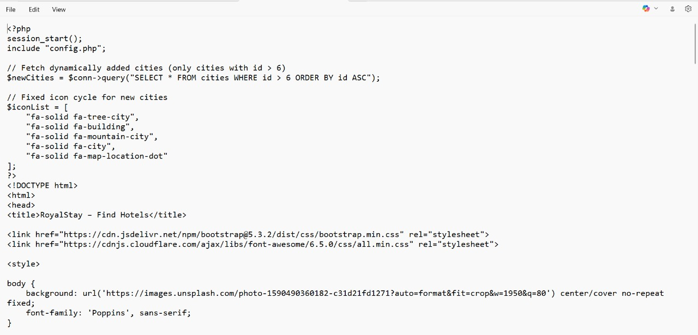
Implementation :

Slide 23
Conclusion:
Online Hotel Reservation System simplifies hotel management.
Guests can book rooms easily from anywhere.
Ensures accuracy, speed, and convenience.
Helps hotels maintain organized booking records.
Enhances overall guest satisfaction and operational efficiency.

Slide 24
Future Scope :
Dynamic room pricing can be implemented using machine learning to adjust prices based on demand, season, and user behavior.
Mobile application support can be introduced for easier booking, cancellation, and feedback submission from anywhere.
Advanced loyalty & personalization features like reward points, personalized offers, and targeted notifications can be added to improve guest engagement.
Providing automated chatbots to assist guests with bookings, FAQs, and cancellations.

Slide 25
References :
Stringam, B. B., & Gerdes, J. H. (2021). Hotel and guest room technology. University of South Florida (USF) M3 Publishing, 17(9781732127593), 6.
Arapou, D., & Kapiki, S. (2023). Enhancing the Guest Experience in Hospitality through Technology: An Outlook of the Future.
Gunjal, P. M. D. S. (2025). Hotel Booking Web Application using MERN Stack.
Halim, A., Rohman, A., & Ifvochy, J. (2025). The Development of A Hotel Room Reservation Application Using The Laravel Framework at Abadi Hotel. ARRUS Journal of Engineering and Technology, 5(1), 88-100.

Slide 26


