Slide 1


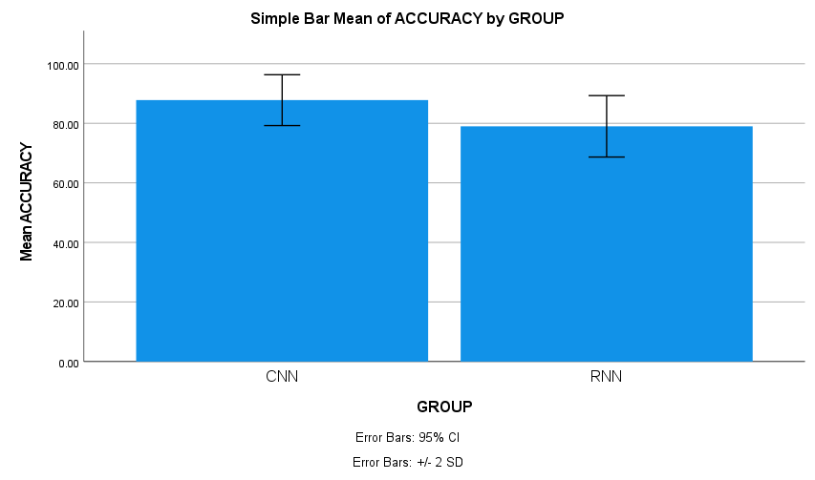
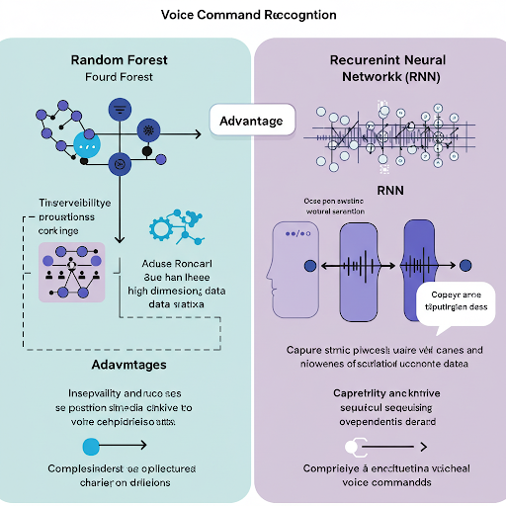
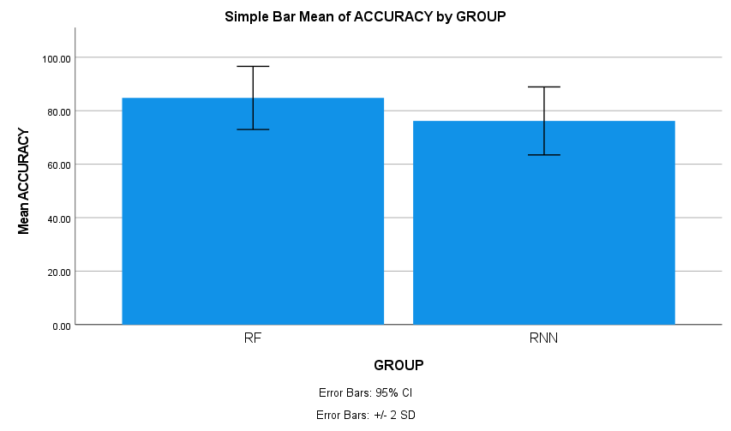
Register No:192373003
Students Name: Chittabattina Mrudhula
Guided By: Dr. C. SenthilKumar
Comparative Analysis Of CNN and RNN for a Voice-Activated AI Assistant On Laptops to Improve Accuracy
INTRODUCTION
Voice-activated AI assistants are becoming standard on laptops for hands-free control and accessibility. CNNs and RNNs are both used for speech recognition.
Existing studies often focus on mobile or smart speaker platforms rather than laptop-based assistants. Few works provide a direct comparison of CNN and RNN performance in real-time voice command accuracy on laptops.
The aim is to analyze and compare CNN and RNN architectures for voice command recognition.
MATERIALS AND METHODS
Data Preprocessing
- Noise reduction
- Normalization
Model Development
- CNN Model Architecture
- RNN Model Architecture
Data Collection
- Voice commands dataset
Result Comparison
- Compare CNN vs RNN - Visualize using bar chart
Model Evaluation
- Accuracy calculations
Model Training Train on preprocessed voice data
RESULTS
The CNN model achieved a higher mean accuracy of 87.8%, compared to 79.0% for the RNN model, indicating better overall performance.
The standard deviation was 4.26 for CNN and 5.16 for RNN, showing that CNN results were slightly more consistent.
The bar chart clearly displays the difference, with CNN's bar taller and minimal overlap in 95% confidence intervals, supporting statistical significance.
DISCUSSION AND CONCLUSION
The CNN model outperformed the RNN model in voice command recognition speed while maintaining accuracy.
Findings align with prior work (e.g., Gehring et al., 2017) suggesting CNNs excel in parallel processing, making them ideal for real-time audio tasks on devices like laptops.
The study was limited to a small set of voice commands and controlled environments, indicating future scope for testing in noisy and diverse user settings.
BIBLIOGRAPHY
Shiri, F. M., Perumal, T., Mustapha, N., & Mohamed, R. (2024). A comprehensive overview and comparative analysis on deep learning models: CNN, RNN, LSTM, GRU. arXiv preprint arXiv:2305.17473.
Markose, A., & Ponnuvarman, R. (2025). Comparative analysis of convolutional neural network and recurrent neural networks for image processing and data analysis. In AIP Conference Proceedings (Vol. 3175, No. 1, p. 020009).
Mishra, S., Bhatnagar, N., Prakasam, P., & T. R, S. (2024). Speech emotion recognition and classification using hybrid deep CNN and BiLSTM model. Journal of Computer Systems and Applications, 2(1), 1–8.
Comparative Analysis of Random Forest and RNN for Voice Command Recognition in AI Assistants to Improve Accuracy
INTRODUCTION
Voice command recognition is a critical function in AI assistants for smart devices and accessibility tools.
Most existing studies favor deep learning models and overlook comparisons with classical methods like Random Forest.
The aim is to compare the performance of Random Forest and RNN in voice command recognition tasks.
MATERIALS AND METHODS
Feature Engineering
-Sequence input for RNN
Data Collection
- Multiple speakers & noise
Data Preprocessing
- Noise reduction
- Silence removal
Model Design
-Random Forest Classifier with RNN
Result Comparison
- Compare RF vs RNN - Visualize using bar chart
Model Training
- Train RF and RNN separately
RESULTS
The Random forest model achieved a higher mean accuracy of 84.8%, compared to 76.2% for the Random Forest model on the voice command recognition task.
The standard deviation was 6.3 for RNN and 5.9 for Random Forest, indicating that Random forest had slightly more stable performance across validation folds.
The bar chart clearly shows Random Forest outperforming RNN , with a visibly taller bar and minimal overlap in their 95% confidence intervals.
DISCUSSION AND CONCLUSION
The RNN model outperformed RF in handling sequential audio data, achieving higher accuracy in recognizing voice commands.
This supports previous findings (e.g., Graves et al., 2013) that RNNs are better suited for time-series data like speech, while Random Forests lag in temporal pattern recognition.
The study was limited to basic voice commands and small datasets; future work can expand too real-world.
BIBLIOGRAPHY
Sarbast, H. (2024).Voice recognition based on machine learning classification algorithms: A review. Indonesian Journal of Computer Science, 13(3).
Shiri, F. M., Perumal, T., Mustapha, N., & Mohamed, R. (2024).A comprehensive overview and comparative analysis on deep learning models: CNN, RNN, LSTM, GRU. arXiv preprint arXiv:2305.17473.
Mishra, S., Bhatnagar, N., Prakasam, P., & T. R, S. (2024).Speech emotion recognition and classification using hybrid deep CNN and BiLSTM model. Journal of Computer Systems and Applications, 2(1), 1–8.
CNN achieved higher accuracy and showed more consistent results, indicating its robustness for voice recognition on laptops.
CNN outperforms RNN in accuracy for voice-activated AI assistants on laptops , CNN is the preferred model for deployment due to better performance and reliability.
Based on T-test Statistical analysis, the significance value of p=0.004 (independent sample T - test p<0.05) is obtained and shows that there is a statistically significant difference between the group 1 and group 2.

