Slide 1
Diamonds
Mark Rudolph, Sean Roth, & Amber Moran

Slide 2

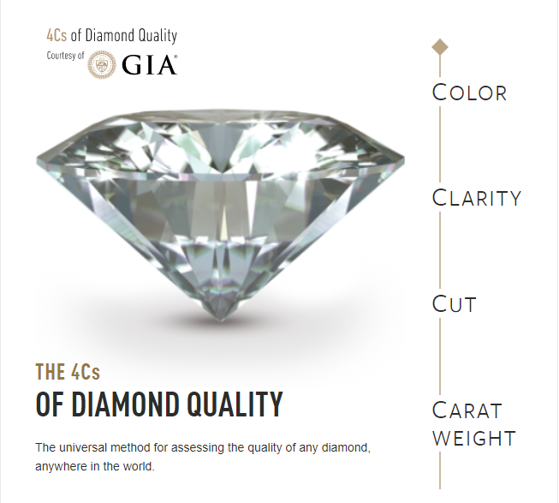
Color
Diamond color actually means lack of color
Categorized as letters D (colorless) to Z (light)
Clarity
Diamond clarity refers to the absence of inclusions and blemishes
Clarity measurement: 1 (worst), SI2, SI1, VS2, VS1, VVS2, VVS1, IF (best)
Cut
Diamond cut grade is really about how well a diamond’s facets interact with light
Cut quality: Fair, Good, Very Good, Premium, & Ideal
Carat
Two diamonds of equal carat weight can have very different values (and prices) depending on three other factors of the diamond
A metric “carat” is defined as 200 milligrams.
Diamond Fact: Diamonds are made of a single element—they’re nearly 100% carbon.

Slide 3
Which category has the biggest impact on a diamond’s price?

Slide 4
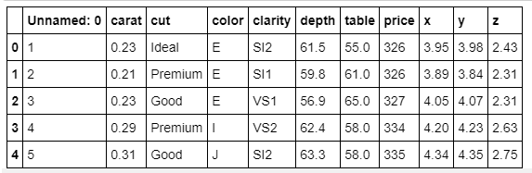
Diamond Data
CSV from Kaggle consists of 55,000 rows of diamond information
Content
price in US dollars (\$326--\$18,823)
carat weight of the diamond (0.2--5.01)
cut quality of the cut (Fair, Good, Very Good, Premium, Ideal)
color diamond color, from J (worst) to D (best)
clarity a measurement of how clear the diamond is (I1 (worst), SI2, SI1, VS2, VS1, VVS2, VVS1, IF (best))
x length in mm (0--10.74)
y width in mm (0--58.9)
z depth in mm (0--31.8)
depth total depth percentage = z / mean(x, y) = 2 * z / (x + y) (43--79)
table width of top of diamond relative to widest point (43--95)

Slide 5
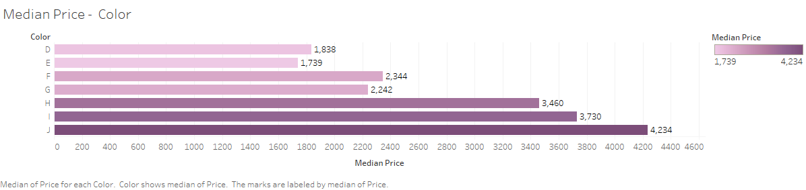
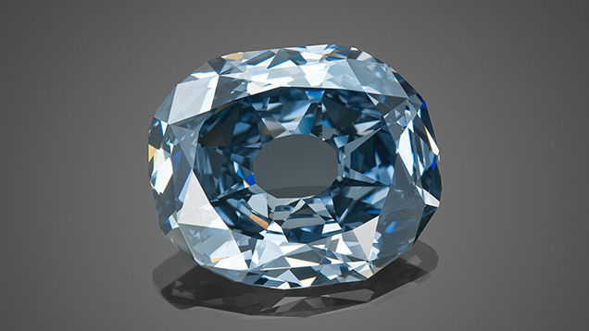
Color
WITTELSBACH-GRAFF DIAMOND
Diamond Fact: D-to-Z color diamonds are the most widely used in jewelry, but diamonds come in all colors of the rainbow. For natural colored diamonds, blue, green, orange and red are the rarest; yellow and brown are the most common.

Slide 6
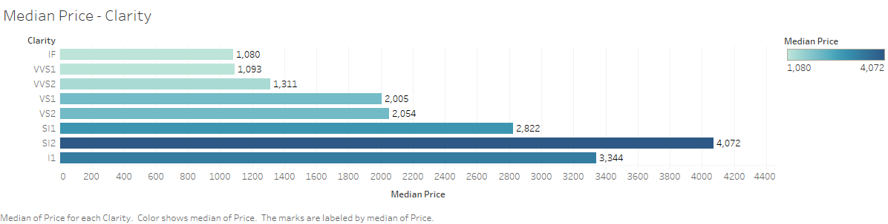
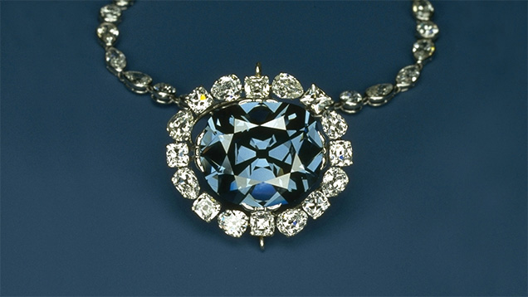
Clarity
While no diamond is perfectly pure, the closer it comes, the higher its value.
Hope Diamond
Diamond Fact: Lab diamonds have the same physical, chemical, and optical properties as mined diamonds.

Slide 7
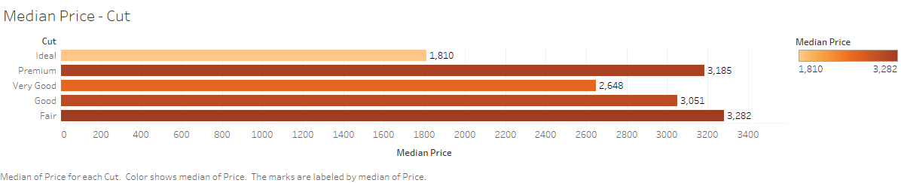
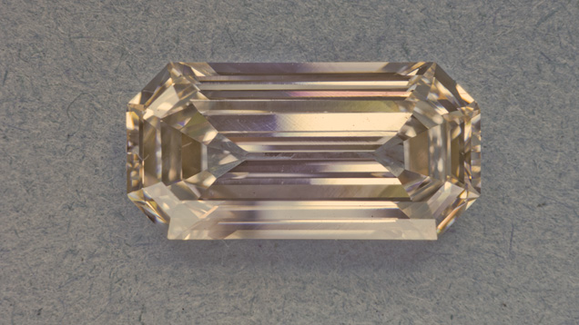
Cut
Uncle Sam Diamond
Diamond Fact: Diamond crystals are brought closer to the Earth’s surface through volcanic activity.

Slide 8
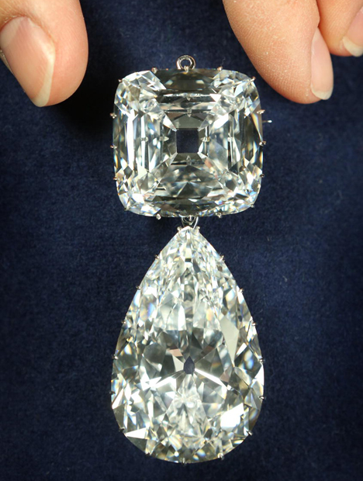
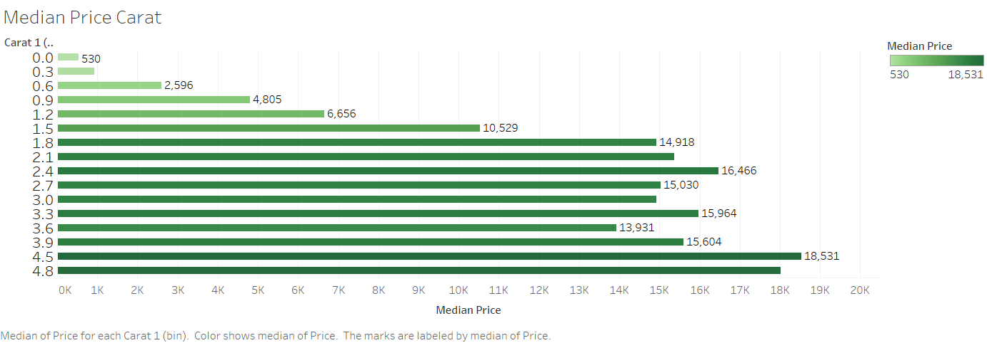
Carat
Cullinan Diamond
Diamond Fact: The largest diamond ever discovered was called the Cullinan diamond, and weighed in at an amazing 3106 carats, or 1.33 pounds.

Slide 9

Data Validation

Slide 10
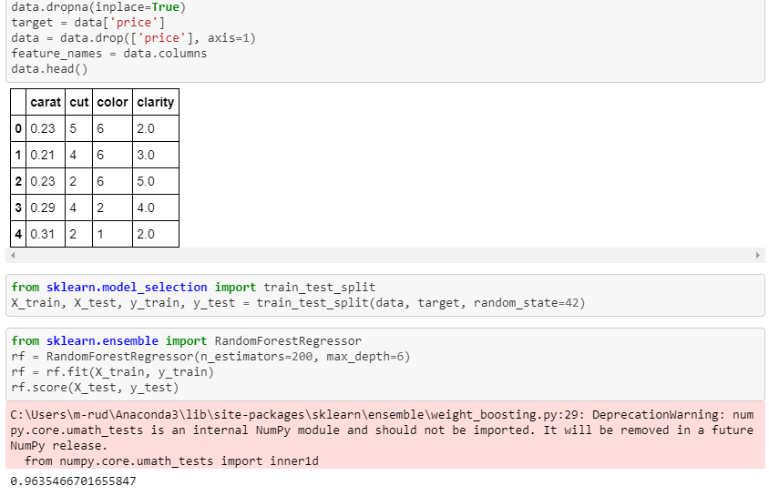
ML Code Example

Slide 11
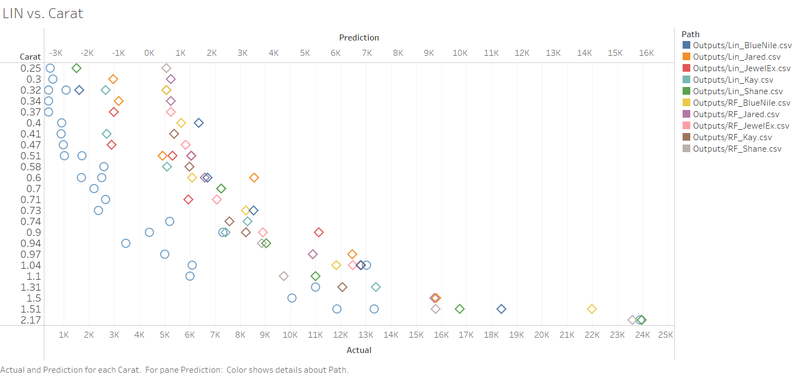
Linear Regression: Prediction vs Actual

Slide 12
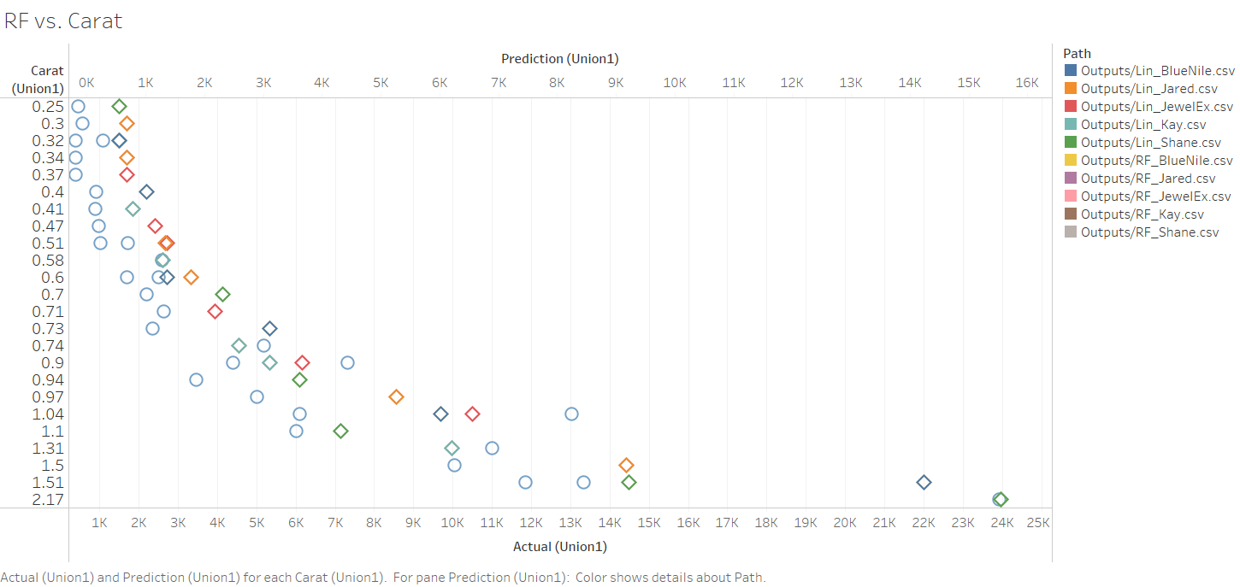
Random Forest: Prediction vs Actual

Slide 13
So, what’s your guess?

Slide 14

Feature Importance
Carat | Clarity | Cut | Color
0.922 | 0.054 | 4.689e-05 | 0.023

Slide 15
Vendor Test Scores
Jeweler | Linear Regression Score | Random Forest Regression Score
Blue Nile | 0.892 | 0.987
Jared | 0.872 | 0.977
Jewelry Express | 0.568 | 0.538
Kay | 0.470 | 0.524
Shane Co. | 0.799 | 0.791

Slide 16
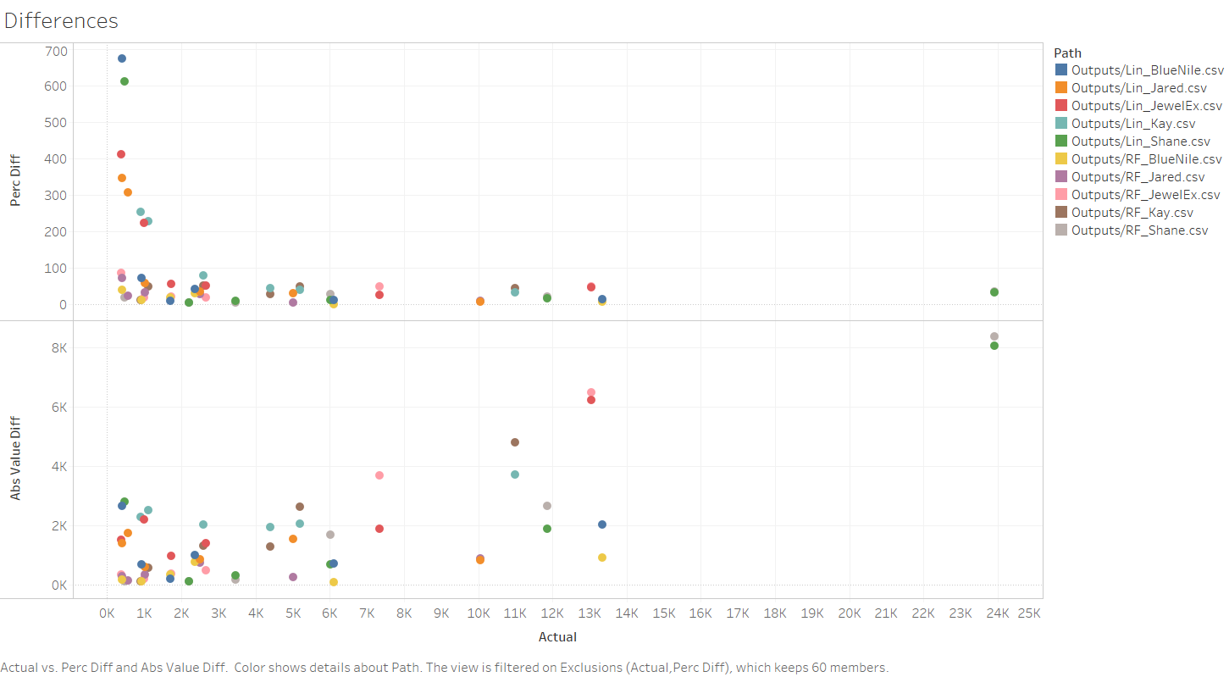

Slide 17
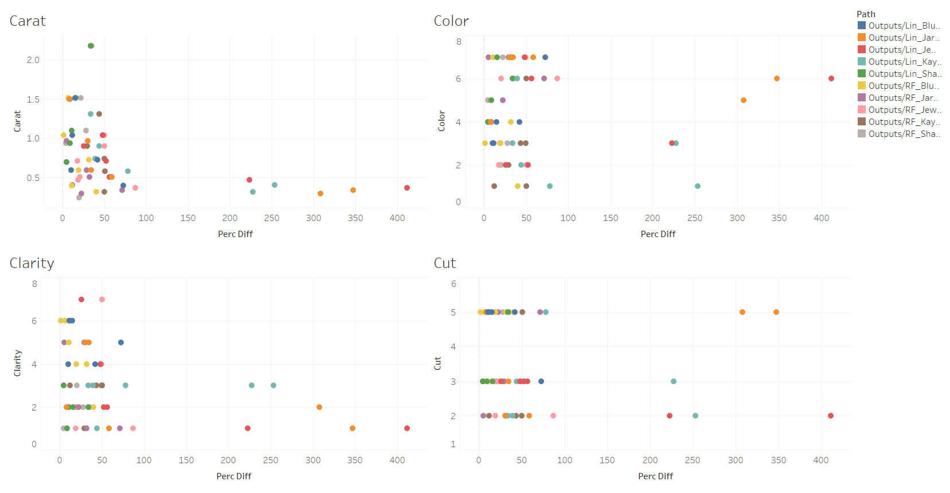

Slide 18
Which category has the biggest impact on a diamond’s price?
However…
THE MOST IMPORTANT C IS CUT. Irrespective of its carat weight, color, and clarity, if the fire and brilliance are absent, then the diamond is not that valuable. ... When a diamond is accurately cut, it will hide blemishes and will cause the diamond to pop and sparkle brilliantly.
Our data says Carat size has biggest impact on price.

