Slide 1
Team 11 Credit Card Transactions Fraud Detection
MEMBERS:
Christina Albert Daniel- NUID 002833358
Satya Siva Sai Mrudula Chilukuri- NUID 002644914

Slide 2
Introduction
Dataset: Detailed credit card transaction records from 2019 to 2020, encompassing 1000 customers and 800 merchants.
Motivation: Addressing the urgent need to enhance fraud detection amidst rising sophisticated fraudster tactics.
Opportunity: Leveraging machine learning on the dataset to proactively detect fraud, optimizing feature selection and model deployment.
Insights: Uncovering transactional patterns, fraudulent behaviors, and dynamics between customers and merchants to fortify fraud detection mechanisms.

Slide 3
GOAL
Objective: Develop and refine machine learning models to accurately detect fraudulent transactions, employing diverse classification strategies like logistic regression and neural networks.
Ambition: Enrich academic discourse on machine learning applications in fraud detection, aiming to contribute actionable insights for enhancing security measures in financial infrastructures.
Approach: Test and optimize classification algorithms to discern fraud patterns effectively, with the goal of fostering a safer transaction environment.
Outcome: Delivering insights that can be implemented to bolster security measures and improve fraud detection in future financial transactions.

Slide 4
Project GOAL
Objectives for developing, testing, and refining ML models.
Aspirations to contribute to safer financial transactions.
Data Processing & Cleaning: Ensure dataset accuracy by removing irrelevant data, filling missing values, standardizing formats, and identifying anomalies.
Exploratory Data Analysis & Feature Engineering: Uncover fraud patterns using EDA techniques, then select key predictors and engineer features for enhanced model performance, incorporating Linear Classifier, Decision Tree/Random Forest, Support Vector Classifier, and Gaussian Naïve Bayes. Additionally, employ time series analysis methods like ARIMA to predict future fraud trends.

Slide 5
DATASET Description
This dataset comprises credit card transactions spanning from January 1, 2019, to December 31, 2020, involving 1000 customers and 800 merchants. Each transaction record contains various attributes such as transaction date and time, credit card number, merchant details, transaction amount, customer demographics including name, gender, address, city, state, and zip code, as well as geographical coordinates, city population, job information, date of birth, and transaction identifiers. The 'is_fraud' column serves as the target variable indicating whether a transaction is fraudulent or not. This dataset offers a comprehensive view of credit card transactions, making it suitable for fraud detection analysis and modeling.

Slide 6
Methodology Overview
Data Processing & Cleaning: Ensure dataset accuracy through removal of irrelevant data, filling missing values, and standardizing formats to prepare for analysis.
Exploratory Data Analysis: Utilize histograms, scatter plots, and correlation matrices to uncover patterns, focusing on key features such as transaction amounts and demographics to identify potential fraud indicators.
Feature Engineering: Select and create features from existing data, emphasizing transaction amount, merchant details, location, and demographic information to enhance model predictive power.
Model Selection & Evaluation: Implement Linear Classifier, Decision Tree/Random Forest, Support Vector Classifier, and Gaussian Naïve Bayes methods to classify transactions, addressing imbalanced data and achieving better classification results.
Time Series Analysis: Apply ARIMA to detect and predict future fraud trends, integrating insights with exploratory data analysis and feature engineering to develop a robust fraud detection system.

Slide 7
Data Cleaning and Pre-processing
Loaded transaction datasets from CSV files and examined data structure for integrity.
Utilized Pandas for data manipulation, ensuring correct data types and formats.
Identified and addressed missing or duplicate data for dataset consistency.
Streamlined data by removing irrelevant features such as the redundant index column.
Checked and handled outliers and anomalies to prepare a clean dataset for analysis.

Slide 8
Exploratory Data Analysis (EDA)
Exploratory Data Analysis (EDA) Importance:
EDA is a fundamental step in data analysis, using statistical and visual methods to summarize and understand data characteristics, revealing patterns and anomalies.
Transaction Categorization and Visualization:
Transactions were categorized and visualized to identify variations in transaction frequency by category, highlighting potential areas for fraud monitoring.
Fraud Proportion Analysis:
Pie charts were created to analyze the proportion of fraudulent transactions within each category, indicating the prevalence of fraud and guiding fraud detection strategies.

Slide 9
Exploratory Data Analysis (EDA)
4. Gender Distribution and Correlation Analysis:
A composite visualization showed transactions by gender, with the occurrence of fraud being slightly higher in male-associated transactions, which assists in gender-specific fraud prevention strategies.
5. Correlation Heatmap and Feature Refinement:
A heatmap was used to identify strong correlations among features and to address multicollinearity by removing redundant features, influencing data preprocessing and feature engineering.

Slide 10
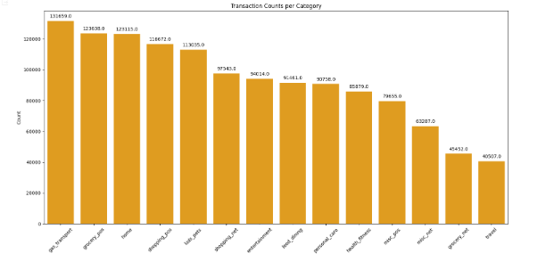
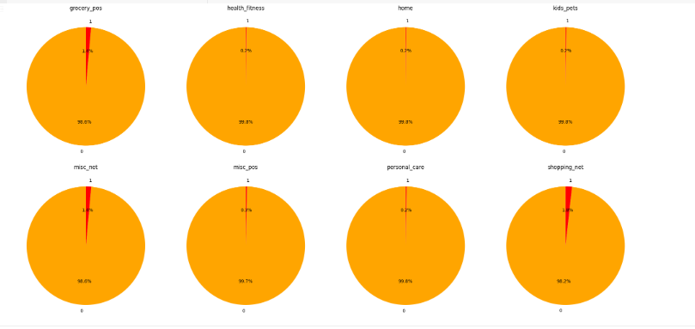
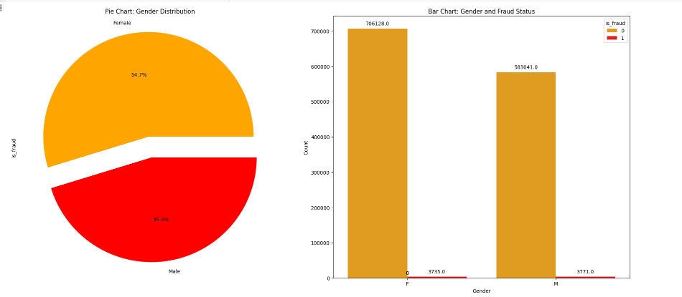
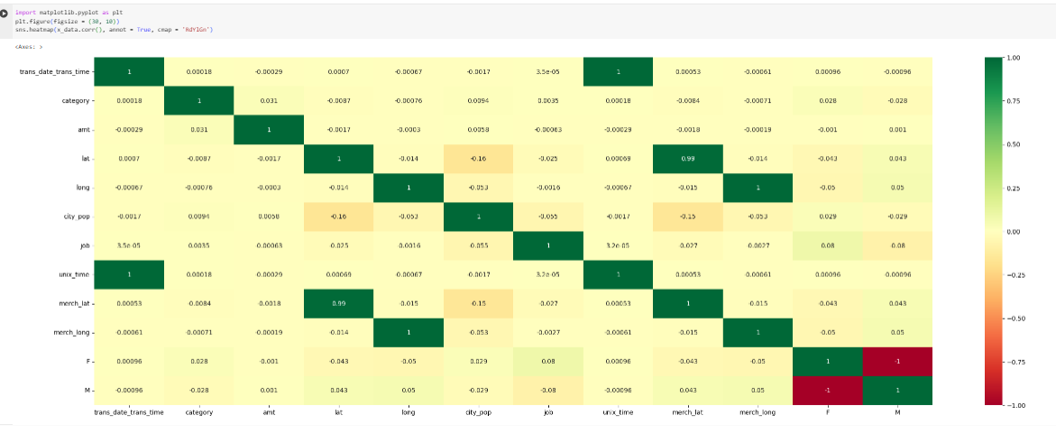

Slide 11
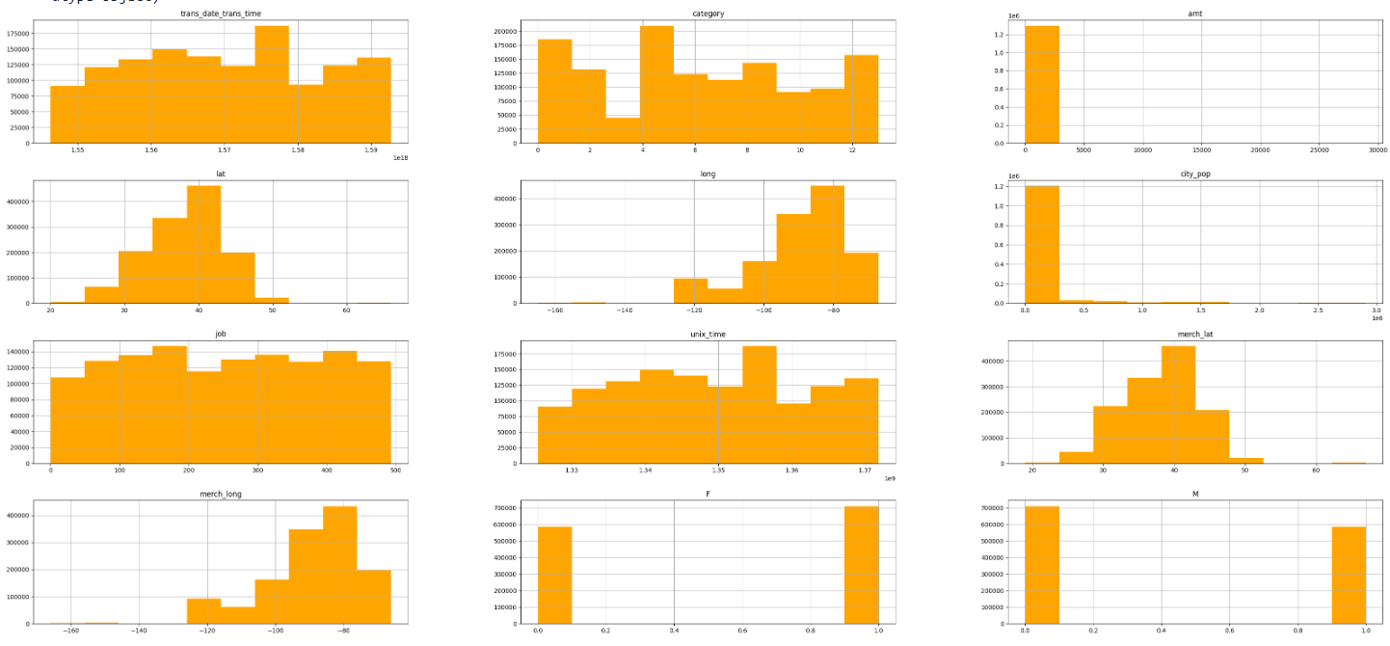

Slide 12
Feature Engineering
Categorical Variable Encoding:
Categorical features such as 'category', 'gender', and 'state' were transformed into numerical representations to enable their use in machine learning models, as shown through various visualizations like pie and bar charts.
Skewed Transaction Amounts:
Transaction amounts in both the training and testing datasets are skewed towards lower values, with smaller transactions being significantly more common than larger ones, as highlighted by the bar graphs.
Consistency for Model Representation:
The consistent distribution of transaction amounts between the training and testing datasets indicates that the machine learning models should be trained on a representative sample that includes transactions of all sizes to ensure balanced learning and performance evaluation.

Slide 13
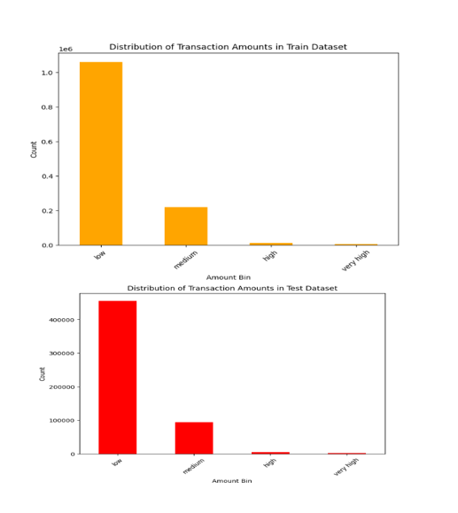

Slide 14
Model Selection and Evaluation
Chose Linear Classifier for initial feature engineering before using complex models.
Evaluated Decision Tree and Random Forest for handling potentially unbalanced data.
Employed Support Vector Classifier to better classify values through dimensional separation.
Applied Gaussian Naïve Bayes method for its proficiency with unbalanced datasets.
Prioritized model hyperparameter tuning to prevent overfitting and optimize performance.

Slide 15
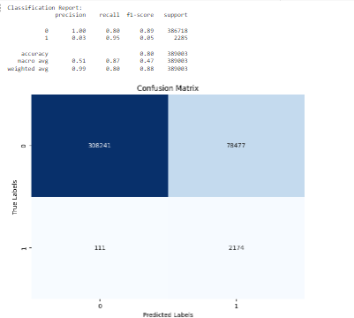
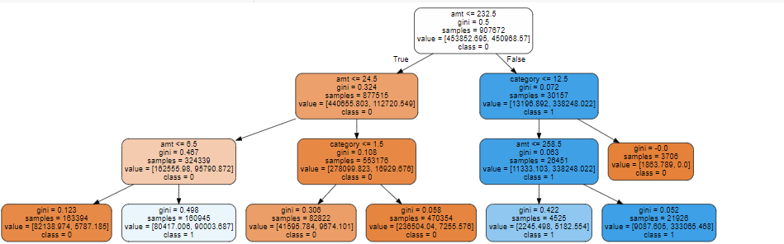
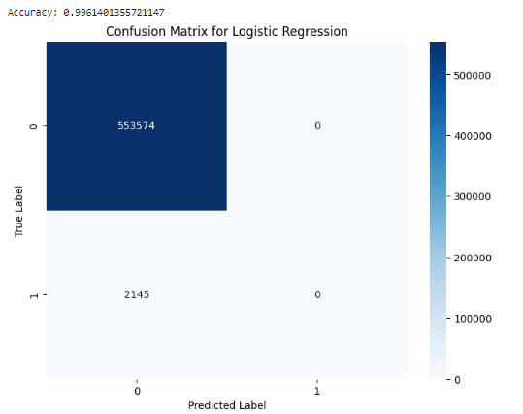
Decision Tree Classifier
Logistic Regression

Slide 16
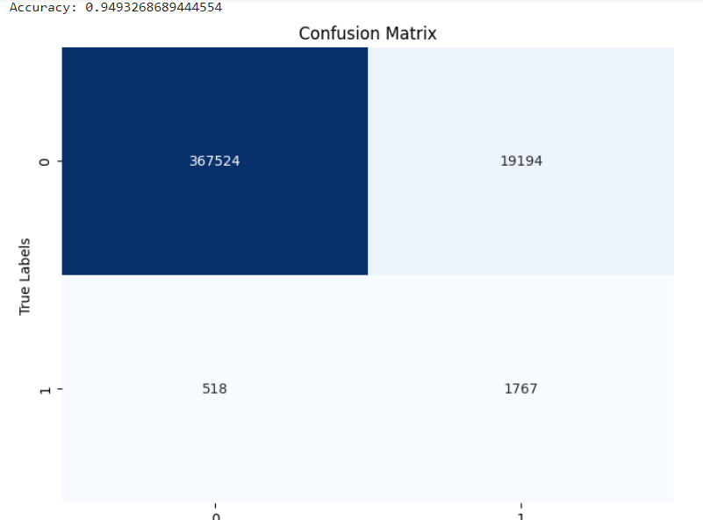
Support Vector Classifier
Time Series Analysis :
ARIMA analysis detects patterns and predicts future fraud trends by correlating time series insights with other predictive indicators identified through exploratory data analysis and feature engineering.
Trained ARIMA model with order (5, 1, 0) forecasts 'is_fraud' values for the testing set, evaluated using Mean Squared Error (MSE) and Mean Absolute Error (MAE), with actual vs. predicted fraudulent transactions plotted using matplotlib.

Slide 17
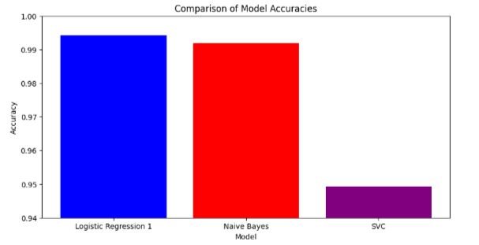
Best Suited Model
Logistic Regression Model excels in accurately identifying fraudulent transactions, leveraging its probabilistic outcomes and compatibility with linearly separable data.
Naive Bayes, though exhibiting lower accuracy, remains pivotal in fraud detection with its foundational statistical approach, simplifying computation and serving as a rapid assessment tool for imbalanced datasets.
Accuracy alone doesn't determine model utility in fraud detection; Naive Bayes' ability to prioritize recall for fraudulent transactions makes it indispensable in real-time fraud detection systems.

Slide 18
Conclusion
Analysis of 2019-2020 transaction data from 1000 customers and 800 merchants drove our proactive approach to enhancing fraud detection mechanisms amidst escalating fraudulent activities.
Methodology involved meticulous data cleaning, exploratory analysis, and feature engineering, showcasing the potential of logistic regression, decision trees, and Naive Bayes in developing effective fraud detection systems.
Logistic Regression Model 2 led in accuracy, while Naive Bayes, despite lower accuracy, proved crucial for rapid initial assessments in imbalanced datasets, highlighting the multifaceted approach needed in combating fraud.

Slide 19
Future Work
We aim to create a sophisticated fraud detection system that combines advanced machine learning, including deep learning and ensemble models, to not only identify but also adapt to new fraudulent patterns in real-time, significantly reducing false positives.
By merging these machine learning models with live transactional data, our goal is to provide financial institutions with an adaptive, learning fraud prevention tool that integrates comprehensive data analysis and predictive analytics for a cutting-edge solution in financial security.

Slide 20
References
s
https://www.kaggle.com/datasets/kartik2112/fraud-detection/dataTop of Form
https://www.sciencedirect.com/science/article/pii/S187705092030065X
https://www.kaggle.com/datasets/mlg-ulb/creditcardfraud/data

