Slide 1

project report submitted in partial fulfilment of the requirements for the Course
MACHINE LEARNING
BACHELOR OF TECHNOLOGY
A.Y.: 2026-27

Slide 2
A PROJECT TITLE
ON
Plant Disease Detection Using CNN and Transfer Learning
by
K.Mrudula(2520090073)
B.Navya(2520090189)
Under the Esteemed guidance of
Ms. Sowmya
Assistant Professor, CSIT
Computer Science & Information Technology

Slide 3
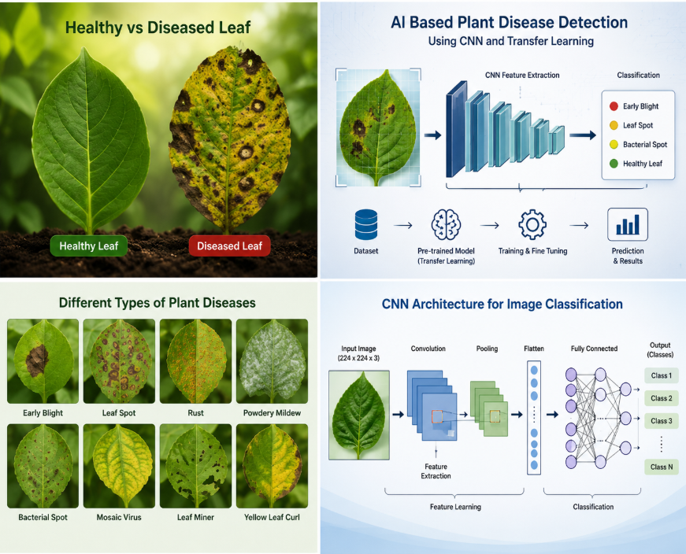
INTRODUCTION
Agriculture plays a vital role in the economy, and plant diseases significantly affect crop production. Traditional disease detection methods require expert knowledge and are often time-consuming. With advancements in Artificial Intelligence and Deep Learning, automatic plant disease detection has become more efficient. CNN models can automatically extract image features, while Transfer Learning uses pre-trained models to achieve high accuracy with less training data. This project develops an intelligent system that detects plant diseases from leaf images quickly and accurately, helping farmers take timely action to improve crop health and productivity.

Slide 4
Problem Statement
• Plant diseases can damage leaves, reduce crop quality, and lower agricultural productivity.
• Manual inspection takes time and may require an experienced agricultural specialist.
• Disease symptoms can look similar, making visual identification difficult for non-experts.
• The project aims to classify a plant-leaf image into a learned healthy/disease category using deep learning.

Slide 5
Motivation
Early identification
AI for agriculture
Practical access
Recognizing possible disease symptoms sooner can help users seek suitable advice and take timely action.
Computer vision can support image-based screening and reduce dependence on repeated manual checks.
A future web or mobile interface could make image-based assistance easier to access.
Project motivation: explore how CNN feature learning and transfer learning can be applied to a real-world agricultural problem.

Slide 6
Objectives
• Prepare and preprocess a labeled plant-leaf image dataset.
• Use a Convolutional Neural Network (CNN) with a pre-trained transfer-learning model.
• Train or fine-tune the model to distinguish the dataset’s plant-disease classes.
• Evaluate the trained model using suitable classification metrics.
• Provide a simple path for users to submit a leaf image and view the predicted class.

Slide 7
Existing System and Its Limitations
Common approach
Limitations
• Can be time-consuming
• Depends on experience and image conditions
• Difficult to scale frequent checks
• Similar symptoms may be confused
• Visual inspection by farmers or experts
• Consultation with agricultural specialists
• Manual comparison with disease references

Slide 8
Proposed System
• Input: a photograph of a plant leaf.
• Preprocessing: resize the image to the model input size and normalize pixel values.
• Prediction: a CNN-based transfer-learning model extracts image features and predicts a class.
• Output: display the predicted class and, if implemented, class confidence.
• The output is intended as decision support, not a replacement for expert diagnosis.

Slide 9
System Architecture / Block Diagram
1. Input Image
➜
2. Preprocessing
➜
3. CNN / Transfer Learning
➜
4. Classifier
➜
5. Output
Plant-leaf photo
Resize • normalize
Feature extraction
Class probabilities
Predicted class
Training stage: labeled images → augmentation → model training/fine-tuning → validation → saved model

Slide 10
Methodology / Workflow
• Collect labeled leaf images from the PlantVillage dataset.
• Inspect labels and split the data into training, validation, and test sets.
• Resize images, normalize pixel values, and apply augmentation to training images.
• Load a pre-trained model such as MobileNetV2, ResNet50, or VGG16 and adapt its classification head.
• Train/fine-tune the model, validate performance, and evaluate on held-out test data.
• Use the trained model to predict the class of a new leaf image.

Slide 11
Technology Stack
Language & environment
Deep learning
Data & visualization
Python 3.x
Jupyter Notebook / Google Colab / VS Code
TensorFlow and Keras
CNN + transfer learning
NumPy, Pandas, OpenCV
Matplotlib, Scikit-learn
Dataset
Hardware
PlantVillage Dataset
Windows 10/11 or Ubuntu; 8 GB RAM minimum; GPU recommended

Slide 12
System Modules / Components
Image input
Preprocessing
Model training
Upload or select a leaf image.
Resize, normalize, and optionally augment images.
Train or fine-tune the CNN-based model.
Prediction
Result display
Map model scores to the supported class labels.
Show predicted class and evaluation summary.

Slide 13
Implementation Plan
• Set up Python and the required libraries in Google Colab, Jupyter Notebook, or VS Code.
• Load the dataset and confirm that image labels and class folders are correct.
• Create preprocessing and augmentation pipelines.
• Build the transfer-learning model, configure the optimizer and loss, then train and validate it.
• Save the trained model and class-label mapping.
• Connect image input to inference and display the predicted class.

Slide 14
Dataset and Input Data
• Dataset named in the project: PlantVillage Dataset.
• Input data: labeled images of plant leaves, including healthy and diseased examples.
• Preprocessing described for this project: resize images and normalize pixel values.
• Data augmentation options: rotation, horizontal/vertical flipping where appropriate, and zooming.
• Before final submission, add the exact number of images, class names, and train/validation/test split used in your implementation.

Slide 15
Algorithm: CNN and Transfer Learning
Convolutional Neural Network (CNN)
Transfer learning
• Learns visual patterns such as edges, textures, and leaf symptoms.
• Builds higher-level image features through convolution and pooling.
• A classifier maps learned features to disease classes.
• Starts from a model pre-trained on a large image dataset.
• Reuses learned visual features.
• Replaces/adapts the final classification layer for the plant-leaf classes.
• Can reduce training time compared with training from scratch.
Candidate backbones listed in the project abstract: MobileNetV2, ResNet50, or VGG16.

Slide 16
Results and Performance Evaluation
No measured training/evaluation results were included in the supplied PPT.
Accuracy
Precision / Recall
F1-score / Confusion matrix
Correct predictions ÷ total predictions
Report per class where possible
Use test-set predictions to summarize errors
Replace this slide with actual values and graphs after running the model. Do not report estimated metrics as measured results.

Slide 17
Screenshots / Demo
Screen 1 — Image input
Screen 2 — Processing
Screen 3 — Prediction
Insert screenshot of the page/notebook where a user selects a leaf image.
Insert screenshot showing preprocessing or model inference.
Insert screenshot of the actual predicted class and confidence, if available.
These are placeholders: screenshots were not present in the supplied files.

Slide 18
Advantages and Applications
Advantages
Applications
• Faster image-based screening
• Consistent model predictions for supported classes
• Reuses pre-trained visual features
• Can be extended to a mobile/web interface
• Preliminary crop-health screening
• Agricultural education and demonstrations
• Support tools for farmers and agricultural workers
• Research on computer vision for plant health

Slide 19
Limitations
• Predictions depend on dataset quality, class coverage, and label correctness.
• Lighting, background, camera quality, and leaf orientation may affect results.
• A model may perform poorly on plant varieties or diseases absent from training data.
• A predicted class does not replace confirmation by an agricultural expert.
• Actual limitations and generalization should be checked using held-out and real-world images.

Slide 20
Future Scope
• Develop a simple web or mobile application for image upload and prediction.
• Evaluate the model on field images collected under varied lighting and backgrounds.
• Expand the dataset to cover more crops, disease classes, and healthy examples.
• Add explainability visualizations to indicate image regions influencing predictions.
• Optimize the model for faster inference on low-resource devices.
• Provide carefully reviewed disease-prevention information alongside predictions.

Slide 21
Conclusion
This project explores plant disease classification from leaf images using CNNs and transfer learning.
Core idea
Expected value
Next step
Learn visual features from leaf images and predict a supported class.
Support earlier screening and reduce time spent on manual checks.
Run the model, record real metrics, and add demo screenshots.

Slide 22


