Slide 1
CLASSIFICATION TECHNIQUES FOR GENE EXPRESSION ANALYSIS
1
DMW Mini Project
Mrugakshi Chidrawar (4153)
Akash Patil (4157)
Apoorva Khuspe (4143)

Slide 2
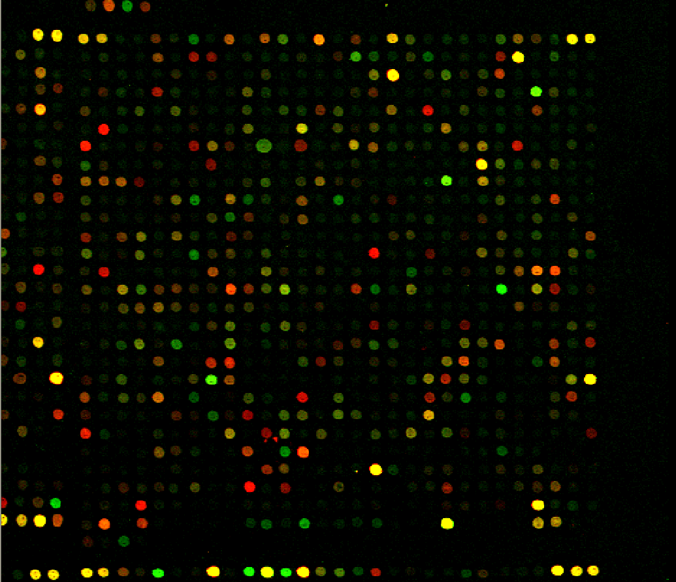
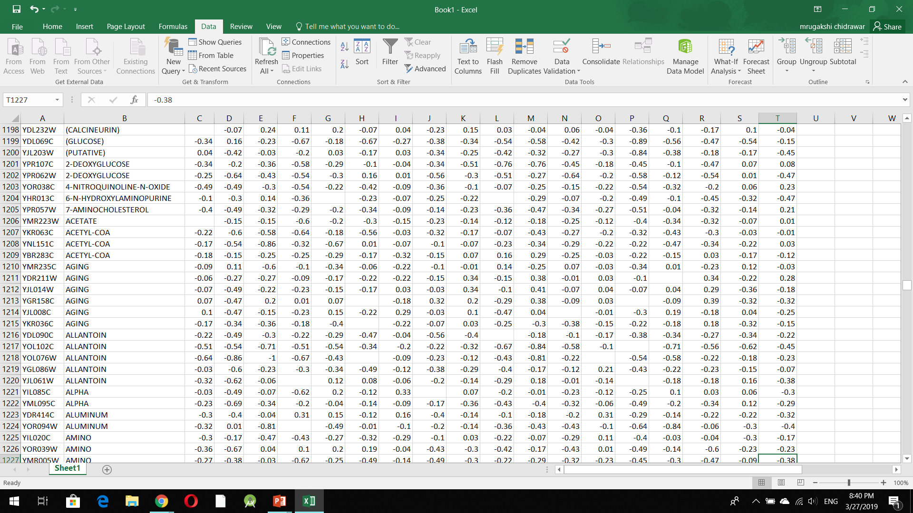
PREPROCESSING
2
Gene expression data
(After normalization)
Microarray

Slide 3
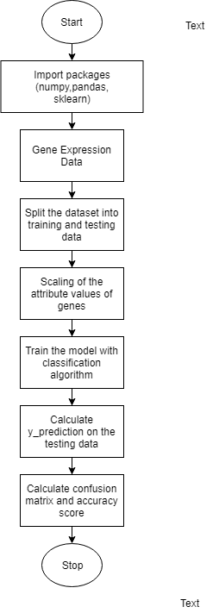
FLOW OF
MODEL
3

Slide 4
K-Nearest Neighbors Classifier
4
K-nearest neighbors is a simple algorithm that stores all available data points and classifies new data points based on a similarity measure (e.g., distance functions).
After the training of our model, the k-NN algorithm (n_neighbors=8) calculates the Euclidean distance to determine the closest 8 neighbors for every gene in the test data to determine which class has attributes that are most similar with the test gene and proceeds to predict the gene function based on its results.

Slide 5
Support Vector Machine
5
A Support Vector Machine (SVM) is a discriminative classifier defined by a separating hyperplane.
After plotting of data from the training dataset, the SVM determines the Maximum Margin Hyperplane which will be used to classify genes from the testing dataset into different functional classes based on which side of the hyperplane the gene value lies.

Slide 6
Decision Tree Classifier
6
Decision Tree learning algorithm generates decision trees from the training data to solve classification problem.
The leaf nodes represent the various gene function classes of our dataset.
In our model, every gene from the test data traverses the decision tree created while training period and depending on the value of its attributes, it reaches a certain leaf node, which is finally it’s predicted function class.

Slide 7
Random Forest Classifier
7
Random forest builds multiple decision trees and merges them together to get a more accurate and stable prediction.
1) Random k data points from the training set are chosen.
2) A decision tree is built with respect to these k data points.
3) Repeat the above steps for n number of times which will result in n number of decision trees.
Now, for every gene in our testing dataset, each of the decision tree will predict the functional class it belongs to. The final prediction will be that of the majority vote.

Slide 8
Implementation Results
8
Classification Model | Accuracy Score
K-NN | 0.5
SVM | 0.451
Decision Tree | 0.342
Random Forest | 0.491
Table 1: Comparison of Accuracy Scores of different Classification Models

Slide 9
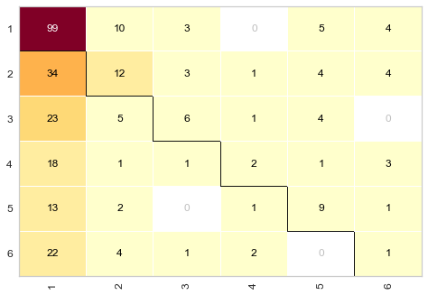
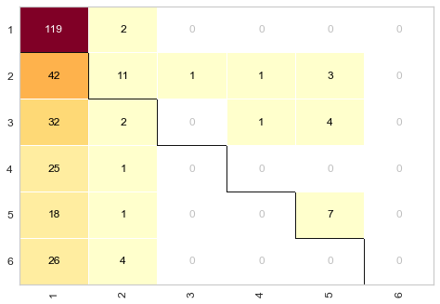
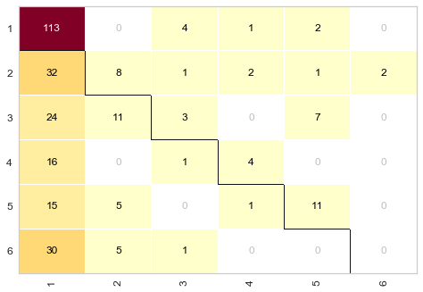
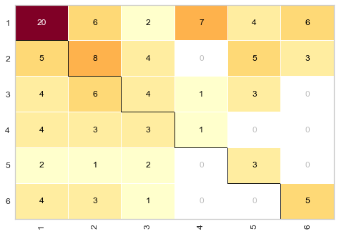
9
Confusion
Matrices
Fig 1: k-NN
Fig 2: SVM
Fig 3: Decision Tree
Fig 3: Random Forest

Slide 10
CONCLUSION
10
Following this study, we observed that various classification techniques are currently used to develop an appropriate methodology for effective gene expression data classification.
After studying 4 hard classification techniques, we can conclude that for the dataset that was used, k-NN performed the best.

Slide 11
REFERENCES
11
[1] P. C. H. Ma and K. C. C. Chan, "Incremental Fuzzy Mining of Gene Expression Data for Gene Function Prediction," in IEEE Transactions on Biomedical Engineering, vol. 58, no. 5, pp. 1246-1252, May 2011. doi: 10.1109/TBME.2010.2047724
[2] M. Aouf, L. Liyanage and S. Hansen, "Critical Review of Data Mining Techniques for Gene Expression Analysis," 2008 4th International Conference on Information and Automation for Sustainability, Colombo, 2008, pp. 367-371. doi: 10.1109/ICIAFS.2008.4783954
[3] Ramaswamy S, Tamayo P, Rifkin R, Mukherjee S, Yeang CH, Angelo M, Ladd C, Reich M, Latulippe E, Mesirov JP, et al. Multiclass cancer diagnosis using tumor gene expression signatures. Proc Natl Acad Sci USA. 2001;98:15149–15154. doi: 10.1073/pnas.211566398.
[4] Dudoit S, Fridlyand J, Speed TP. Comparison of discrimination methods for the classification of tumors using gene expression data. J Am Stat Assoc. 2002;97:77–87. doi: 10.1198/016214502753479248.
[5] Spellman Dataset- http://genome-www.stanford.edu/clustering/ , last cited on 27/03/2019.

Slide 12
12
THANK YOU!

