Slide 1

World Wide Energy Consumption

Slide 2
About me
Mrugakshi Anant Harkare
B.E. in Electronics & Telecommunication Engineering (D. Y. Patil College Of Engineering, Akurdi, Pune)
Why I Want to Learn Data Science:
I want to learn Data Science because it’s a skill that connects technology with decision-making. It helps me turn data into useful insights, which is valuable for solving real problems and building a strong career in tech.
Work Experience / Projects:
Energy Consumption Analysis — SQL & Excel-based study of global energy usage and trends.
Student Progress Analytics — Built in Excel for analysing academic results and improvement areas.
GPS-Enhanced Safety Pouch — IoT project using ESP32, GPS, and GSM for personal safety tracking.
Profiles:
LinkedIn: linkedin.com/in/mrugakshi-harkare-ab4701251
GitHub: https://github.com/mrugakshiharkare

Slide 3
Objective
To study how energy usage impacts the environment and contributes to global emissions.
To use SQL for analyzing real-world energy data and find meaningful patterns and insights.
To understand how population growth and economic development affect energy demand and pollution.
To highlight the need for sustainable and efficient energy use across countries.
To apply data analysis for supporting global goals like reducing carbon emissions and promoting clean energy.

Slide 4
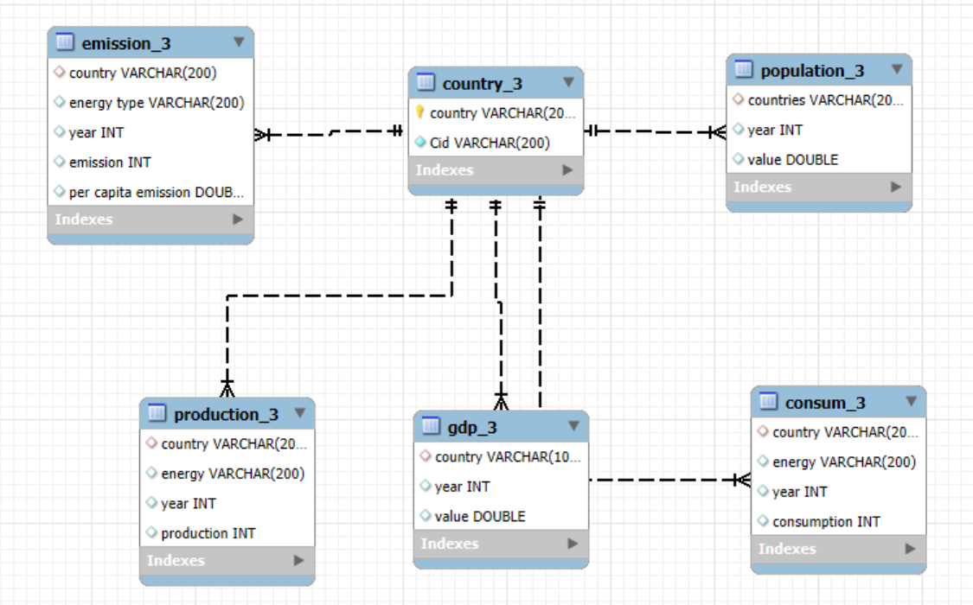
ER Diagram

Slide 5
Schema Explanation
The database consists of 6 tables:
country_3: Stores country names and country IDs.
consum_3: Contains energy consumption data (country, energy type, year, consumption).
production_3: Records yearly energy production by each country.
emission_3: Stores CO₂ emission data and per capita emissions.
gdp_3: Contains GDP values for each country per year.
population_3: Holds population data for different countries and years.
The country_3 table is the central table, linked to all others through the country field.
This relational structure helps in performing SQL joins for comparative and time-based analysis.

Slide 6
Key analysis questions
What is the total emission per country for the most recent year available?
Which energy types contribute most to emissions across all countries?
How have global emissions changed year over year?
What are the top 5 countries by GDP in the most recent year?
Has energy consumption increased or decreased over the years for major economies?

Slide 7
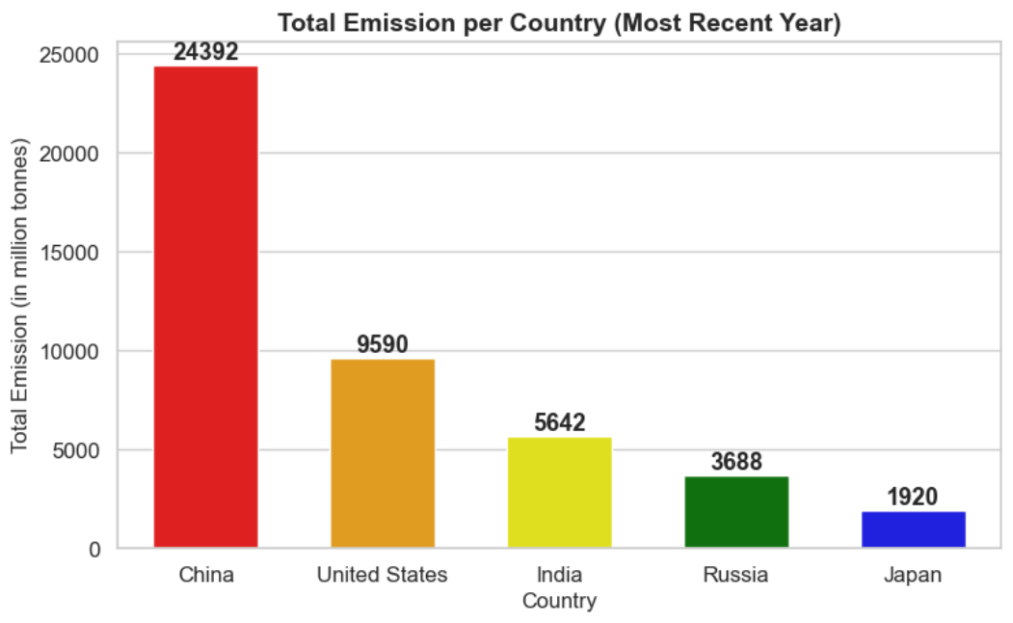
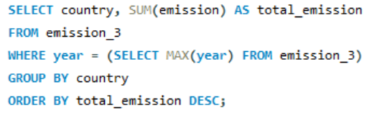
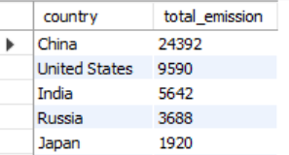
What is the total emission per country for the most recent year available?

Slide 8
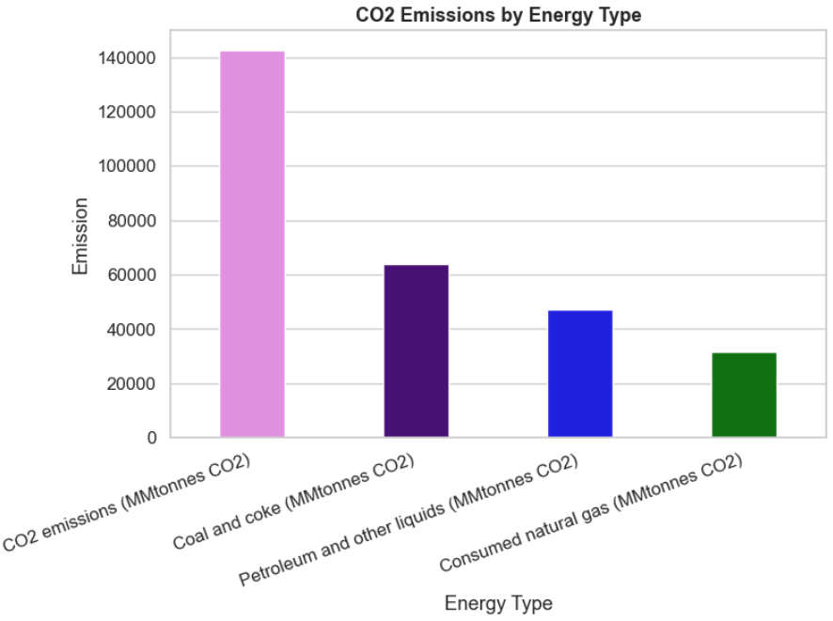
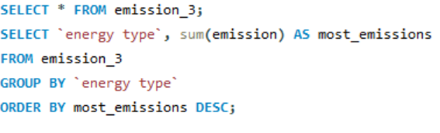
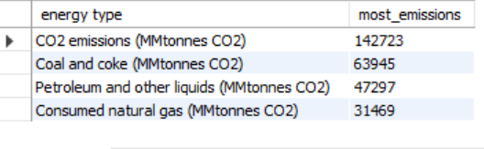
Which energy types contribute most to emissions across all countries?

Slide 9
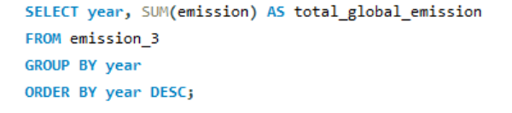
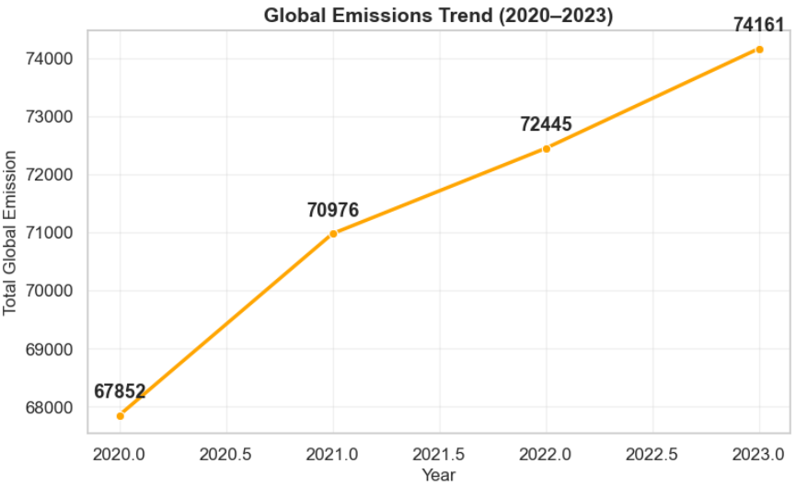
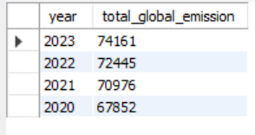
How have global emissions changed year over year?

Slide 10
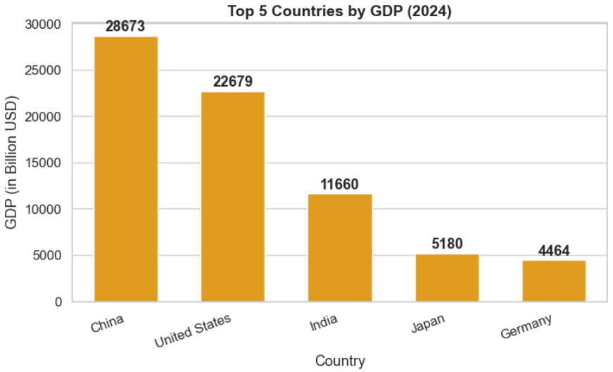
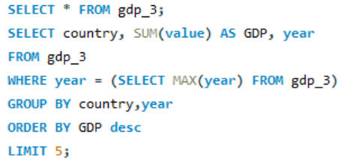
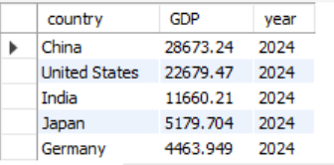
What are the top 5 countries by GDP in the most recent year?

Slide 11
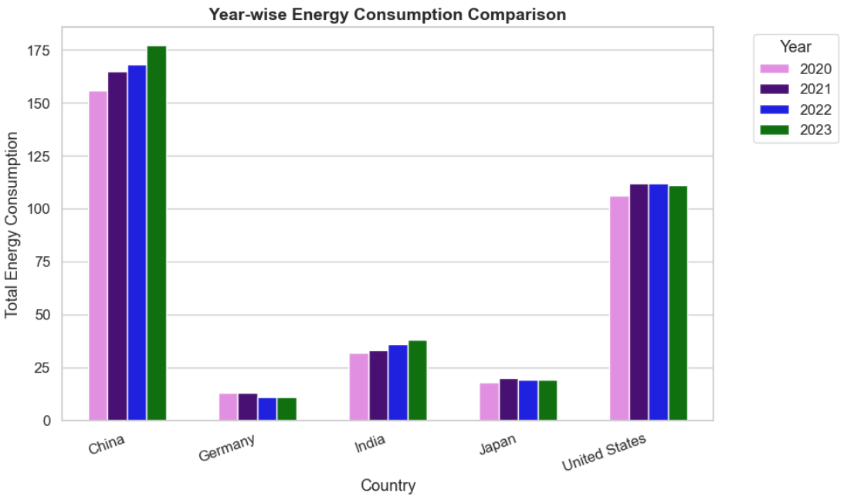
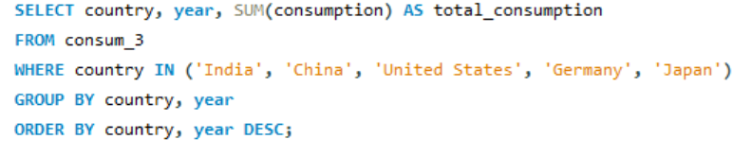
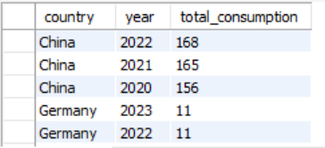
Has energy consumption increased or decreased over the years for major economies?

Slide 12
Experiences and Challenges
Experiences
Learned how to use SQL for analyzing large real-world datasets effectively.
Gained a better understanding of data cleaning, joining tables, and using aggregate functions.
Realized how data analysis can help in solving global issues like energy consumption and emissions.
Challenges
Faced issues while joining multiple tables and handling column mismatches.
Some queries gave null or incorrect results, which required debugging and logical thinking.
It was difficult to understand data relationships and connect them meaningfully for analysis.

Slide 13
Conclusion
The analysis shows that energy use and emissions are increasing every year, mainly due to industrial growth and population rise.
China, the United States, and India are among the highest contributors to global emissions.
The study highlights the importance of balancing economic growth with environmental protection.
Using SQL helped to analyze large datasets easily and draw meaningful insights from real-world data.
Promoting clean energy and sustainable practices can help reduce global pollution and secure a better future.

Slide 14

THANK YOU

