Slide 1
OPERATING
SYSTEMS
Task Manager for Android
Mruganshi Gohel (B20CS014)
Harshita Gupta (B20CS018)
Atul Khobragade (B20CS027)

Slide 2
Introduction
In our application we created an application that can be used on an Android device to give the user specific operating system information.
This Task Manager Android Application is similar to the Windows Task Manager, but it focuses on the details, services, and CPU tabs.
In our application we created a simple app that can be used on an Android device to present the user with important operating system information.
It was designed with the intention of giving a user more information and control over the device it is installed on.
Managing “tasks” as the title of our project states refers to the processes running on the device itself.

Slide 3





Problem Statement and Objectives
To gather details, services and CPU utilization of rooted device
Explore the different permissions , memory
To filter the different processes (if you are looking for specific one)
To retrieve all available services
To show uptime , load average, CPU utilization of each process

Slide 4
Features and Outcomes
App Details Button
Details Tab
Services Tab
CPU Tab
Search view
Stopping the Task Manager Application
Stop button
From toolbar
Keyboard shortcut
Force stop

Slide 5
App Details
The App Details button shows you all the available information about the Task Manager Application. This is including if the user would like to know more about the application’s storage, permissions, notifications, and memory. This allows the user to also force stop or uninstall the application.

Slide 6
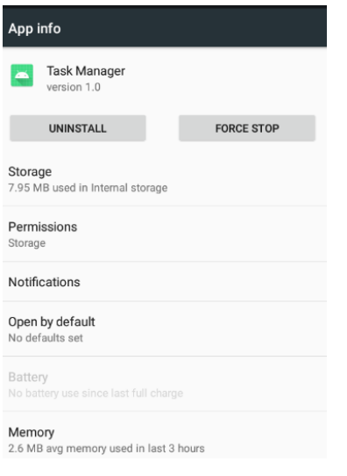

Slide 7
2. Details Tab
The Details Tab shows all processes from all available users. To retrieve the running processes from all the available users, the command “su -c ps” is being run. A SearchView is found at the top to filter the different processes if you are looking for a specific one without having to spend time finding it.

Slide 8
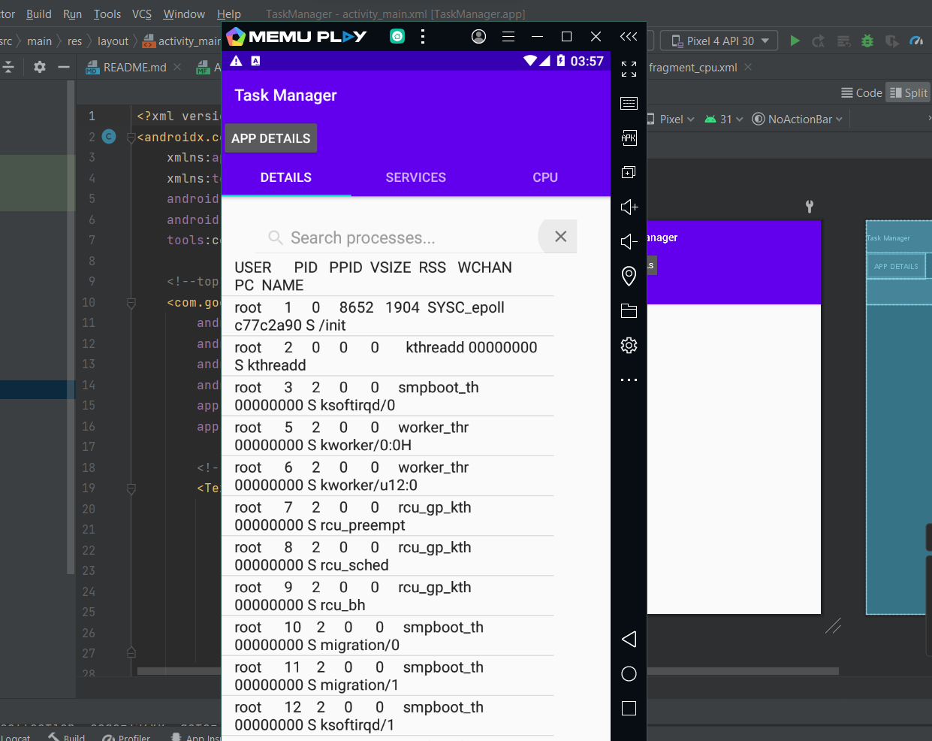

Slide 9
3. Service tab
The Services Tab shows all available services, as well as the currently running ones. To retrieve all available services the command “su -c service list” is being run. To retrieve only the running services, the command “cmd -l” is being run.

Slide 10
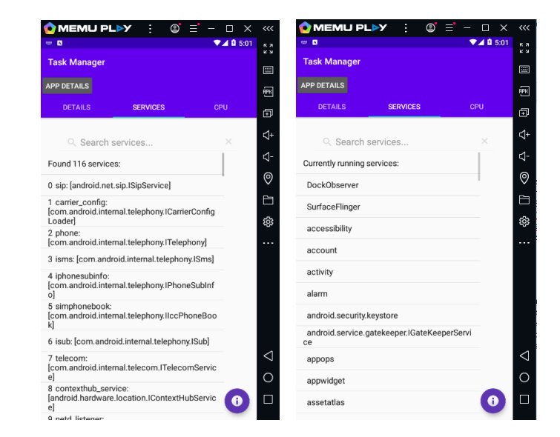

Slide 11
4. CPU Tab
The CPU tab shows a lot of useful information about the CPU. This would include uptime, load average, CPU utilization, and the CPU % of each process.

Slide 12
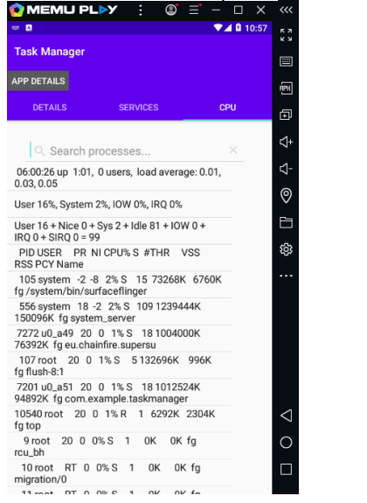

Slide 13
5. Stopping the Task Manager Application
There are several ways that you can stop the Task Manager Application.

Slide 14
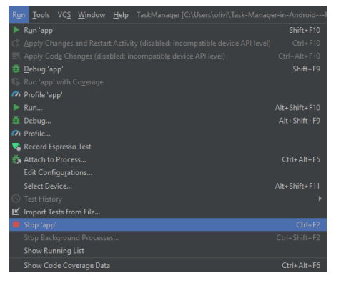
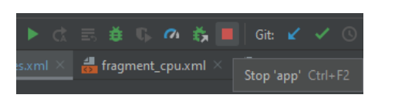
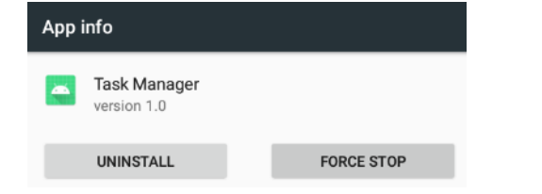

Slide 15
Lessons Learned
The biggest challenge for this project was related to the security of the privileged information we want to extract. The information we want is protected because the operation system relies on it. Any app installed will not have access to this operating system information.
Administrative Privileges
Requesting User Permission
Packet Manager
How to Run Linux in Java in an android application
getRuntime().exe(command)
Rooting

Slide 16
Thank you!

