Slide 1

        A
        Project Report
        On
        Language Translator
        Developed by:
    Hamirsinh Kumpavat (IT-043) - Department of IT, DD University
    Mrugnayani Lankapati (IT-044) - Department of IT, DD University
    Internal Guide:
    Prof. Roshni M. Raval
    Department of Information Technology
    Faculty of Technology
    DD University

Slide 2
Language description/feature:
In this project we made a compiler of our language. It is a compiler which performs string manipulation operations like:
Program starts with keyword ‘$start’ and end with keyword ‘$end’.
Variable name should be a capital letter with length one.
assign(var A , string S) :This function allocate string S to the variable A.
concat(var A, var B) : This function concates two string stored in var A and B.
search(var A, char c):This function print whether or not character c is found in var A or not.
replace(var A, char c, char d) : This function will replace character c with d in variable A.
length(var A) :This function will print length of the string in variable A.
display(var A): This function displays the string stored in variable A.

Slide 3
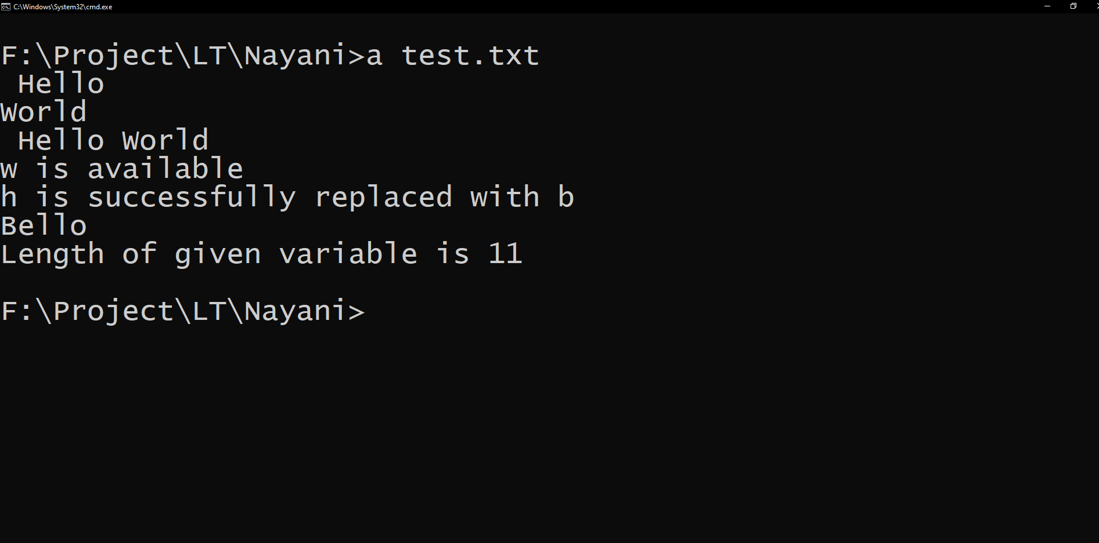
Possible inputs and their outcomes:
$start
var A,B;
assign(A,Hello);
assign(B,World);
display(A);
display(B);
var C;
C=concat(A,B);
display(C);
search(C,w);
replace(A,h,b);
display(A);
length(C);
$end

Slide 4
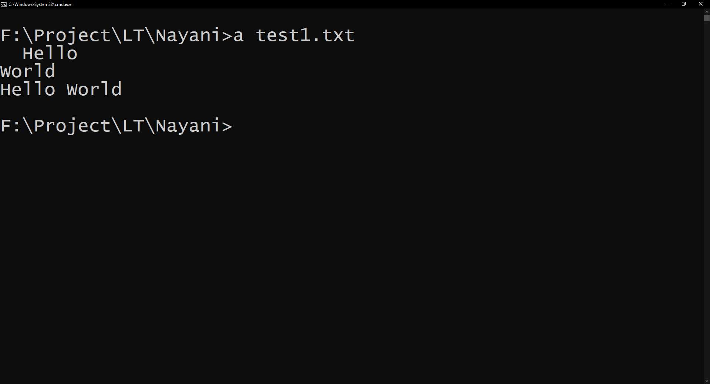
Possible inputs and their outcomes:
$start
var A,B;
assign(A,Hello);
assign(B,World);
var C;
C=concat(A,B);
display(A);
display(B);
display(C);
$end

Slide 5
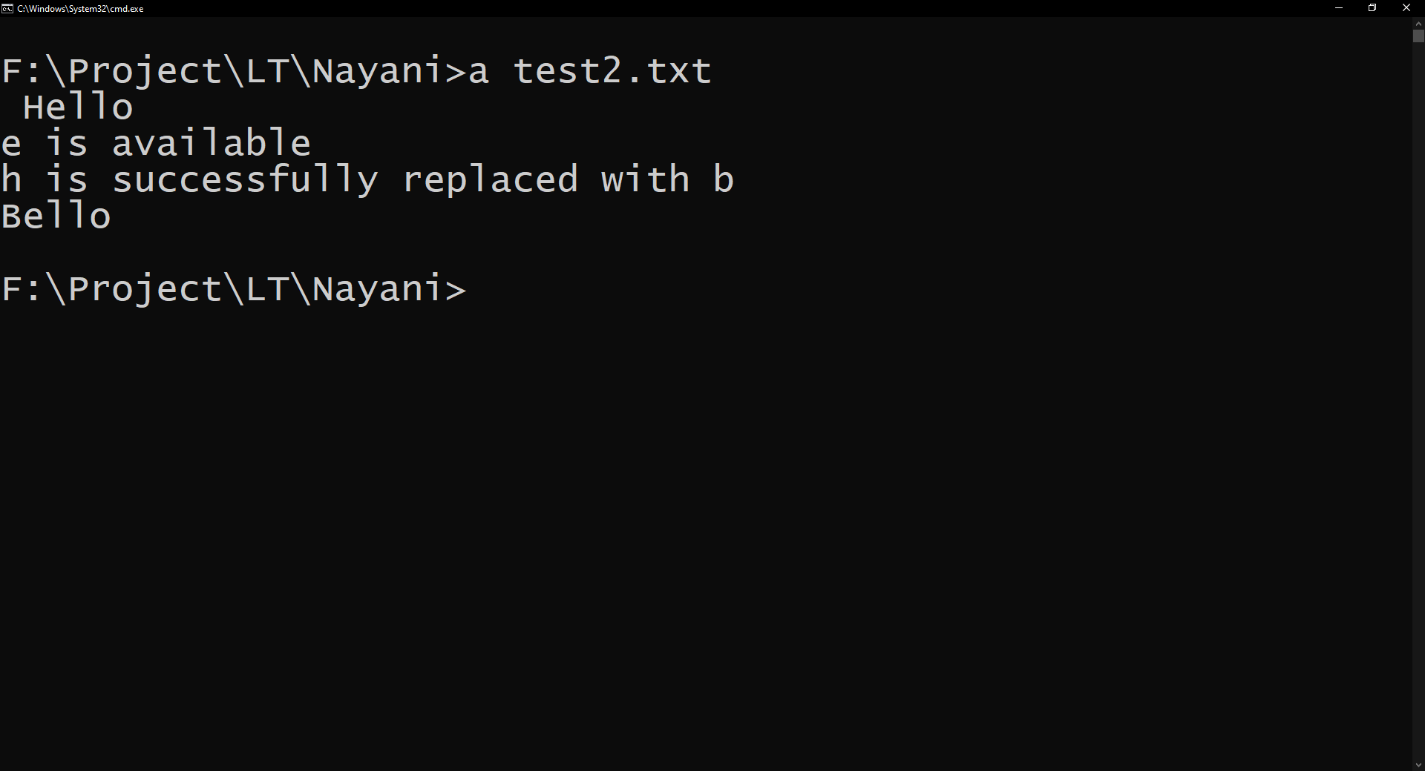
Possible inputs and their outcomes:
$start
var A;
assign(A,Hello);
display(A);
search(A,e);
replace(A,h,b);
display(A);
$end

Slide 6
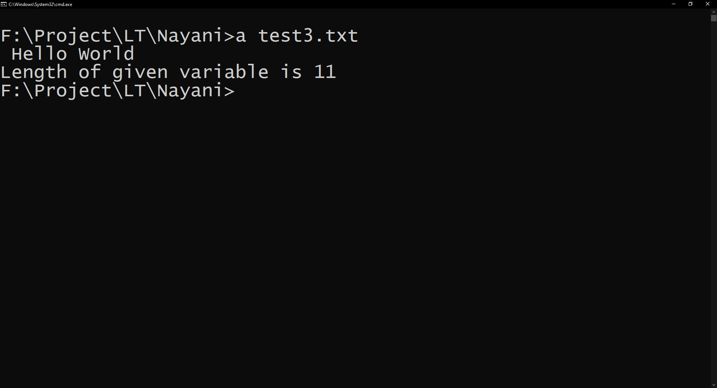
Possible inputs and their outcomes:
$start
var A,B,C;
assign(A,Hello);
assign(B,World);
C=concat(A,B);
display(C);
length(C);
$end

