Slide 1
Selection
Step
Functions
Combining the modelling of movement & selection processes

Slide 2
Day 3 – Extending SSFs

Slide 3
Day 2: Take home messages
Fitting simple SSFs in R is not difficult
Formatting the data is what takes the most time
We can add selection terms for step length and turning angle to our model
These terms allow us to get selection-free movement coefficients
Notes:
This is all stuff we will see the next 2 days
Often no clear cut answer

Slide 4
Day 3 – Expanding SSFs
Learning objectives:
SSFs with temporally varying movement/selection kernels
Non-linear selection kernels
SSFs with multiple individuals
Scale and selection
Unconventional movement kernels

Slide 5
SSFs with temporal effects

Slide 6
SSFs with temporal effects
Adding time to our kernels
Does the animal move/select differently at different times?

Slide 7
SSFs with temporal effects
Adding time to our kernels
How do we model time in general and cyclical time patterns in particular?

Slide 8
SSFs with temporal effects
Adding time to our kernels
case_ ~
sl_ +
cos(ta_) +
habitat +
time +
strata(step_id_)
Can we do this?

Slide 9
SSFs with temporal effects
Adding time to our kernels
case_ ~
sl_ +
sl_:cos(time) +
sl_:sin(time) +
cos(ta_) +
habitat +
strata(step_id_)
Time affects step length

Slide 10
SSFs with temporal effects
Adding time to our kernels
case_ ~
sl_ +
cos(ta_) +
habitat +
habitat:cos(time) +
habitat:sin(time) +
strata(step_id_) +
Time affects selection for habitat

Slide 11
SSFs with temporal effects
Adding time to our kernels
Movement and selection parameters can depend on other variables (such as time)

Slide 12
Coding temporal SSF

Slide 13
Non-linear effects in SSFs

Slide 14
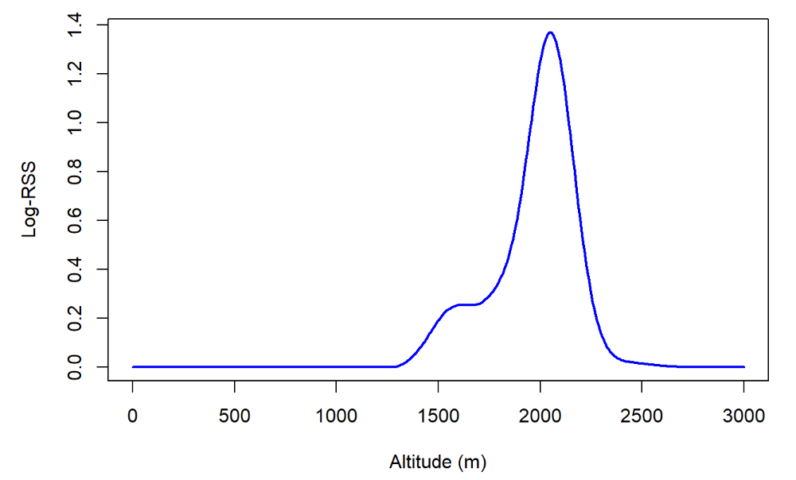
Non-linear effects in SSFs
Allowing non-linear responses

Slide 15
Non-linear effects in SSFs
Allowing non-linear responses

Slide 16
Non-linear effects in SSFs
Non-linear frameworks
Regression splines
GAM
Machine Learning

Slide 17
Non-linear effects in SSFs
Pros & cons?
Notes:
QUESTION: Ask them about what is nice and not so nice about these models

Slide 18
Coding non-linear SSF

Slide 19
Dealing with multiple individuals

Slide 20
Dealing with multiple individuals
Do we expect inter-individual behavioural differences?
Personality
Age
Sex
Social status
Health
etc

Slide 21
Dealing with multiple individuals
How do we model variation between individuals?
Fixed effects vs random effects

Slide 22
Coding multiple individuals SSF

Slide 23
Unconventional movement kernels

Slide 24
Unconventional movement kernels
What is a movement kernel
How would you model movement in your study systems?

Slide 25
Unconventional movement kernels
What is a movement kernel
What does your data look like?

