Slide 1



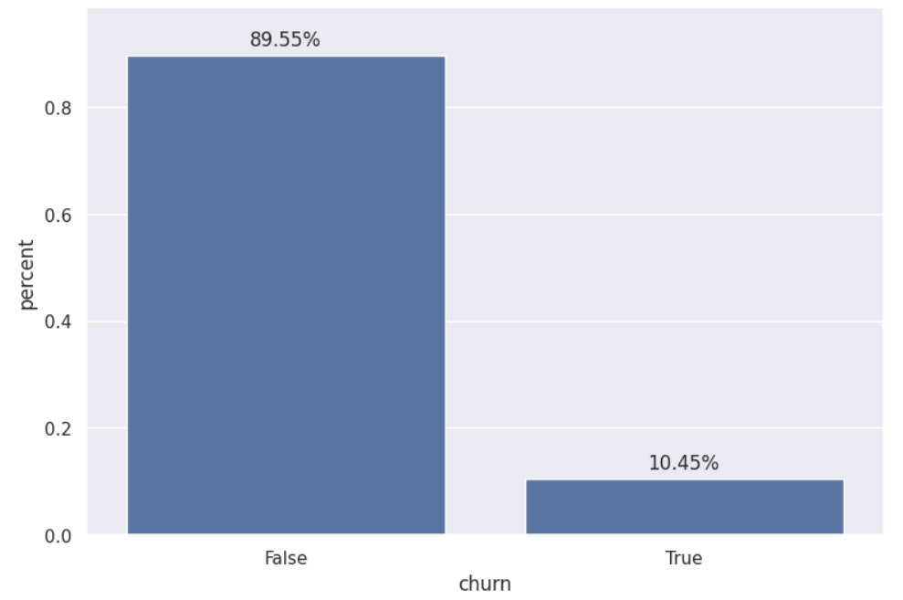
EXECUTIVE SUMMARY
Situation:
Powerco is grappling with a significant challenge of customer churn, suspecting it to be linked to customers' price sensitivities. They have collected extensive data but lack insights into the underlying factors driving churn.
Machine Learning Modeling:
Random Forest Classifier was employed to predict churn probabilities. The model achieved an accuracy of 90% and a Precision score of 91% on the test set.
Insights:
Churn Rate: Approximately 10.45% of customers have churned, indicating a significant but not overwhelming problem.
Net Margin: The net margin on power subscription and consumption over the last 12 months emerged as the top predictor of churn.
Meter Rental: Forecasted bill of meter rental for the next 2 months also showed significant influence on churn probability.
Time Factors: Customer tenure, activity duration, and contract update frequency appeared as influential factors, suggesting that longer-standing customers or those with recent contract updates may exhibit different churn behaviors.

