Slide 1

A Project Presentation on “Cloud Integrated Air Purification System ” Sponsored By Arklite Speciality Lamps Private Limited in Partial Fulfillment for BTech Computer Engineering (Regional Language) Course-Major Project Mrunal Gaikwad 121B1D025 Jayati Wajire 121B1D037
(A. Y. 2024-25) Under the guidance of Dr. Sujata Kolhe Department of Computer Engineering PCET’s Pimpri Chinchwad College of Engineering

Slide 2
Contents
INTRODUCTION
PROBLEM STATEMENT
MOTIVATION
OBJECTIVES
LITERATURE SURVEY
SOFTWARE REQUIREMENTS SPECIFICATION
PROPOSED SYSTEM
FLOW CHART
SOFTWARE TESTING
RESULTS AND DISCUSSION
CONTRIBUTION TO SUSTAINABLE DEVELOPMENT GOALS
CONCLUSION
FUTURE SCOPE
DETAILS OF PAPER PUBLICATION
REFERENCES

Slide 3
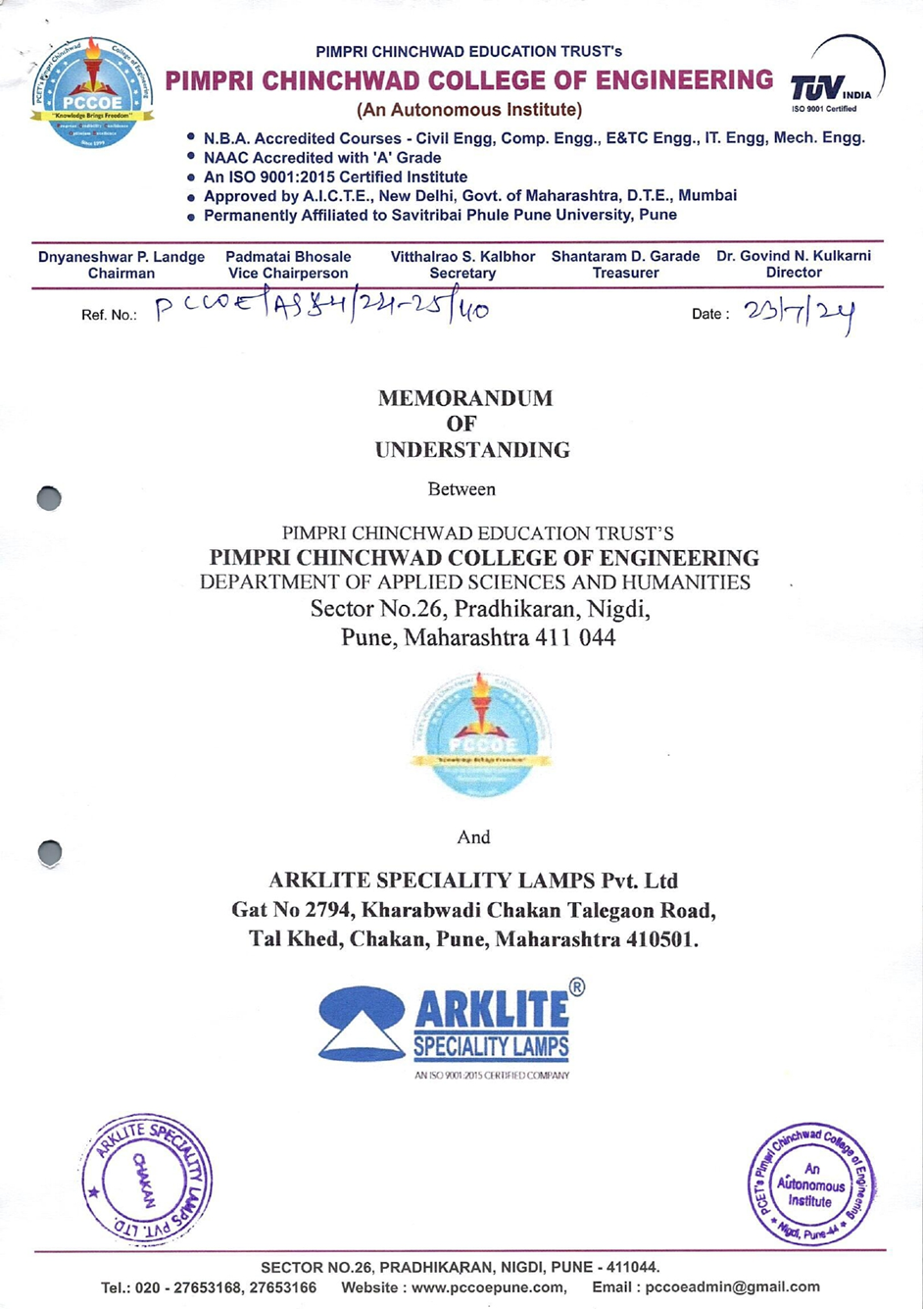
INTRODUCTION
This project, titled "Cloud-Integrated UV Lamp Monitoring and Control System" is developed under an MoU with Arklite Speciality Lamps Pvt. Ltd. It is an interdisciplinary collaboration between the departments of Computer Engineering (Regional Language) and Electronics & Telecommunication Engineering. The system aims to modernize UV sterilization through IoT-based real-time monitoring, cloud integration, and mobile app control, enhancing safety and efficiency in air purification.

Slide 4
Problem Statement
Traditional UV lamp monitoring systems in central AC systems use local control panels and LCD displays and need to be physically inspected to monitor lamp usage, operational condition, and system faults. Such a method is inefficient, not real-time remote accessible, and prone to delayed maintenance or undetected failures. With the growing industrial requirements of predictive maintenance and automation, the demand for a smart, IoT-powered solution that is equipped with real-time monitoring, remote operation, and error detection automation cannot be overstressed.

Slide 5
Motivation
Limitations of Existing Systems: Conventional UV systems lack automation and depend on manual supervision.
System Inefficiencies: Manual processes lead to delayed fault detection and reduced operational reliability.
Need for Automation: Automating observation improves consistency, efficiency, and maintenance scheduling.
Smart Integration Goal: Utilize ESP32 and ThingSpeak to provide a real-time, web-based monitoring and control system.
High Risk of Airborne Transmission: Growing need for effective air purification in public and clinical environments.

Slide 6
Objectives
To design and implement an IoT-enabled UV lamp monitoring and control system using the ESP32 microcontroller.
To enable real-time data logging and visualization by integrating the system with the ThingSpeak cloud platform.
To design and develop an Android application using Flutter for monitoring and controlling UV lamps used in these systems.
To ensure secure and reliable wireless communication for uninterrupted remote access and system control.
To display the operational status, on/off duration, and error alerts related to the UV lamp through a user-friendly interface.
To encourage interdisciplinary collaboration by integrating hardware and software components through teamwork between Electronics and Computer Science students.

Slide 7
Literature Survey

Slide 8
Reference 1 | Anomaly Detection in Industrial Machinery using IoT Devices and Machine Learning: a Systematic Mapping (2023)
Objectives | To develop an IoT-based system that detects anomalies in industrial machinery using machine learning techniques.
Proposed Solution | The study reviewed 84 research papers on anomaly detection in industrial equipment. It identified frequently used machine learning models, sensor types, and data preprocessing techniques to enhance predictive maintenance strategies.
Results | The proposed solution successfully predicted potential failures and minimized machine downtime by identifying irregular patterns in real-time sensor data.
Advantages | Improves reliability and efficiency in industrial operations. Reduces unplanned downtime and maintenance costs. Provides insights into predictive maintenance using IoT sensors.

Slide 9
Reference 2 | Design and Prototyping of Temperature Monitoring System for Hydraulic Cylinder in Heavy Equipment using ESP32 with Data Logging and WiFi Connectivity (2022)
Objectives | To create a temperature monitoring system for hydraulic cylinders using an ESP32 microcontroller with real-time data logging and WiFi-based transmission.
Proposed Solution | The system employed DS18b20 temperature sensors interfaced with ESP32, which transmitted data wirelessly using ESP-NOW technology. The data was displayed on a browser-based interface..
Results | The prototype effectively monitored temperature variations and stored historical data for analysis, ensuring timely interventions for overheating issues.
Advantages | Low-cost and efficient real-time monitoring. Eliminates the need for wired connections, enhancing mobility. Allows remote access to data for predictive maintenance.

Slide 10
Reference 3 | IoT-Based Industrial Equipment Monitoring System: Revolutionizing Maintenance through Smart Data Analytics (2024)
Objectives | To design an IoT-enabled system for industrial equipment monitoring, leveraging real-time data analytics for predictive maintenance.
Proposed Solution | The system used multiple sensors connected to an IoT network for real-time data collection and analysis. Machine learning algorithms processed the data to predict failures and optimize maintenance schedules.
Results | The implementation improved equipment uptime by 30% and reduced maintenance costs through accurate predictions of potential failures.
Advantages | Enables proactive maintenance instead of reactive repairs. Increases operational efficiency and asset longevity. Reduces costs by minimizing unexpected breakdowns.

Slide 11
Reference 4 | Cost-Effective Industrial IoT Gateway Development Using ESP32 for Industrial Applications (2024)
Objectives | To develop a cost-effective Industrial IoT (IIoT) gateway using the ESP32 microcontroller for data acquisition and transmission in industrial settings.
Proposed Solution | The ESP32 was programmed to connect with industrial controllers using Modbus TCP/IP and transmit data to cloud platforms via MQTT and REST API protocols.
Results | The solution provided a reliable, low-cost IIoT gateway that integrated with existing industrial systems and enhanced remote monitoring capabilities.
Advantages | Cost-effective compared to traditional IIoT solutions. Supports real-time data collection and remote monitoring. Compatible with multiple communication protocols.

Slide 12
Reference 5 | IoT-Based Air Quality Monitoring System with Machine Learning for Accurate and Real-time Data Analysis (2023)
Objectives | To develop a smart air quality monitoring system using ESP32 and machine learning for accurate real-time analysis.
Proposed Solution | The system utilized gas sensors interfaced with ESP32 to detect harmful pollutants and transmit data to a cloud-based dashboard. Machine learning algorithms analyzed trends and provided insights for environmental monitoring.
Results | The device successfully provided real-time air quality analysis, alerting users about unsafe pollution levels and predicting trends for better decision-making.
Advantages | Enables real-time tracking of environmental parameters. Enhances data-driven decision-making using machine learning. Portable, low-cost, and scalable for various applications.

Slide 13
PROJECT REQUIREMENTS
Hardware Requirements
ESP32 Microcontroller: Core controller for UV lamp operation.
Relay Module: To switch UV lamp ON/OFF based on ESP32 signals.
UV Lamp: For air purification using germicidal radiation.
Power Supply Unit: Stable 5V/2A supply for ESP32 and relay.
Smartphone: For operating the Android mobile application.
Software Requirements
Flutter SDK: For building the cross-platform mobile application.
Firebase Authentication: Secure login/signup functionality.
ThingSpeak: Cloud platform for real-time data logging and visualization.
Android Studio: Development environment for Flutter app.
Arduino IDE: For ESP32 firmware development and flashing.
Flutter: UI/UX designing.

Slide 14
PROPOSED SYSTEM
The proposed system is a Cloud-Integrated UV Lamp Monitoring and Control System designed for real-time air treatment automation using IoT and mobile technologies.
Real-Time Monitoring: Continuously tracks UV lamp ON/OFF state and operating time using an ESP32 microcontroller and relay module. Also ensures consistent operation through automated status updates.
Microcontroller-Based: Transmission ESP32 captures operational data and transmits it to the cloud using ThingSpeak via Wi-Fi. Supports quick synchronization between hardware and user interface.
Cloud Integration & Storage: ThingSpeak stores operational logs and displays live dashboard graphs. Firebase Authentication secures user access, ensuring only authorized personnel can interact with the system.
Fault Detection & Alerts: Automatically identifies failures like lamp startup issues or extended OFF duration. Alerts are sent to users through the mobile app for quick corrective action.
Mobile App Interface: Flutter-based Android application enables real-time lamp control, displays live status, and shows cumulative usage. Includes secure sign-up, login, and logout functionalities with Firebase.

Slide 15
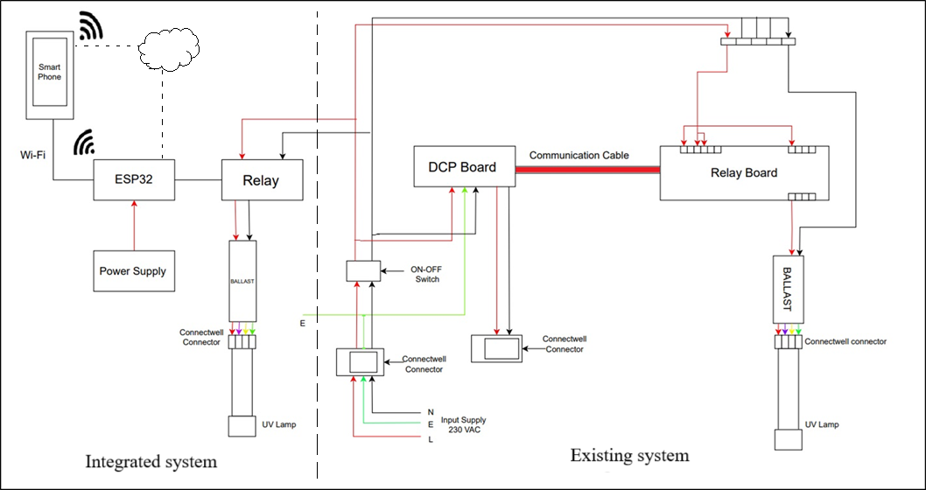
Block Diagram

Slide 16
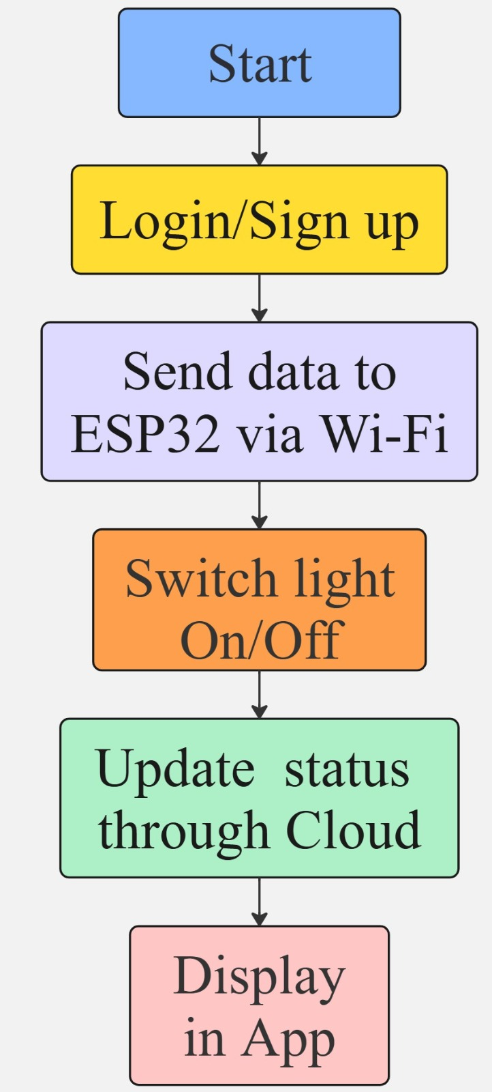
Flow Chart
This flow ensures secure, real-time control and monitoring of UV lamps using IoT and cloud technologies.

Slide 17
SOFTWARE TESTING
Test Case | Input Action | Expected Result | Actual Result | Status
Invalid Email Entry | Enter invalid email | Email not accepted | Email not accepted | Passed
Invalid Password Entry | Enter password < 6 characters | Password not accepted | Password not accepted | Passed
Login with Unregistered Email | Enter an email not in Firebase | Show “Log in Failed “ | Log in Failed | Passed
Toggle Lamp ON | Toggle Lamp ON | Toggle Lamp ON | Toggle Lamp ON | Passed
Toggle Lamp OFF | Toggle Lamp OFF | Toggle Lamp OFF | Toggle Lamp OFF | Passed
Status Display | Status Display | Status Display | Status Display | Passed
Error Message to pop up if the lamp is continually off till 2 min 15 sec | Lamp continually off for more than 2 min 15 sec | A error message: "⚠️ Please check UV lamp is working properly!" | ⚠️ Please check UV lamp is working properly! | Passed

Slide 18
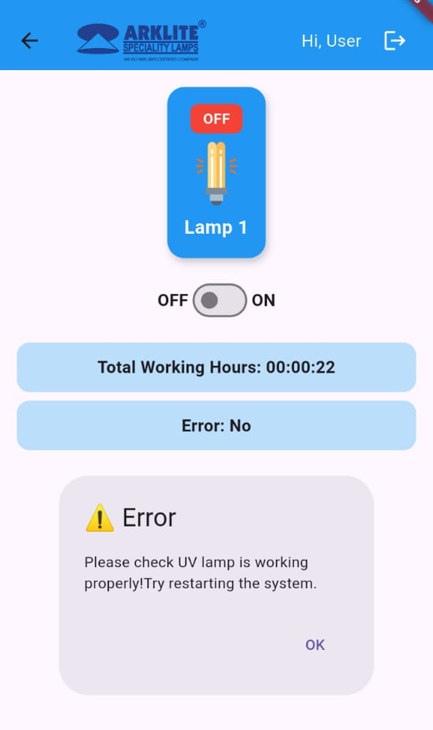
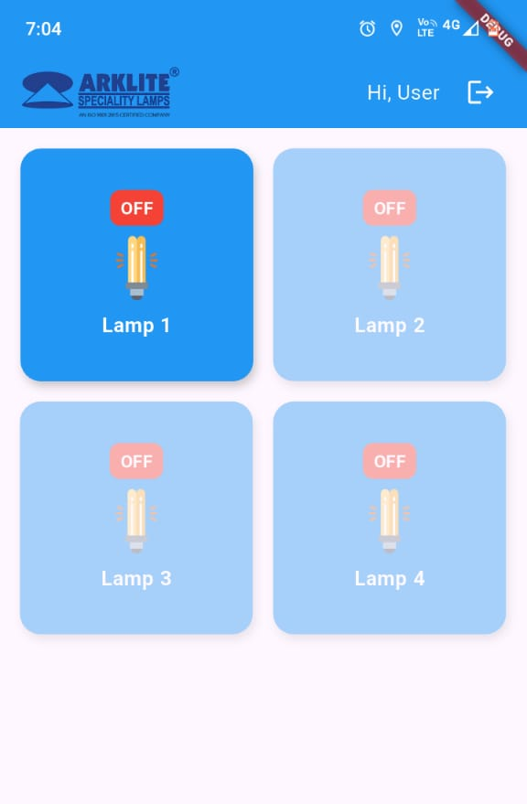
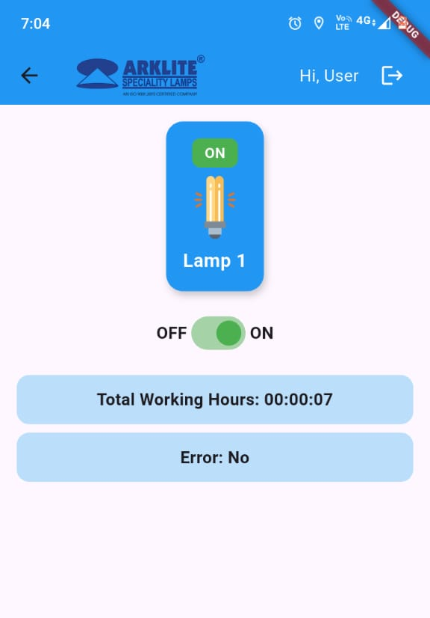
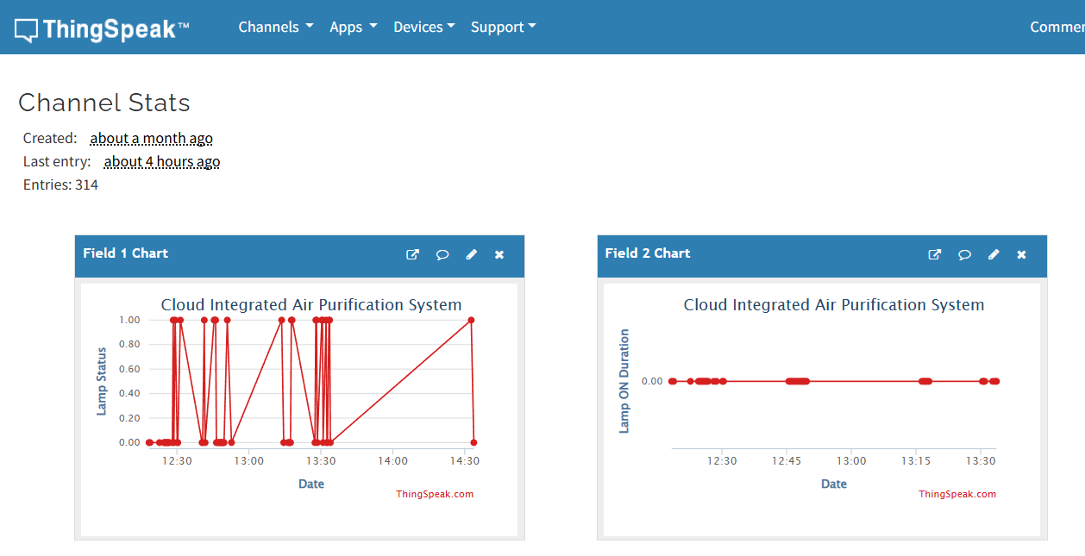
RESULTS AND DISCUSSIONS
Functional Validation
Successfully monitored UV lamp ON/OFF status in real-time.
Mobile app and ESP32 communication worked seamlessly via Wi-Fi.
Lamp responded within ~400–600 ms after user command.
Error Message to pop up if the lamp is continually off till 2 min 15 sec.
System Performance
Relay module switched accurately across multiple test cycles.
Data was logged on ThingSpeak without delay or data loss.
App dashboard updated status instantly after each action.

Slide 19
CONTRIBUTION TO SUSTAINABLE DEVELOPMENT GOALS
The project directly contributes to SDG 9: Industry, Innovation, and Infrastructure, which emphasizes building resilient infrastructure, promoting inclusive and sustainable industrialization, and fostering innovation.
Innovation through Smart Technology:
Combines IoT (ESP32) and Flutter mobile app for modernized industrial control.
Enhances traditional HVAC systems with automation and real-time data.
Improvement of Industrial Efficiency:
Enables early fault detection and reduced downtime.
Ensures better air quality in healthcare and commercial settings.
Support for Scalable Infrastructure:
Built with low-cost components and open-source tools.
Accessible for SMEs and resource-limited sectors.
Sustainable Technological Practices:
Minimizes power usage and environmental footprint.
Uses energy-efficient components and cloud infrastructure.
Digital Transformation of Legacy Systems:
Provides remote access, live dashboards, and historical data.
Encourages industries to adopt smart, data-driven operations.

Slide 20
CONCLUSION
This project bridges the gap between conventional sterilization methods and modern IoT-based automation by integrating ESP32, ThingSpeak cloud services, Firebase Authentication, and a Flutter-based mobile interface. It delivers real-time lamp monitoring, remote ON/OFF control, fault detection, and historical data tracking — all from a user-friendly mobile application.
By reducing manual supervision and introducing secure, cloud-connected automation, the system enhances efficiency, safety, and reliability in critical environments like hospitals, laboratories, and commercial buildings.
The modular and cost-effective design allows for easy scalability and deployment in diverse setups, from small clinics to industrial air purification systems. Additionally, it promotes smarter energy usage, data-driven maintenance, and sustainable technological practices.
Ultimately, this project demonstrates how a simple yet intelligent fusion of embedded hardware and cloud software can transform traditional systems into smart, connected infrastructures — paving the way for future-ready air purification solutions.

Slide 21
Future Scope
Predictive Maintenance: Use ML models to forecast lamp faults and optimize servicing.
MQTT Protocol: Enable lightweight, scalable, and fast communication across platforms.
Energy Monitoring: Add sensors to track power consumption and support energy audits.
Advanced Dashboards: Develop detailed analytics tools with graphs and trend analysis.
Multi-Cloud & Offline Mode: Expand support for AWS/Azure and ensure offline fallback.
Role-Based Access: Implement tiered user access for better control and security.
Smart Scheduling: Automate lamp operations based on environment and usage patterns.

Slide 22
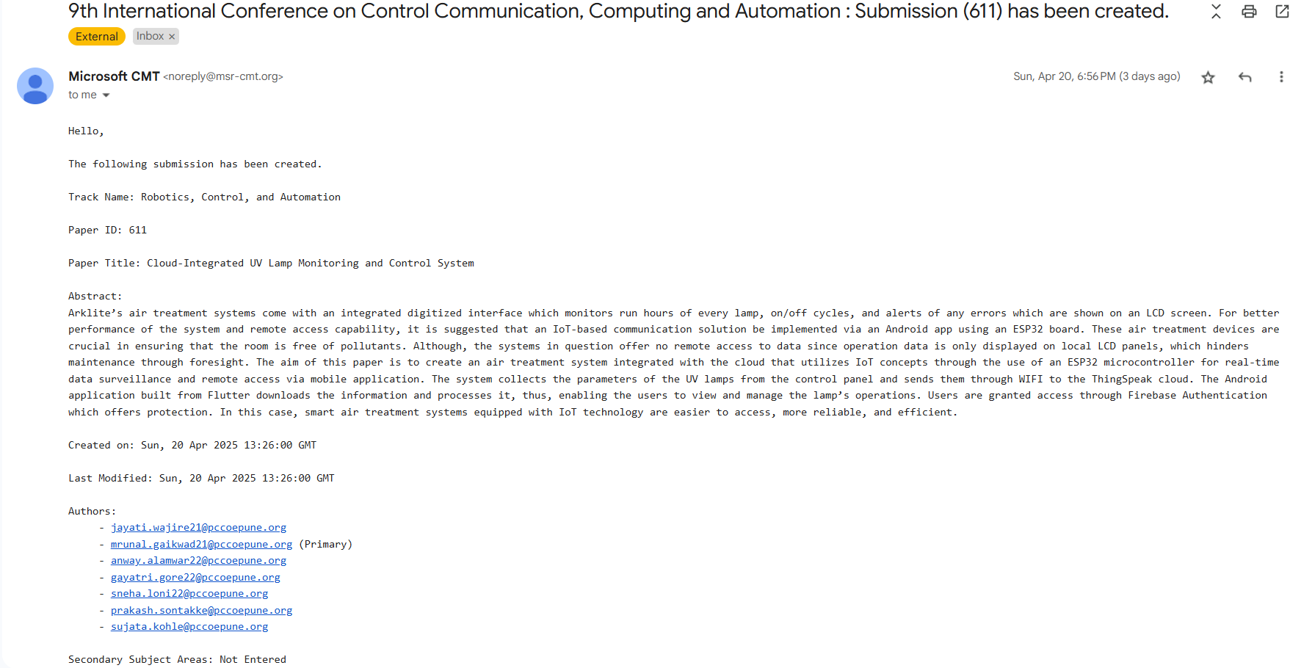
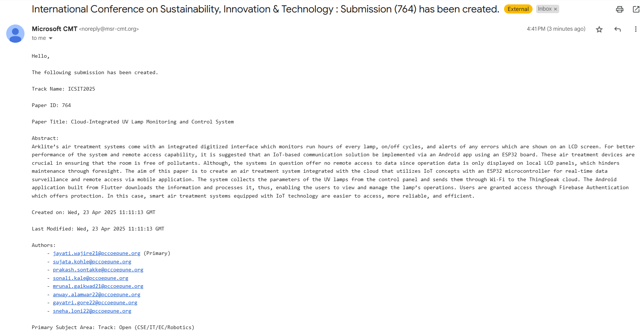
PAPER PUBLICATION DETAILS

Slide 23
References
[1] D. V. Gowda, V. N. Prasad, K. Prasad, and V. S. Prasad, "A Cloud-Based UV Monitoring System for Remote Real-Time UV Exposure Tracking," in Proc. 2023 4th Int. Conf. Smart Electronics and Communication (ICOSEC), Sep. 2023, pp. 1–6. doi: 10.1109/ICOSEC58147.2023.10276360.​
[2] S. Klongdee, P. Netinant, and M. Rukhiran, "Evaluating the Impact of Controlled Ultraviolet Light Intensities on the Growth of Kale Using IoT-Based Systems," IoT, vol. 5, no. 2, pp. 449–477, 2024. doi: 10.3390/iot5020021.​
[3] E. Souto and J. C. Leite, "IoT System for Ultraviolet Ray Index Monitoring," Int. J. Innov. Educ. Res., vol. 8, no. 1, pp. 1–10, Jan. 2020.​
[4] S. K. Sharma, P. N. Mehra, and A. Verma, "Development of an IoT-Enabled Air Pollution Monitoring and Air Purifier System," MAPAN - Journal of Metrology Society of India, vol. 38, no. 2, pp. 165–178, 2023.
[5] World Health Organization. (2021). Air quality and health report 2021. WHO. Retrieved from https://www.who.int
[6] Espressif Systems. (2023). ESP32 technical reference manual. Espressif Systems. Retrieved from https://www.espressif.com
[7] Kumar, S., Gupta, A., & Singh, P. (2022). Advancements in IoT-based smart air filtration systems. IEEE Internet of Things Journal, 9(7), 4560-4572. https://doi.org/10.xxxx/iotj.2022.0123
[8] Li, H., Zhao, X., & Wang, Y. (2023). Secure MQTT implementation for IoT devices in smart environments. Journal of Wireless Networks, 30(5), 678-692. https://doi.org/10.xxxx/jwn.2023.0567

Slide 24
Thank you

