Slide 1

Analysis of Populous Cities of India to find cities with similar restaurant culture
P N M MRUDU
Data science project

Slide 2
How this helps restaurant chains?
Finding similar cities in terms of Restaurant venue category helps restaurant chains to narrow down on certain cities where the restaurant culture is inclined towards their venue category.
They can get an insight on the most common venue categories prevalent in India.
New businesses can look for similar cities to initially start their restaurant.
Existing businesses can look for cities where the probability of low acceptance and inflow of customers is reduced.

Slide 3
Data, extraction and cleaning
Populous cities of India dataset scrapped from Wikipedia. (Link: https://en.wikipedia.org/wiki/List_of_cities_in_India_by_population)
Original data contains a list of 300 cities, top 45 cities has been utilized for this project.
Venue and venue category for every city has been collected from Foursquare API.
Venue limit has been placed at 100 and city radius at 60,000 meters.
Both the datasets has been combined to form a dataset with all 45 cities and their corresponding 20 most common venue categories.

Slide 4
Algorithm applied
Since we wanted the cities to be grouped into similar clusters, K-means algorithm has been applied to the final dataset.
As a result the dataset has been clustered to 5 different clusters.
Cluster Number | Number of cities
Cluster 1 | 1
Cluster 2 | 11
Cluster 3 | 21
Cluster 4 | 4
Cluster 5 | 8

Slide 5
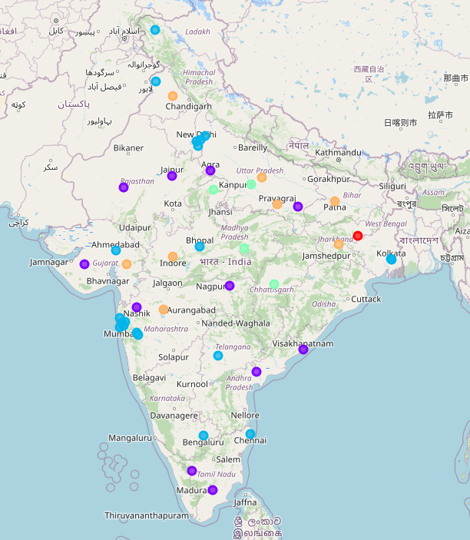
Visualization of the clusters on map

Slide 6
List of Cluster 1 Cities:

Slide 7
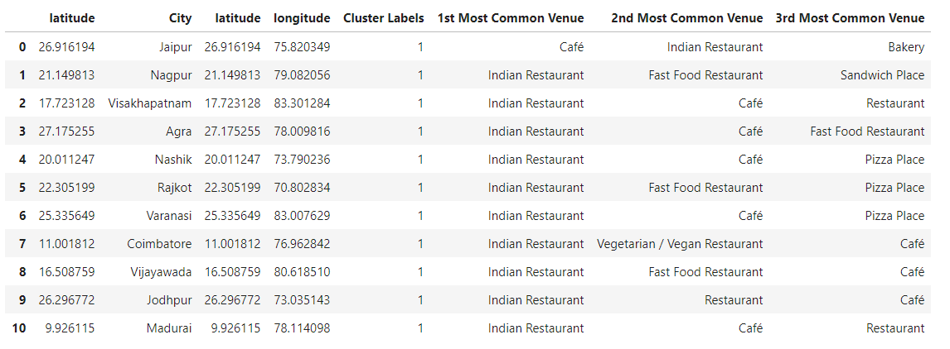
List of Cluster 2 Cities:

Slide 8
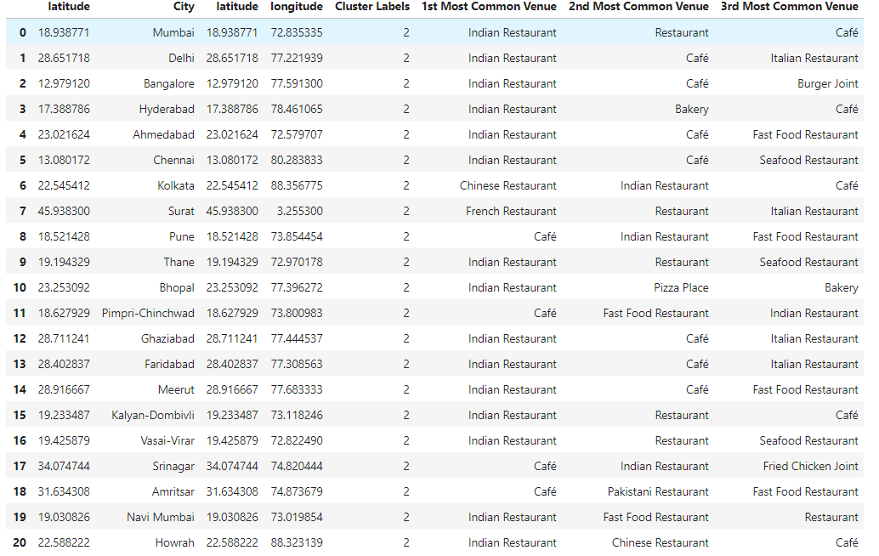
List of Cluster 3 Cities:

Slide 9
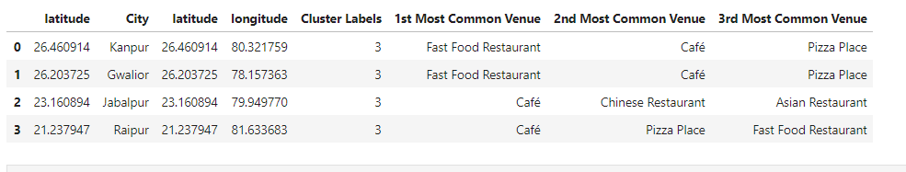
List of Cluster 4 Cities:

Slide 10
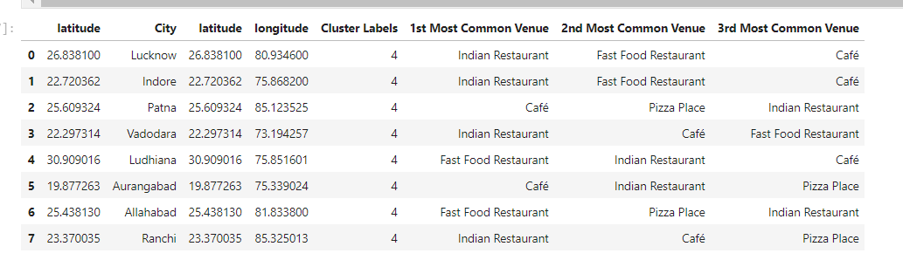
List of Cluster 5 Cities:

Slide 11
Results
From all the results, we can observe that Indian Restaurants, Cafes and Fast Food Restaurants are the most common Venues in India. Venturing into any one of these or a combination of these venue categories is advisable for starting a new Restaurant chain.
Existing Restaurants who want to expand their business to other cities can look up the cluster data:
Restaurants already in Indian restaurant category can expand to cities in cluster 2 or to cluster 3 cities if they want to start Café venue category along with Indian restaurants category.
Pizza seems to be very common venue in Dhanbad, if any pizza restaurant which doesn’t have a branch in Dhanbad can definitely try to start one.
From the Data we can observe that Chinese, seafood and French restaurants are not so common in India.
Restaurants with a combination of Fast food and café venue category can target cluster 4 cities.

Slide 12
Conclusion and future direction
. All this data and insights could be utilized by both new and existing restaurant chains. For example, Indian restaurant category and cafés appears to be the common restaurant culture in India, therefore, venturing into any one of these venue categories reduces the possibility of poor in-flow of customers.
This analysis could be further enhanced by adding: (i) reviews and ratings data of each venue category.(can help in understanding user acceptance).
(ii) venue menus.

