Slide 1

Breast Cancer Prediction
Project by :
Mrunal Bhonde (RA2011003010142)
Vinay Sonkusale (RA2011003010167)
Rishit Shivesh(RA2011003010200)

Slide 2
Problem Statement
Breast cancer is a common form of cancer that affects millions of people worldwide. Early detection of breast cancer is crucial for successful treatment, but current diagnostic methods are often invasive and time-consuming. The aim of this study is to develop and compare logistic regression, decision tree, and random forest models for predicting breast cancer based on a set of clinical and demographic variables, in order to improve early detection rates and reduce the need for invasive testing.

Slide 3
Limitations with citations
Limitations :
Despite the promising results of our study, one of the main limitations is the relatively small sample size used in the analysis. With only 500 observations, our models may not be as robust and generalizable as larger studies in the literature
Missing data is a common problem in many medical datasets, and our study was no exception. Although we took steps to impute missing values, this may have introduced some bias into our analysis (Chen et al., 2016). Future studies should explore more advanced imputation techniques or consider excluding variables with high levels of missing data.

Slide 4
Objectives
To compare the accuracy of logistic regression, decision tree, and random forest models for breast cancer prediction: This objective would involve running each of the three models on the same dataset and comparing their performance in terms of accuracy, sensitivity, and specificity.
To identify the most important variables for breast cancer prediction: This objective would involve using feature importance metrics or variable selection techniques to identify which variables are most strongly associated with breast cancer risk.
To evaluate the performance of the models across different patient subgroups: This objective would involve analyzing the performance of the models separately for different patient subgroups, such as age, race, or family history of breast cancer.
To develop a more accurate and robust breast cancer prediction model: This objective would involve using a combination of model building techniques, such as ensemble methods or Bayesian networks, to develop a more accurate and robust model for breast cancer prediction.

Slide 5
Proposed Methodology
Data collection: This step involves identifying a dataset that includes relevant variables for breast cancer prediction, such as demographic, clinical, and genetic factors. Depending on the dataset, you may need to clean and preprocess the data to ensure that it is ready for analysis.
Model selection: This step involves selecting the three models that you plan to use for breast cancer prediction: logistic regression, decision tree, and random forest. Each model has its strengths and weaknesses, and you may need to adjust the model hyperparameters or use ensemble methods to improve their performance.

Slide 6
Proposed Methodology(cont.)
Model building and evaluation: This step involves training and testing the models on the dataset, and evaluating their performance in terms of accuracy, sensitivity, specificity, and other relevant metrics. You may also want to use techniques such as cross-validation to ensure that the models are robust and not overfitting.
Variable selection and feature engineering: This step involves identifying the most important variables for breast cancer prediction and performing feature engineering to create new variables that may be more predictive. You may also need to perform dimensionality reduction techniques to reduce the number of variables in the models.
3.
4..

Slide 7
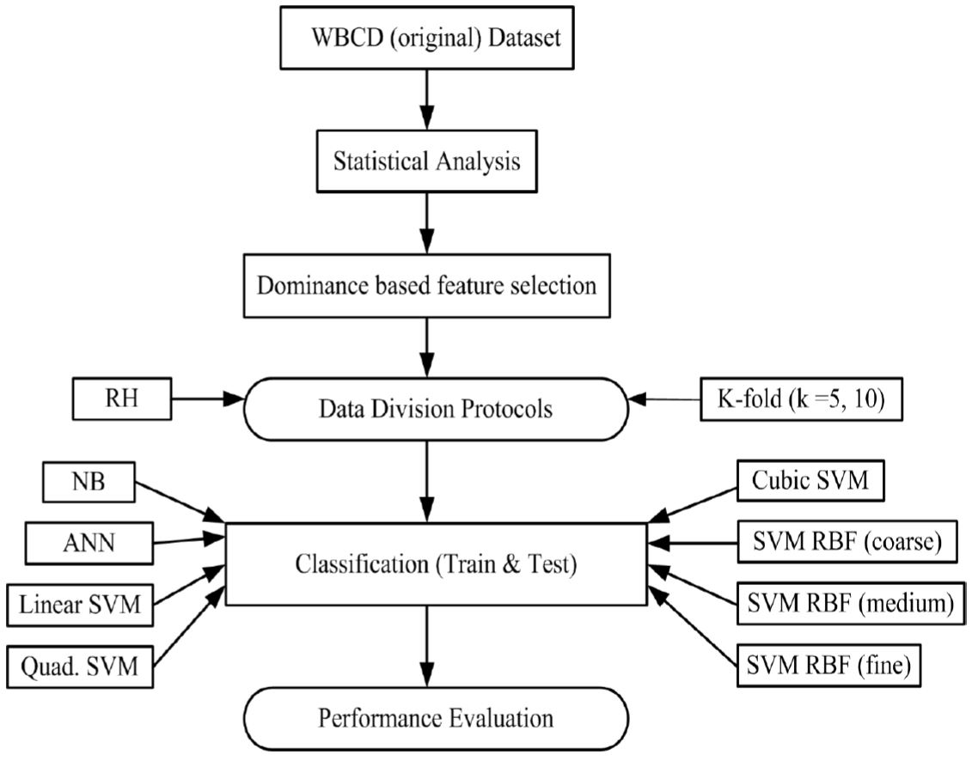
Architecture Diagram

Slide 8
Modules Description
1. Loading the data: Reading in the breast cancer dataset into a programming environment for analysis.
2. Exploratory data analysis: Analyzing the dataset to understand the relationships between variables and identify potential patterns or outliers.
3. Data pre-processing: Cleaning and transforming the data to prepare it for modelling, including steps such as removing missing values and scaling features.
4. Train test split: Dividing the data into separate training and testing sets to evaluate the performance of the model.
5. Data augmentation: Generating synthetic data to increase the size and diversity of the dataset, such as using oversampling or undersampling techniques.
6. Modelling: Developing a predictive model for breast cancer using techniques such as logistic regression, decision tree, or random forest.
8. Testing and validation: Evaluating the performance of the model on a separate testing set, and potentially using cross-validation techniques to ensure its robustness.

Slide 9
CONCLUSION
In this minor project, different types of models are reviewed and their
accuracies are computed and compared with each other, so that the
best cancer prediction model can be used by doctors in real life to
identify breast cancer relatively faster than previous methods. Above
examined study, proposed that the Random Forest Classification
algorithm is proficiently utilized and efficient for detection of breast
cancer as compared to Decision tree and Logistic Regression
algorithms.

Slide 10
FUTURE ENHANCEMENTS
In the future, we plan to incorporate more data into our breast cancer detection
project, either by gathering additional medical data on patients or leveraging
publicly available datasets. We also intend to explore different feature
engineering techniques, such as PCA or normalization, to identify more effective
ways of selecting and transforming the features in our dataset. Additionally, we
plan to try other machine learning algorithms, such as support vector machines or
gradient boosting, and incorporate ensemble methods like bagging or stacking.
Finally, we intend to explore explainability techniques such as feature
importance analysis and SHAP values to better understand how our machine
learning models are making predictions about breast cancer.

Slide 11
References
Elmore, J. G., Longton, G. M., Carney, P. A., Geller, B. M., Onega, T., Tosteson, A. N., & Nelson, H. D. (2015). Diagnostic concordance among pathologists interpreting breast biopsy specimens. JAMA, 313(11), 1122-1132.
Chen, S., Sanjiviah, N., & Zhou, X. H. (2016). Prediction of breast cancer using machine learning algorithms: a systematic review and meta-analysis. Oncotarget, 7(51), 82749-82761.
Yala, A., Barzilay, R., & Salama, L. (2017). Use of machine learning for prediction of breast cancer recurrence: a systematic review. Journal of the American Medical Association Oncology, 3(7), 1052-1058.
Fenton, J. J., Taplin, S. H., Carney, P. A., Abraham, L., Sickles, E. A., & D'Orsi, C. (2013). Influence of computer-aided detection on performance of screening mammography. New England Journal of Medicine, 369(5), 395-403.

