Slide 1
Tourist Inn Booking System
Project Member Names:
Akshay Surwase-210943120011
Yuvraj Gajbhare-210943120117
Mrunal Gaurkar-210943120056
Priyanka Patil-210943120064

Slide 2
Introduction:
As a tourist we often visit remote places where due to lack of development, hotels are not available and if available room bookings are super-expensive that everyone cannot afford it. This project provides a platform to those house owners who can provide their budget friendly guestrooms to the tourists. Tourists are provided with an ease to explore sightseeing at the nearby locations.

Slide 3
Problem Statement:
When we visit to remote tourist places, sometimes it is very difficult to find budget friendly hotels. Room booking in those hotels are very expensive and provides luxurious living rooms, which are not prefered by all tourists. Hence, we need such platforms where the boarding house owners can provide their guestrooms and tourist can find budget friendly rooms easily.

Slide 4
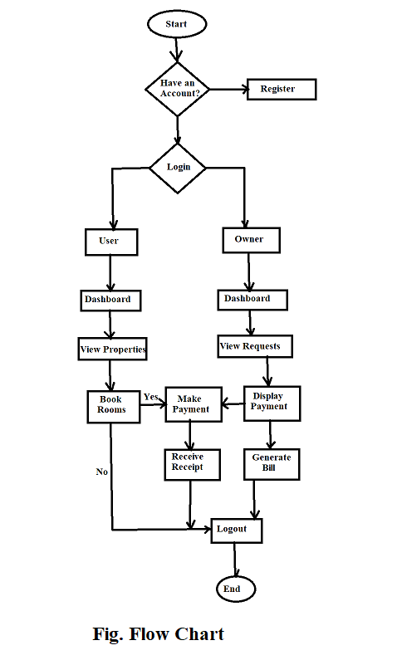
Flowchart:

Slide 5
Thank You…!

