Slide 1
PREDICTING AMOUNT OF GLOBAL HOSPITAL BEDS
SDL-ML PROJECT
SCET011:-MRUNALI (T204010)
SCET118:-TRISHARAN (T204018)
SCET125:-VIVEK (T204108)
SCET124:-VIJAYKUMAR (T204017)

Slide 2
AIM AND OBJECTIVE :
AIM
To design system for predicting Global hospital bed capacity for covid-19
OBJECTIVES
1) To estimate the timing of surges in hospital capacity demand
2) To know the best and worst-case scenarios of local COVID-19 prediction
3) To inform clinical operations and stafﬁng demands and identify when hospital capacity would be saturated
4) Critical care infrastructure with a focus on the distribution of ICU beds

Slide 3
PROBLEM STATEMENT :
The Adverse effect of COVID-19 pandemic has lead to the rise in corona cases.Due to this the bed availability in hospital has been reduced.The smart system will predicate the required no of bed to be managed for future upcoming crises.

Slide 4
ALGORITHM(S) :
General algorithm :
Algorithm used in project is logistic regression
Logistic regression is a statistical model that in its basic form uses a logistic function to model a binary dependent variable, although many more complex extensions exist.
he predicted values are probabilities and are therefore restricted to (0,1) through the logistic distribution function because logistic regression predicts the probability of particular outcomes rather than the outcomes themselves.

Slide 5
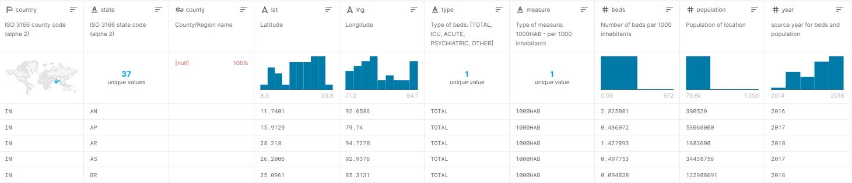
DATA SET EXPLANATION :
[https://www.kaggle.com/ikiulian/global-hospital-beds-capacity-for-covid19]
Our dataset having main csv files for us state
Each File having greater than 1000 records acc.size of country
Number of records are depends on population and regions in country

Slide 6
Country - country of origin, if present State - more granular location, if present Lat - latitude Lng - longitude Type - [TOTAL, ICU, ACUTE(some data could include ICU beds too), PSYCHIATRIC, OTHER(merged ‘SPECIAL’, ‘CHRONIC DISEASE’, ‘CHILDREN’, ‘LONG TERM CARE’, ‘REHABILITATION’, ‘WOMEN’, ‘MILITARY’] Measure - type of measure (per 1000 inhabitants) Beds - number of beds per 1000 Population - population of location based on multiple sources and wikipedia Year - source year for beds and population data Source - source of data Source_url - URL of the original source
COLUMNS IN DATASET

Slide 7
FEATURE VECTOR SELECTED:
For type of beds
[TOTAL, ICU, ACUTE, PSYCHIATRIC, OTHER]
For predicting bed occupancy
[ beds per 1000 inhabitants, population,year ]
Input features
[country code,latitude,longitude ]

Slide 8
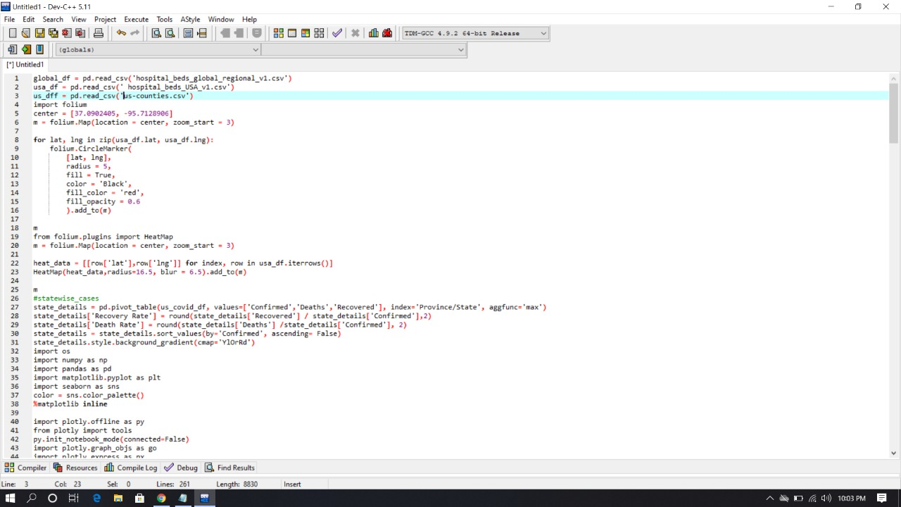
IMPLEMENTATION/code

Slide 9
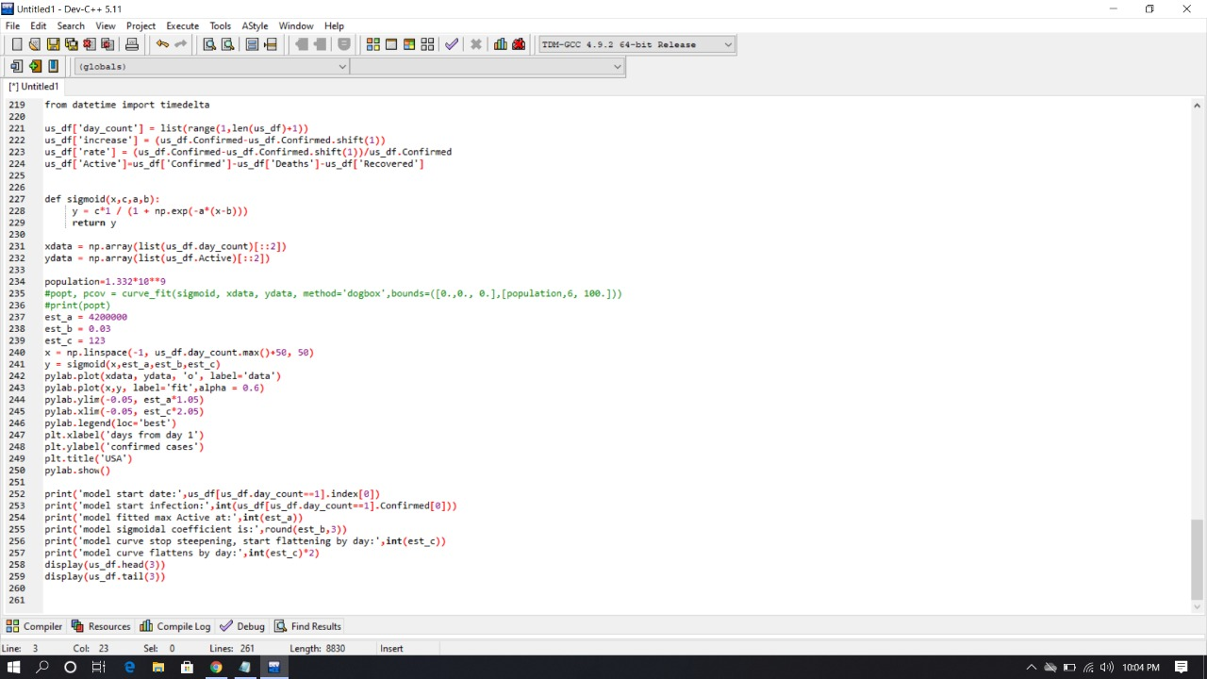

Slide 10
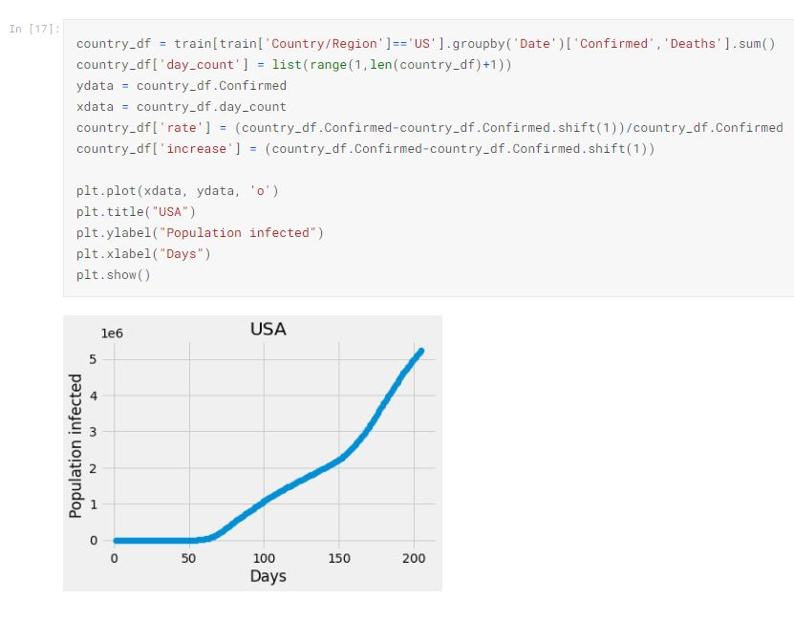
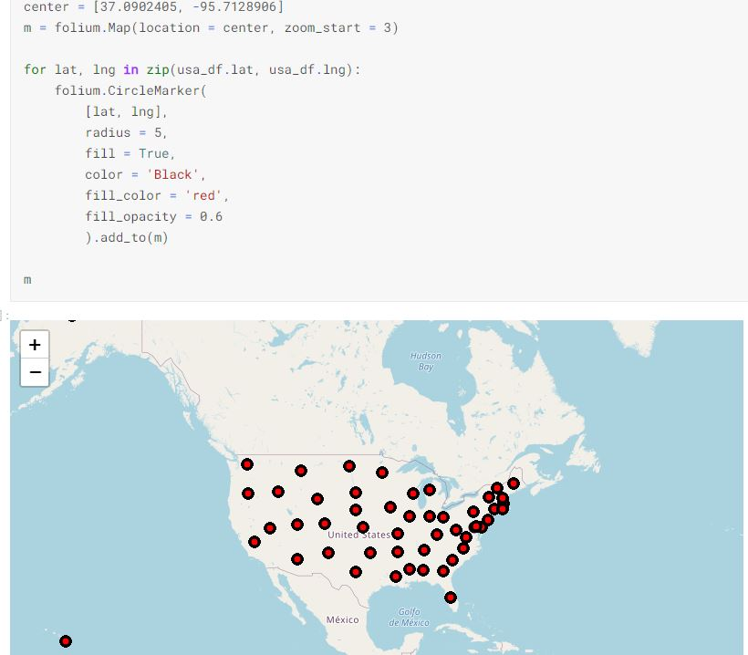
RESULTS/ANALYSIS

Slide 11
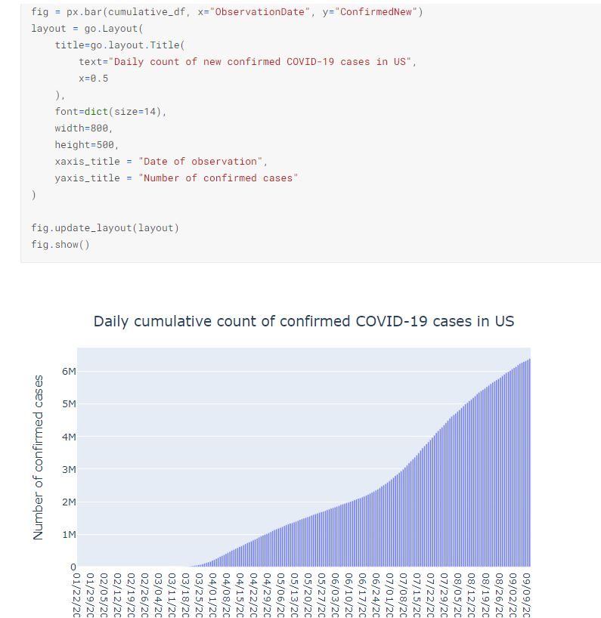
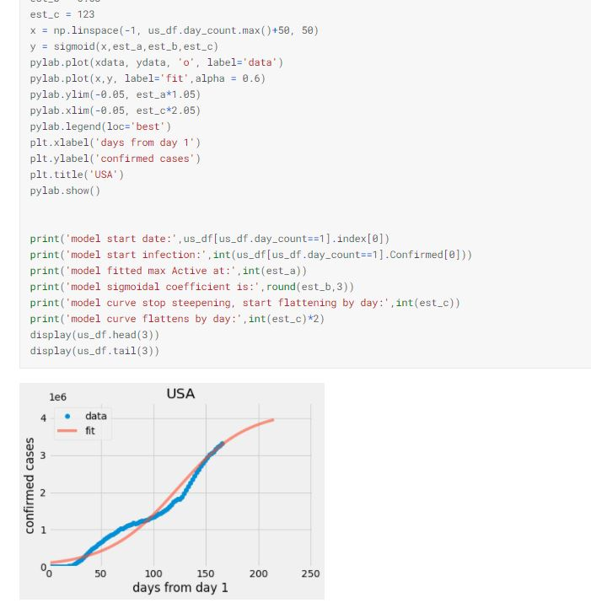

Slide 12
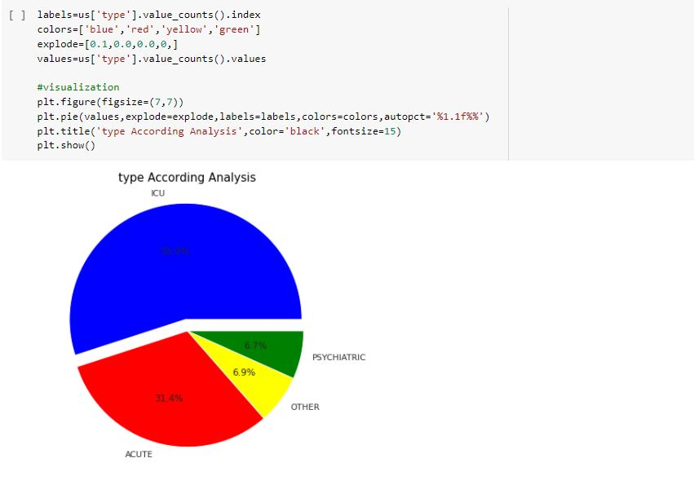
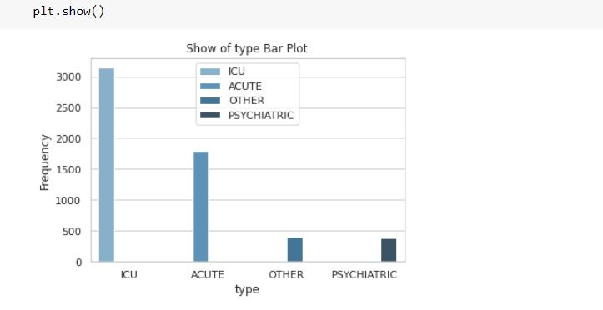
For type of beds results

Slide 13
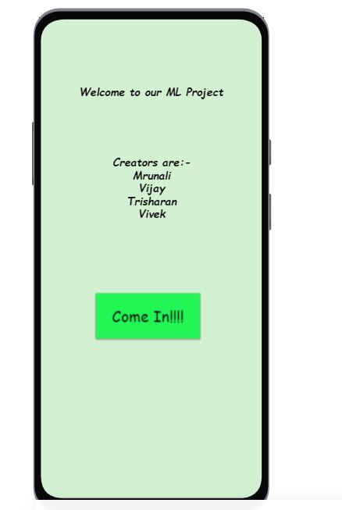
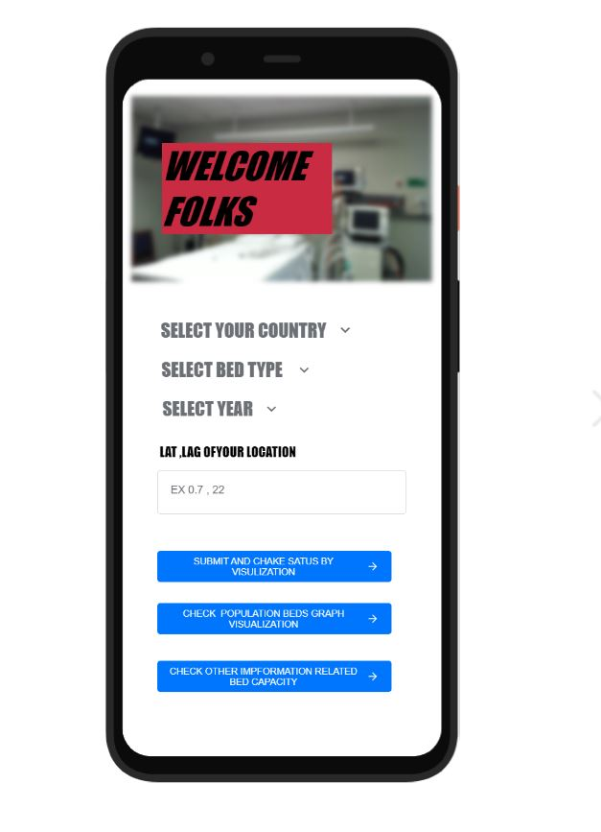
gui

Slide 14
COCLUSION
We are discuss a few regression models to predict two of the most important variables in a pandemic from the point of view of decision-making and emergency planning
The proposed algorithm can be quickly set up and is an added value during the COVID-19 pandemic to predict the needed capacity within the hospital by ward type.
We also got conclusion that in such emergency situations like covid pandemic machine learning algorithms can help to help customers and information department of each country
These models can be applied to different regions and countries as the pandemic phenomenon has the same qualitative features

Slide 15
FUTURE WORK
Here are some problems which will be going to solved by the machine learning algorithm in future
How quickly the disease spreads?
What % of the population gets infected?
What % of the population recovers?
What should be our hospital capacity?
We will trying to work on SRI models which predicts future infection with help of following parameters
Population size
Time to recovery
Transmission rate

Slide 16
REFERENCES:
https://www.kaggle.com/ikiulian/global-hospital-beds-capacity-for-covid19/notebooks
https://www.researchgate.net/

Slide 17
THANK YOU !!! ANY QUESTIONS ?

