Slide 1
“Recipe Preparation Agent” using IBM Cloud & Granity
IBM PROJECT
Presented By:
Student name : Mrunali Ganesh Bhoyar
College Name & Department : MIT Academy of Engineering
[ Computer Engineering ]

Slide 2
OUTLINE
Problem Statement
Technology used
Wow factor
End users
Result
Conclusion
Git-hub Link
Future scope
IBM Certifications

Slide 3
Problem Statement
In today’s fast-paced lifestyle, people often struggle to decide what to cook using only the ingredients they have at home. While many recipe apps exist, most require users to have specific ingredients and rarely offer meaningful substitutions. This limitation leads to frequent food waste, unnecessary grocery trips, and missed opportunities to make healthy home-cooked meals. Additionally, individuals with dietary restrictions such as veganism, gluten intolerance, or food allergies often face even greater difficulty finding suitable recipes.
Goal:
Build an AI-powered Recipe Agent that:
Accepts available ingredients.
Suggests personalized recipes.
Offers smart substitutions and dietary adaptations.
Reduces food waste and saves time.

Slide 4
Technology used
IBM Cloud Lite Services: Free-tier IBM cloud platform used for hosting, storage, and serverless app deployment.
Natural Language Processing (NLP): Enables the agent to understand user input and generate human-like recipe instructions.
Retrieval-Augmented Generation (RAG): Combines document retrieval and AI-generated responses for personalized recipe suggestions.
IBM Granite Model: IBM’s large language model used to generate customized, context-aware cooking steps and substitutions.

Slide 5
IBM cloud services used
IBM Cloud Watsonx AI Studio: Platform to build and customize AI models.
IBM Cloud Watsonx AI Runtime: Scalable environment to deploy and run AI models.
IBM Cloud Agent Lab: No-code tool to create and deploy conversational agents.
IBM Granite Foundation Model: Foundation language model for natural language understanding and recipe generation.

Slide 6
Wow factors
AI-Powered Recipe Personalization: Uses advanced IBM Granite foundation models combined with RAG to generate tailored recipes based on your exact ingredients.
Smart Ingredient Substitutions: Suggests real-time alternatives for missing ingredients, ensuring you can always cook something delicious.
Dietary Adaptation: Automatically adjusts recipes for allergies, vegan, gluten-free, and other dietary needs.
Sustainability Focus: Helps reduce food waste by maximizing use of pantry items.
Conversational Agent: Easy-to-use interface built with IBM Agent Lab for natural, interactive cooking assistance.
Cloud-Native & Scalable: Powered by IBM Watsonx AI runtime and cloud services for fast, reliable performance anywhere.

Slide 7
End users
Home cooks who want quick, easy meal ideas from available ingredients.
Busy professionals and students needing fast, hassle-free recipe suggestions.
People with dietary restrictions like vegan, gluten-free, or allergies seeking safe, tailored meals.
Beginners and elderly users who benefit from step-by-step guidance.
Environmentally conscious individuals aiming to reduce food waste.
Families looking for practical, budget-friendly cooking solutions.

Slide 8
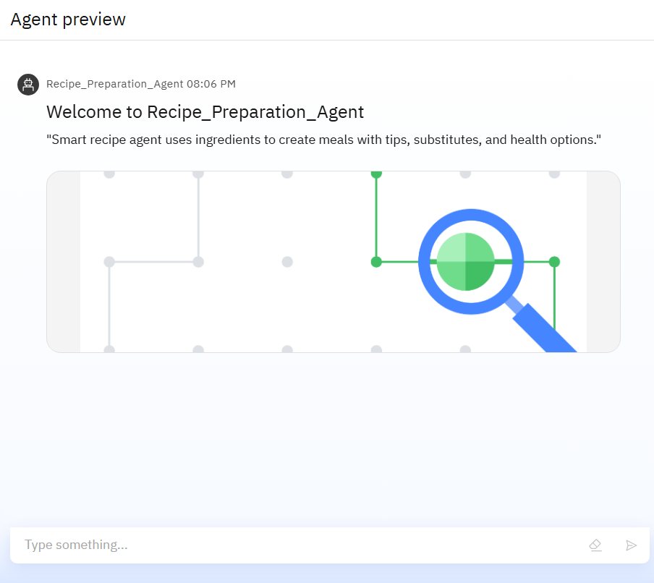
Results
[ Successfully built Recipe_Preparation_Agent ]
It Accepts user input: ingredients, preferences, and restrictions.
Retrieves relevant recipes and adapts them using AI.
Suggests substitutions if ingredients are missing.
Outputs include:
-Step-by-step instructions.
-Estimated preparation time.
-Substitutions and cooking tips.
Demonstrated reduction in decision time and ingredient waste.

Slide 9
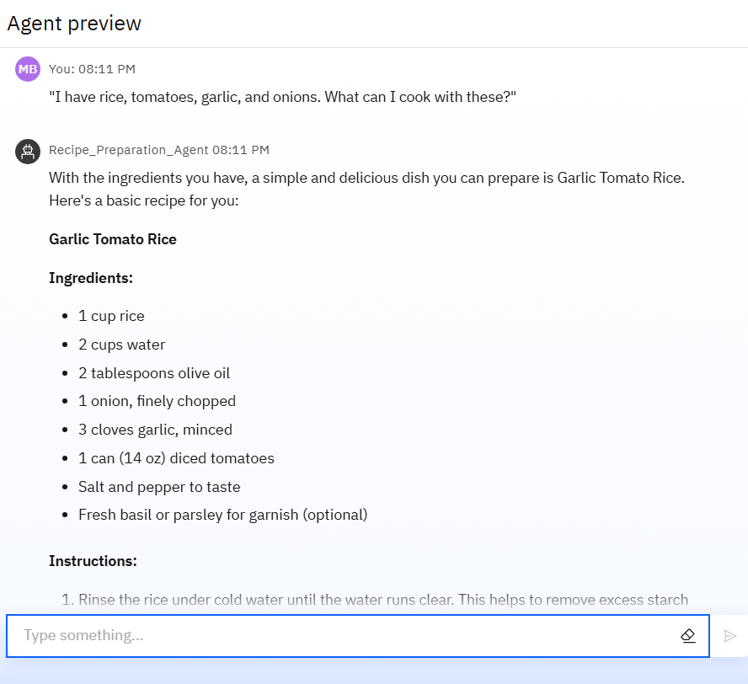
Results
When the user inputs ingredients like tomato, rice, garlic, and onion, the agent intelligently suggests a recipe for Garlic Tomato Rice.
It provides the recipe’s ingredients, step-by-step cooking instructions, and helpful tips — demonstrating how the AI customizes meal ideas based on what’s available.

Slide 10
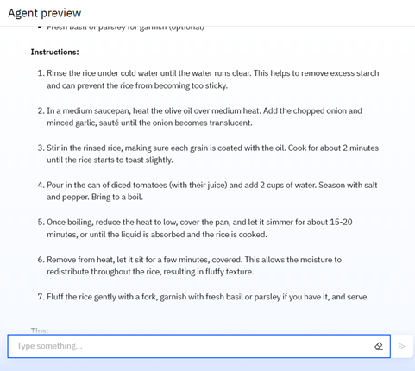
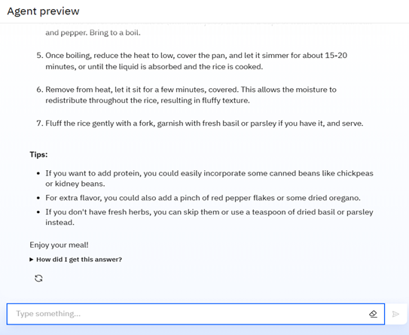
RESULTS

Slide 11
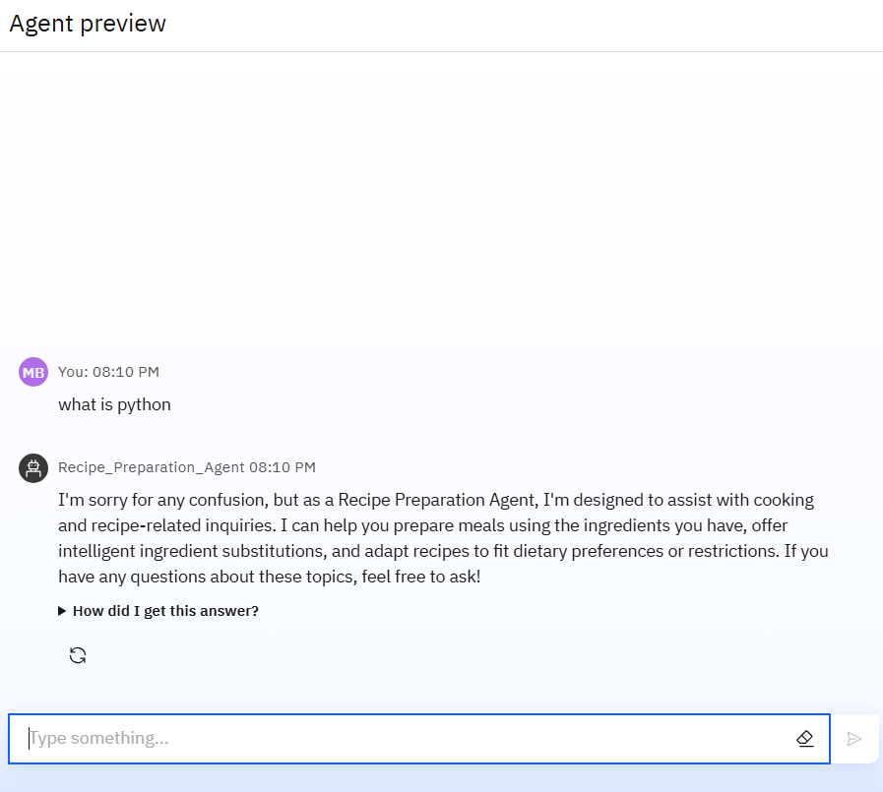
RESULTS
The agent is focused only on recipes related inquiries.
Ignoring unrelated topics like “What is Python?” keeps it accurate and user-friendly.
To stay relevant, the agent is trained only for cooking related help , not for general knowledge like programming terms or any other.
The agent ignores non-recipe questions to avoid confusion and keep the cooking experience simple and focused.

Slide 12
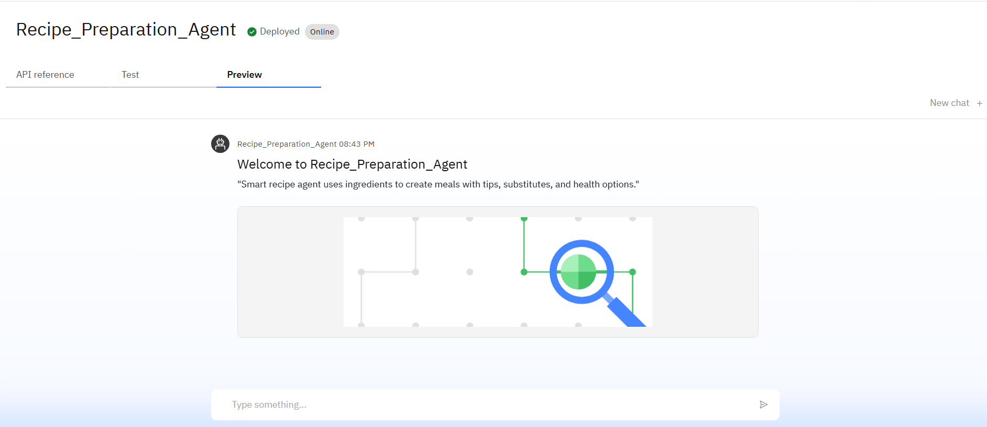
Results
Deployed AI Agent

Slide 13
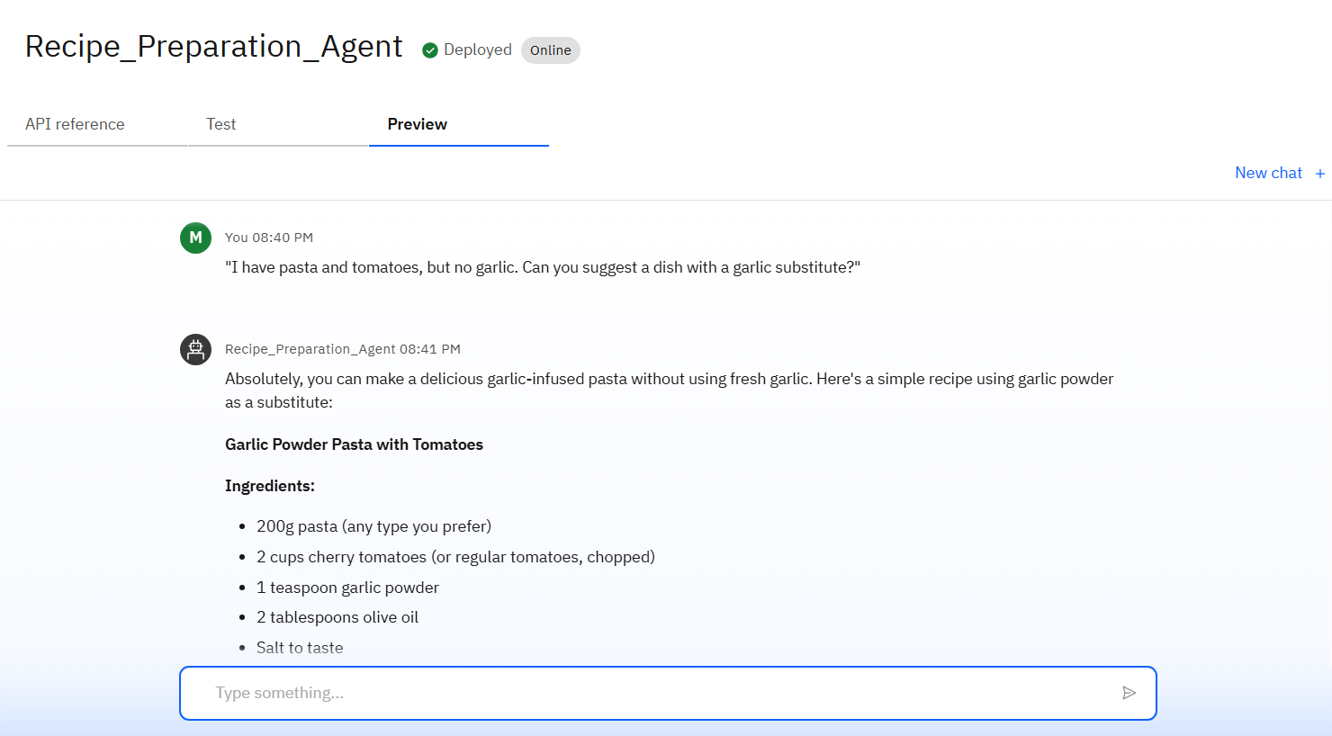
RESULTS
When the user inputs “I have pasta and tomatoes but no garlic,” the agent suggests Garlic Powder Pasta with Tomatoes as a suitable dish.
It smartly replaces fresh garlic with garlic powder, demonstrating the agent’s ability to provide intelligent ingredient substitutions while still offering a flavorful, practical recipe.

Slide 14
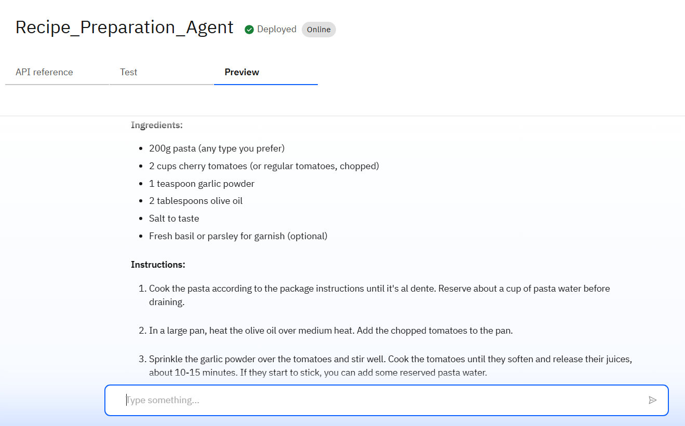
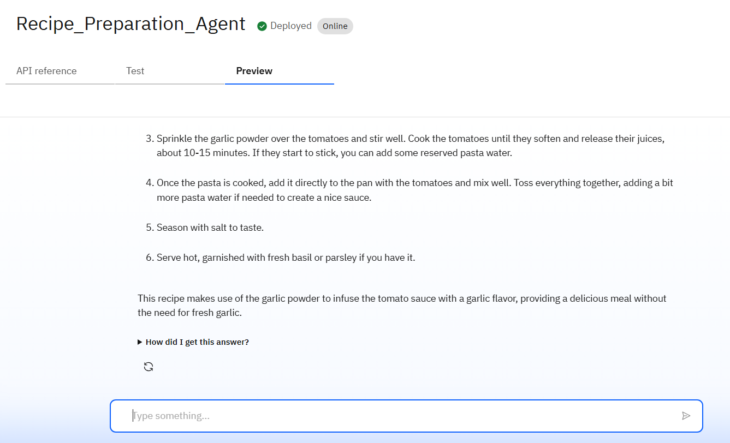
RESULTS

Slide 15
Conclusion
This Recipe Preparation Agent offers a smart, sustainable way to cook with what you already have.
By using IBM Granite models and RAG architecture, it delivers personalized, practical recipes in real time.
It supports ingredient substitutions, dietary needs, and cooking tips — reducing food waste and saving time.
The system is domain-specific, ensuring focused, accurate assistance in the kitchen.

Slide 16
GitHub Link
https://mrunalibhoyar.github.io/recipe-preparation-agent/

Slide 17
Future scope
Adding voice and image input for easier interaction.
Offering personalized meal plans and nutrition tracking.
Support multiple languages and regional recipes.
Provide detailed calorie and nutrient breakdown for each recipe.
Provide tips for reducing food waste even more.

Slide 18
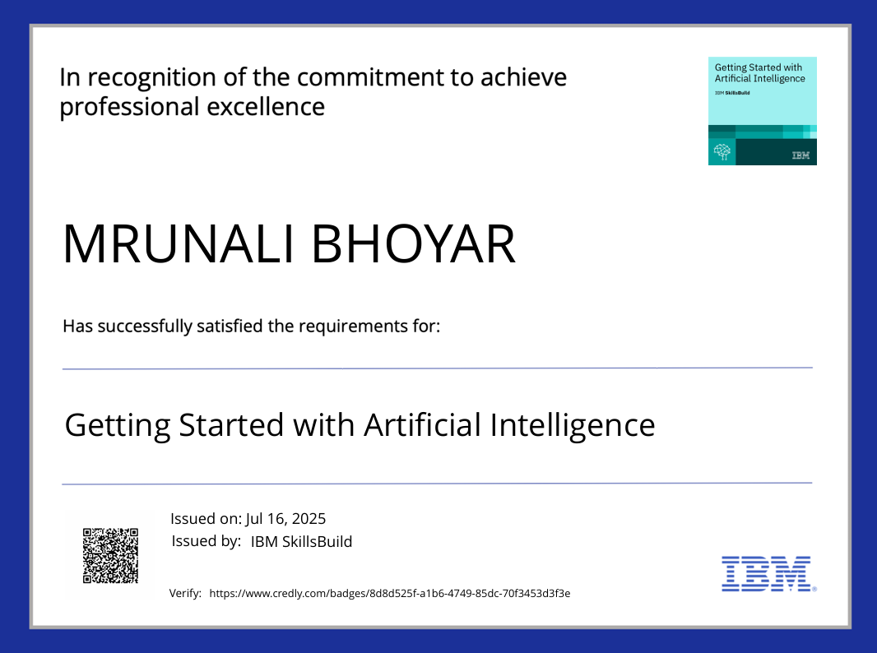
IBM Certifications
Getting Started With Artificial Intelligence

Slide 19
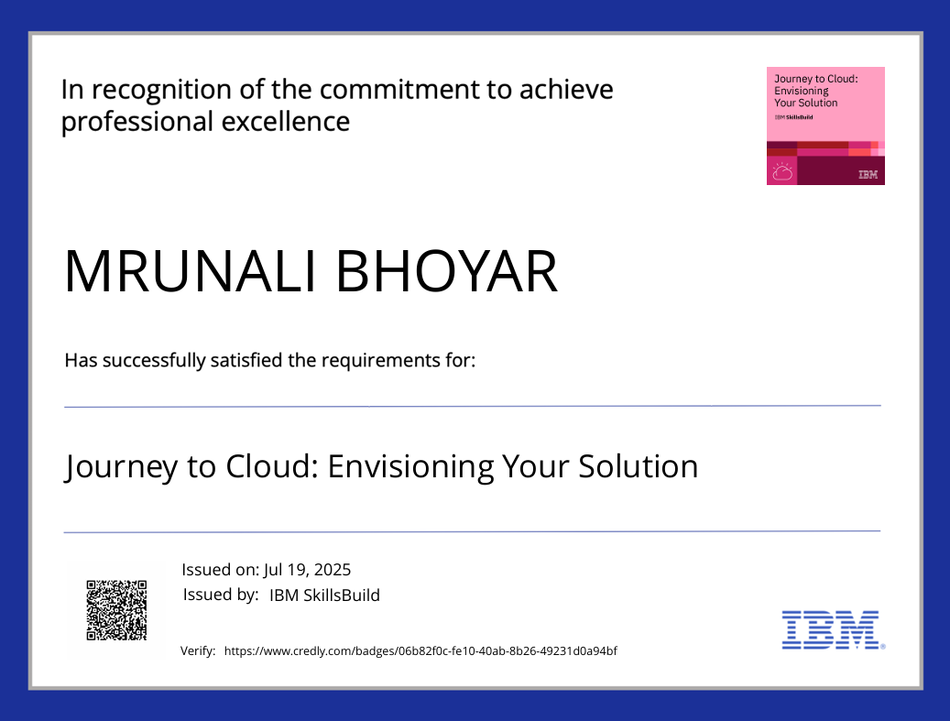
IBM Certifications

Slide 20
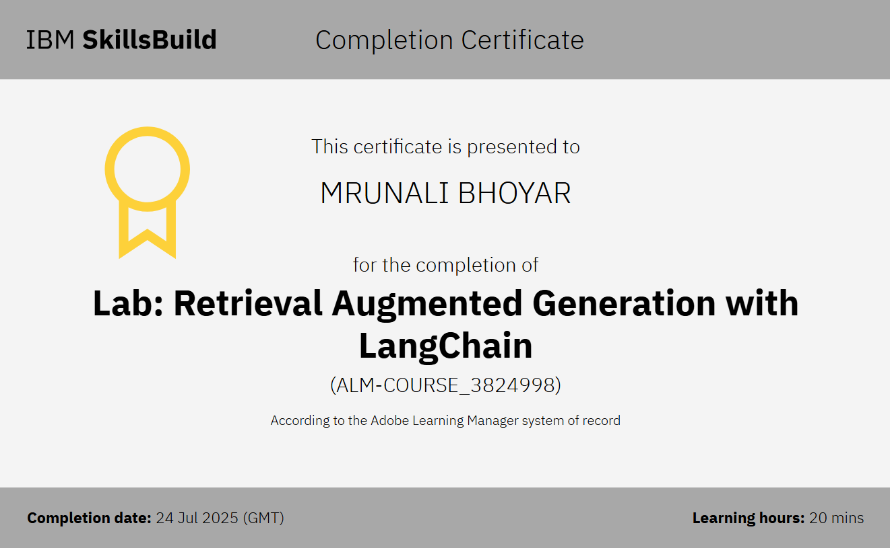
RAG Lab Completion Certificate

Slide 21
THANK YOU

