Slide 1


Amazon Fine Food Reviews Big Data Analytics
Mrunali Kadam

Slide 2

Outline
Introduction
Purpose of Project
Data Transformation
Model Building
Results and Assessment
Vision versus Product
Takeaway

Slide 3

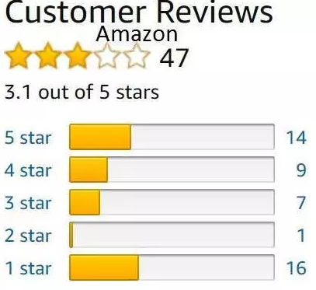
Purpose of Project
Amazon is one of the biggest sellers in ecommerce
Driven by consumers and its reviews
Essential to analyze the future trends of fine foods
Decision making to make changes
Sentimental and predictive analysis

Slide 4
Data Set Description
October 1999 to October 2012
Reviews years span
568,454 Total number of reviews
74,258
Total number of products
256,059
Total number of users

Slide 5


Data Preparation
Data Consolidation
Single CSV file
Data Cleaning
Missing values
Duplicate Records
Adjustments to data types
Outliers

Slide 6
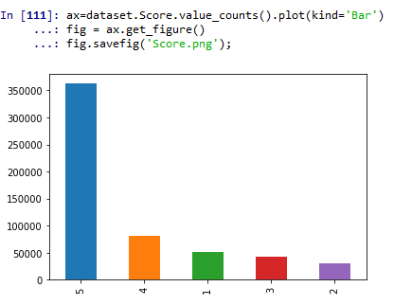
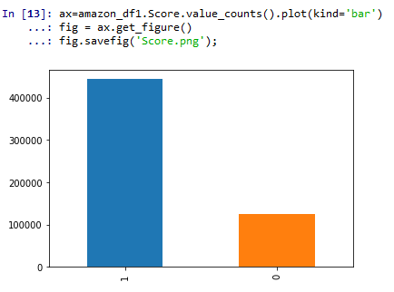
Data Preparation
Data Transformation
‘Score’ conversion
Data Reduction
‘Time’ – Unix format

Slide 7

Model Building
Tokenization: Texts into sentences, Sentences to words
Stemming: Obtaining the stem of a word
Removal of Stop words: Unwanted text
Strip spaces, punctuations, numbers

Slide 8
Results and Assessment

Slide 9
Original Vision versus Final Product

Slide 10
Takeaways

Slide 11

Any Questions?

