Slide 1

NU MUSIC
- Mrunali Pawar

Slide 2


OVERVIEW
Designing and implementing a music streaming application platform like Spotify and Apple Music.
Managing music-related information and user subscriptions, curated content, playlists, and millions of songs
Making all genres, artists, and songs available at the user's fingertips and helping them discover new music

Slide 3
Proposed Solution
NU Music is a user-friendly music streaming app with a vast collection of songs, personalized recommendations, and features such as custom playlists and marking songs as favorites.
It offers two subscription models, Paid and Unpaid, with auto-renewal available for the paid subscription. Paid subscribers can download songs, while unpaid subscribers cannot.
Users can have multiple cards associated with their account, but each card belongs to only one user.
Users can create multiple custom playlists on the app, and each playlist can contain multiple songs, which can be categorized by artist, album, and song.
Each user has a single favorite playlist, and songs can be marked as favorites by multiple users.

Slide 4
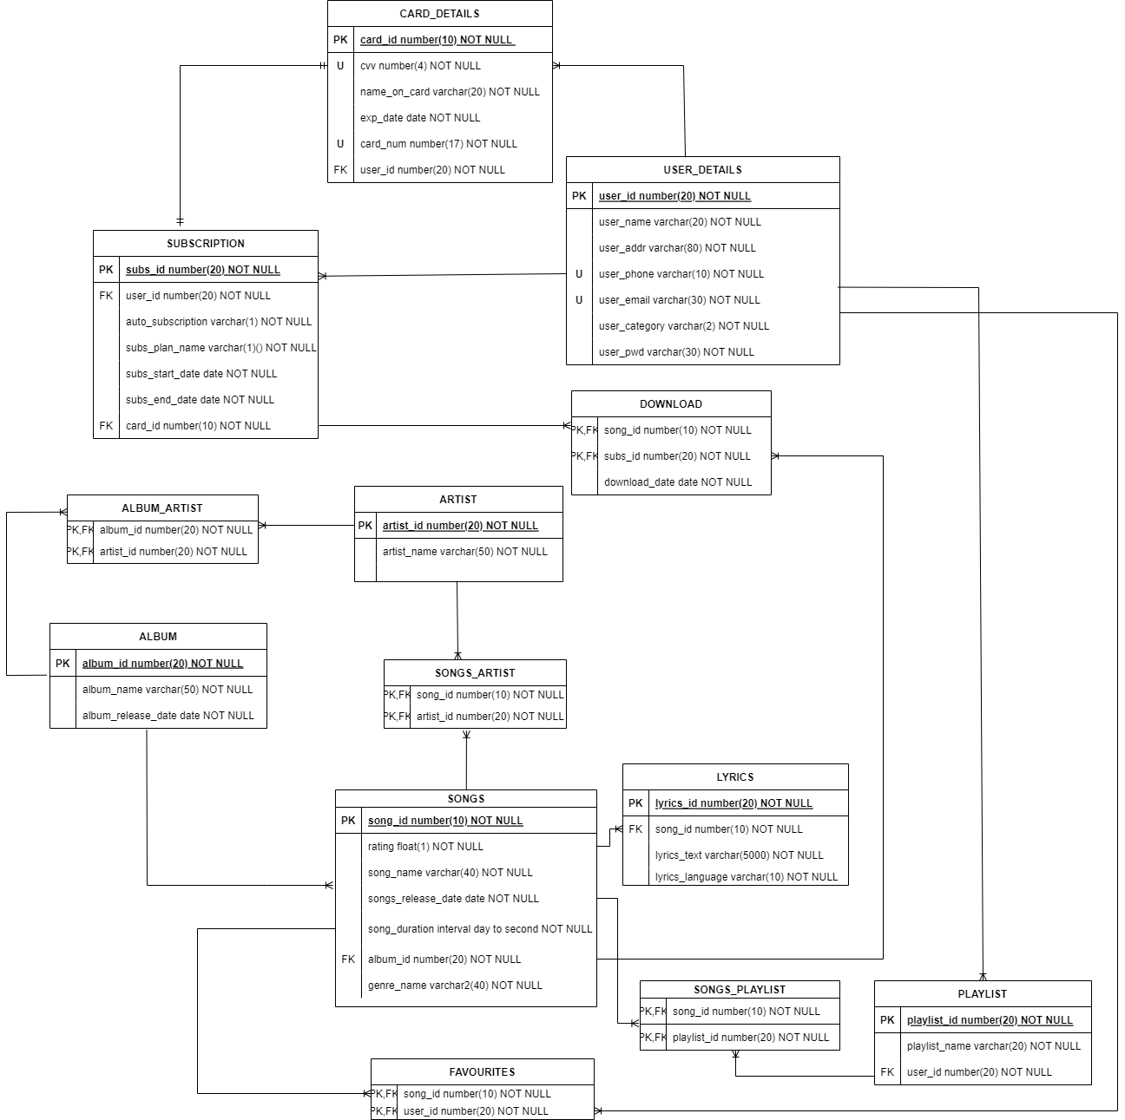
ER Diagram
We have represented er model of our application which includes entities and their relationships based on our business rules.

Slide 5
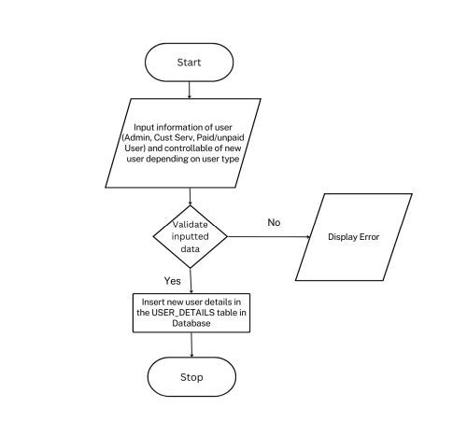
DATA FLOW DIAGRAM
User Registration

Slide 6
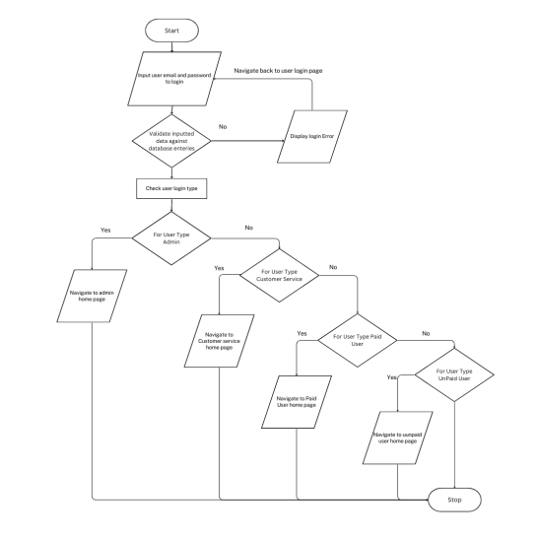
DATA FLOW DIAGRAM
User Login

Slide 7
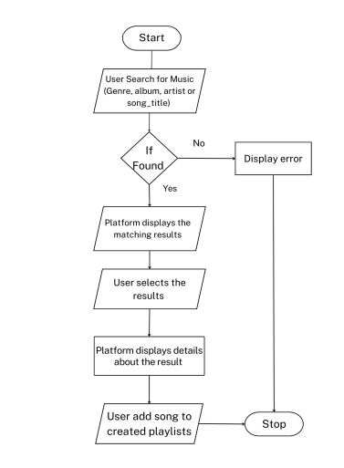
DATA FLOW DIAGRAM
MUSIC DISCOVERY

Slide 8
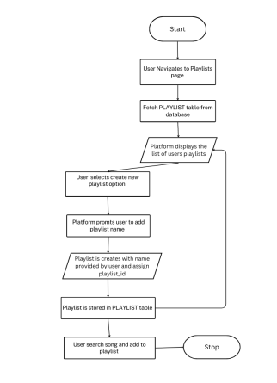
DATA FLOW DIAGRAM
CREATE PLAYLIST

Slide 9
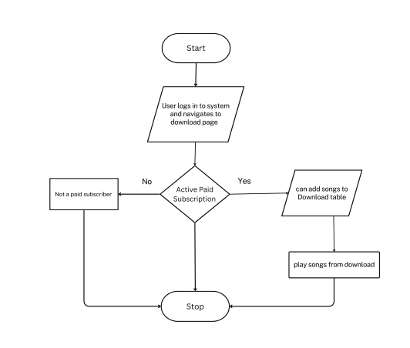
DATA FLOW DIAGRAM
DOWNLOAD SONGS

Slide 10
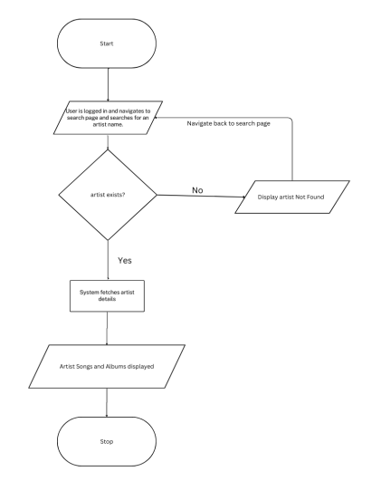
DATA FLOW DIAGRAM
ARTIST MANAGEMENT

Slide 11
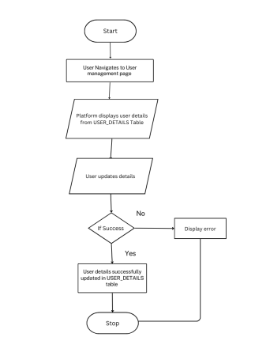
DATA FLOW DIAGRAM
USER
MANAGEMENT

Slide 12
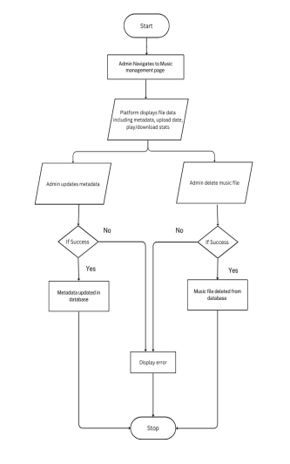
DATA FLOW DIAGRAM
MUSIC
MANAGEMENT

Slide 13
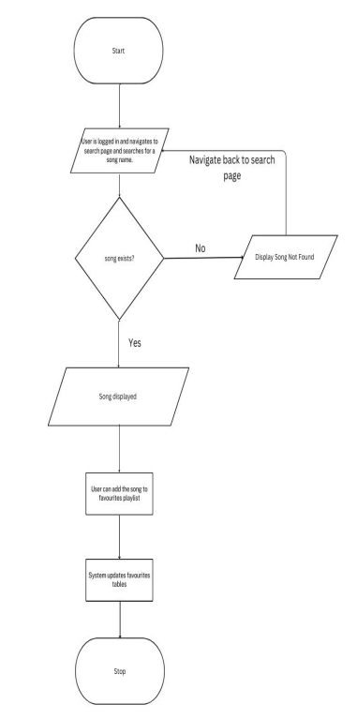
DATA FLOW DIAGRAM
FAVOURITE
MANAGEMENT

Slide 14
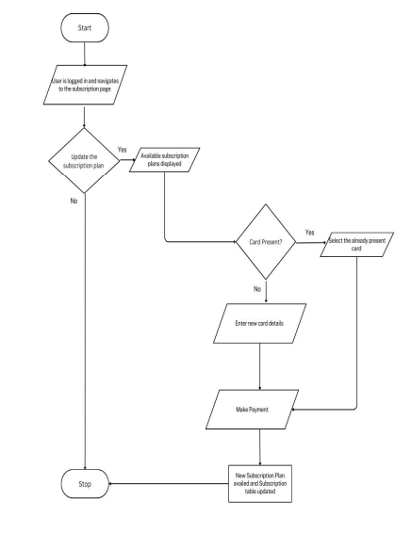
DATA FLOW DIAGRAM
SUBSCRIPTION
MANAGEMENT

Slide 15
Key Functions
Tables
Procedures
Packages
Sequences
Triggers
Functions
User Roles
Views
Reports

Slide 16
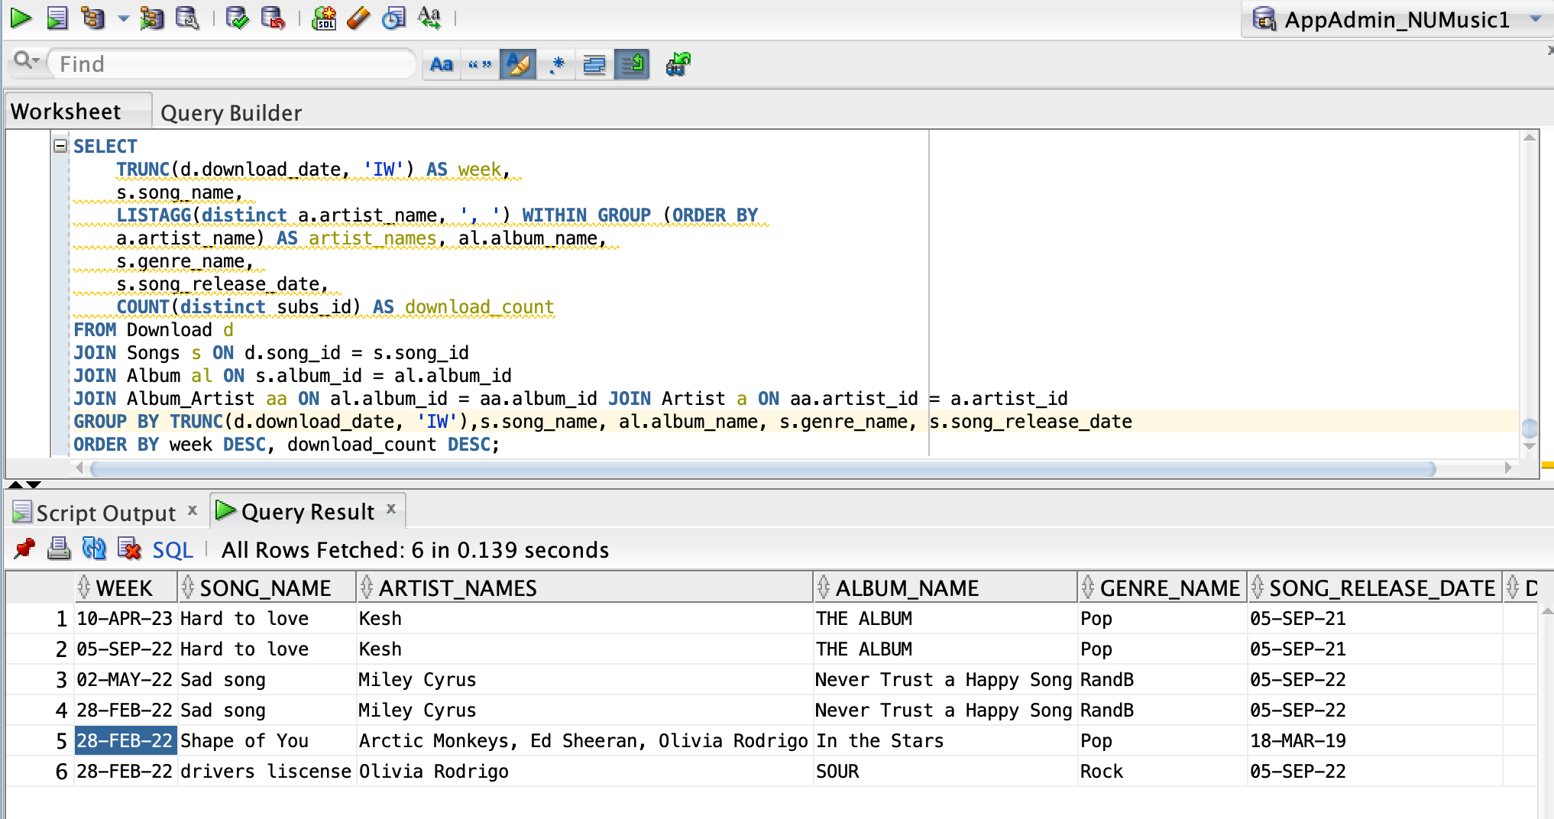
REPORT 1: get week wise number of songs downloaded in the last 3 years

Slide 17
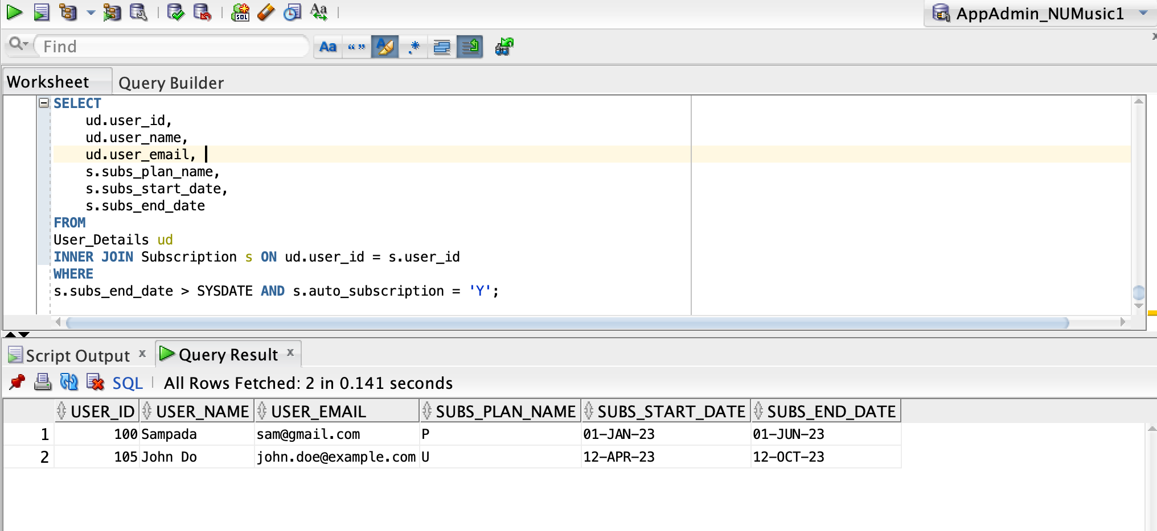
REPORT 2: To show user who are currently subscribed to a paid subscription on plan and have auto subscription-on on

Slide 18
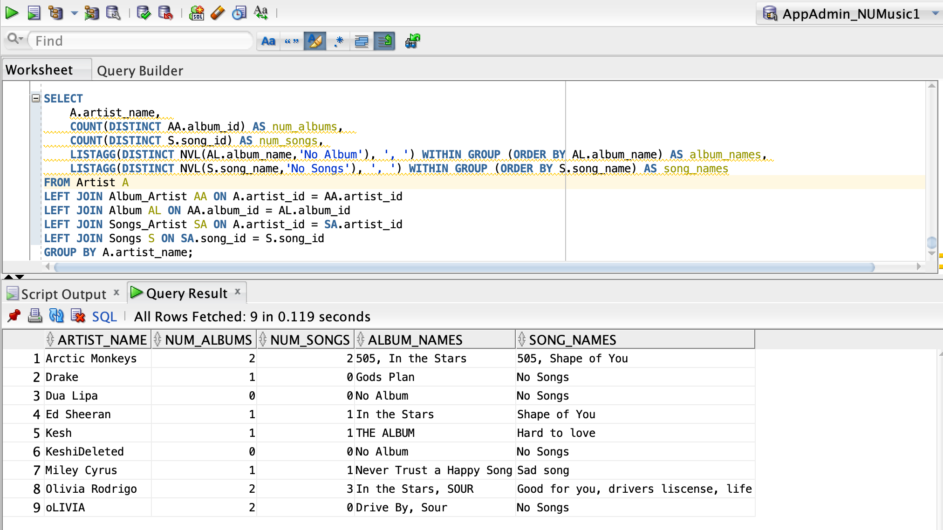
REPORT 3: To show a list of all artists and the number of albums and songs they have in the database along with album names and song names

Slide 19
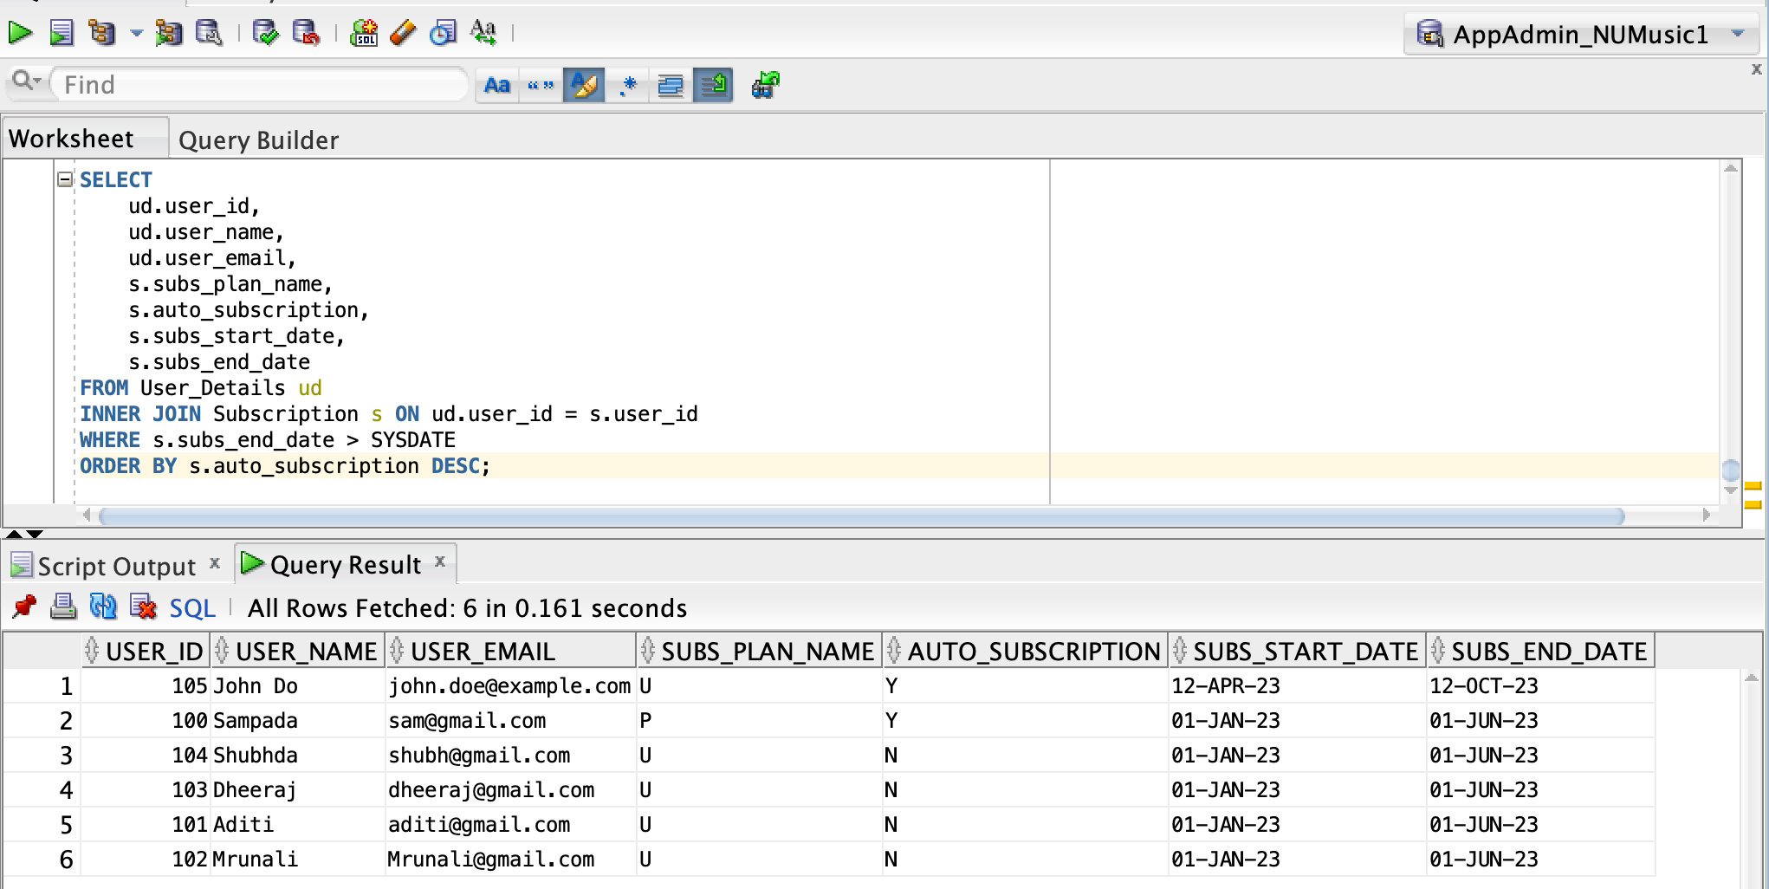
REPORT 4: To show the subscription status of all user along with their subscription plan details sorted by active subscription status for both paid and unpaid customers

Slide 20
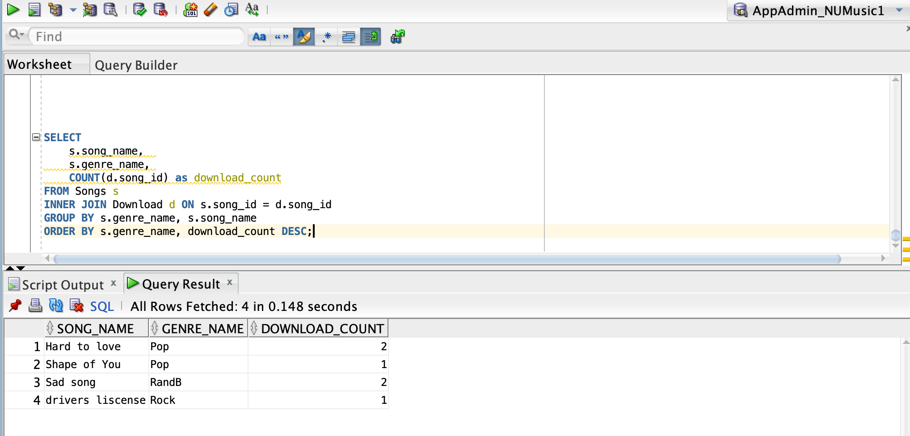
REPORT 5: To show the top songs in each genre based on the number of times they have been downloaded

Slide 21
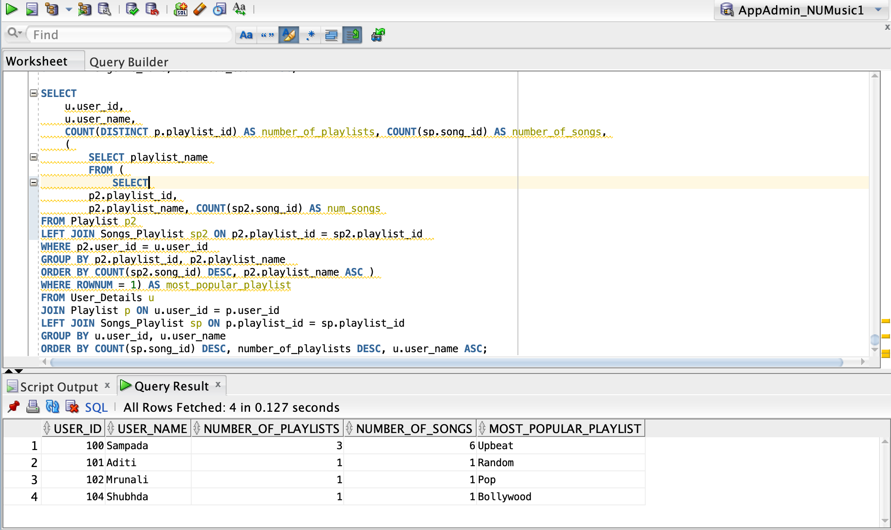
REPORT 6: To provide information on the playlists created by users within the music streaming service including the number of songs on each playlist, no of playlist for each user and most popular playlist for each user

Slide 22

Thank you

