Slide 1
HTML5 TAGS
CE– TE– Web Design Lab
Namrata Jiten Patel
Assistant professor
Dept. of Computer Engineering
SIES Graduate School of Technology

Slide 2
<article>
<article id="article1">Hello HTML5</article>
ARTICLE Tag is such an element of HTML5, which can be used to write
the article. If a user wants to write a part of the website in different style
and looking in different manner, the ARTICLE Tag can be used there to represent
it in a different way.
<aside>
<aside> <h1>Once upon a time</h1> in SIES GST</aside>
Mainly ASIDE Tag is used in sidebar of a page, whenever
user clicks on the index; it redirects the user on the related content.

Slide 3
<audio> and <video>
<audio>
<video>
<audio id="audio1" controls="">
<source src="../audio/hello.mp3”
type="audio/mpeg">
<source src="../audio/jeffbob.ogg" type="audio/ogg"> </audio>
AUDIO Element has been introduced for playing the audio
file in the browser with full user control support. Yet, before the development of HTML5
AUDIO Element, we were unable to play a audio file without using the third party browsers
plug-in as flash player or quick time.

Slide 4
<bdi> .... </bdi> Bi-direction isolation
The BDI Element stand for Bi-Directional Isolation Element, which is one
of the best feature of HTML5, specially when someone wants to display a
text in the Bi-direction way around the remaining text. Whenever we write
the aroma, Hebrew or Urdu fonts, it shows from the opposite side of the
general fonts

Slide 5
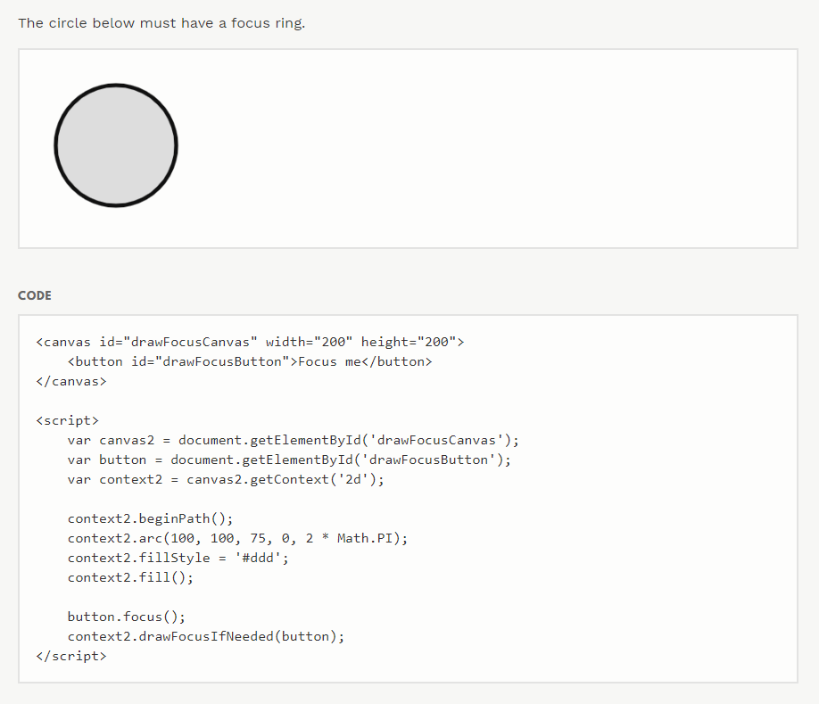
<canvas> .... </canvas>
The another solution of graphical representation has been introduced with
the develpment of HTML5 as CANVAS Element.

Slide 6
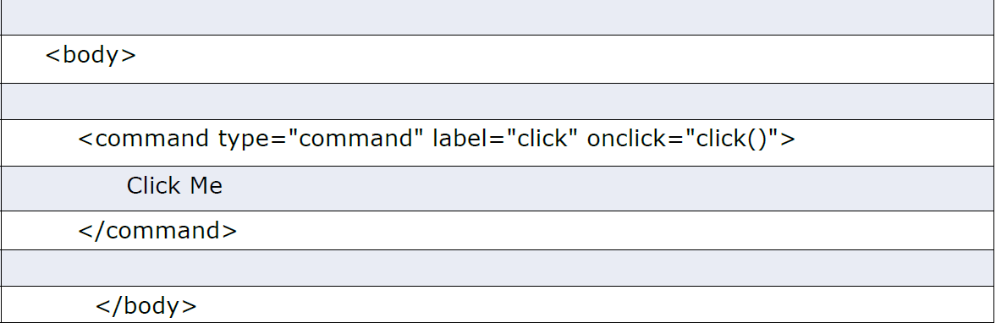
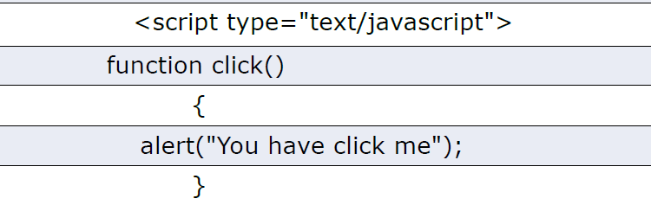

<command> .... </command>
COMMAND Element is basically used for commanding code of HTML5. As if
we want to save a file, open a file or anything else that shows the command
function, will be prompted with COMMAND Element.

Slide 7
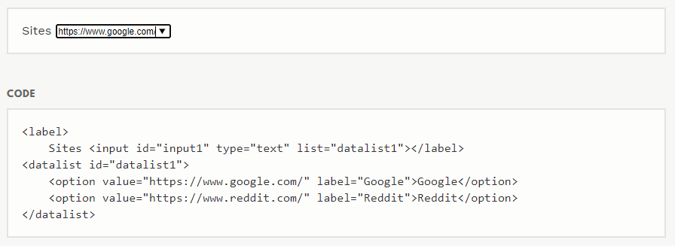
<datalist> .... </datalist>
DATALIST Element is basically use for auto completion of the form. The
complete list is put in the option box, and when the user double click the
input field the option is dragged down.

Slide 8
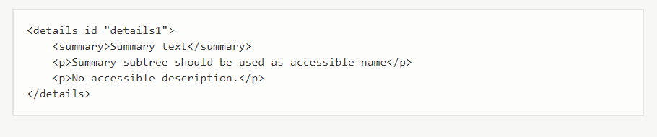
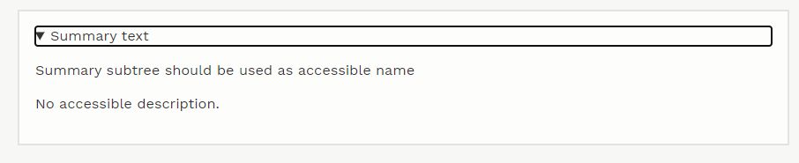
<details> .... </details>
DETAILS Element is used to invoke the show and hide function of HTML5.

Slide 9
<embed> EMBED Element is another media element, which is used to call a media file in browser. A browser pluging may be require to play the media files. EMBED Element is specially used for calling a flash movie. <figure> <figcaption>

Slide 10
<hgroup> .... </hgroup>
The HGROUP Element is commonly used for wrapping the <h1> to <h6>
element. The HGROUP Element is best useful when, someone wants to put a
header and sub header or we can say multiple header in the document.

Slide 11
<keygen name=”key”>
The KEYGEN Element is commonly used for generating the keypair in the
form. Whenever user hit the submit button, the KEYGEN Element creates two
key pair, first one is Public Key and another one is Private Key. Private key is
encrypted and stored in local key database and the public key is sent with the
form data to server. The KEYGEN Element is most useful when user wants to
generate the unique key for a particular form.

Slide 12
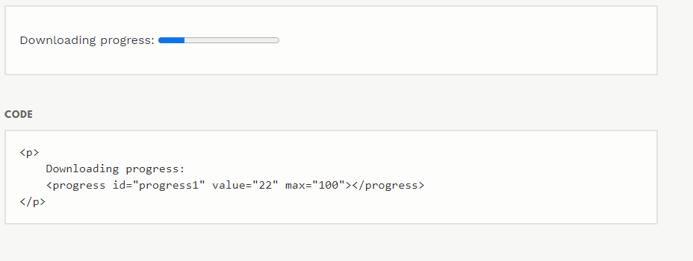
<progress> . . . </progress>
The PROGRESS Element is used to show the completion or progress of a
specific task. We often see that on the website while downloading some text
or video and even on uploading some contents on Internet, a progress bar
comes before us and displays its current progress or completion of specific
task.

Slide 13
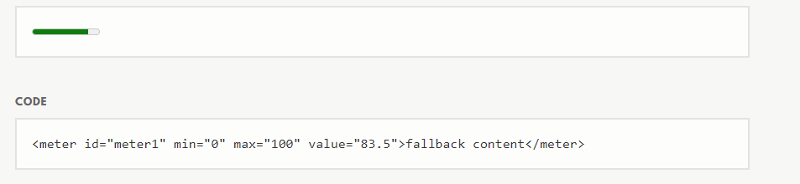
<meter>. . . </meter>
The METER Element is basically used for scalar measurement for known
range or known a fractional value. This can be used for disk usage, relevance
query status results and e.t.c. The METER Element can’t be used if we don’t
have the known range. There are six attributes allowed in METER Element:
value, min, max, high, low and optimum.

Slide 14
The METER Element is basically used for scalar measurement for known
range or known a fractional value. This can be used for disk usage, relevance
query status results and e.t.c. The METER Element can’t be used if we don’t
have the known range. There are six attributes allowed in METER Element:
value, min, max, high, low and optimum.

Slide 15
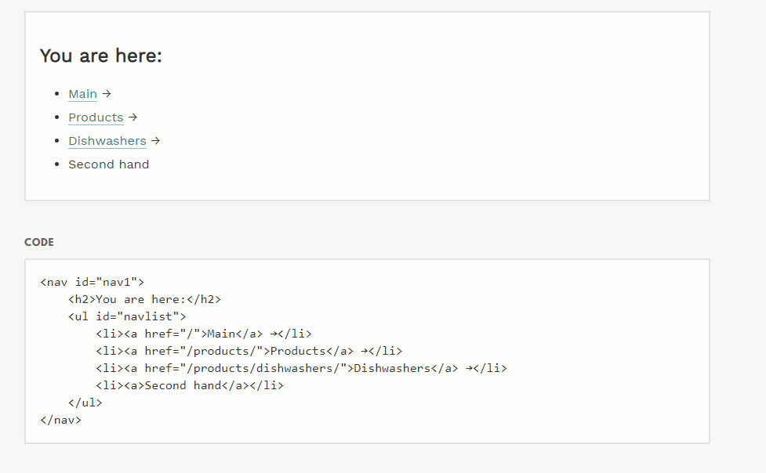
<nav>

Slide 16
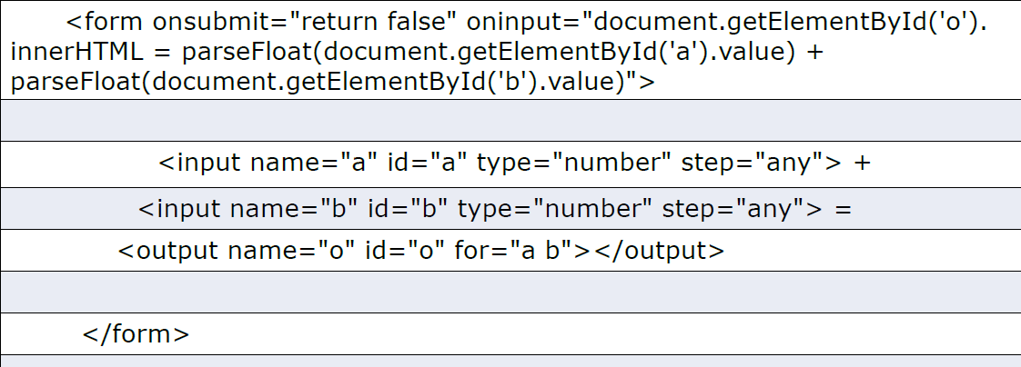
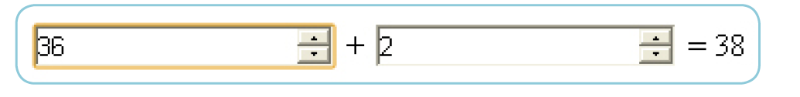
<output> . . . </output>
The OUTPUT Element is used for resulting a calculation.

Slide 17
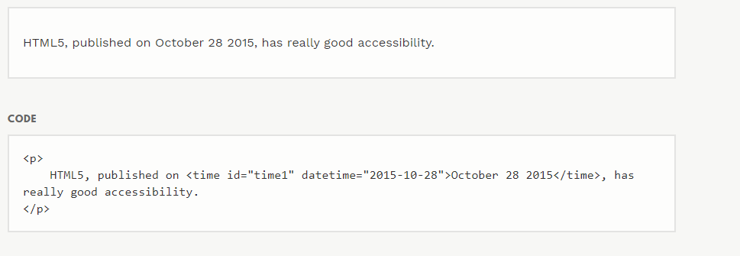
<time>
The TIME Element can’t be used to see the front end effect on HTML5 document.
It is pure machine readable element

Slide 18
<wbr>
The WBR Element is used to change the default behavior of browser of line
breaking. If the sentence is too long than the container, will be break for proper displaying.

Slide 19
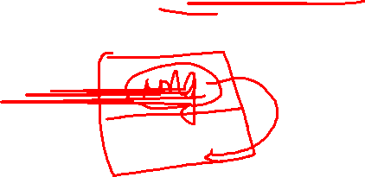
Drag and Drop in HTML5
The Drag and Drop Event is the most fabulous properties of HTML5. With
the help of Drag and Drop features We can move an object from one place
to another place.

Slide 20
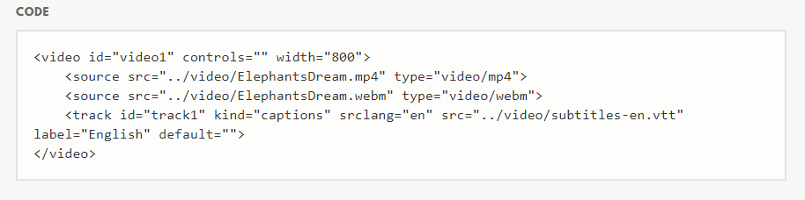
<track>

Slide 21
Thank You!
(namratap@sies.edu.in)

