Slide 1
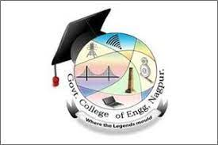

Government College of Engineering, Nagpur
Sign Language To Speech Conversion Smart Gloves Using IoT
TEAM MEMBERS
1. Mrunal Tarwatkar 2. Shardul Nagrare
3. Shriyansh Thote
4. Tushar Vaidya

Slide 2
Table of Content
Introduction
Aim
Objective
Motivation
Materials Required
Block Diagram
Algorithm
Circuit Diagram
Working Model of Glove
Result
Future Scope
Conclusion
References

Slide 3
Introduction
Communication is vital for effective interaction and collaboration, enabling the sharing of ideas, thoughts, and information. It's the bedrock of relationships, fostering trust and understanding. However, mute individuals face challenges in traditional communication methods. Smart hand gloves, equipped with sensors, enable real-time gesture interpretation, converting it into audible speech via text-to-speech technology. They empower mute individuals, facilitating better engagement and independence in various aspects of life, including education and work.

Slide 4
Aim
To develop a smart speaking glove for speech-impaired people using flex sensor, ESP32, Accelerometer and gyroscope sensor, which sense different sign language gestures for communication assistance.

Slide 5
Objective
To facilitate communication, the speech-impaired smart speaking glove integrates a Flex sensor, ESP32, Accelerometer, and gyroscope sensor, aiming to aid individuals with speech impairments.
To ensure communication accessibility, the glove employs technology to interpret hand motions or movements into spoken words, granting speech-impaired individuals an alternative means of expression.
To promote mobility and accessibility, the glove is designed to be wearable and portable, enabling users to carry it conveniently and use it in various environments.
To foster self-reliance and empowerment, the smart speaking glove provides speech-impaired individuals with an independent method of communication, enhancing their ability to interact with others and signal for assistance when needed
To reduce the problem of miscommunication between the normal people and the speech impaired people.
To develop a user friendly reliable automatic gesture recognition system that recognizes the hand gestures made by the speech impaired people.

Slide 6
Motivation
There are several motivations for developing sign language to speech conversion smart gloves using IoT:
Accessibility: These gloves can bridge the communication gap between hearing-impaired individuals who use sign language and those who do not understand sign language. It promotes inclusivity and enables seamless communication in various settings.
Independence: Users can communicate more independently without relying on interpreters or third parties, empowering them to express themselves in real-time situations such as meetings, classrooms, or public interactions.
Education and Learning: It can be a valuable tool for teaching sign language and promoting understanding and acceptance of different communication methods.
Technological Advancement: Developing such innovative solutions pushes the boundaries of IoT applications and showcases the potential of technology to improve quality of life and promote inclusivity.

Slide 7
Materials Required
ESP32
Flex Sensor
Accelerometer and Gyroscope Sensor (MPU6050)
Voltage Regulator (AMS1117 3.3V)
Diode (1N4007)
Resistor (10K Ohm, 220 Ohm)
Capacitor (0.1µF, 0.3µF, 100µF, 10µF)
LED
Push Button
Battery (9V)

Slide 8
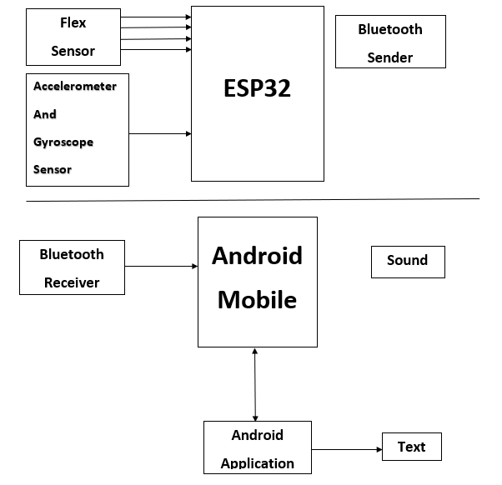
Block Daigram

Slide 9
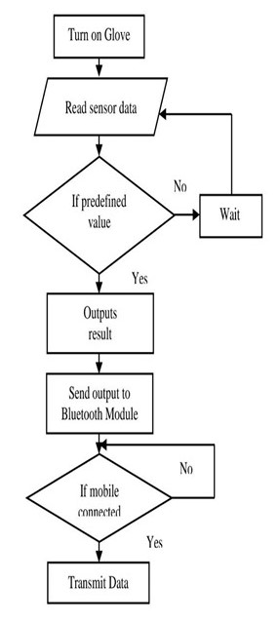
Algorithm

Slide 10
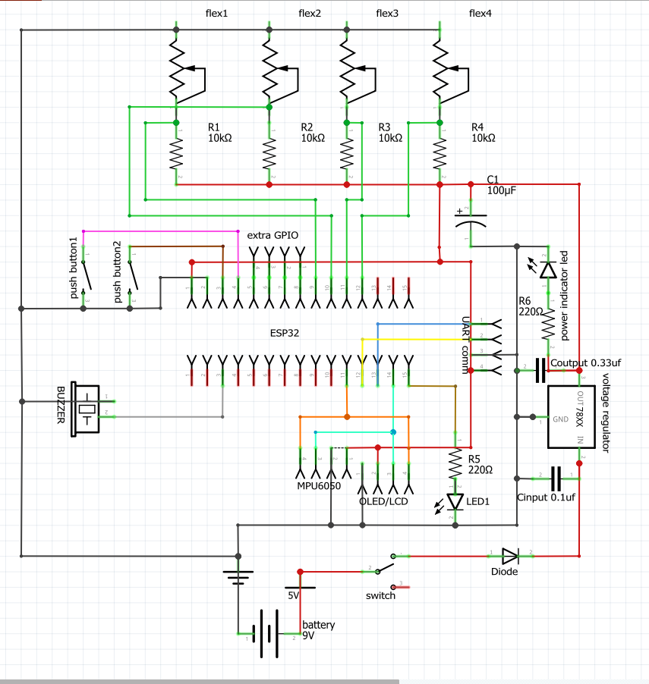
Circuit Diagram

Slide 11
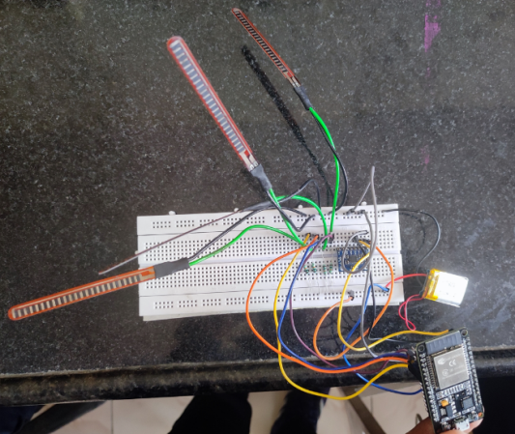
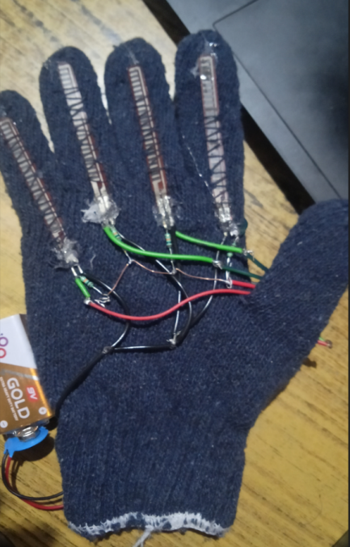
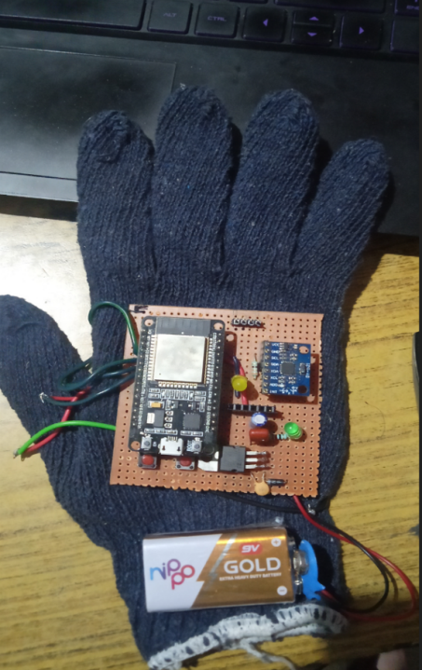
Working Model of Glove
Fig. 4.1.1 Initial Prototype
Fig. 4.1.2 Final Prototype Down Part
Fig. 4.1.2 Final Prototype Up Part

Slide 12
Working
Gesture Sensing: Utilizing sensors such as flex sensors, accelerometers, and gyroscopes to detect hand movements, including finger direction, bending, and palm angle.
Gesture Recognition: Converting analog sensor data into digital signals to identify specific sign language gestures using predefined codes stored in the ESP32 microcontroller.
Output Transmission: Transmitting recognized gestures wirelessly via Bluetooth to an Android application for real-time interpretation.
Final Output: Displaying interpreted gestures as text within the Android app and converting them into audible speech using the device's microphone, facilitating communication for the deaf-mute community.

Slide 13
Result
With the help of the flex sensor, ESP32, accelerometer and gyroscope sensor the SIGN LANGUAGE TO SPEECH CONVERSION SMART GLOVES for people with speech difficulties can recognize hand gestures and translate them into audible speech. The matching movements were recorded by the flex sensor. The glove then processed the gathered data and produced spoken output by identifying gestures.
Many different motions, such as finger movements, palm orientation, and hand forms, were effectively recorded by the flex sensor, accelerometer and gyroscope sensor. These movements were successfully converted by the glove into coherent speech output, and displayed on the mobile screen. The glove's interface translates motions into verbal output, provides a useful and effective way to communicate.

Slide 14
Future Scope
It is possible to develop the other glove such that it can perform both hand gestures and phrase production.
By employing a compact lipo battery, which can be charged and reused multiple times, the gadget can be made more portable.
The usefulness and connectivity of the smart speaking glove can be improved by looking at integration with currently available smart devices, such as smartphones or tablets. Features like message writing, text-to-speech conversion, and communication app compatibility are examples of these.
The speech output produced by the glove can have greater coherence and fluency because to developments in natural language processing (NLP). Improved sentence construction, tone, and context awareness can all contribute to more organic and successful communication.

Slide 15
Conclusion
The technology bridges the communication barriers between deaf and normal persons by acting as a conduit for information between the two groups. With little weight and power, the gloves are autonomous and portable. The hand movements are translated by the system into text and then back into voice. There is a feature built into the text system that allows a person to read and comprehend what someone else is trying to say even in situations where they are unable to hear sounds. As of right now, cables are used to connect the gadget to the microcontroller. The device's early testing indicates that the cords may obstruct hand movements. To address this issue, a wireless connection between the device and microcontroller will be used in the future.

Slide 16
References
[1] J. Nagar, R. Gandhi Salai, C. -, D. Anu Me, and S. Vigneshwari, “SMART GLOVE FOR SIGN LANGUAGE TRANSLATION USING IoT,” SATHYABAMA INSTITUTE OF SCIENCE AND TECHNOLOGY (DEEMED TO BE UNIVERSITY), 2020
[2] J. B. Krishnaa, R. Haritha, G. D. Haritha, J. S. Lekha, and S. R. Malathi, “GLOVE BASED GESTURE RECOGNITION USING IR SENSOR,” International Research Journal of Engineering and Technology, 2023,
[3] K.Ravi Chandra, K.S.D.Charishma Patnaik, V.Suhruth, M.J.N.Sandeep “SMART GLOVE FOR SIGN LANGUAGE TRANSLATION USING ARDUINO,” ANIL NEERUKONDA INSTITUTE OF TECHNOLOGY AND SCIENCES, 2021
[4] R. Ambar, C. K. Fai, M. H. Abd Wahab, M. M. Abdul Jamil, and A. A. Ma’Radzi, “Development of a Wearable Device for Sign Language Recognition,” in Journal of Physics: Conference Series, Institute of Physics Publishing, Jun. 2018. doi: 10.1088/1742-6596/1019/1/012017.
[5] A. Z. Shukor, M. F. Miskon, M. H. Jamaluddin, F. Bin Ali Ibrahim, M. F. Asyraf, and M. B. Bin Bahar, “A New Data Glove Approach for Malaysian Sign Language Detection,” in Procedia Computer Science, Elsevier B.V., 2015, pp. 60–67. doi: 10.1016/j.procs.2015.12.276.
[6] J. Waykule, Y. Jhunjhunwala, P. Shah, P. Patil, and S. Sushila, “SIGN LANGUAGE TO SPEECH CONVERSION USING ARDUINO,” 2017.

Slide 17
Thank You !

