Slide 1
PlantAnywhere
Web-based Farming Simulation
using Javascript/HTML5
Hack UCSC 2015
Kevin Cameron

Slide 2
Hello, Everyone!
Great to be standing here after two days of hacking.
Some quick shout outs:
  Peter Biggam
  Andrew Donnely
  Quentin Lindh, CityBlooms
  I'm sure there are more
  Thank you to all involved!

Slide 3
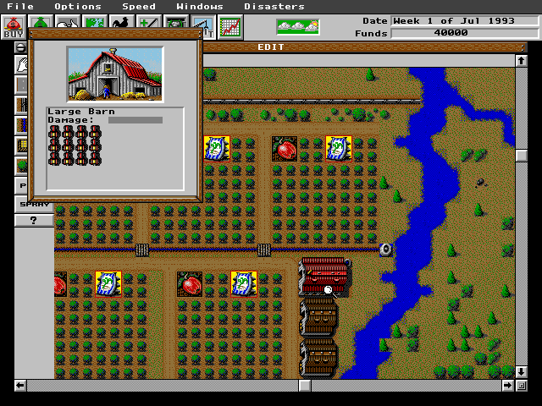
What is PlantAnywhere?
Simulator game
  Based on SimFarm.
  Recreates a small garden
  or hydroponic farm,
  like CityBlooms.
Goal
  Allow small farmers to experiment with different techniques and materials before applying them to the real world.

Slide 4
That's great. So?
Web Application Advantages
  Allows synching the simulation with real world sensor data.
  Written in Javascript, the same language used for CityBloom's sensors.
  Instant updates from web database
    Sync plants, materials, and other models with database.
    Allows instant access to latest information.
    e.g. organic fertilizers, new crops, etc.

Slide 5

Development Process
Framework is Backbone.js
  Used it to set up data structures and models early on.
  Client-only right now, but Backbone is very server friendly.
  Used MVC pattern extensively.
    Let me switch from text display to graphics fairly quickly.
    Same data, different presentation
    Can tweak properties of many objects at once.
    Helpful for deciding how sprites should look.

Slide 6


Development Process
Graphics are done through Kinetic.js
  Older library.
  Provides support for simple shapes as well as images.
  Also used Bacon.js for event structure.
UI is functional, but a little bare-bones.
Simulation could also use a bit of tweaking.
Still, it's a working MVP.

Slide 7
Live Demo Time!
(link)
Layout
Query Tool
Add Plant
Watering Can
Whole Row
Whole Field

Slide 8
Thank You!
Any questions?

