Slide 1
Project management

Slide 2
Options
Installing collaborative version control on AFS is not impossible but very difficult with permissions
Therefore, we will encourage the following:
Google code (Git or SVN repository)
GitHub
Local version control (SVN/Git)
The only difference between using Google and a local repository is Google is visible to the outside world.

Slide 3
Open source licence(s)
We recommend you release your code under the GPL. Details here:
http://opensource.org/licenses/gpl-3.0.html
In short, you maintain the rights to the code and others can modify it, but they must credit you as original developers and release it to the public domain.

Slide 4
Git vs. subversion?
Subversion
Subversion is a well-known centralized VCS and the most widely used for open source projects.
Subversion can scale to support larger projects, but it works especially well for small/medium sized projects.
Subversion also works well for teams where most software contributions are expected from other team members.
Mercurial/Git
Mercurial and Git are Distributed Version Control Systems (DVCS) that enables developers to work “offline” and define more complex workflows such as peer-to-peer pushing/pulling of code.
DVCS makes it easier for outside contributors to contribute to projects, as cloning and merging of remote repositories is very easy.
Large projects with multiple developers and external contributors benefit the most from DVCS because of the ease of branching and tagging. Smaller projects typically only experience the benefit of being able to work offline.

Slide 5
Google
Google provides free project management support to open source projects with the following features:
SVN/Git/Mercurial backend
Wiki to document project
Mailing lists including Google groups
Issue/bug tracking

Slide 6
Customizing a project
Project Summary subtab -- You can modify some of the options that you set during project creation, as well as set up blogs, analytics, and a custom project logo. This also provides another opportunity to set up project labels, which will help others find your project.
Project Members subtab -- You can add new owners or committers to the project.
Source subtab -- You can elect to have non-project members review your code.

Slide 7
Fostering a collaborative environment
You'll also likely want to set up mailing lists for notifications of commits and issue changes. The emails allow project members and others to keep track of changes to the source code that might affect them.
If you need to create mailing lists, you may want to use Google Groups.
Add (your-project-name)@googlecode.com as an allowed poster to all mailing lists that will receive notifications.
In your project, click the Administer tab.
Click the Source subtab.
In the Activity Notifications area, enter mailing lists that will receive notifications of All commits and click Save Changes.
Click the Issue Tracking subtab.
In the Activity Notifications area, enter mailing lists that will receive notifications of All issue changes and click Save Changes.

Slide 8
Checking out
For instructions on how to check out a project's repository from the command line, go to the Source tab. Any user, regardless of whether they have a Google account, can check out and browse the repository anonymously, while project owners and committers are granted full read and write permissions. You can add project owners and committers at the Administer tab.

Slide 9
Issue tracker
The Issues tab is a great way to keep track of the ongoing features, tasks, and bugs in your project. It allows multiple project members to see what others are currently doing.
After you click the New issue subtab to create a new issue, please note the Labels fields. Labels are strings that are meaningful to the project members. When an issue label contains a dash, such as Priority-Medium, it is interpreted as a key-value pair that you can use like a custom field.
The prefix before the first dash is the key.
The part after the first dash is the value.
You can configure the issue list to show a column for any prefix. You can also search for the values within a specific custom field by using prefix:value.

Slide 10
FAQ (Google)
Why would I want to host my open source project on Google Code?
Our project-hosting service is simple, fast, reliable, and scalable, so that you can focus on your own open source development.
Are there any restrictions on who can use the site?
Just a couple. You'll need to be in a country where Google is able to conduct business, and your project needs to be open source.
Are you going to put ads on my project page?
No. Ads aren't part of Google Code at this time.
How long does it take for my project to be approved for hosting?
As soon as you create a project, it's available for use.
Can I use Google Code to host projects that aren't open source?
Nope. Open source projects only.
Why open source projects only?
Most proprietary software projects have funding, and can therefore afford to pay for commercially offered development tools and environments. The goal of hosting on Google Code is to promote healthy open source development by offering hosted tools that most open source projects can't afford.

Slide 11
Other FAQs
http://code.google.com/p/support/wiki/SubversionFAQ
http://code.google.com/p/support/wiki/IssueTrackerFAQ
http://code.google.com/p/support/wiki/GitFAQ

Slide 12
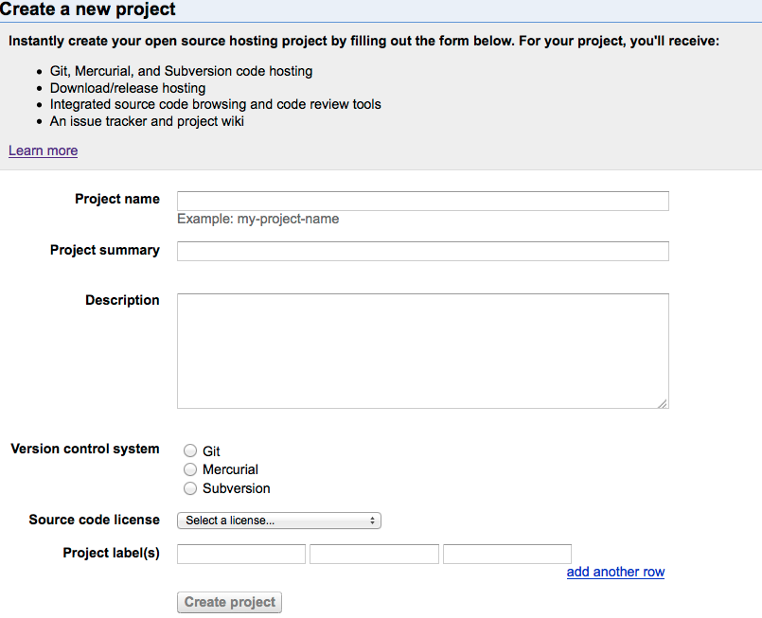

Slide 13
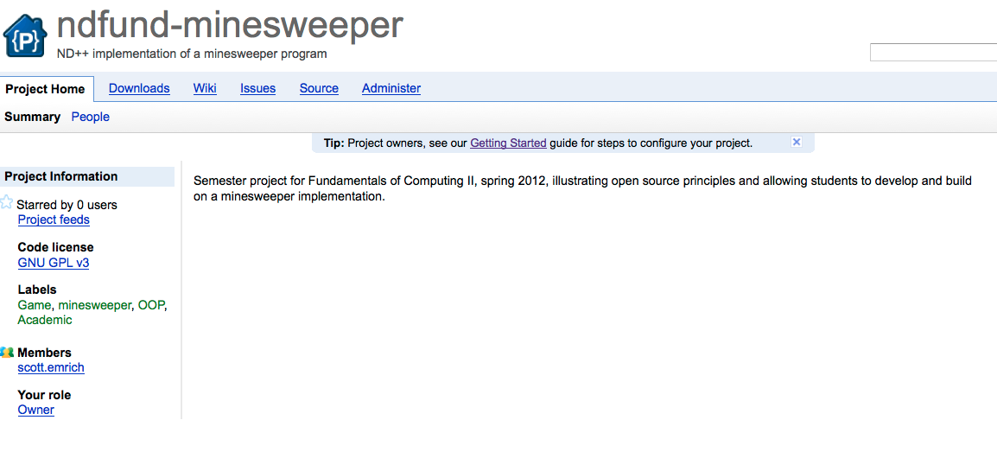

Slide 14
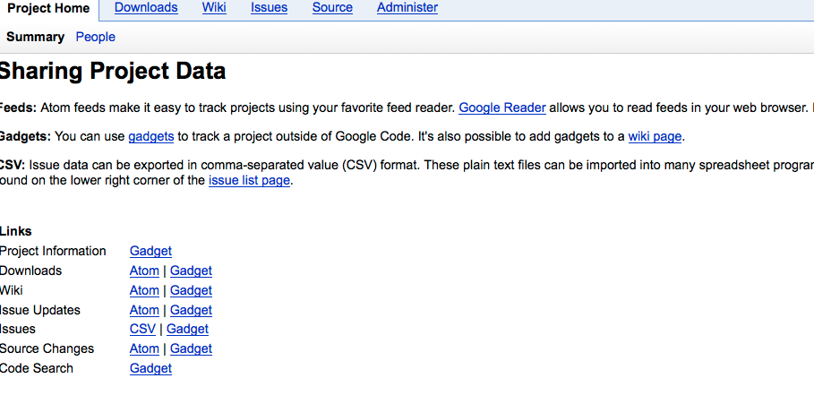

Slide 15
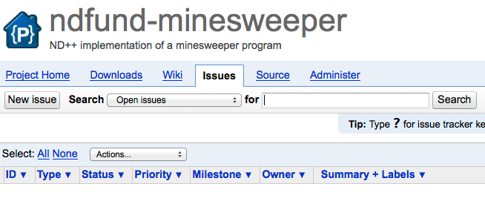

Slide 16
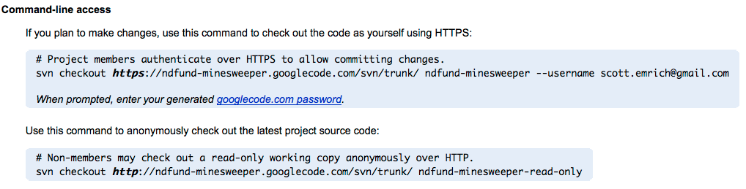
svn import https://ndfund-minesweeper.googlecode.com/svn/trunk/ --username scott.emrich@gmail.com -m "importing code for first time”
svn up https://ndfund-minesweeper.googlecode.com/svn/trunk/ --username scott.emrich@gmail.com

Slide 17
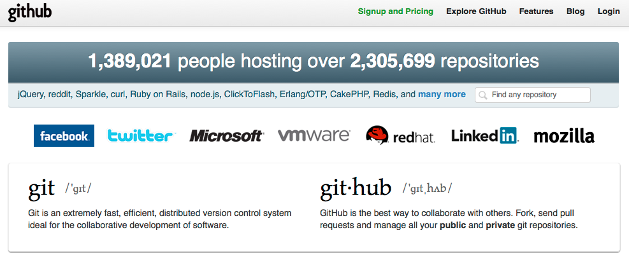

Slide 18
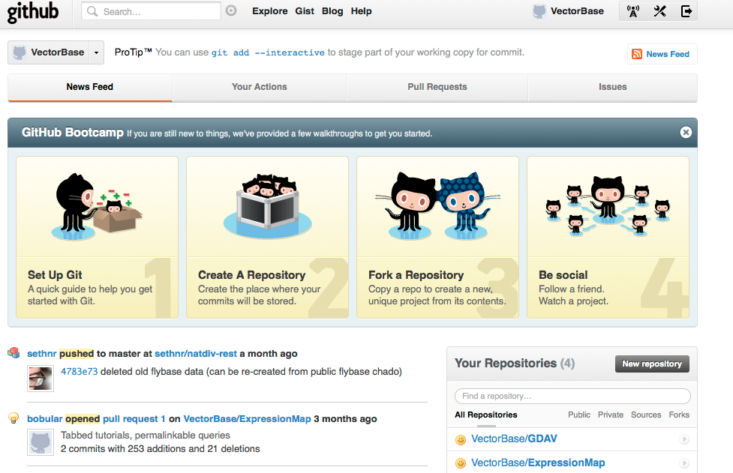

Slide 19
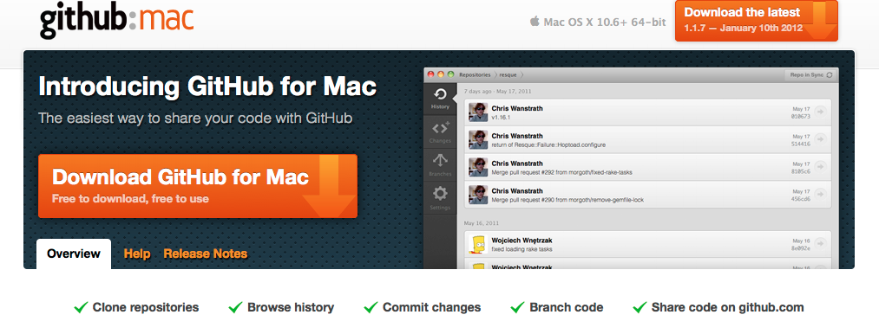

Slide 20
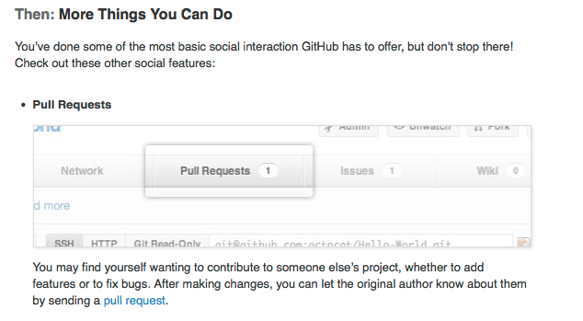
Release manager?

Slide 21
