Slide 1
Gcov Testing Primer
杨立峰
311155@qq.com
2013-05-20

Slide 2
Agenda
Motivation
The gcov Tool
An example using gcov
How does gcov do it
gcov subtleties
Further structural testing measures
Flowcharts
Structural testing and flowcharts
Minimal test suites
Path coverage
Testing loops

Slide 3
Motivation
Consider a typical programming project:
We have designed code based on requirements
We have also built in some additional features
Additional features interact with required features in various ways
We need to test code of additional features
We don’t remember what all of them are
Because new features are not mentioned in requirements, testing based on requirements will not help us
Consider a function to sort an array of integers
Requirements state only that resulting array must preserve original elements and be sorted
Many different algorithms exist for doing this
A test suite which tests one algorithm thoroughly may not test another

Slide 4
Motivation(Continued)
我们的问题是：
我们怎么知道测试了所有的代码？
有些代码我们的测试用例覆盖不到
这些没有覆盖代码用户执行到了
用户是这些代码第一个执行的人
第一个？嗯……你们懂的！
我们已经测试了所有的代码吗？
有工具可以帮助我们回答这个问题
这些工具统称为“代码覆盖工具”
帮助我们知道测试用例的测试覆盖率
这些工具通常针对某种编程语言
针对C/C++有开源的工具
貌似Java只有商业版的工具
我们只对C/C++

Slide 5
gcov
gcov: GNU Project coverage utility
基于早前的tcov
GNU Project:
Supplies free software
Created gcc compiler for C
Most Linux utility programs come from GNU Project
使用gcov (简介):
Compile your C program using gcc with special switches
Run your program normally
While running, your program will write information to special “log files”
After running test cases, run lcov
lcov will generate a coverage report listing which lines have been executed
我们将详细描述每一步

Slide 6
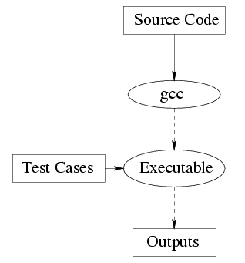
Normal Compilation of a Program
In the above diagram,
Inputs
Outputs
Normally, we just:
Compile a program from source code
Execute it on some selected test cases
Look at the output for correctness

Slide 7
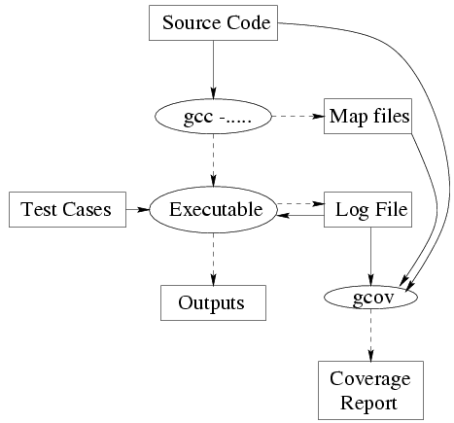
Compilation Using gcov
Compilation / execution with gcov is basically the same
However, extra switches to gcc cause extra things to happen
Switches: ­fprofile­arcs ­ftest­coverage
if (BUILD_APP STREQUAL "unittest")
cxx_test(protocol_parser "gtest_main")
endif()

Slide 8
Compilation Using gcov continued
When we compile with the extra switches, gcc does the following
extra things:
Generates “map file” of the blocks of code in our source files
Generates object code which counts the number of times each block of code has been executed
“Block of code”:
Any sequence of statements such that executing one of them guarantees we must execute the next one
Example (program protocol_parser_unittest.cc):
cxx_test(protocol_parser "gtest_main") gcc -g -O0 -­fprofile­arcs ­-ftest­coverage protocol_parser_unittest.cc
gcc generates map file wordcount.gcno
Exact format of the “map file” is not important to us

Slide 9
Running a gcov-Compiled Program
Run program as normal on test cases
First time program is run, a coverage data file appears (with extension .gcda)
Coverage data file contains information about how many times each line of code has been executed
Example:
After running protocol_parser_test, file protocol_parser_test.gcda is created
Coverage data is updated every subsequent time program is run
Coverage data is cumulative; e.g.
Line 42 executed 5 times on first run;
Line 42 executed 10 times on second run;
Therefore, coverage data stored in .gcda file shows 15 executions of line 42

Slide 10
Getting Information from .gcda
ADD_CUSTOM_TARGET(${_targetname}_lcov
# depend on the test
DEPENDS ${_targetname}_test
# remove output dir
COMMAND rm -rf ${_outputname}
# Cleanup lcov
COMMAND ${LCOV_PATH} --directory . --zerocounters
# make output dir
COMMAND mkdir -p ${_outputname}
# Run tests
COMMAND ${_targetname}_test
#COMMAND ${_testrunner} ${ARGV3}
# Capturing lcov counters and generating report
COMMAND ${LCOV_PATH} --directory . --capture --output-file ${_outputname}.info
COMMAND ${LCOV_PATH} --remove ${_outputname}.info 'testing/*' '/usr/*' --output-file ${_outputname}.info.cleaned
COMMAND ${GENHTML_PATH} -o ${_outputname} ${_outputname}.info.cleaned
COMMAND ${CMAKE_COMMAND} -E remove ${_outputname}.info ${_outputname}.info.cleaned
WORKING_DIRECTORY ${CMAKE_BINARY_DIR}
COMMENT "\nResetting code coverage counters to zero.\nProcessing code coverage counters and generating report."
)
Run lcov to capturing coverage data
lcov processing gcda, generating .info
genhtml reading .info file, generating html output

Slide 11
Measuring the Usefulness of a Test Suite
A good structural test suite will execute most lines of code
It may not be possible to execute all lines
Executing a large percentage may be acceptable
Hence, measure of code covered (% of lines executed) is a good measure of the usefulness of such a test suite
However, with gcov:
As we keep executing test cases, the .gcda file keeps getting updated
Therefore, to measure goodness of a test suite, what we would like to do is:
Reset all counts in .gcda file to 0
Run test suite
Run gcov and look at % of lines covered
To reset all counts in the .gcda file:
Just remove the file!
Your compiled code will:
Assume this is the first time it has been run again
Create the .gcda file anew

Slide 12
How Does gcov Do It?
Each block in code numbered
gcc inserts some code into your program at beginning of main, beginning of each block, end of main
At beginning of main:
Program zeros out a big array
During execution:
Every time block n executed, entry n of array incremented
At end of main:
If .gcda file does not exist, program creates it
Otherwise, program reads .gcda file, increments counts in array, writes out .gcda file again
Does similar processing for calls to exit() as at end of main
Map files map source line number to block
gcov program matches block execution counts in .da file with source lines

Slide 13
gcov Subtleties
If we compile and link many source files with the “gcov options”:
Each source file gets a .gcno file (the map file)
When we run the program, each source file gets a .gcda file (the coverage data file)
Thus, we can/must get a separate report from gcov on each separate source file
Useful if we are interested in coverage of each module of our program
Example:
We have a main program main.c and two modules, StackImplementation.c and IO.c
On compilation, we get main.gcno, StackImplementation.gcno and IO.gcno
Every time we run the program, files main.gcda, StackImplementation.gcda, and IO.gcda are updated
We can say gcov StackImplementation.c
Get a report on StackImplementation.c separately
Useful if that is the module we are interested in

Slide 14
gcov, Lines and Statements
Consider the following code:
scanf(“%d”, &x); /* Read x from terminal */
if (x >= 0) {
pos = 1;
}
printf(“%d %d \n”, x, pos);
We can execute 100% of lines in this code only if we input a positive number for x sometime
Now consider the following code:
scanf(“%d”, &x); /* Read x from terminal */
if (x >= 0) {pos = 1;}
printf(“%d %d\n”, x, pos);
We can execute 100% of lines in this code even if we input only negative numbers for x

Slide 15
gcov, Lines and Statements continued
Reason:
In second code fragment, the sub­statement pos = 1 of the if is on the same line as the if
We have executed the if in the sense that we have evaluated its condition (x>=0)
Line is considered executed even when only some of the code on it is executed
Moral: to ensure all statements executed:
Must put each statement on a separate line

Slide 16
Is gcov Enough?
gcov is OK for a simple analysis of the thoroughness of a test suite
It tells us what percentage of the lines of code we have executed
However, a test suite executing 100% of lines may still not catch some problems
Example: consider again the code
scanf(“%d”, &x); /* Read x from terminal */
if (x>=0) {
pos = 1;
}
printf(“%d %d\n”, x, pos);
If all tests in our test suite set x to a positive number, we can achieve 100% line coverage
However, we have still not tested the case in which x is negative or zero
That case might be handled incorrectly
For instance, maybe pos is supposed to be 1 if x is positive, and 0 otherwise
To talk about stronger measures of thoroughness, it is useful to have a graph of the program control flow

Slide 17
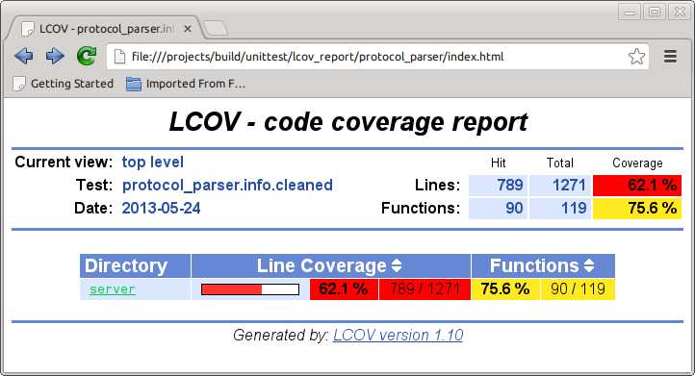
Screenshots

Slide 18
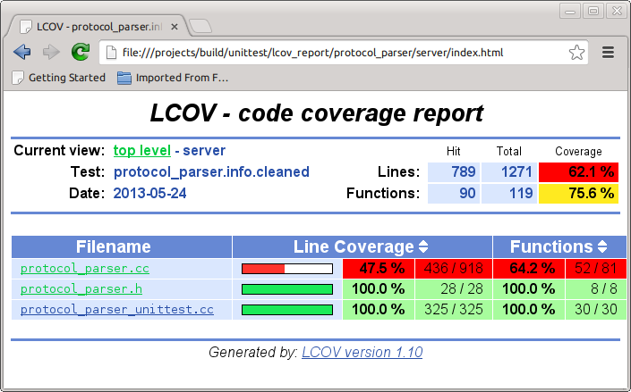
Screenshots

Slide 19
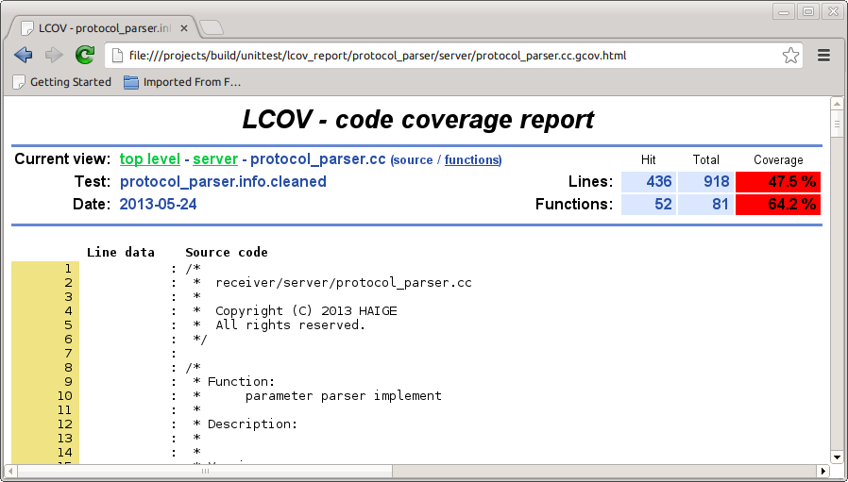
Screenshots

Slide 20
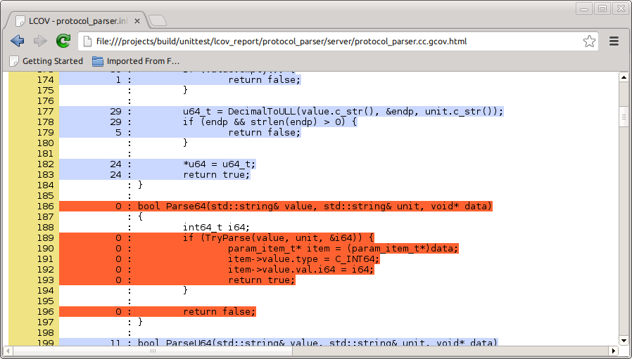
Screenshots

Slide 21
Demos
Please see it in the test machine
Several steps below:
Write test cases
Compile with -ftest-coverage -fprofile-arcs
Run
Generated files: xx.gcda, xx.gcno for coverage
LCOV
Generated files: covinfo for coverage
genhtml (generate html format coverage report)
Confirm test report(xx.xml)
Confirm coverage report

Slide 22
谢谢

