Slide 1
Linux kernel 2.6 Memory Management
杨立峰（Michael Yang）
311155@qq.com
Sep 20th, 2011
Rev 0.1
Notes:
Nortel Corporate Presentation
© 2004 Nortel

Slide 2
Agenda
Review the MMU of the different architecture
  MIPS architecture
  PowerPC architecture
  i386 series architecture
Linux Memory Management
  Multiple level pages system
  The description about the physical memory
  Boot Memory Allocation
  Buddy system
  Slab system
  Virtual address space & organization
  Memory Mapping
  On-demand page
  Copy on write
  RMAP
HAIGE CONFIDENTIAL

Slide 3
Review the MMU for different architecture (hardware)
HAIGE CONFIDENTIAL

Slide 4
What is MMU?
It is the abbreviation for the Memory Management Unit.
It resides in the CPU, which is a controller for being used to
manage the virtual memory and physical memory, and also it
is responsible for translating the virtual address to the physical
address and providing the protecting system in hardware level.
HAIGE CONFIDENTIAL

Slide 5
PowerPC MMU
  The feature of the MMU about the Classic PowerPC
  architecture is as follows:
      1. Support for the block address translation (BAT), page address translation (PAT).
      2. Support for the real mode.
      3. Fixed 4KB pages.
      4. Segmental memory model.
      5. Hardware page address translation.
      6. Support for the demand page.
HAIGE CONFIDENTIAL

Slide 6
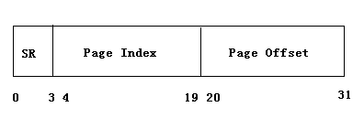
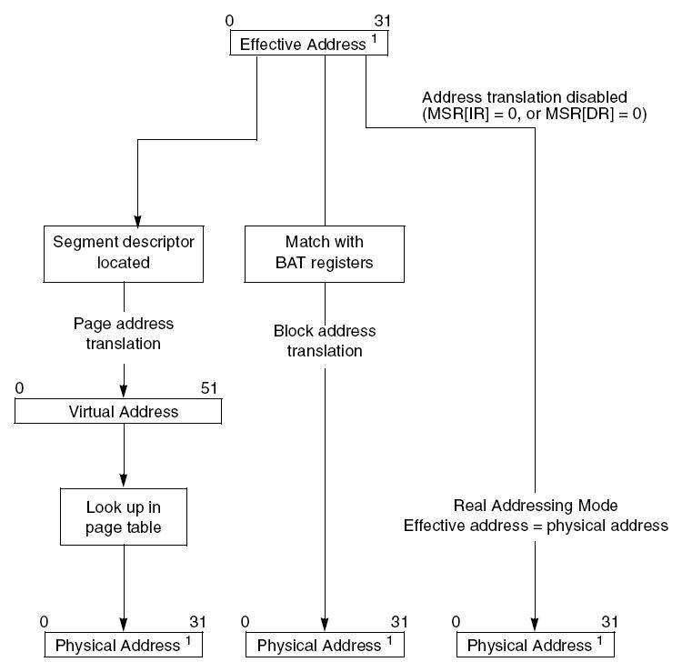
Address structure & translation
1
2
Segment number: 16
Segment size: 256M
Page size: 4KB
Page numbers in one segment: 65536
Max size: 4G
VSID: 24bits
Linear address: 52bits
Page Index + VSID = page entry index
TLB
HAIGE CONFIDENTIAL
Notes:
Nortel Corporate Presentation
© 2004 Nortel

Slide 7
  The feature of the MMU about the Enhanced PowerPC
  architecture is as follows:
  1. Support for the page address translation.
  2. Support for the both fixed and variable-sized page translation
  mechanism.
  3. No hardware table hashing and additional features that support
  management of page translation and protection in the TLB in
  software. We could access the TLB directly by the software. The
  exception will be generated, and we must search the destiny page via the software.
  4. Support for the demand page.
HAIGE CONFIDENTIAL

Slide 8
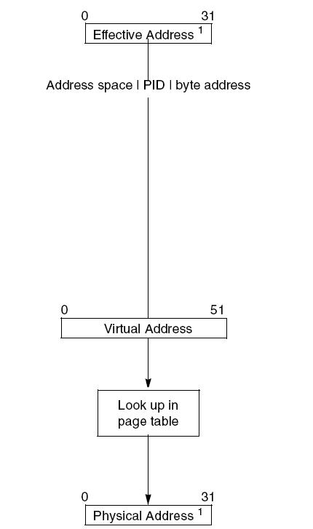
Translation
TLB match
HAIGE CONFIDENTIAL

Slide 9
  The feature of the MMU about the MIPS architecture is
  as follows:
  1. Support for the page address translation.
  2. No real-mode.
  3. Support for the both fixed and variable-sized page translation
  mechanism. (4KB, 16KB, 64KB, 256KB, 1MB, 4MB and 16MB)
  4. No hardware table hashing and additional features that
  support management of page translation and protection in the
  TLB in software. We could access the TLB directly by the
  software. If mismatching in the TLB, “refill” exception will be
  generated. We must search the destiny page via the software.
  5. Each TLB entry is doubled up to map two consecutive VPN to
  independently specified physical pages.
  6. Support for the demand page.
HAIGE CONFIDENTIAL

Slide 10
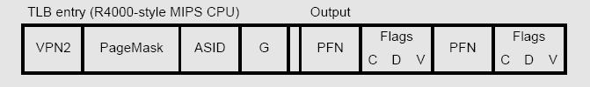
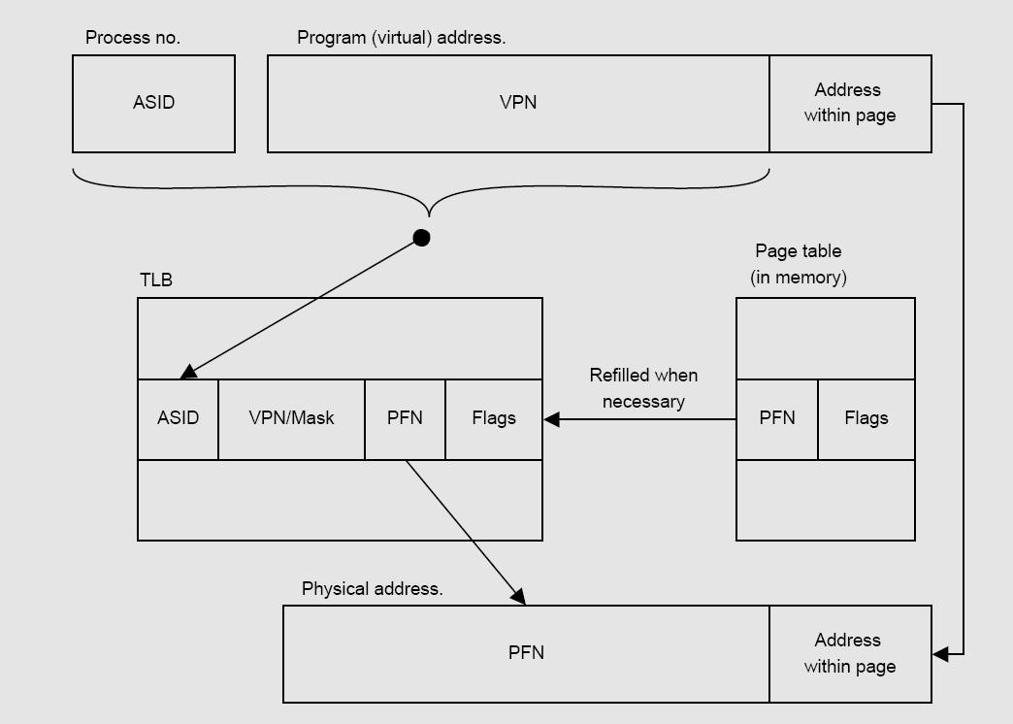
Address structure & translation
More detail:
<<See MIPS Run>>
HAIGE CONFIDENTIAL

Slide 11
  The feature of the MMU about the X86 architecture is
  as follows:
1. Support for the segmental-page memory management.
2. Support for the real mode and protected mode.
3. Support for the both fixed and variable-sized page
translation mechanism. Normally, the page size is 4KB.
(4KB, 2MB and 4MB)
4. Hardware page address translation definition with little
architected support for software management.
5. Support for the demand page.
HAIGE CONFIDENTIAL

Slide 12
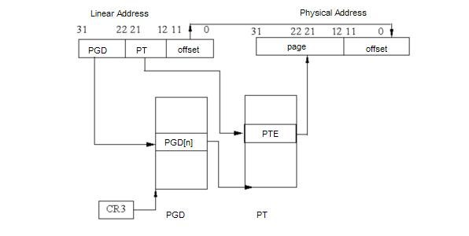
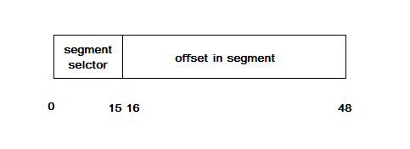
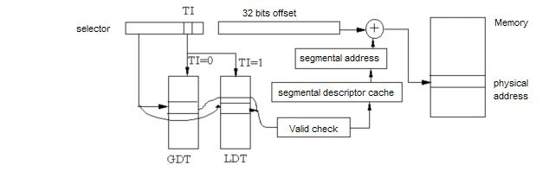
Address structure & translation
HAIGE CONFIDENTIAL

Slide 13
In LTE, the architecture of the OAM/Callp and BH card is MIPS;
the MAC card is the PowerPC architecture.
HAIGE CONFIDENTIAL

Slide 14
Linux kernel 2.6(4G) Memory Management
(software)
HAIGE CONFIDENTIAL

Slide 15
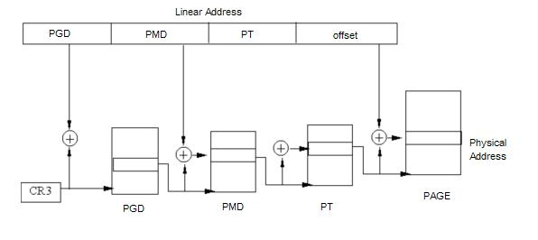
Multiple level page
The common paging model is adopted by the Linux 2.6 kernel,
4-level paging.
3-level paging
i386 2-level, PAE enabled 3-level, 64bits 3 or 4-level
PGD->PUD->PMD->PT
HAIGE CONFIDENTIAL

Slide 16
int __handle_mm_fault(struct mm_struct *mm, struct vm_area_struct *vma,
unsigned long address, int write_access)
{
pgd_t *pgd;
pud_t *pud;
pmd_t *pmd;
pte_t *pte;
__set_current_state(TASK_RUNNING);
count_vm_event(PGFAULT);
if (unlikely(is_vm_hugetlb_page(vma)))
return hugetlb_fault(mm, vma, address, write_access);
pgd = pgd_offset(mm, address);
pud = pud_alloc(mm, pgd, address);
if (!pud)
return VM_FAULT_OOM;
pmd = pmd_alloc(mm, pud, address);
if (!pmd)
return VM_FAULT_OOM;
pte = pte_alloc_map(mm, pmd, address);
if (!pte)
return VM_FAULT_OOM;
return handle_pte_fault(mm, vma, address, pte, pmd, write_access);
}
pud=pgd
pmd=pud=pgd
HAIGE CONFIDENTIAL

Slide 17
Describe about the physical memory
UMA (Uniform Memory Architecture): The CPU accesses any
address in the address space has the same time.
Example: SMP
NUMA (None-Uniform Memory Architecture): The CPU accesses
any address in the address space has no the same time.
Example: MPP
In the Linux
Node : Every UMA is corresponding with a Node. It is consisted of
several zones.
Zone : There are three types of the zone. They are DMA, NORMAL
and HIGHMEM.
Page : It is corresponding with a physical page frame, and consist
of the Zone.
HAIGE CONFIDENTIAL
Notes:
Nortel Corporate Presentation
© 2004 Nortel

Slide 18
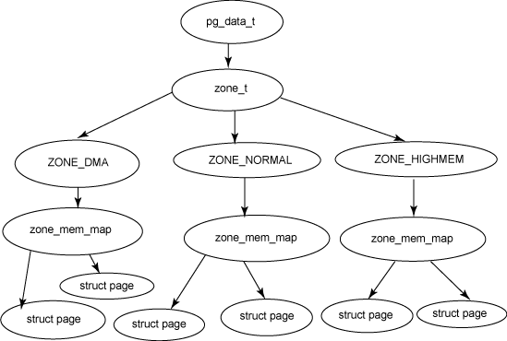
Relationship
HAIGE CONFIDENTIAL

Slide 19
HIGHMEM for x86
4G
FIXADDR
VMALLOC_END
vmalloc/vfree
kernel
VMALLOC_START
8MB
HIGHMEM
kmalloc/kfree
3G
User application/ system call sys_brk
0
The high memory(physical) could not be mapped by the kernel, need page table.
HAIGE CONFIDENTIAL

Slide 20
Data structure
struct page ;
typedef struct pglist_data {
..................
} pg_data_t;
struct zone;
HAIGE CONFIDENTIAL

Slide 21
Boot Memory allocation
This memory allocator is used in the booting stage.
Method: arch_mem_init
Initializing the memory bit map. (structure boot_mem_map)
struct boot_mem_map {
int nr_map;
struct boot_mem_map_entry {
phys_t addr; /* start of memory segment */
phys_t size; /* size of memory segment */
long type; /* type of memory segment */
} map[BOOT_MEM_MAP_MAX];
};
#define BOOT_MEM_RAM 1
#define BOOT_MEM_ROM_DATA 2
#define BOOT_MEM_RESERVED 3
HAIGE CONFIDENTIAL

Slide 22
The boot allocator will set up the memory bit map.
static inline void bootmem_init(void)
1. Initialize the bootmem_data_t structure. (low memory)
bootmap_size = init_bootmem_node(NODE_DATA(0), mapstart, min_low_pfn, max_low_pfn);
2. Initialize the bit map.
free_bootmem(PFN_PHYS(curr_pfn), PFN_PHYS(size));
3. Reserve the memory for the bitmap.
reserve_bootmem(PFN_PHYS(first_usable_pfn), bootmap_size);
Memory BIT Map
_end
bss
_edata
Bootmem.h/cc
data
_etext
One byte -> eight pages
Kernel code
_text
reserved
HAIGE CONFIDENTIAL

Slide 23
Buddy System
After the memory initialization, the kernel need set up a stable
and effective system for allocating and releasing a series of
the consecutive pages.
Firstly, the manager will allocate in the virtual address space,
and then allocate in the physical address space, at last, the
map from the virtual address to physical address will be set up.
The buddy system is used to organize the physical page frame
and provide the container for the pages.
HAIGE CONFIDENTIAL

Slide 24
Data structure:
struct free_area {
struct list_head free_list; // free pages list
unsigned long nr_free; // the number of the free pages
};
struct free_area free_area[MAX_ORDER];
0
nr_free = 2
1
nr_free = 2
2
nr_free = 1
MAX_ORDER -1
HAIGE CONFIDENTIAL

Slide 25
Allocating memory from the buddy system
struct page * fastcall
__alloc_pages(gfp_t gfp_mask, unsigned int order,
struct zonelist *zonelist);
static struct page *
get_page_from_freelist(gfp_t gfp_mask, unsigned int order,
struct zonelist *zonelist, int alloc_flags)
[note]: if order = 0, then allocating the page from the cold/hot page queue.
static struct page *__rmqueue(struct zone *zone, unsigned int order);
static inline void expand(struct zone *zone, struct page *page,
int low, int high, struct free_area *area);
Releasing the memory
fastcall void __free_pages(struct page *page, unsigned int order);
[note]: if order = 0, then releasing the page into hot queue.
static void __free_pages_ok(struct page *page, unsigned int order)
HAIGE CONFIDENTIAL
Notes:
Nortel Corporate Presentation
© 2004 Nortel

Slide 26
Cold & Hot pages
In every CPU, there are two queues which are the hot/cold page queue.
When the releasing the page which size is one page size(4KB), this page will
be put into the hot page queue until the queue is up to the high water mark, at
this time, these pages will be released to the buddy system.
Releasing the pages:
if (pcp->count >= pcp->high) {
free_pages_bulk(zone, pcp->batch, &pcp->list, 0);
pcp->count -= pcp->batch;
}
2. If you want to apply one page, allocating the pages from the cold or hot page queue which is
decided by the caller. If the queue is empty, the system will refill the queue from the buddy
system.
Allocating the pages:
if (!pcp->count) {
pcp->count += rmqueue_bulk(zone, 0,
pcp->batch, &pcp->list);
if (unlikely(!pcp->count))
goto failed;
}
HAIGE CONFIDENTIAL

Slide 27
User application allocates the memory from heap. (hot pages
queue)
static inline int handle_pte_fault(struct mm_struct *mm,
struct vm_area_struct *vma, unsigned long address,
pte_t *pte, pmd_t *pmd, int write_access)
static int do_anonymous_page(struct mm_struct *mm, struct vm_area_struct *vma,
unsigned long address, pte_t *page_table, pmd_t *pmd,
int write_access)
static inline struct page *
alloc_zeroed_user_highpage(struct vm_area_struct *vma, unsigned long vaddr)
struct page *
alloc_page_vma(gfp_t gfp, struct vm_area_struct *vma, unsigned long addr)
HAIGE CONFIDENTIAL

Slide 28
User application maps the file into memory from the disk. (cold pages queue)
static inline int handle_pte_fault(struct mm_struct *mm,
struct vm_area_struct *vma, unsigned long address,
pte_t *pte, pmd_t *pmd, int write_access)
static int do_no_page(struct mm_struct *mm, struct vm_area_struct *vma,
unsigned long address, pte_t *page_table, pmd_t *pmd,
int write_access)
static struct vm_operations_struct linvfs_file_vm_ops = {
.nopage = filemap_nopage,
.populate = filemap_populate,
};
static int fastcall page_cache_read(struct file * file, unsigned long offset)
static inline struct page *page_cache_alloc_cold(struct address_space *x)
HAIGE CONFIDENTIAL

Slide 29
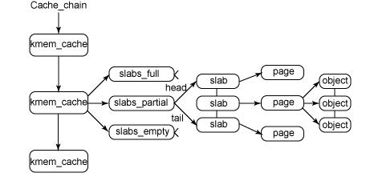
Slab
The SLAB is object-oriented conception for managing the memory
in kernel, which is put forward in SUN OS 2.2. It is a series of
consecutive pages. It is used to reduce the accessing of the buddy
system.
HAIGE CONFIDENTIAL

Slide 30
Data structure
struct slab;
struct kmem_cache;
Functions
static inline void *kmalloc(size_t size, gfp_t flags);
void kfree(const void *objp);
HAIGE CONFIDENTIAL

Slide 31
The free memory procedure:
1. Converting the virtual address which will be released into page, and then in terms of
the page structure, the cache will be gotten.
2. For every CPU, there is an array cache for optimization. The object will be released
into the cache in batch, if the array cache is full, and then, release all the objects from
the array cache into slab
if (likely(ac->avail < ac->limit)) {
STATS_INC_FREEHIT(cachep);
ac->entry[ac->avail++] = objp;
return;
} else {
STATS_INC_FREEMISS(cachep);
cache_flusharray(cachep, ac);
ac->entry[ac->avail++] = objp;
}
Data structure
HAIGE CONFIDENTIAL

Slide 32
/*
* struct array_cache
*
* Purpose:
* - LIFO ordering, to hand out cache-warm objects from _alloc
* - reduce the number of linked list operations
* - reduce spinlock operations
*
* The limit is stored in the per-cpu structure to reduce the data cache
* footprint.
*
*/
struct array_cache {
unsigned int avail;
unsigned int limit;
unsigned int batchcount;
unsigned int touched;
spinlock_t lock;
void *entry[0];
};
HAIGE CONFIDENTIAL

Slide 33
Flushing the cache array
if (l3->shared) {
struct array_cache *shared_array = l3->shared;
int max = shared_array->limit - shared_array->avail;
if (max) {
if (batchcount > max)
batchcount = max;
memcpy(&(shared_array->entry[shared_array->avail]),
ac->entry, sizeof(void *) * batchcount);
shared_array->avail += batchcount;
goto free_done;
}
}
free_block(cachep, ac->entry, batchcount, node);
HAIGE CONFIDENTIAL

Slide 34
The procedure of allocating memory:
1. Getting the object from the array cache.
2. If the array cache is empty, then re-fill the cache from the slab cache.
if (likely(ac->avail)) {
STATS_INC_ALLOCHIT(cachep);
ac->touched = 1;
objp = ac->entry[--ac->avail];
} else {
STATS_INC_ALLOCMISS(cachep);
objp = cache_alloc_refill(cachep, flags);
}
HAIGE CONFIDENTIAL

Slide 35
The management about the virtual address space
Data structure
struct mm_struct;
struct vm_area_struct;
    1. One process owns one mm_struct structure, which describes the whole user address space.
    2. Multiple virtual address zones are consisted of the virtual address space.
    3. These virtual address zones are organized by the red-black tree.
    4.Putting the last accessing zone into the mmap_cache field.
HAIGE CONFIDENTIAL

Slide 36
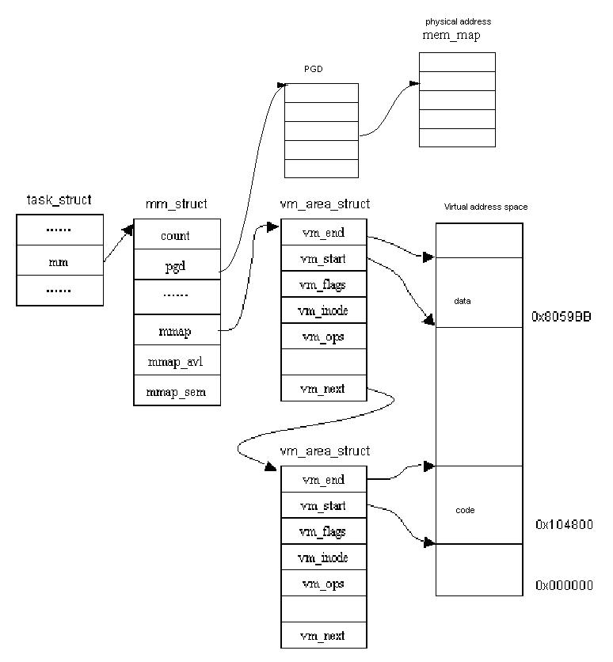
HAIGE CONFIDENTIAL

Slide 37
What is the virtual address zone?
It is used to describe a virtual address segment, including the file mapping,
dynamic library mapping and common memory zone.
How does the kernel allocate the dynamic memory?
Allocating the space for the process in the virtual address space.
2. If the R/W the space which was allocated before, the physical address space
will be allocated.
HAIGE CONFIDENTIAL

Slide 38
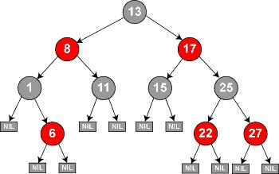
Red-Black tree
1. The time of searching, deleting and inserting is O (log n).
2. The node is either red or black.
3. The root node is black.
4. If one node is red, the child node must be black.
5. There are same numbers of the black node from any node to the leaf node.
HAIGE CONFIDENTIAL

Slide 39
Data structure
struct rb_node
{
struct rb_node *rb_parent;
int rb_color;
#define RB_RED 0
#define RB_BLACK 1
struct rb_node *rb_right;
struct rb_node *rb_left;
};
The implementation is Rbtree.c.
I think it is a good library for reusing via object-oriented encapsulation.
HAIGE CONFIDENTIAL

Slide 40
Core functions
struct vm_area_struct * find_vma(struct mm_struct * mm, unsigned long addr);
Looking up the first VMA which satisfies addr < vm_end.
1. Checking the cache first. (Cache hit rate is typically around 35%.)
2. Checking the red-black tree. If it is found, it will be saved into the cache.
If it is not found, it will return NULL.
unsigned long do_brk(unsigned long addr, unsigned long len);
1. Creating the vm_struct structure with kmem_cache_alloc from slab.
2. Initializing the structure.
3. Inserting the vm into red-black tree.
[note]: which is called by system call sys_brk.
HAIGE CONFIDENTIAL

Slide 41
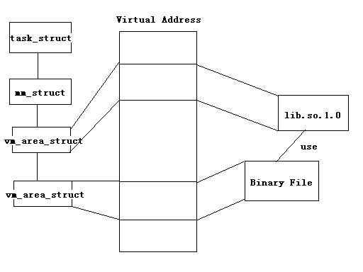
Memory Mapping
Conception: When the binary image begins to execute, the executive file and
the dynamic libraries which are used by the binary image will be linked into the
virtual address space of the process. The real physical memory will not be
allocated until the program is executed. The binary image will be described by
the vm_area_struct structure.
HAIGE CONFIDENTIAL

Slide 42
Core functions
static inline unsigned long do_mmap(struct file *file, unsigned long addr,
unsigned long len, unsigned long prot,
unsigned long flag, unsigned long offset);
unsigned long do_mmap_pgoff(struct file * file, unsigned long addr,
unsigned long len, unsigned long prot,
unsigned long flags, unsigned long pgoff);
1. Looking up the vm_area_struct in the red-black tree of the current process.
munmap_back:
vma = find_vma_prepare(mm, addr, &prev, &rb_link, &rb_parent);
if (vma && vma->vm_start < addr + len) {
if (do_munmap(mm, addr, len))
return -ENOMEM;
goto munmap_back;
}
HAIGE CONFIDENTIAL

Slide 43
2. Allocating the vm_area_struct structure by the slab allocator.
vma = kmem_cache_alloc(vm_area_cachep, SLAB_KERNEL);
if (!vma) {
error = -ENOMEM;
goto unacct_error;
}
memset(vma, 0, sizeof(*vma));
vma->vm_mm = mm;
vma->vm_start = addr;
vma->vm_end = addr + len;
vma->vm_flags = vm_flags;
vma->vm_page_prot = protection_map[vm_flags & 0x0f];
vma->vm_pgoff = pgoff;
3. Linking the vm_area_struct into the red-black tree.
vma_link(mm, vma, prev, rb_link, rb_parent);
HAIGE CONFIDENTIAL

Slide 44
On-Demand page
It is a dynamic memory allocating technique. The allocating of the physical page
will be delayed as late as it could be. The page fault will be raised.
Advantage: Enhancing the throughput of the system, and improving
the efficiency of the memory.
Disadvantage: Take more cycle of the CPU for handling the page fault exception.
HAIGE CONFIDENTIAL

Slide 45
Core functions
int __handle_mm_fault(struct mm_struct *mm, struct vm_area_struct *vma,
unsigned long address, int write_access)；
Allocating the page table, page directory item and middle page directory.
pgd = pgd_offset(mm, address);
pud = pud_alloc(mm, pgd, address);
if (!pud)
return VM_FAULT_OOM;
pmd = pmd_alloc(mm, pud, address);
if (!pmd)
return VM_FAULT_OOM;
pte = pte_alloc_map(mm, pmd, address);
if (!pte)
return VM_FAULT_OOM;
HAIGE CONFIDENTIAL

Slide 46
static inline int handle_pte_fault(struct mm_struct *mm,
struct vm_area_struct *vma, unsigned long address,
pte_t *pte, pmd_t *pmd, int write_access);
if (!pte_present(entry)) {
if (pte_none(entry)) {
if (!vma->vm_ops || !vma->vm_ops->nopage)
return do_anonymous_page(mm, vma, address,
pte, pmd, write_access);
return do_no_page(mm, vma, address,
pte, pmd, write_access);
}
static int do_no_page(struct mm_struct *mm, struct vm_area_struct *vma,
unsigned long address, pte_t *page_table, pmd_t *pmd,
int write_access);
new_page = vma->vm_ops->nopage(vma, address & PAGE_MASK, &ret);
HAIGE CONFIDENTIAL

Slide 47
COW (Copy on write)
  When creating the child process, the parent process will shared the address space
  with the child process, that means the page directory table and page table will be
  shared.
  Once the page is shared with different process, it could not be modified. If the page
  is tried to modify, the page fault will be generated, the COW will occur.
  The new page will be generated, and the content in the old page will be copied into
  the new page, and open the writing permission for the new page.
  When one process tries to write the old page, if the process is the only owner of the
  page, the writing permission will be opened.
HAIGE CONFIDENTIAL

Slide 48
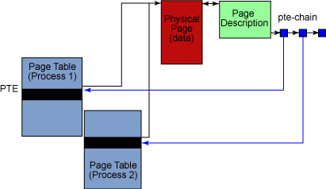
RMAP
The kswapd kernel thread will switch some pages into swap disk if the memory is not enough for current running process by the swapping algorithm. At this time, the kswapd will decide the page table of these pages which will be switched into disk. So it will traverse all the tables of the processes. It is time
consuming.
Rmap.c/h
page->vm_area_struct->mm_struct->pte
Advantage: the performance of the swapping is enhanced.
Disadvantage: More memory will be used.
HAIGE CONFIDENTIAL

Slide 49
vmscan.c -> shrink_page_list
if (page_mapped(page) && mapping) {
switch (try_to_unmap(page, 0)) {
case SWAP_FAIL:
goto activate_locked;
case SWAP_AGAIN:
goto keep_locked;
case SWAP_SUCCESS:
; /* try to free the page below */
}
}
Rmap.c->try_to_unmap_anon
anon_vma = page_lock_anon_vma(page);
list_for_each_entry(vma, &anon_vma->head, anon_vma_node) {
ret = try_to_unmap_one(page, vma, migration);
if (ret == SWAP_FAIL || !page_mapped(page))
break;
}
Rmap.c->try_to_unmap_one
struct mm_struct *mm = vma->vm_mm;
pte = page_check_address(page, mm, address, &ptl);
page_remove_rmap(page, vma);
HAIGE CONFIDENTIAL

Slide 50
void page_add_anon_rmap(struct page *page,
struct vm_area_struct *vma, unsigned long address)
{
if (atomic_inc_and_test(&page->_mapcount))
__page_set_anon_rmap(page, vma, address);
/* else checking page index and mapping is racy */
}
static void __page_set_anon_rmap(struct page *page,
struct vm_area_struct *vma, unsigned long address)
{
struct anon_vma *anon_vma = vma->anon_vma;
BUG_ON(!anon_vma);
anon_vma = (void *) anon_vma + PAGE_MAPPING_ANON;
page->mapping = (struct address_space *) anon_vma;
page->index = linear_page_index(vma, address);
/*
* nr_mapped state can be updated without turning off
* interrupts because it is not modified via interrupt.
*/
__inc_zone_page_state(page, NR_ANON_PAGES);
}
HAIGE CONFIDENTIAL

Slide 51
Q & A
HAIGE CONFIDENTIAL

