Slide 1
Linux Device Driver and Concurrency
杨立峰（Michael Yang）
311155@qq.com
Sep 20th, 2011

Slide 2
Agenda
Linux Device Drivers
  Overview
  Classes and Modules
Concurrency and Race condition
  Overview
  Semaphores and Mutexes
  Spin lock
  Completions
  Per-CPU variable
  Atomic operation
  Appendix

Slide 3
Linux device driver overview
Loadable Module
  configured in the kernel
Load/unload a module (module para)
  Insmod/rmmod/lsmod
Driver debug tech
  Printk/proc/kdb
Device file /dev
  Block/char

Slide 4
Overview -- structure
static int hello_init(void)
{
  Probe/Register
  …
return 0;
}
static void hello_exit(void)
{
  cleanup
}
module_init(hello_init);
module_exit(hello_exit);

Slide 5
Important data structure
struct file_operations {
struct module *owner;
loff_t (*llseek) (struct file *, loff_t, int);
ssize_t (*read) (struct file *, char __user *, size_t, loff_t *);
ssize_t (*write) (struct file *, const char __user *, size_t, loff_t *);
int (*ioctl) (struct inode *, struct file *, unsigned int, unsigned long);
int (*open) (struct inode *, struct file *);
int (*release) (struct inode *, struct file *);
….
};

Slide 6
Classes and Modules
3 fundamental devices
Char device
  accessed as a stream of bytes
  Usually implement open, close, read, write system calls.
  Each device has a device file: e.g. /dev/ttyS0
Block device
  Accessed in one or more blocks (e.g. 512bytes a block)
  E.g. disk/flash
Network device
  Accessed via interface (a hw device for recv/send packets).
  Has a name (E.g. eth1), but no device file

Slide 7
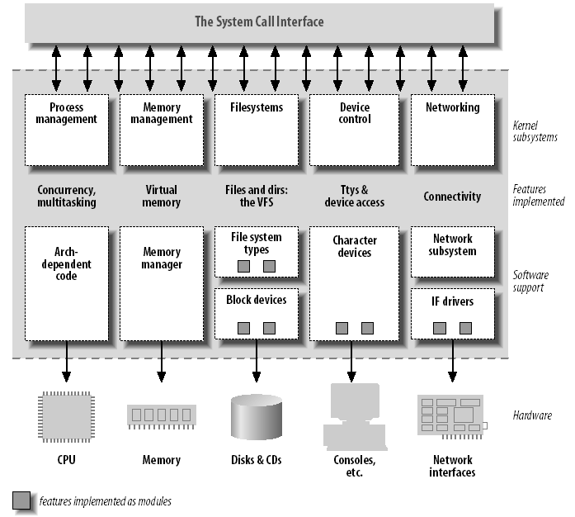
Classes and Modules

Slide 8
Agenda
Linux Device Drivers
  Overview
  Classes and Modules
Concurrency and Race condition
  Overview
  Semaphores and Mutexes
  Spin lock
  Completions
  Per-CPU variable
  Atomic operation
  Appendix

Slide 9
Overview – 1/2
  Early Linux kernels
    No SMP, only interrupt needs concurrency
  Race condition
    A result of uncontrolled access to the shared resources, which can leads to memory leak (scull example), system crash, etc.
  Concurrency sources
    multi processes
    multi CPU
    Interrupt
    Tasklet
    Timer
    Waitqueue
    etc.

Slide 10
Overview – 2/2
Principles
    To avoid shared resource if possible (e.g. don’t use global variable, etc)
    Hard rule of resource sharing by >1 threads: explicit manage access to it (usually using: locking or mutex)
    Resource must exist if outside reference to it exists. So, driver must track its ref.
Fine-grained VS. coarse-grained lock
    Big kernel lock on SMP in early kernel (v2.0) – waiting lock on other CPUs
    Now, thousands of locks, each for a small critical region. – easy for bug.

Slide 11
Agenda
Linux Device Drivers
  Overview
  Classes and Modules
Concurrency and Race condition
  Overview
  Semaphores and Mutexes
  Spin lock
  Completions
  Per-CPU variable
  Atomic operation
  Appendix

Slide 12
Semaphores and mutexes 1/2 Overview
Goal: make the operation atomic
Blocked/Sleep (yield the CPU) if critical region is busy
Semaphores: P(decremented the integer),V(Increment the integer and wake up the sleeping proccesses)
Semaphores: initial value is set to 1 for mutex (mutual exclusion).
Notes:
Almost all semaphores are used as mutex in Linux kernel.

Slide 13
Semaphores and mutexes 2/2
(asm/semaphore.h)
Init
  Sem_init(struct semaphore *sem, int val)
  DECLARE_MUTEX(name)
  Init_MUTEX(struct semaphore *sem)
Down (P)
  Void Down(struct semaphore *sem); //deprecated
  Int Down_interruptible(struct semaphore *sem) // used mostly, see note
  Int Down_trylock(struct semaphore *sem)
Up (V) // Only one function
  Up(struct semaphore *sem);
UDM examples
  udm_ethDrv.c
  udm_mdio.c
Notes:
Down_interruptible(struct semaphore *sem)
The interruptible version is almost always the one you want. Allow the user space process that is waiting on a semaphore to be interrupted. Can avoid dead lock.
/**
* down_interruptible - acquire the semaphore unless interrupted
* @sem: the semaphore to be acquired
*
* Attempts to acquire the semaphore. If no more tasks are allowed to
* acquire the semaphore, calling this function will put the task to sleep.
* If the sleep is interrupted by a signal, this function will return -EINTR.
* If the semaphore is successfully acquired, this function returns 0.
*/
Int Down_trylock(struct semaphore *sem)
No sleep, return a non-zero number immediately if the sema is not available.
信号量是进程级别的，用于多个进程之间对资源的互斥，虽然也是在内核中，但是该内核执行路径是以进程的身份，代表进程来竞争资源的。如果竞争失败，就会发生进程上下文切换，当前进程进入睡眠状态，CPU将运行其他进程。鉴于进程上下文切换的开销也很大，因此只有当进程占用资源时间较长时，用信号量才是较好的选择。当所要保护的临界区访问时间比较短时，用自旋锁是非常方便的，因为它节省上下文切换的时间。但是CPU得不到自旋锁会在那里空转知道其他执行单元解锁为止。所以要求锁不能在临界区里常时间停留，否则会降低系统的效率。
自旋锁对信号量
------------------------------------------------------
需求 建议的加锁方法
低开销加锁 优先使用自旋锁
短期锁定 优先使用自旋锁
长期加锁 优先使用信号量
中断上下文中加锁 使用自旋锁
持有锁是需要睡眠、调度 使用信号量

Slide 14
Read/write semaphores
(linux/rwsem.h)
Why?
  Multiple readers are allowed, so improve reader performance.
  Writer has a high priority
Problem
  Reader may starve
When to use?
  In the situation where writer is rare.

Slide 15
Rwsem interface
Init
  Init_rwsem(struct rw_semaphore *sem);
Down
  Void down_read(*rwsem);
  Void down_read_trylock(*rwsem);
Up
  Up_read(*sem);
The same for write interface

Slide 16
Agenda
Linux Device Drivers
  Overview
  Classes and Modules
Concurrency and Race condition
  Overview
  Semaphores and Mutexes
  Spin lock
  Completions
  Per-CPU variable
  Atomic operation
  Appendix

Slide 17
Spin lock
Why use spin lock?
  In case the code can’t sleep, e.g. interrupt handler
Similar to mutex, but only has 2 values: locked/unlocked.
How?
  Go into tight loop (spin) if critical is already locked, and repeatedly check the lock.
  Uninterruptible once wait for spin lock – will spin
When to use?
  Spin lock intend for multiple CPU
  Uni-processor with preemptive kernel (behave as SMP) can also use it.
Notes:
“test and set” operation must be done in atomic mode.

Slide 18
Scenarios for dead lock
Scenarios 1 – solution: Disable local CPU interrupt (inf)
  Code A takes a spin lock
  An interrupt occurs, and the handler will take the same spin lock
  CPU turn to interrupt handler code B, code B will spin forever.
Scenario 2 – solution: Disable preemption (always)
  On uni-processor system
  Code A takes a spin lock
  A preemption task running (high priority) also needs the spin lock
  CPU turn to new task and spin forever.

Slide 19
Spin lock -- rules
Kernel code that holds a spin lock can’t sleep
Disable preemption
  To avoid deadlock.
Must hold a spin lock for min time
  To avoid high priority task waiting.

Slide 20
Spin lock API
Void Spin_lock_init(spinlock_t *lock);
Lock API
  Void Spin_lock(lock); // interrupt enabled
  Void spin_lock_irqsave(lock, flags); //disable local irq
  Void spin_lock_irq(lock); //disable local irq, not save flag
  Void spin_lock_bh(lock) //disable sw irq, enable hw irq.
Unlock APIs
  4 APIs responding to lock API.
Try version spin lock API: with interrupt enabled
  Int spin_try_lock(lock);
  Int spin_try_lock_bh(lock); //disable sw interrupt
Read/write spin lock
  Similar to r/w semaphore
Notes:
For those spin lock which can be used by interrupt handler, it must be locked with interrupt disabled.
For those spin lock which can be used by sw interrupt handler but not used by hw interrupt, spinlock_bh(lock) can be used.

Slide 21
Agenda
Linux Device Drivers
  Overview
  Classes and Modules
Concurrency and Race condition
  Overview
  Semaphores and Mutexes
  Spin lock
  Completion
  Per-CPU variable
  Atomic operation
  Appendix

Slide 22
completion
Completion: light-weight mechanism, allow one thread to tell another the job is done.
Interface:
  DECLARE_COMPLETION(comp);
  Init_completion(comp);
  Wait_for_completion(comp); //uninterruptible
  Complete(comp);

Slide 23
Completion -- typical use
USB module uninstall
  Run module cleanup
  Module waiting for the USB thread to be finished (e.g. is still in copying…)
  USB thread send complete() when finish
  USB module exit
  See driver/usb/storage/usb.c for detail.

Slide 24
Agenda
Linux Device Drivers
  Overview
  Classes and Modules
Concurrency and Race condition
  Overview
  Semaphores and Mutexes
  Spin lock
  Completion
  Per-CPU variable
  Atomic operation
  Appendix

Slide 25
Per-CPU variable
The simplest and most efficient synchronization mechanism
An array of data structure, 1 element for 1 CPU.
Prone to preemption (preemption should be disabled).
Can’t provide protection against interrupt/swirq, etc. Additional mechanism should be used.
API
  DEFINE_PER_CPU(type, name)
  Per_cpu(name, cpu); / __get_cpu_var(name)
  Get_cpu_var(name)
  Put_cpu_var(name)
  …
Example: per cpu time (in cpu_clock() for printk time)

Slide 26
Agenda
Linux Device Drivers
  Overview
  Classes and Modules
Concurrency and Race condition
  Overview
  Semaphores and Mutexes
  Spin lock
  Completion
  Per-CPU variable
  Atomic operation
  Appendix

Slide 27
Atomic operation
Being executed without being interrupted (e.g. read-modify-write)
Must be defined as type: atomic_t.
API (bit / var):
  Atomic_add(v,i);
  Atomic_inc(v);
  Atomic_dec(v);
  clear_bit(nr, addr);
  Set_bit(nr, addr);
  … …

Slide 28
Agenda
Linux Device Drivers
  Overview
  Classes and Modules
Concurrency and Race condition
  Overview
  Semaphores and Mutexes
  Spin lock
  Completion
  Per-CPU variable
  Atomic operation
  Appendix

Slide 29
Appendix 1 – Deadlock
Try to acquire a lock twice – Be careful
  Function A acquire a lock
  Function A call function B, which also try to get the lock
  Leads to deadlock.
To get 2 locks – get the locks in the same order (local lock first, then external lock )
  Function A try to acquire lock x, then y
  Function B try to acquire lock y, then x
  Deadlock: A wait for y, B wait for x

Slide 30
Appendix 2
Read-Copy-Update: rcupdate.h
  Used when readers are common, writers are rare.
  Should be accessed via pointer (for change)
  Write: copy->change copy->update to new version
  E.g. route table
Alternatives to locking
  Recast your algorithm to be lock free (Kfifo.h )
    e.g. circular buffer (network adaptor). Seqlock: appear in 2.6
  Used for frequently reader access, and with rare writers
    Reader check the sequence value on exit, if mismatch, re-do.
    Writer will change sequence value on entering critical region.

Slide 31
References:
Understanding the Linux kernel, 3rd edition.
Linux device driver, 3rd edition.
Linux kernel source code.

Slide 32
Thanks!

