Slide 1
CSE 5330
Course and Project Experience
Team-09
Sameer Miriyala (UTA ID: 1002024871)
Mayukha Thumiki (UTA ID: 1002055616)
Venkata Sai Hemanth Narayana (UTA ID: 10020892)
Mrunmai Nitin Magar (UTA ID: 1002092125)

Slide 2
Project
Fresh Food System offers four categories.
Meat, Poultry and Seafood.
Meals, Baked and Grilled items.
Juices, fruits and vegetables.
Dairy Products.
Two types of order types.
Delivery.
In-store pickup.
Delivery within a 30-mile distance. Delivery pilots will be available in the open hours.
Customer has an option to place the orders online and can pickup from the store.
Self pickup will avoid long distance lines.

Slide 3
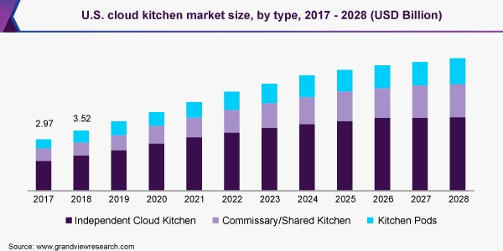
Project
A Commercial platform - City Storage System, Cloud Kitchen.
Less Maintenance expenditure.
Low Overhead Cost.
Convenience for customer.
(Source : www.grandviewresearch.com)

Slide 4
Project Overview
3-4 tables for each interacting entities:-
Employee
Department
Product
Sales
Order
Order Details
Customer
Tables rows size of approximately 40-60 (150-160 rows for Product table).
CSE5330: <Team-09>

Slide 5
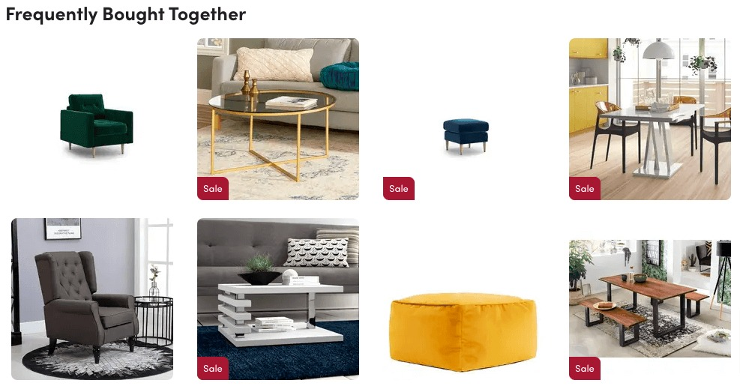
Project Goal
Met all business goals and most interesting goal is ‘highest frequently bought together products’
Involves 3 entities namely:
Product
Orders

Slide 6
Project Takeaway
Individual research on each category.
Group discussions and suggestions for improvements.
Phase 5, involves UI design.
Provide privileges to fresh food Pro Customers
Free delivery
Prioritizing the order
Exclusive discounts on certain products.

Slide 7
Project Takeaway
Perfectly balanced with the lectures in the classroom.
Practical experience along with subject knowledge
Hands-on Experience
Pragmatic and clear idea about how to toy databases work
All techies interact with the database
How to break down large tasks into smaller chunks
How to meet all business goals within applied constraints
Detailed planning is essential to ensure that a project goes smoothly.

Slide 8
Overall Feedback
Having weekly improvement reports within the team.
Automatically populate the data into the database without having to write 100s of insert queries.
Awarding bonus points for class participation.
5 min breakout sessions to share their opinions, knowledge and experience.
Bonus questions in the test.
Self Testing Techniques.

Slide 9
General
We learned important skills that will help us grow in our professional career.
Test were tricky and challenging
Study Material and recorded sessions were extremely helpful.

Slide 10
Discussion

