Slide 1
Maverick Activity Centre
Hruthik Reddy Chada-1002116689
Mrunmai Nitin Magar-1002092125

Slide 2
Agenda
Introduction
SDLC approach
Planning
Implementation
Testing
Maintenance
Future Scope
Challenges Faced

Slide 3
Introduction
Welcome to Maverick Activity Center! Your go-to for personalized workouts, community engagement, and wellness. Our user-friendly platform offers diverse, self-guided workout plans for all fitness levels. No trainers needed—empower yourself on your fitness journey. Engage with our community in online forums, sharing achievements and drawing inspiration. From high-intensity to yoga, find a plan that suits your style. Access nutritional tips and wellness articles in our resource hub. Set goals, and see results. Maverick is where health meets community. Welcome to a space where every workout brings you closer to your best self!

Slide 4
SDLC Model: Waterfall Model
The Waterfall Model is suitable for projects with well-defined and stable requirements, making it a potentially effective approach for the Maverick Activity Center website if the specifications are clear and unlikely to change significantly during development. However, it's essential to consider that the Waterfall Model may have limitations when dealing with dynamic projects where requirements are subject to change. In such cases, an iterative or Agile approach might be more appropriate.

Slide 5
Planning

Slide 6
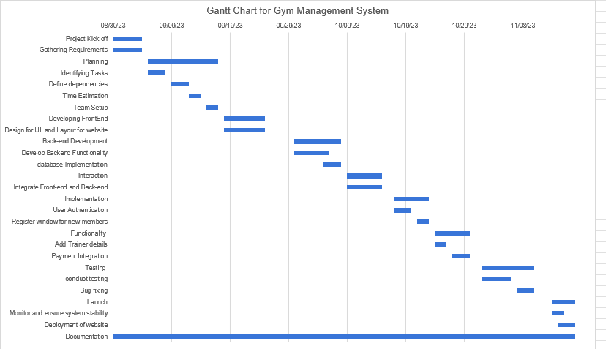
Gantt Chart

Slide 7
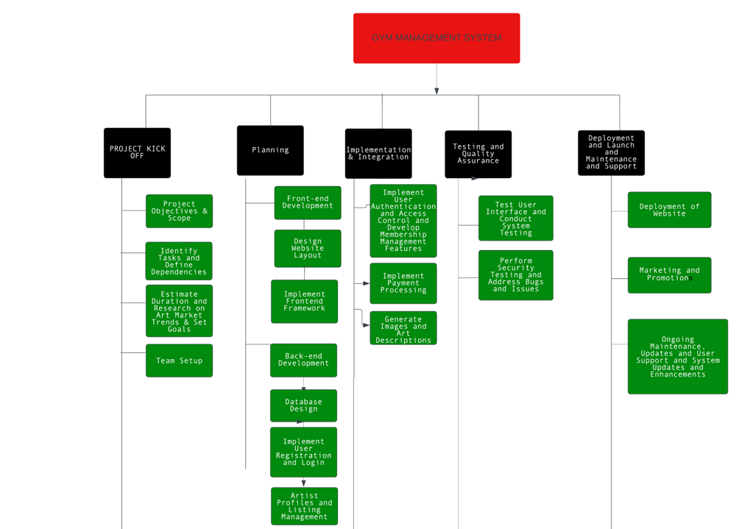
Work Break Down Structure(WBS)

Slide 8
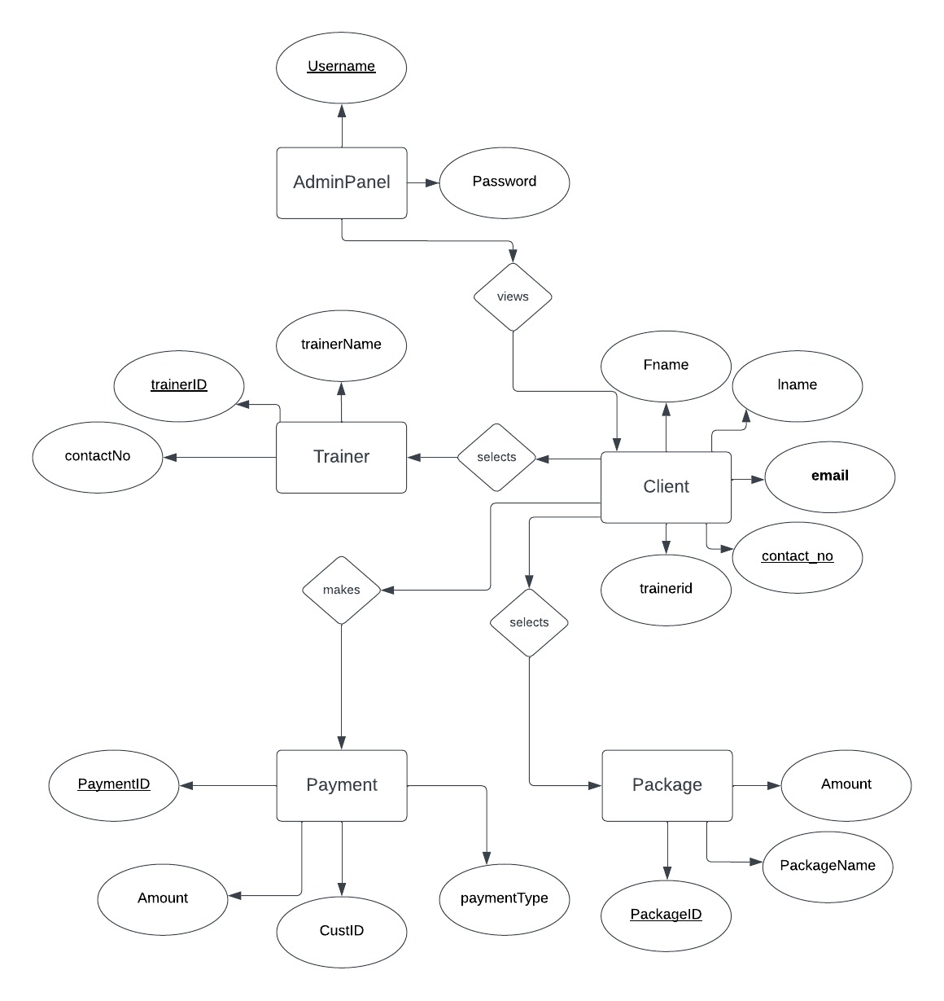
E-R Diagram

Slide 9
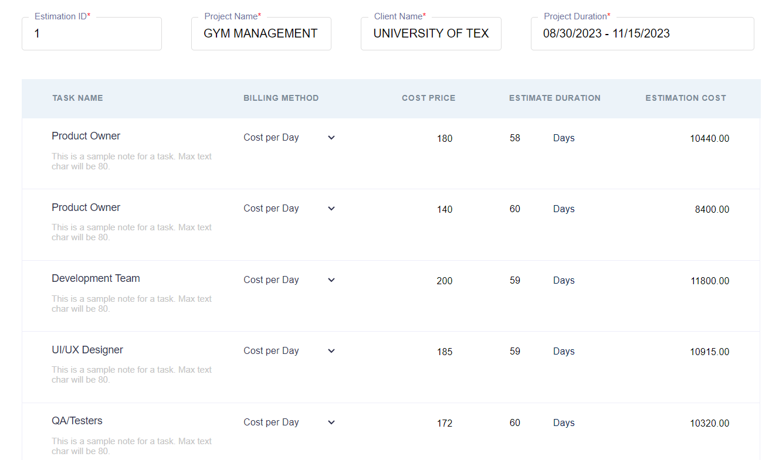
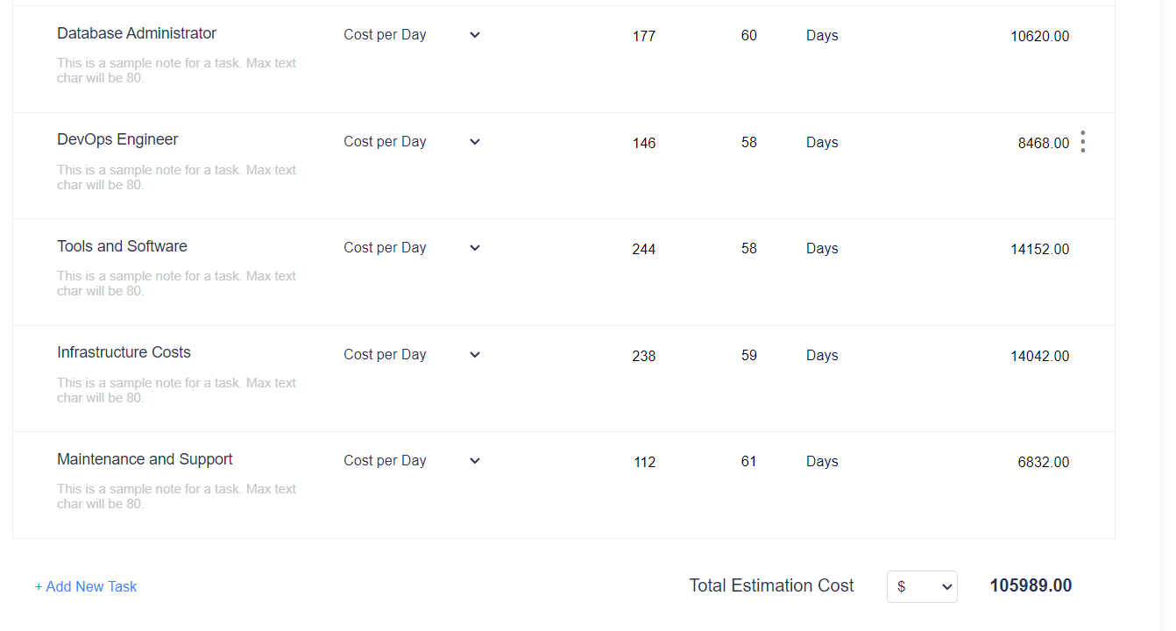
Cost Estimation

Slide 10
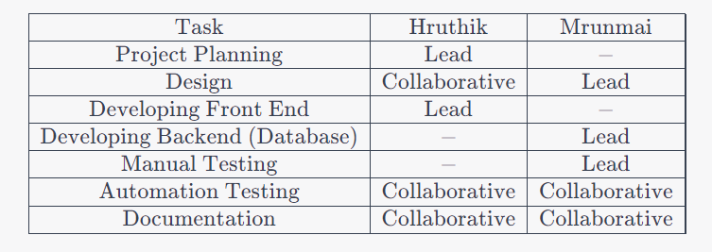
Work Division

Slide 11
Burndown Chart

Slide 12
Implementation
Planning tools:
JIRA
Software Infrastructure:
XAMPP, Visual Studio
Programming Languages:
HTML, CSS, JavaScript (Frontend)
MySQL (Database)
PHP
Testing:
Extension Debugs Test

Slide 13
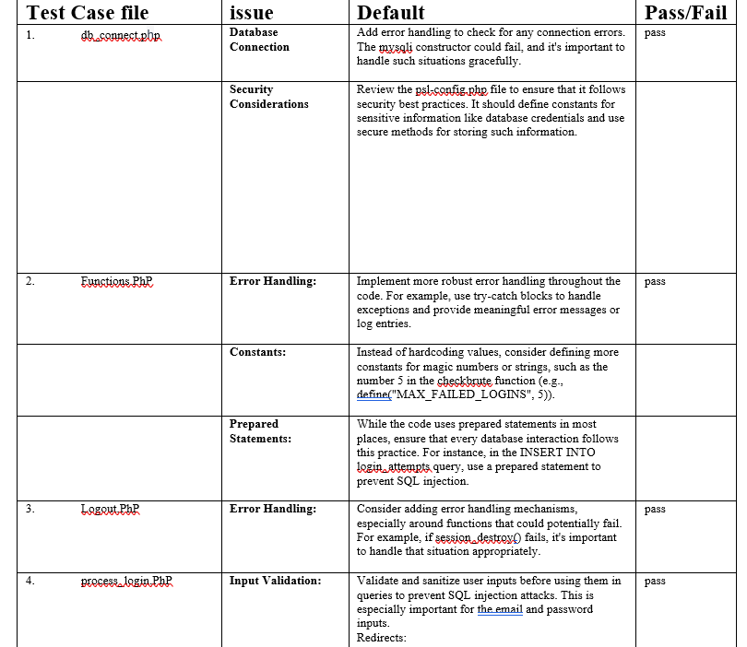
Manual Testing

Slide 14
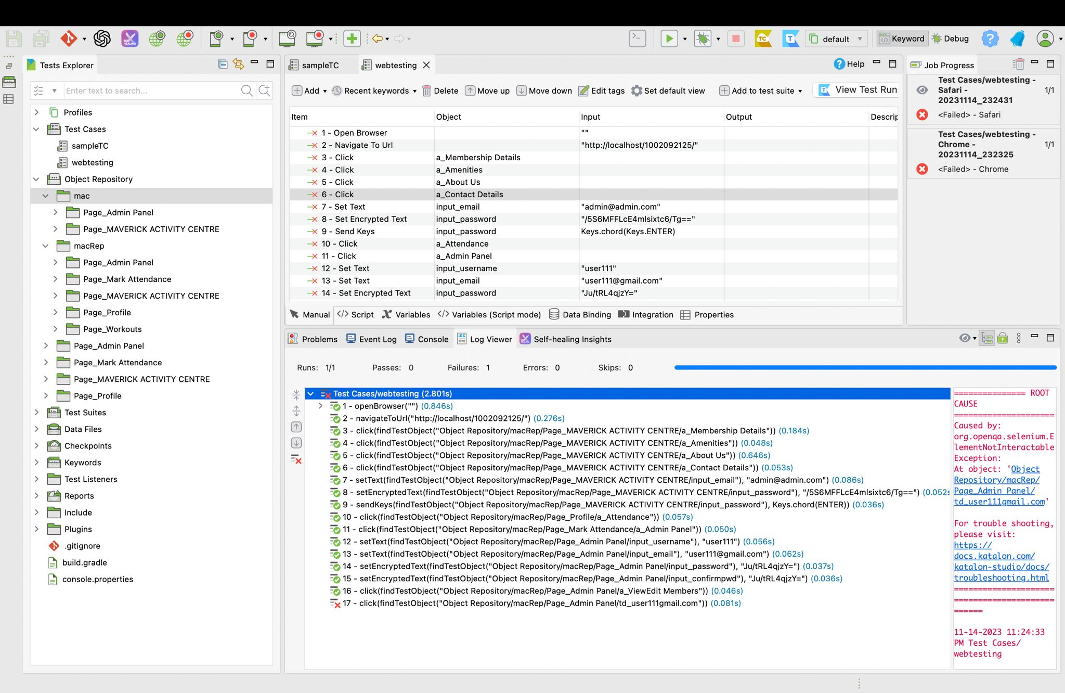
Automation Testing

Slide 15
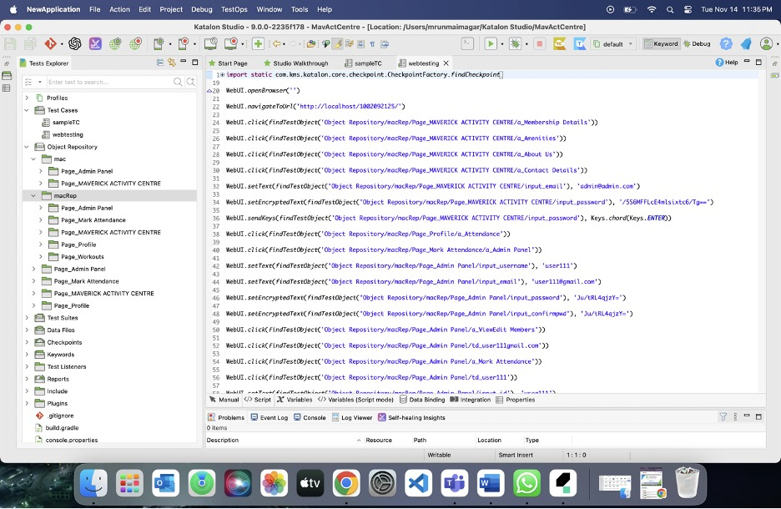

Slide 16
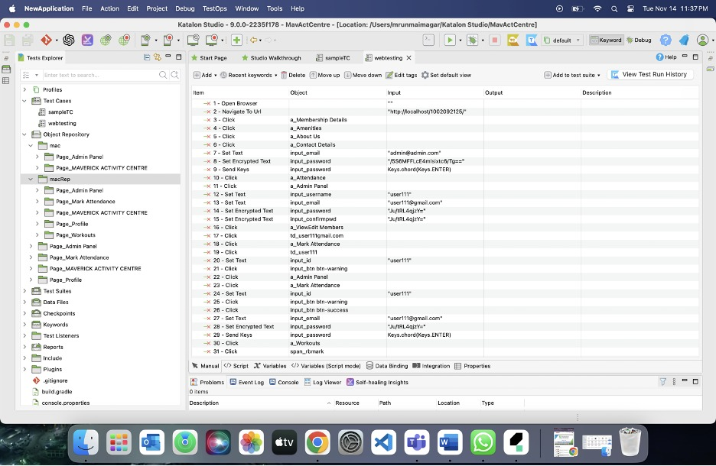

Slide 17
Maintenance
Regular Database Backups:
Schedule routine backups of the website's database.
Admin Access Management:
Regularly review and update admin access credentials.
Software Security Updates:
Keep the website's content management system (CMS) and associated software up to date.
Performance Optimization:
Monitor and optimize the website's performance.
Content Maintenance:
Ensure all gym-related information is accurate and up to date.

Slide 18
Future Scope
1. Integration of Advanced Fitness Technologies
2. Enhanced User Engagement Features
3. Expansion of Community and Social Features
4. Mobile App Development

Slide 19
Challenges faced
Responsive Design Challenges:
Ensuring the website remains visually appealing and functional across various devices and screen sizes.
Load Time Optimization:
Addressing challenges related to page load times to maintain a smooth user experience.
Content Management and Updates:
Managing and updating content regularly to ensure it stays relevant and accurate.
User Interface/User Experience (UI/UX):
Striving to provide an intuitive and user-friendly interface that enhances the overall user experience on the website.

Slide 20
Thank you

