Slide 1
Facial Image Quality Estimation
Alisha Shahane, Aditya Deshpande,
Darshana Gadre, Mrunmayi Deshpande
Internal Guide : Dr. Siddhivinayak Kulkarni
External Guide : Dr. Bhushan Garware
Sponsored by Persistent Systems Ltd.

Slide 2
Outline
Literature Survey
Introduction
ML Approach
Deep Learning
Conclusion
Mathematical Model
UML Diagrams
Applications
Paper Publication
References

Slide 3
Literature Survey
[1] Maximizing Face Recognition Performance for Video Data Under Time Constraints by Using a Cascade
Authors: Christian Herrmann, Jürgen Beyerer
Publication: 2014 11th IEEE International Conference on Advanced Video and Signal Based Surveillance (AVSS)
Facial Recognition in real time applications.
Size of data captured, increasing exponentially.
Trade-off between accuracy and time.

Slide 4
Literature Survey
[2] Face Image Quality Assessment Based on Learning to Rank
Authors: Jiansheng Chen, Yu Deng, Gaocheng Bai, and Guangda Su
Publication: IEEE SIGNAL PROCESSING LETTERS, VOL. 22, NO. 1, JANUARY 2015
Uncontrolled environment in real time applications.
Visa Data set (high quality images): 0.3% error rate.
LFW Data set (low quality images): 18% error rate.
Pruning low quality images in real time data not possible.

Slide 5
Literature Survey
[3] Predicting Face Recognition Performance Using Image Quality
Authors: Abhishek Dutta, Raymond Veldhuis, Luuk Spreeuwers
Publication: 24 Oct 2015
Predicting facial recognition based on image quality.
Low match score ← bad quality image or non-match identity?
Need for developing accurate, unbiased standardized Image Quality Assessment system.

Slide 6
Hardware & Software
Face Recognition Software: OpenFace
Languages: Python
Libraries: OpenCV, numpy, scipy, scikit, pandas
Frameworks: Viola-Jones, Amazon Rekognition
Platform: Ubuntu 16.04, Amazon EC2
Tools: Jupyter Notebooks

Slide 7
OpenFace
A general-purpose face recognition library
It is a Python and Torch implementation of face recognition with deep neural networks
Compares two images to give a MatchScore in the range of 0 to 4, with 0 being the best MatchScore

Slide 8
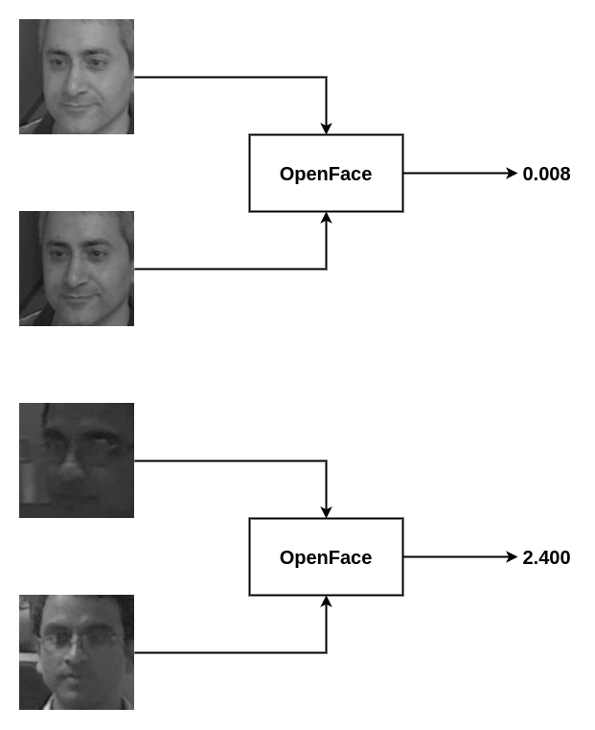
OpenFace

Slide 9
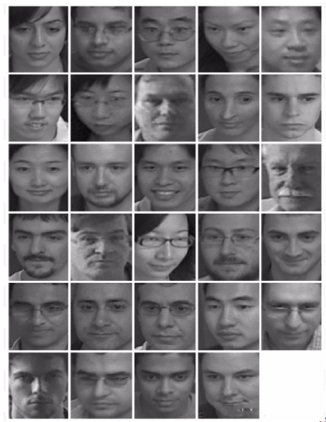
ChokePoint Dataset
Staged experiment
Specially designed for security applications
Number of Subjects: 29
Total number of images: 64,204
Number of images used: 29,022

Slide 10
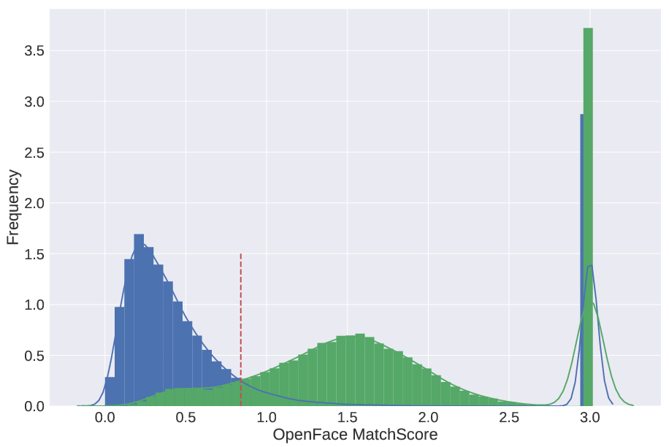
Genuine Impostor MatchScore Distribution

Slide 11
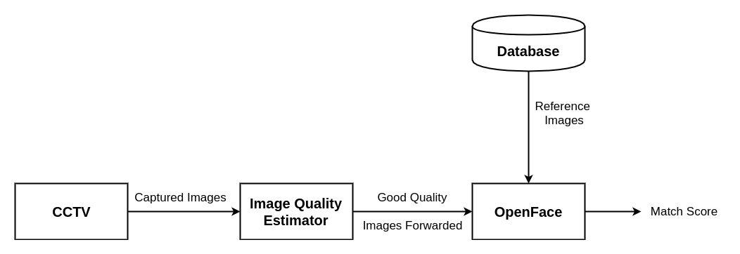
Problem Statement
Framework to run before matcher
Maximum processing at Edge
Reduced Latency

Slide 12
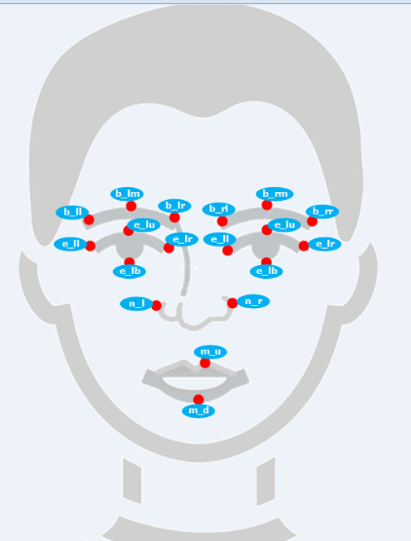
ML Approach
Feature Extraction using
Amazon Rekognition
Features
1. Brightness
2. Sharpness
3. Face Area
4. Eyes Distance
5. Mouth Distance
and so on

Slide 13
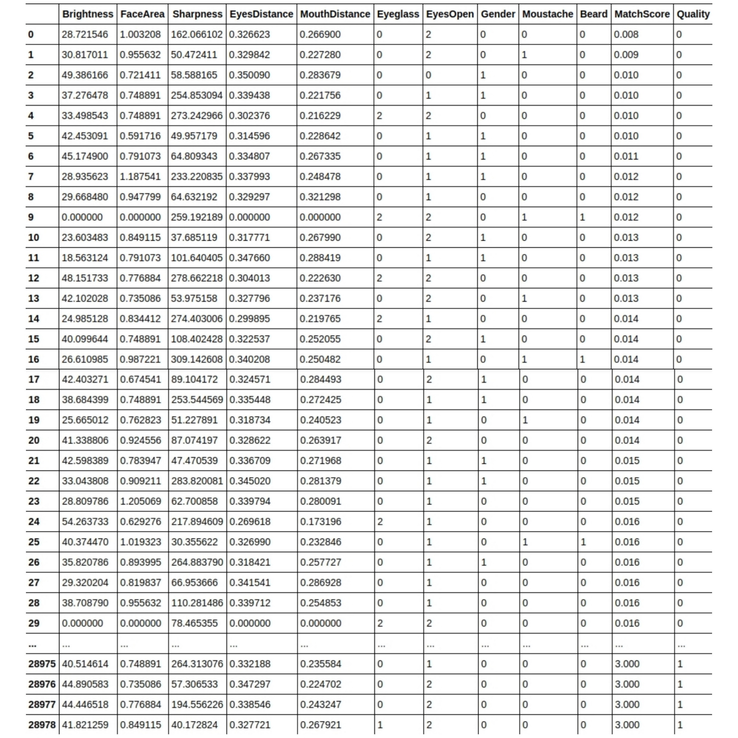
Dataset

Slide 14
Classification
Classification Algorithms and f1-score
Algorithm | f1-score
Gaussian NB | 0.66
Decision Tree | 0.68
Random Forest | 0.62
SVM | 0.66
KNN | 0.66

Slide 15
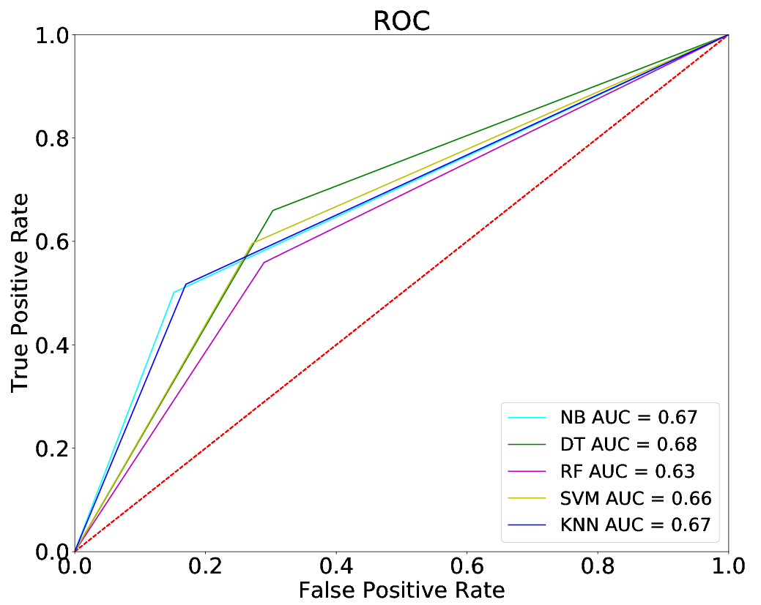
Classification Result

Slide 16
Neural Network
Model Summary:
Total params: 180
Trainable params: 180
Non-trainable params: 0
Layer Output Shape Param | Layer Output Shape Param | Layer Output Shape Param
dense 1(Dense) (None, 10) 110 | dense 1(Dense) (None, 10) 110 | dense 1(Dense) (None, 10) 110
dropout 1(Dropout) (None, 10) 0 | dropout 1(Dropout) (None, 10) 0 | dropout 1(Dropout) (None, 10) 0
dense 2(Dense) (None, 5) 55 | dense 2(Dense) (None, 5) 55 | dense 2(Dense) (None, 5) 55
dropout 2(Dropout) (None, 5) 0 | dropout 2(Dropout) (None, 5) 0 | dropout 2(Dropout) (None, 5) 0
dense 3(Dense) (None, 2) 12 | dense 3(Dense) (None, 2) 12 | dense 3(Dense) (None, 2) 12
dropout 3(Dropout) (None, 2) 0 | dropout 3(Dropout) (None, 2) 0 | dropout 3(Dropout) (None, 2) 0
dense 4(Dense) (None, 1) 3 | dense 4(Dense) (None, 1) 3 | dense 4(Dense) (None, 1) 3

Slide 17
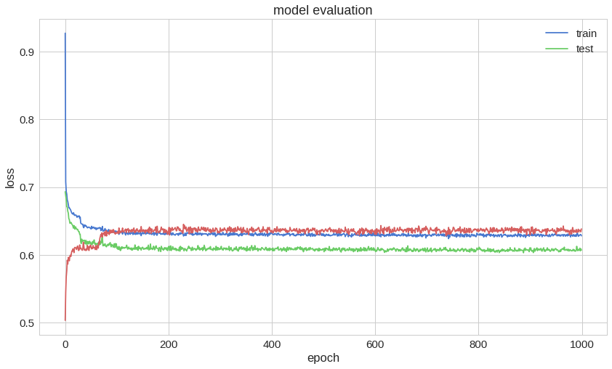
NN Result

Slide 18
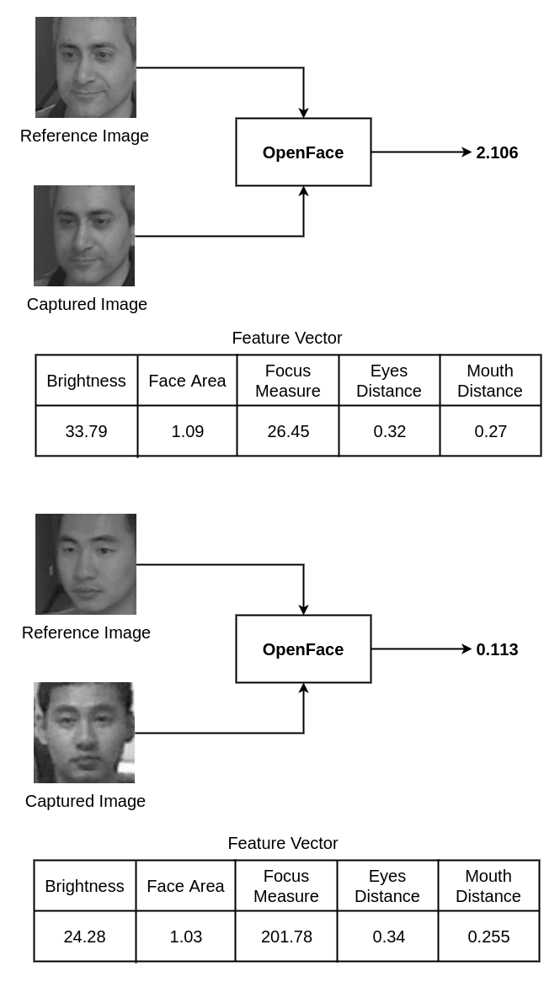
Need for Deep Learning

Slide 19
Need for Deep Learning

Slide 20
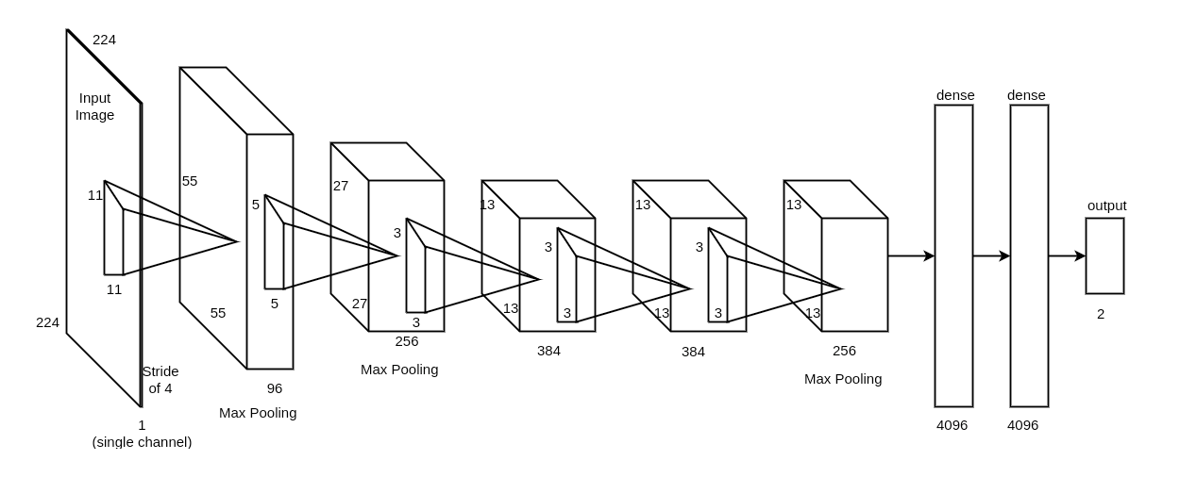
CNN Architecture

Slide 21
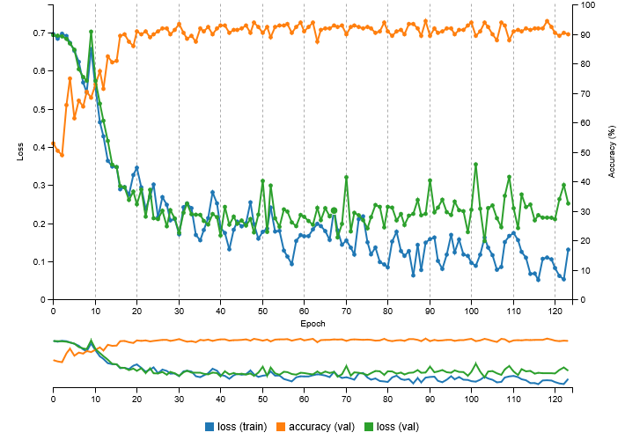
CNN Result

Slide 22
Mathematical Model
Let the system be S = { DD, NDD, i/p, o/p, f, S, F } where-
DD : Deterministic Data = { vector features }
features = { x₁, x₂, x₃, … , x_{n} }
NDD : Non-Deterministic Data = {ŷ }
i/p : input = { image }
o/p : output = { quality estimate }
f : functions = { extract_features(), extract_matchScore(), regression_model() }
S : Success = quality estimate is close to matcher’s score
F : Failure = large difference between quality estimate and match score

Slide 23
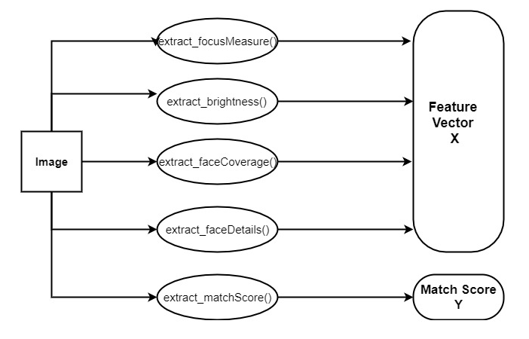

Slide 24
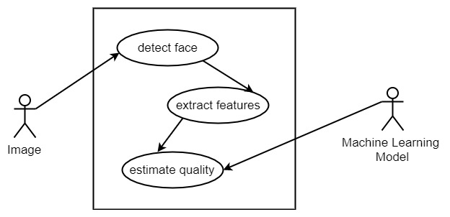
Use Case Diagram

Slide 25
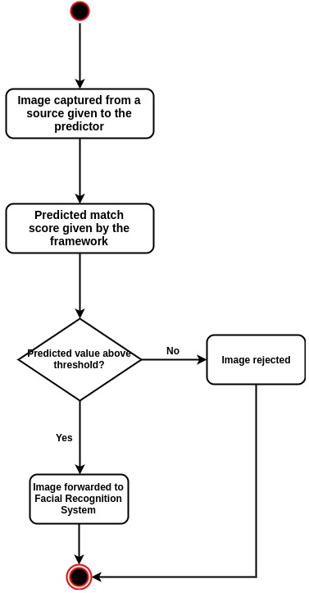
Activity Diagram

Slide 26
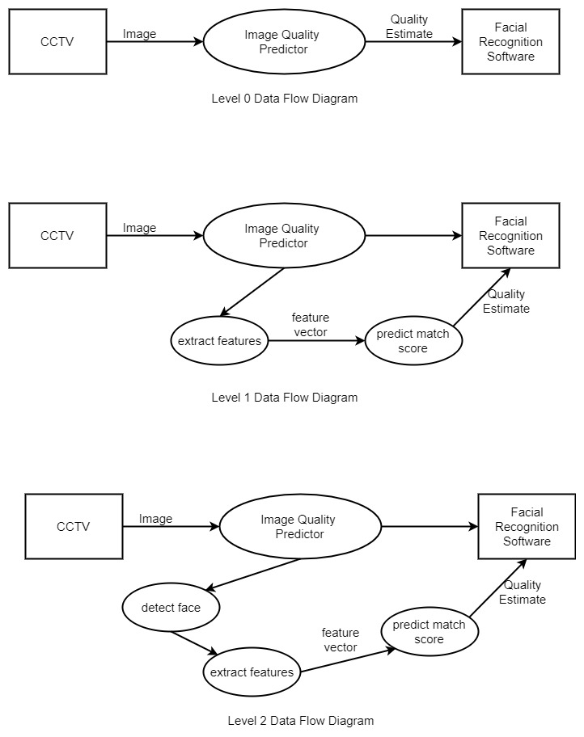
Data Flow Diagram

Slide 27
Data Flow Diagram

Slide 28
Data Flow Diagram

Slide 29
Applications
CCTV Monitoring and Real Time Analysis
Criminal Identification / Detecting Trespasser
Automated Attendance System
E-commerce Payments
Prevent Underage Drinking
Social Media Tagging
Smart Phones

Slide 30
Paper Publication
IEEE’s 3rd INTERNATIONAL CONFERENCE FOR CONVERGENCE IN TECHNOLOGY (I2CT) PUNE
Date of Conference: 06-08 April 2018
http://ieeepune.i2ct.in/

Slide 31
References
[1] - Christian Herrmann, Jürgen Beyerer. Maximizing face recognition performance for video data under time constraints by using a cascade. 2014 11th IEEE International Conference on Advanced Video and Signal Based Surveillance (AVSS)
[2] - Jiansheng Chen, Member, IEEE, Yu Deng, Gaocheng Bai, and Guangda Su. Face Image Quality Assessment Based on Learning to Rank. IEEE SIGNAL PROCESSING LETTERS, VOL. 22, NO. 1, JANUARY 2015
[3] - Abhishek Dutta, Raymond Veldhuis, Luuk Spreeuwers. Predicting Face Recognition Performance Using Image Quality. arXiv:1510.07119v1 [cs.CV] 24 Oct 2015
[4] - Jeffrey Edgell , Andrew Trimpe. 4 Limitations of Facial Recognition Technology. https://fedtechmagazine.com/article/2013/11/4-limitations-facial-recognition-technology

Slide 32
Thank You!

