Slide 1
Boosting algorithm
Ada boosting
Xg boosting
Lg boosting

Slide 2
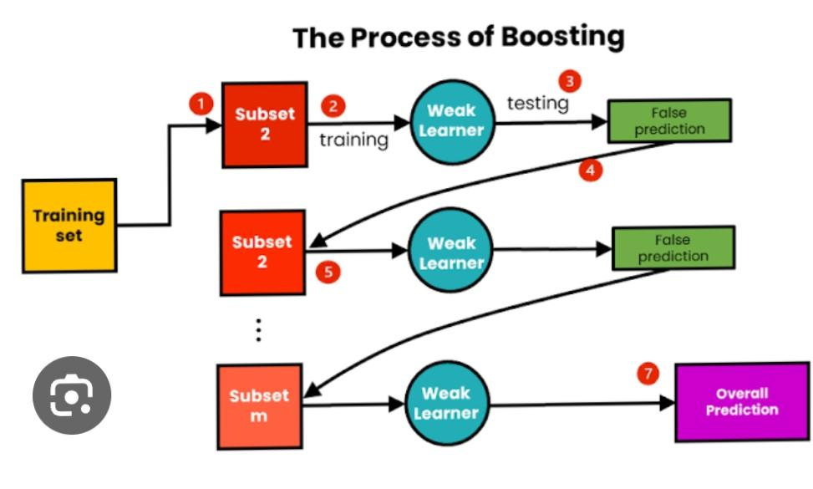
Boosting
The boosting algorithm assesses model predictions and increases the weight of samples with a more significant error. It also assigns a weight based on model performance. A model that outputs excellent predictions will have a high amount of influence over the final decision.
Notes:
Hi

Slide 3
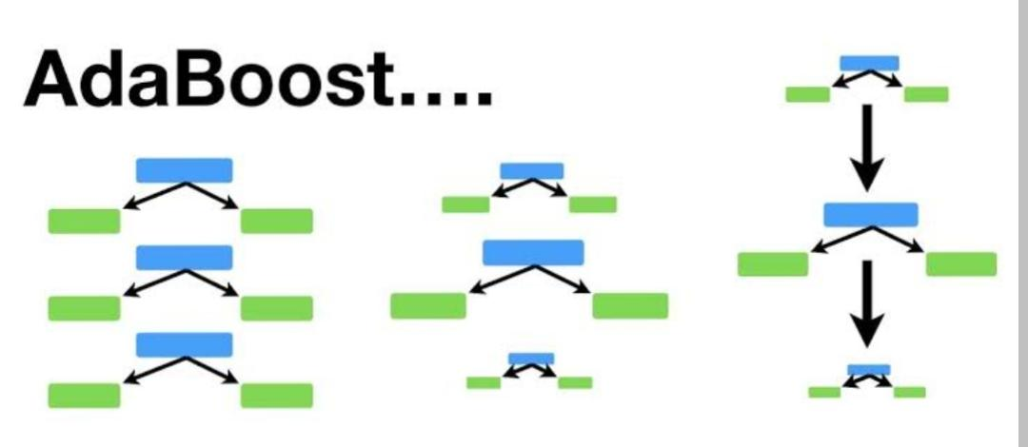
ADA BOOSTING
AdaBoost algorithm, short for Adaptive Boosting, is a Boosting technique used as an Ensemble Method in Machine Learning. It is called Adaptive Boosting as the weights are re-assigned to each instance, with higher weights assigned to incorrectly classified instances.

Slide 4
How it works?
This algorithm does is that it builds a model and gives equal weights to all the data points. IT then assigns higher weights to points that are wrongly classified.
An AdaBoost regressor is a meta-estimator that begins by fitting a regressor on the original dataset and then fits additional copies of the regressor on the same dataset but where the weights of instances are adjusted according to the error of the current prediction.

Slide 5
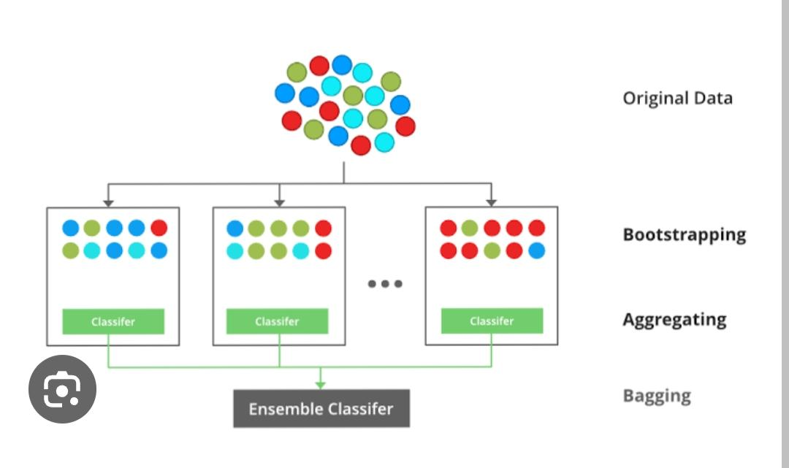
Xg boosting (gradient boosting)
XGBoost is a popular and efficient open-source implementation of the gradient boosted trees algorithm. Gradient boosting is a supervised learning algorithm, which attempts to accurately predict a target variable by combining the estimates of a set of simpler, weaker models.

Slide 6
How it works?
XGBoost is a boosting algorithm. It takes in training data, uses it to train a model, and then evaluates the model on new data. This process repeats until the model stops improving.

Slide 7
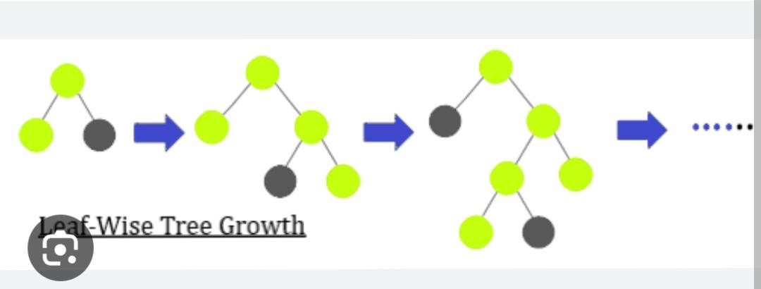
Lg boosting (Light gbm)
LightGBM is a gradient-boosting framework based on decision trees to increase the efficiency of the model and reduces memory usage. It uses two novel techniques. Gradient-based One Side Sampling(GOSS) Exclusive Feature Bundling (EFB)

Slide 8
How it works?
LightGBM is a gradient boosting ensemble method that is used by the Train Using AutoML tool and is based on decision trees. As with other decision tree-based methods, LightGBM can be used for both classification and regression. LightGBM is optimized for high performance with distributed systems. It creates decision trees that grow leaf wise, which means that given a condition, only a single leaf is split, depending on the gain. Leaf-wise trees can sometimes overfit especially with smaller datasets. Limiting the tree depth can help to avoid overfitting.

