Slide 1
Serverless typically implemented as Container or Functional Workloads
Embracing 12-factor Application Methodology
Serverless
Workloads
Increased Developer Agility
Decreased focus on
Operations,
Platforms,
Service Frameworks
Functions
(on FaaS)
include only function and dependent libraries.
Containers
(on CaaS)
include function’s language and framework stack
Platform
Native
(PaaS)
Virtual
Machines
(IaaS)
Native
(Bare metal)
Increasing ability to Horizontally Scale
Decreased “Cold Start” Times
Notes:
In terms of developing more efficient workloads for hosting on the same Compute hosts, Serverless computing is the logical next step…
In Serverless, the workload is a simple, individual, single-tasked Functional piece of code.
where there are no back-end services to configure
and the Cloud provider can scale the function based upon (the volume or load) of incoming events that are associated with a single function.
---------
Serverless is much closer to development.
Serverless now brings the possibility of NoOps, at least for particular use cases

Slide 2

Serverless’ Least Common Denominator (LCD) Programming Model
Events - representation of real-world, “Source” events that carry actionable Input data
Manual (CLI) or Automated Events
Carrying structured or unstructured data
Triggers - are named channels for a class of Events that “Feed” the Fx
Typically Named resources often backed by Message Queues
Potential Normalization of data
Functions - relatively short-running, standalone functions invoked Reactively as an event handler
Based upon Reactive, Event-Driven Functions
“Source”
“Feed”
T
“React”
Fx
Raw Event Data
Origination Context & Data
Feed Data MAY include:
Context Metadata
(Protocol, Event & Operational Environment)
Optional Parameters
Raw Data
Event
Trigger
Function
Notes:
In terms of developing more efficient workloads for hosting on the same Compute hosts, Serverless computing is the logical next step…
In Serverless, the workload is a simple, individual, single-tasked Functional piece of code.
where there are no back-end services to configure and the Cloud provider can scale the function based upon (the volume or load) of incoming events that are associated with a single function.
---------
Serverless is much closer to development.
Serverless now brings the possibility of NoOps, at least for particular use cases

Slide 3
OpenWhisk Programming Model reflects an Observer Pattern
Rule - Associates one trigger with one action. Can be viewed as an on/off switch.
Rules
T
Fx
“Feed”
“React”
Rule
Trigger
Action
Observer Pattern
A
T
T
Rule 1
Action X
Trigger B
Rule 3
A
Trigger A
A
T
Action Z
Rule 2
Action Y
Trigger C
Rule 4
Notes:
In terms of developing more efficient workloads for hosting on the same Compute hosts, Serverless computing is the logical next step…
In Serverless, the workload is a simple, individual, single-tasked Functional piece of code.
where there are no back-end services to configure and the Cloud provider can scale the function based upon (the volume or load) of incoming events that are associated with a single function.
---------
Serverless is much closer to development.
Serverless now brings the possibility of NoOps, at least for particular use cases

Slide 4
Full OpenWhisk Programming Model
Target Namespace
Trigger
Event
Source
Action
Feed
JSON
JSON
Rule
Web
Action
HTTP
HTTP

Slide 5

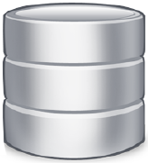
Scheduled, Periodic Tasks | “Cron Jobs”
Configurable Alarm Feed to fire a Trigger for a Function at a specified frequency
Serverless Platform
A
Periodic Intervals - every X secs/mins
Time Windows - start / stop by date-time
Specific date/time - “fire once”, or recurring
T
Alarm “Feed”
Batched
Data
Data-at-Rest
Alarm Triggered Functions can process waiting “Data-at-Rest”

Slide 6






Extract, Transform and Load (ETL) Pipelines
Arrival of Raw Data in datastore or message queue Triggers ETL pipeline
Serverless Platform
Transform
T
Fx
DB
Raw Data
Data-at-Rest
Enhanced Data
Queue
Streaming Data
Live Log data
IoT sensor data
Financial (market) data
In-Stream Analytics
e.g., TensorFlow
Data-in-Motion
Analyze, Annotate / Enhance
TensorFlow
Improved Data Integration for downstream consumers

Slide 7
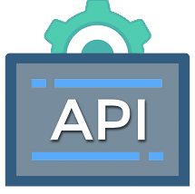
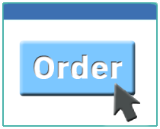
API Management for Serverless MicroServices
Create Serverless Functions
Mapping of REST API Endpoints to your Serverless Functions
1
Serverless Platform
POST
Fx
T
Define API Endpoints (URLs) and map to Actions
POST: mydomain.com/…/order
GET: mydomain.com/…/order
DELETE: mydomain.com/…/order
createOrder
GET
Fx
2
getOrder
DELETE
Fx
deleteOrder
Effectively limitless, “free” public or private APIs without any hosting costs

Slide 8

Operations Research / Combinatorial Optimization
“Divide and Conquer” large data sets using large #s of concurrent Functions
Any kind of Embarrassingly Parallel task is well-suited for Serverless functions
Fx
Fx
Fx
Fx
Fx
Fx
Map-Reduce Operations
Monte-Carlo Simulations
Genetic Algorithms
Hyperparameter tuning
Web scraping
Genome processing
Fx
Fx
Fx
Fx
Fx
Fx
Fx
T
Fx
Fx
Fx
Fx
Fx
Fx
Aggregated Results
Fx
Fx
Fx
Fx
Fx
Fx
Fx
Fx
Fx
Sometimes used as a “Cheaper” option to
Notes:
Typical per-function limits (basic account)
1,000s concurrent activations
10-15 minutes per function
Execution Memory: 2-8 GB per function

Slide 9

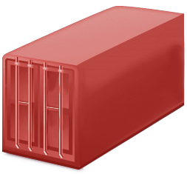
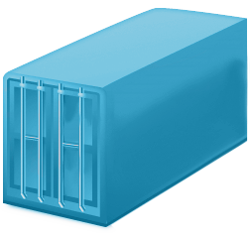
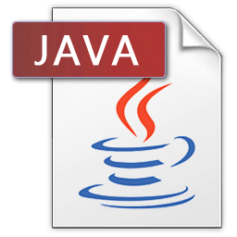

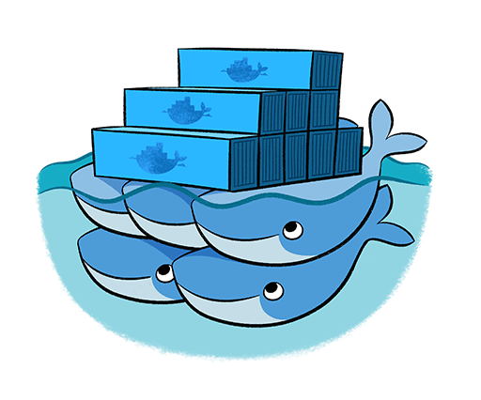


Supports “Source-to-Container” solutions for deployment
Using a general Containerization approach for Serverless “Lift and Shift”
Serverless
Container Builder
Serverless “platform-aware” Tooling “bakes” Functions into a Runtime Container
Starts with compatible “Base” Java Runtime image
”Pulls” & Builds Application Source
Places JAR in a “known” location
Stores final Image to chosen target Image Repository
1
2
3
Docker Hub
GitHub
Image Repo.
Tooling and “final” image often dedicated to single target platform

Slide 10






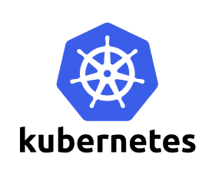
Scales Horizontally, On-Demand from 0..N instances
Then Scales to Zero when no more requests are detected (after some time)
Serverless Platform
Meaning Intelligent Scheduling to use “Pre-Warmed” and “Warm” Containers
Stem Cells: Term for Containers ready and waiting for Language Runtimes (DNA) to be loaded into them
Pre-Warm: Runtimes ready for Function to be “loaded” into
Warm: Requests for Same Function routed to already ”loaded” Runtime
Clusters of Container Pools
Stem Cells
?
?
?
?
Requests
Scheduler
Pre-Warmed Containers
Warm Containers
Implementations often rely on technologies like Kubernetes and Knative that can manage and scale Container Pods within Clusters
Fx
Fx
Fx
Fx
Bonus points for platforms that can scale cross Cloud / Container Technologies
Notes:
Squeezing the milliseconds: How to make serverless platforms blazing fast! (Markus, Warm, Pre-Warm)
https://medium.com/openwhisk/squeezing-the-milliseconds-how-to-make-serverless-platforms-blazing-fast-aea0e9951bd0

Slide 11

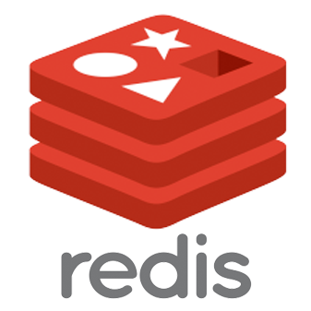









Supports “out-of-box” connectivity to Event Sources
“Hooking up” events to your function should be very easy
Event Sources Examples
Serverless Platform
No-Ops Event Sources with simple configurations
Data Stores - SQL, NoSQL, S3, Real-time, Memory …
Message Queues - Kafka, RabbitMQ, MQTT …
Social / Team - Slack, Twitter, Mobile Push …
DevOps - GitHub, Jenkins …
Extensible for your own Event Sources
Secure, “On Premise” data connectivity too your functions
e.g., via RPC or Message Queues
S3
Alarms
S3 Object
Storage
RabbitMQ
Mobile Push
Slack
Twitter
GitHub
Developers can readily connect with Event Sources to process data

Slide 12
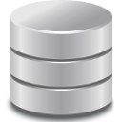

Supports Compositions to Create Serverless Apps
At minimum supports simple declarative Sequences
Serverless Application
Data Stores
with Conditional Logic
Fx
Fx
Fx
SQL, NoSQL,
S3 (Objects),
Key-Value (KV)
sequence
Fx
REST APIs
then
Fx
Application State
Externalized
fanout
Fx
Fx
else
Fx
if
Queues
But also, supports Compositions with Conditional logic

Slide 13


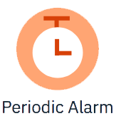
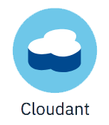





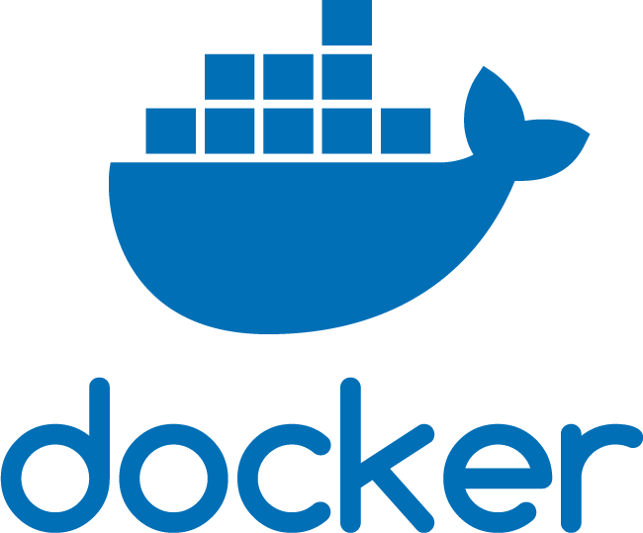

endeavors to provide these features…
Built-In
Event
Integrations
IAM
Cloud Functions Platform Components
Language
Runtimes
Identity, Access Mgmt.
Message
Bus
API GW /
Router
Controller
Invokers
Invokers
Invokers
REST API
REST
IAM
Artifact
Stores
Service Provider Interfaces (SPIs)
S3
Cloud Object
Storage
Web UI
Storage
Logging
Monitoring
Compliance
Log Analysis
Log Search
IBM Cloud Services
Slack
Recently added a developer Implementation that runs as an Executable JAR file

Slide 14
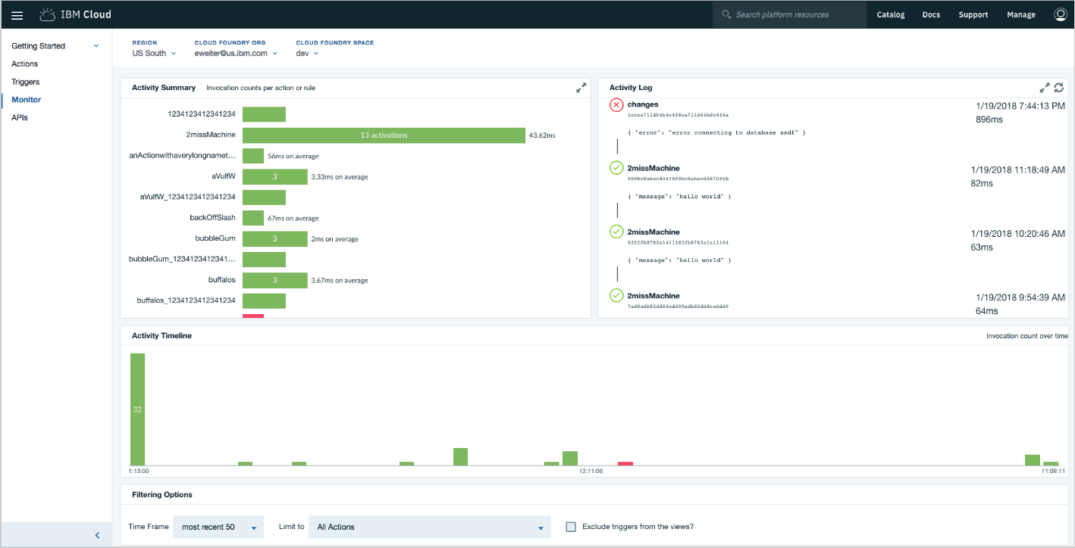
Integrated Logging and Metrics
Developers do NOT need to write any Logging or Metric Code, It’s all done for you!
Integrated Logging
Real-time log event data from Functions
Supports “live” debug
Retention / Backup
Logical Groupings – Region, Version, etc.
Per-Function, Per-API Metrics
Usage - Function & Corresponding API Usage Metrics
Granularity - Duration, Cold Start, Histograms, etc.
via Dashboards or CLIs
Independent of Java Frameworks or Plug-ins (zero Function overhead or config)

Slide 15

1
Write Function
2
Select target Runtime
3
4
Submit to FaaS platform
with runtime identifier
Create archive
(if needed)
Fx
Language Runtimes
Supported by FaaS Platform
Fx
Fx
FaaS Platform
REST API
NodeJS 10
NodeJS 12
Java 11
Additional
Libraries
NodeJS 10
Fx
Others …
Python 2.7
Python 3.7
Write Function
Select target language runtime
Optionally, create archive with Function and any additional libraries it needs
Submit to FaaS Serverless platform with runtime identifier
Notes:
In general, with a FaaS Serverless implementation, the Developer needs only
submit a single function and any dependencies (i.e., packages or libraries) that are not already "built in" to the language runtime the Serverless provider prepares.
This packaging step usually involves creating an archive format like ZIP or JAR (Java).
In these cases, the Serverless provider usually has "ready made" containers that not only contain system and language libraries for languages such as
JavaScript (NodeJS), Python, Java and others,
but also libraries support data transformation, network access and connections to databases and message queues.

Slide 16
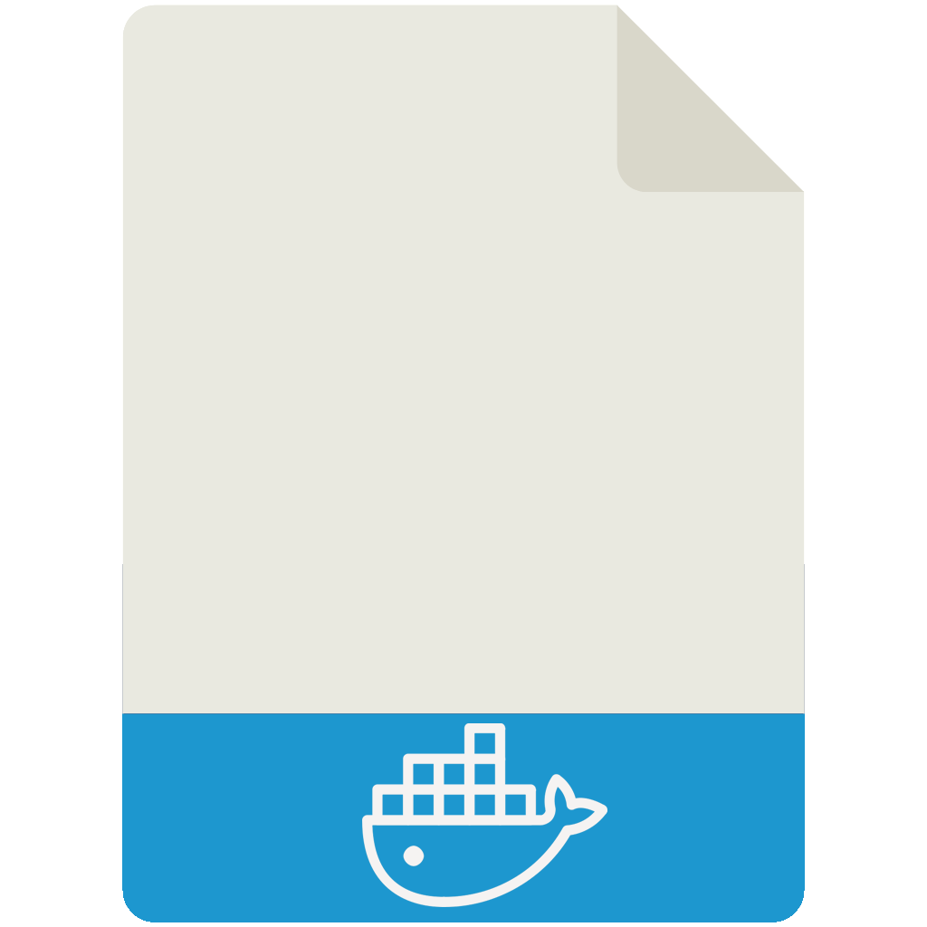

1
Write Function
2
Select base Docker image
3
Build Function,
Supporting Libraries
& Framework (if needed) Into image
4
Configure Service
Endpoint for Function
(route, port)
5
Submit Image to
CaaS platform
Fx
Fx
Fx
Libs.
Fx
Libs.
Libs.
/myapp:8080
CaaS Platform
REST API
RHEL, NodeJS 10 “base” image
Image
Repository
Write your function and host it using a language-specific service framework.
Select a base image from a repository with the language runtime version you desire. If able, select one that may have your service framework already installed.
Build your function, any supporting libraries needed and service framework if not already included.
Export your function as a service endpoint from your framework.
Submit resultant image to CaaS Serverless platform. This could be a direct submission or indirect from a supported image repository.
Notes:
In general, with a FaaS Serverless implementation, the Developer needs only
submit a single function and any dependencies (i.e., packages or libraries) that are not already "built in" to the language runtime the Serverless provider prepares.
This packaging step usually involves creating an archive format like ZIP or JAR (Java).
In these cases, the Serverless provider usually has "ready made" containers that not only contain system and language libraries for languages such as
JavaScript (NodeJS), Python, Java and others,
but also libraries support data transformation, network access and connections to databases and message queues.

Slide 17
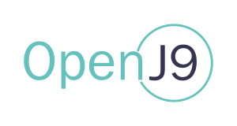











Java Serverless CI/CD Pipeline Vision Being Developed Now!
Automatically building Java “Profiles” with optional Frameworks
1
2
3
4
5
6
7
Clones Java App
Source as Resource
Build JAR
using Maven
Select “base image”
VM, JDK version
Select Optional
Framework
Select optional
Profile libraries
Compile & Create Shared Class Cache for JVM
finalize Serverless
Function Image &
Publish/Deploy
1
PipelineResource
type: git
2a
6a
7a
2
3
4
5
6
7
Create-Jar-With-Maven
Build-Uber-Runtime-with-Gradle
Build-Shared-Class-Cache
Finalize-Runtime-with-Function
Task
Task
Task
Task
JavaServerlessPipeline
Lead by Priti Desai, a Tekton Contributor, from the IBM Open Source team
https://tekton.dev/
Notes:
Create-JAR-with-Maven (build-with-maven, copy-input-to-output) <- resource (git) app-git
run-build-gradle (copy-dependencies) <- resource git (app-git), git (runtime-git) <- W_JAVA_VERSIN
create-one-jar / create-java-runtime-jar (create-runtime-jar)
openwhisk-java-runtime (update-dccker (update-dckerfile-for-image, build-openwhisk-app-image) <— DCERKFILE, OW_RUNTIME_CNTEXT

Slide 18
Functions Approach – “JAR your function with its libraries”
Runtime (Container image)
1
“Create” Function (Archive) in FaaS Platform
Select a supported Language Runtime image
Opinionated with “built-in” System & Profile Libraries
Library-based “Profiles” may be selectable
Configure FaaS-dependent Settings
e.g., Function’s Namespaced Path Name,
Limits (e.g., CPU, memory, timeouts, etc.),
Platform Proxy (Enforce Platform Conventions)
1
Function Context
Input
Fx
Output
“App” Libraries
When Function is “Triggered” the Platform Proxy
Injects “Function” as raw code or archive
Loads Function’s Deterministic Dependencies
Packaged with your Function
e.g., JAR or ZIP and/or
Declared in a language manifest
e.g., NodeJS “package.json”, Java Maven “POM” XML
Sets Context Information In Environment or in Input Arguments
Manages the Logging and Monitoring
Context
Environment Vars.
“System” Libraries
“Profile” Libraries
(Provider dependent)
“built-in”
Language Runtime
(fixed version)
FaaS Platform
FaaS Platform scales just Functions by injecting them into ready-made pools of compatible runtimes
Notes:
Eclipse OMR: https://www.eclipse.org/omr/
What is OMR? https://www.eclipse.org/omr/starter/whatisomr.html

Slide 19
Containers Approach - ”Build your own Docker image with everything”
Developers Create a “Full Stack” Runtime image with Function and dependencies “baked in”
1
1
Select base language runtime image
Compatible with target cloud’s hardware architecture
Typically language communities provide versioned Docker image to select from
Runtime (Container image)
3
Server Framework or HTTP Server
4
Framework Context
2
Install ”Profile” libraries
approved by your project
Input
Fx
Output
3
Installing Service Framework or Http Server
to run your “function” as a service
7
“App” Libraries
4
Install “function” + Dependencies into Service Framework
Export route to your “function” on provider designated port
5
Environment Vars.
2
5
Configure your own Context
Fixed into Environment Variables
“System” Libraries
“Profile” Libraries
(Provider dependent)
6
Language Runtime
Handle Granular logging or monitoring
7
Manage Concurrency
6
CaaS Platform
Serverless Platform Invokes Endpoint and Scales Container
Notes:
Eclipse OMR: https://www.eclipse.org/omr/
What is OMR? https://www.eclipse.org/omr/starter/whatisomr.html

