Slide 1
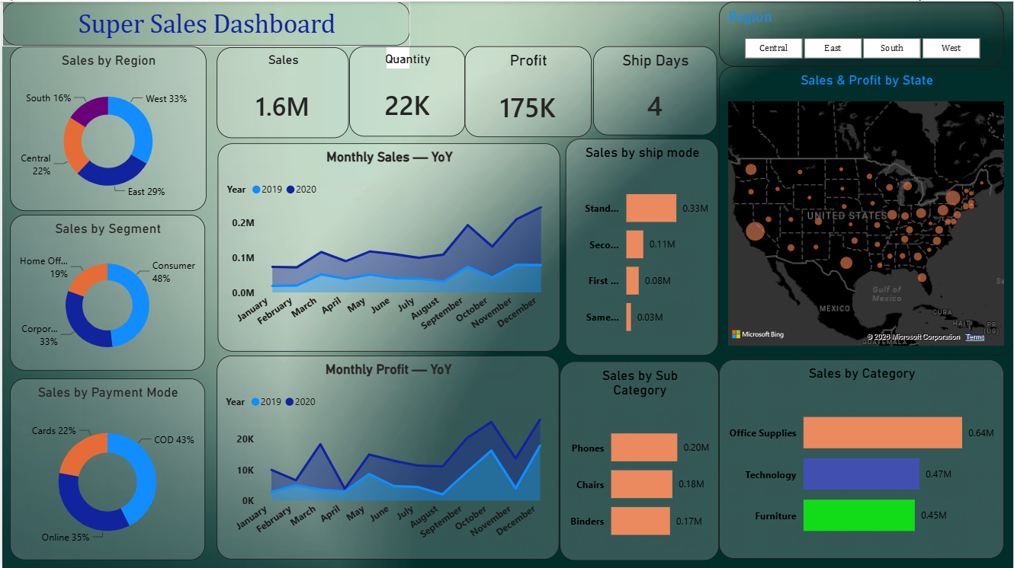
DATA ANALYTICS PORTFOLIO
Super Sales
Dashboard
A Power BI project that turns sales performance into clear management actions
Mrutyunjay Das
Data Analytics Project Showcase
Notes:
[Sources]
- User-provided Super Sales Dashboard screenshot (dashboard values and visual evidence).
[/Sources]

Slide 2
SUPER SALES DASHBOARD
One dashboard connects performance to action
Business question
Where is revenue coming from—and where should management focus next?
1.6M
175K
Sales
Profit
The report combines financial, customer, product, logistics, geographic, and time-based views in one interactive experience.
22K
4
Quantity
Ship days
02

Slide 3
SUPER SALES DASHBOARD
West, East, and Consumer concentrate demand
Regional contribution
Customer segment
West
33%
Consumer
48%
East
29%
Corporate
33%
Central
22%
Home Office
19%
South
16%
62%
of sales comes from West + East; Consumer alone contributes nearly half.
03

Slide 4
SUPER SALES DASHBOARD
Office Supplies leads; Phones top the displayed sub-categories
Category sales (M)
Top displayed sub-categories (M)
Office Supplies
0.64M
Phones
0.2M
Technology
0.47M
Chairs
0.18M
Furniture
0.45M
Binders
0.17M
Portfolio implication
Use Office Supplies as the volume anchor, then cross-sell Technology products to increase value per customer.
04

Slide 5
SUPER SALES DASHBOARD
Standard shipping and COD dominate the operating mix
Sales by ship mode
Payment mode share
Standard
0.33M
COD
43%
Second Class
0.11M
Online
35%
First Class
0.08M
Cards
22%
Same Day
0.03M
Opportunity
Review Standard Class cost and encourage prepaid digital payments where practical.
05

Slide 6
SUPER SALES DASHBOARD
Performance strengthens late in the year
The dashboard’s monthly views show sales and profit reaching their strongest levels toward year-end, with December especially prominent.
Management response
• Build inventory before the late-year rise
• Align campaigns with peak months
• Investigate the recurring mid-year softness
• Validate whether seasonality repeats across regions
Trend reconstructed directionally from the visible dashboard lines
06

Slide 7
SUPER SALES DASHBOARD
The dashboard turns seven findings into a focused action plan
01
Protect core regions
Maintain West and East momentum while diagnosing South.
02
Double down on Consumer
Target the segment responsible for 48% of sales.
03
Plan for year-end demand
Prepare inventory and campaigns before the late-year rise.
04
Optimize mix
Cross-sell Technology and review Standard Class economics.
05
Improve payment quality
Encourage prepaid digital methods where suitable.
Portfolio-ready analysis: clear metrics, evidence-based insights, and business recommendations.
07

