Slide 1

Smart lock system
Vikgramm Yagambara Raja
Khaw Chee Horng
Lee Jia Yu

Slide 2
Problem statement

Slide 3
Project background
Tutorial rooms uses magnetic door locks equipped with a RFID scanner and PIN lock security system.
Solve the issue of not allowing students to enter the class without the teacher opening it.
Leaving the door open throughout the whole period.
Taking attendance

Slide 4

Project description
AIM:
To reduce the inconvenience of student not being able to enter the class with the presence of the lecturer.
Take attendance at the start of the class
Not having the classroom door to stay open during the class
SOLUTION:
(Internet of Things)

Slide 5

User classes
CLIENT:
Swinburne University of Technology Sarawak Campus (Facilities & Services).
PRIMARY USER:
Students
SECONDARY USER:
Lecturer and Staff

Slide 6

Project objectives
All necessary software and hardware will be gathered.
Every tasks of this project are realistically achievable.
The project will make as few assumptions as possible.
All required tasks will be done before the semester end.
Students will be able to enter classroom with their ID card.

Slide 7







Project outputs
PROJECT PLAN
SYSTEM REQUIREMENT
SPECIFICATION
SYSTEM ARCHITECTURE
DESIGN
SYSTEM DESIGN
DOCUMENTATION
FIRST SYSTEM
PROTOTYPE
SYSTEM PROTOTYPE
REPORT

Slide 8
Expected outcome
The users will be able to access the room according to their class session.
Attendance will be taken.
Fast and efficient.
Much eco-friendly and paperless environment.
Disturbance will be reduce.

Slide 9
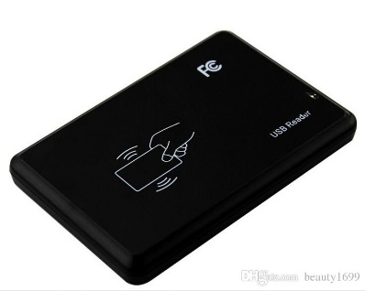
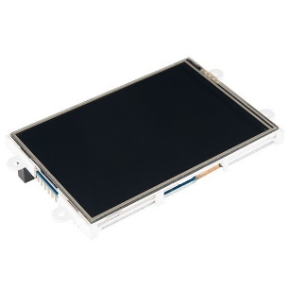

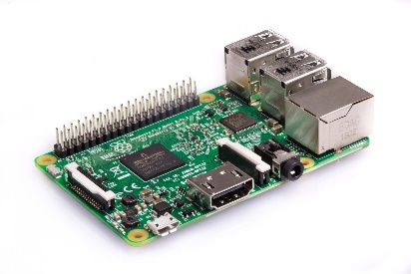

System design
Read and Send RFID code
RFID reader
Display Output to user
Request Checking of RFID code
Respond result of RFID code
Raspberry LCD display
Raspberry Pi 3
MySQL database
Send instruction to door lock
Door lock

Slide 10

Functional requirements
Receiving RFID information of ID Cards.
Locking and unlocking door.
Taking attendance.
Displaying details of the class.
Indicating door status.
Indicating attendance taking status.
Indicate a message after scanning an ID card.

Slide 11

Project estimated cost
ITEMS REQUIRED | ESTIMATED COST
Raspberry Pi 3 B+ | RM 200.00
RFID Reader | RM 50.00
Relay Switch | RM 15.00
Electric Strike | RM 50.00
LCD Display | RM 75.00
GPIO Expansion Board | RM 25.00
DuPont Cables | RM 10.00
Other Accessories | RM 75.00
Grand Total: | RM 500.00

Slide 12







Use case scenario
Door open,
Attendance Taken
Smart Door
User
Smart Door
Legend
Rasberry Pi 3
RFID Scanner
Smart Door
Door Locked,
Attendance Not Taken
LCD Screen (Access Granted)
LCD Screen (Access Denied)
RFID Card (Student ID)

Slide 13

Key performance indicators
Agile.
Risk is highly reduced due to developing through well-known hardware.
Clear objectives
Teamwork is the key.

Slide 14


