Slide 1
Data set describes the orders from the Indian restaurant for the last year. It contains information about the orders, total number of items, product price, name of the product, order date and order ID.

Slide 2
1. Read in the data set.
2. Display the first 50 data entries/rows as well as last 50 entries/rows.

Slide 3
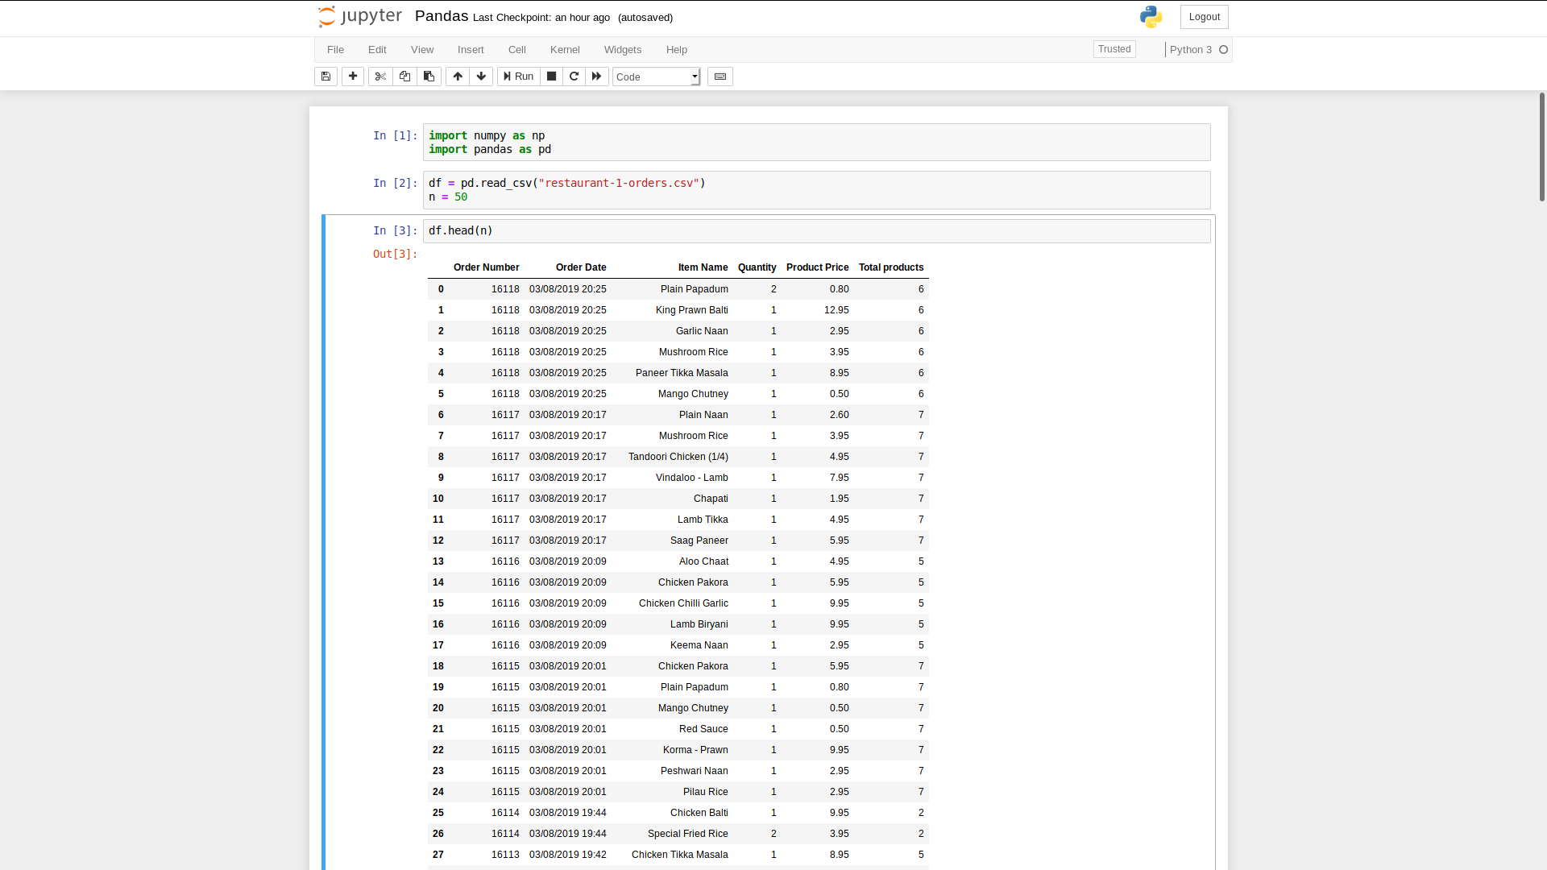

Slide 4
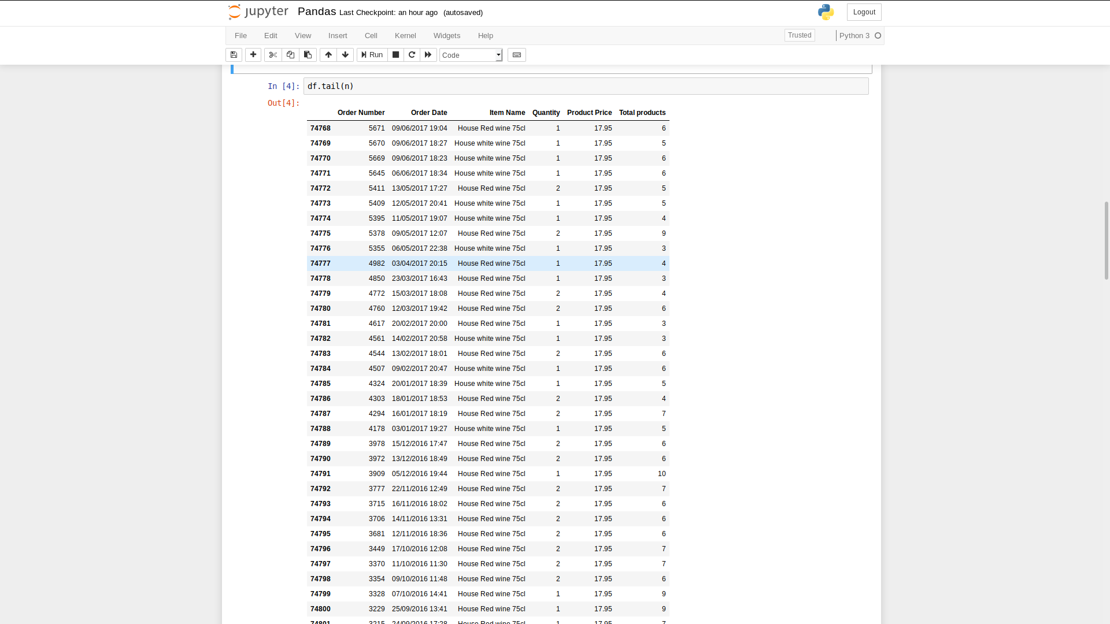

Slide 5
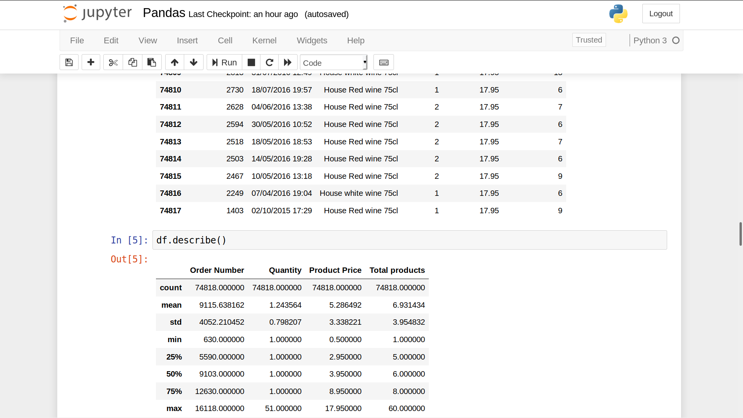
3. Display a quick statistical information on all numerical columns such as count, mean, std, min, max, etc.

Slide 6
4. Select a subset of rows (you decide which subset to select or which criteria to use for selection.) Display the first 10 data entries selected.

Slide 7
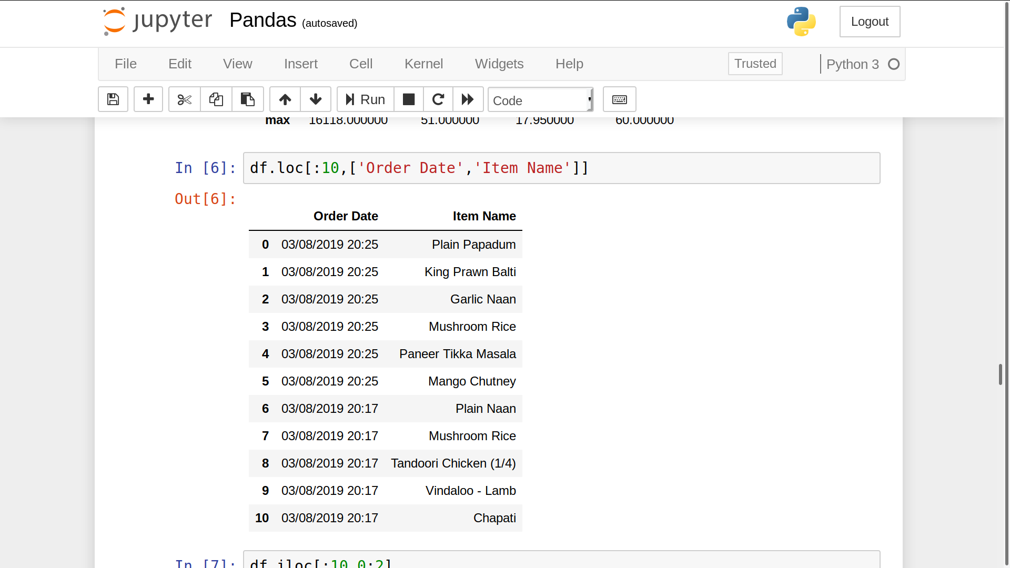

Slide 8
5. Similar to 4, but select a subset of columns (from original data). Display the first 10 data entries with selected columns.

Slide 9
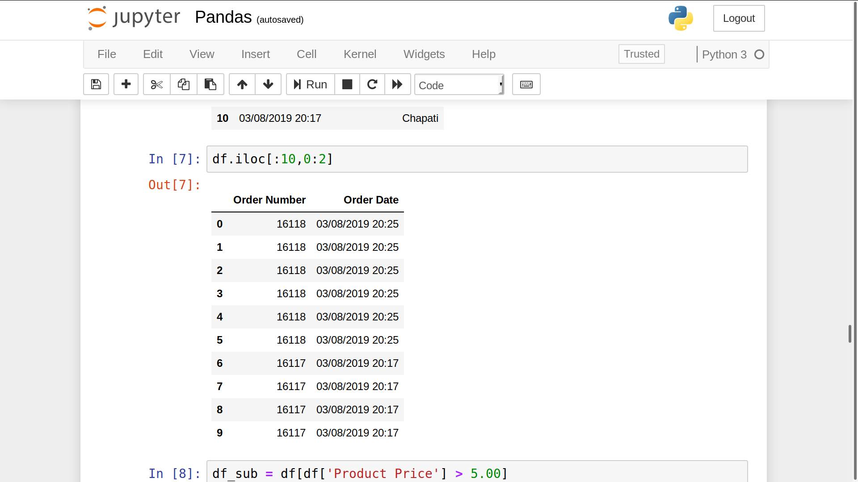

Slide 10
6. From original data, filter out some data, for example, filter out those salary lower than certain amount. After filtering out the data, display the first 50 data entries.

Slide 11
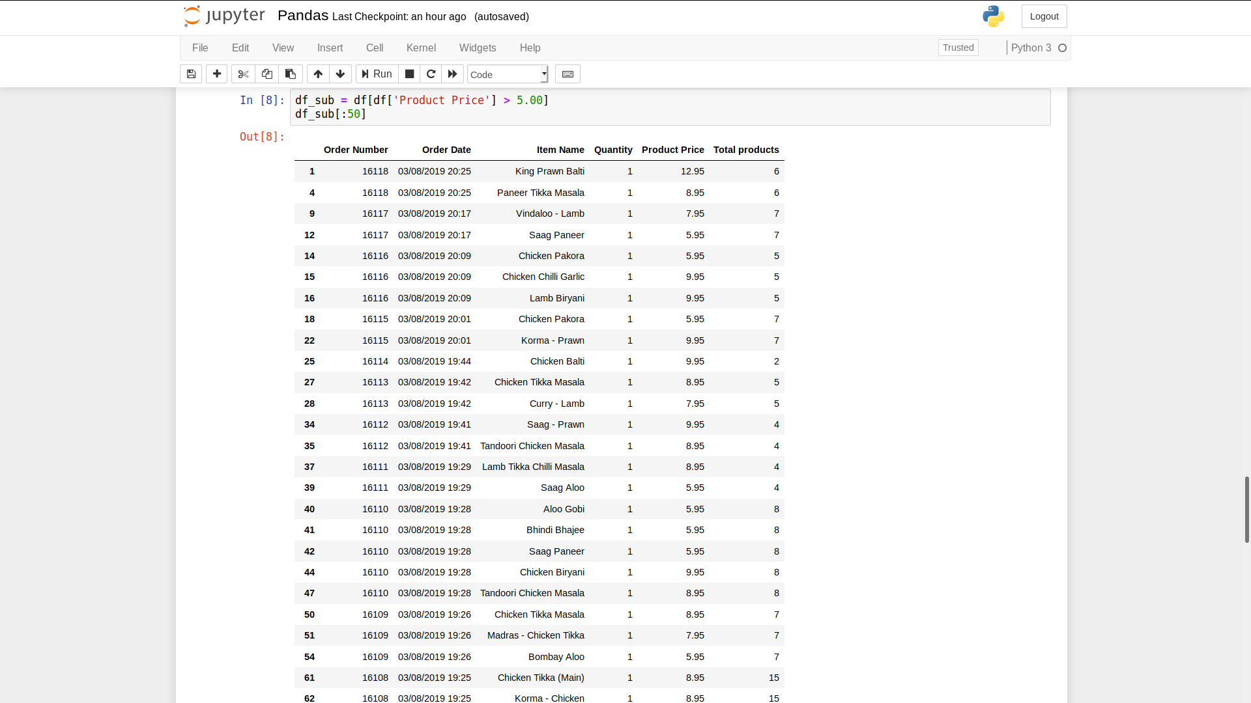

Slide 12
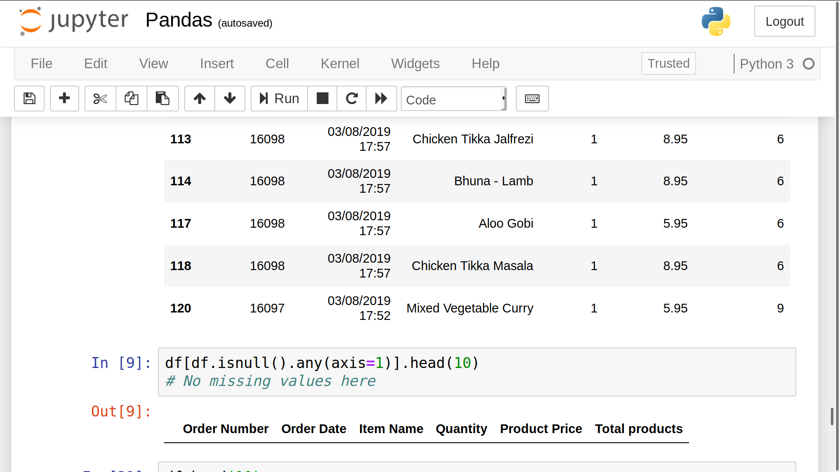
7. From original data, find out all entries with missing values. Display the first 10 entries.

Slide 13
8. Manipulate the original data by changing numerical values of specific column(s) (for example, give everyone 10% raise!) Display the first 10 entries before update and after update.

Slide 14
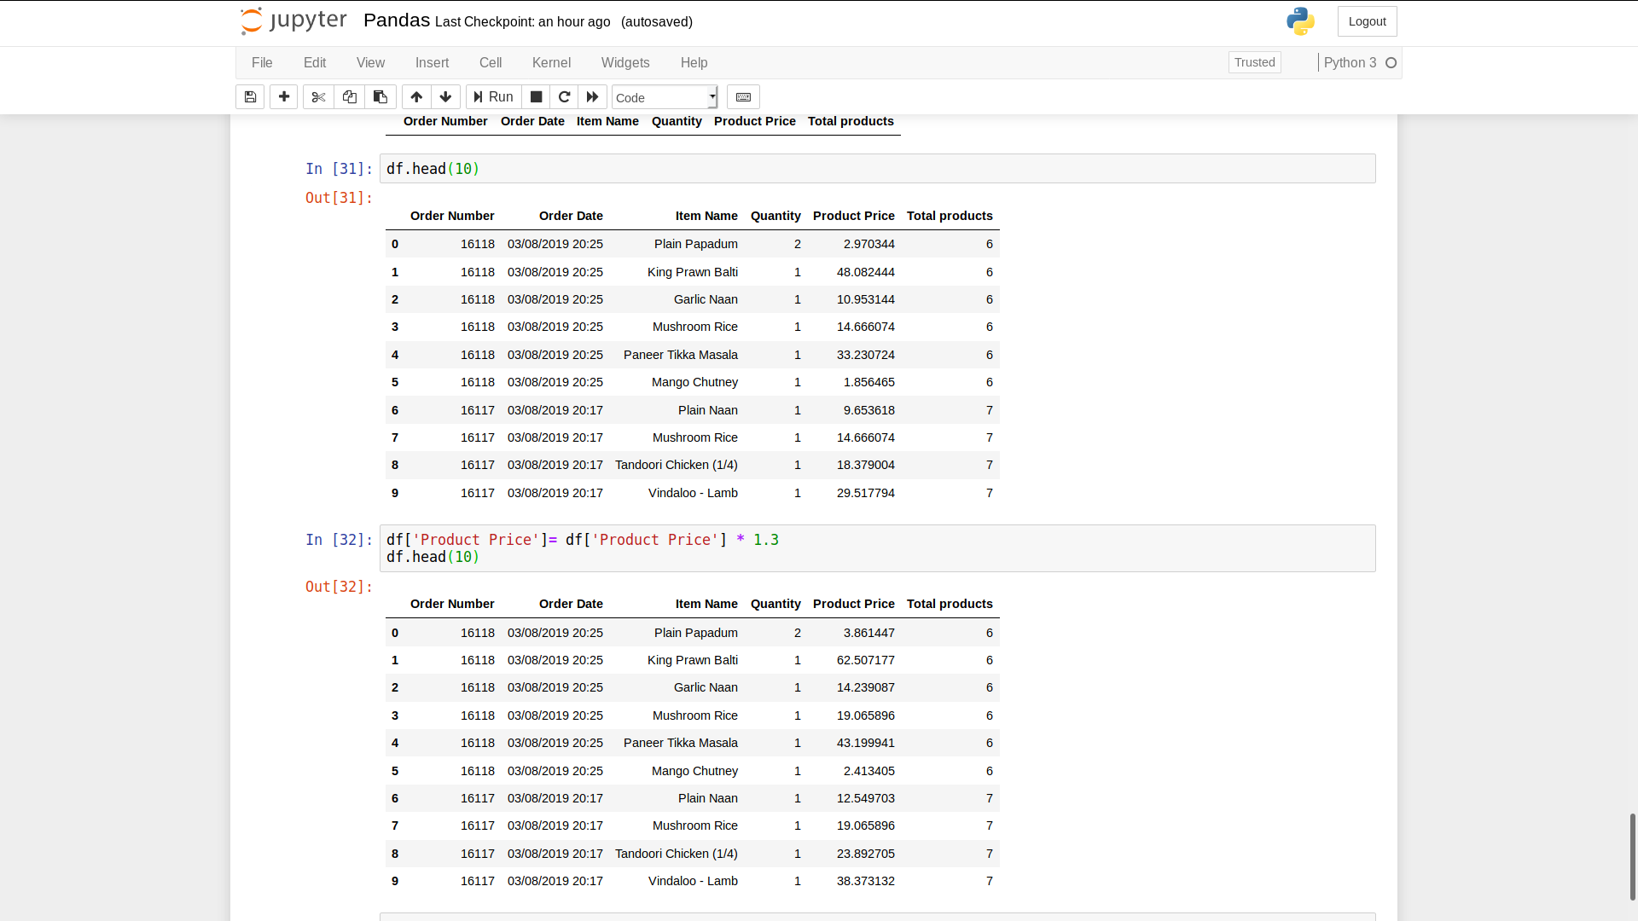

Slide 15
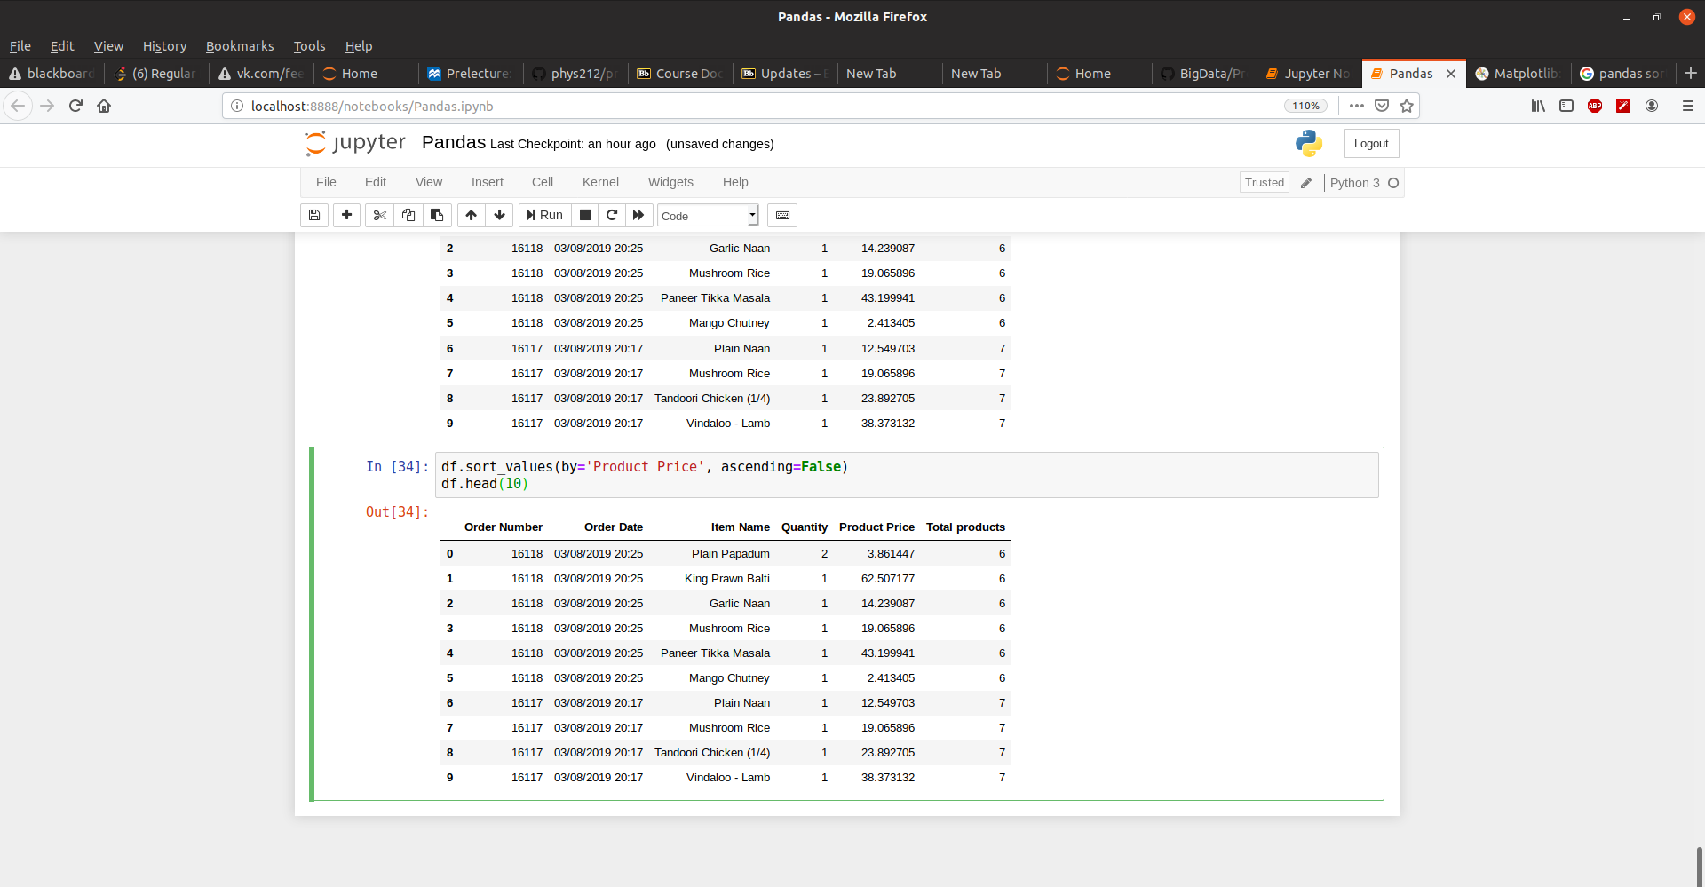

Slide 16
10. Group the data set from step 9 based on certain category (e.g. group based on rank of Professor, Assoc Professor, etc.)

Slide 17
