Slide 1
Government Eng. College Rajkot (gecr)
Presented by
kishan vasani
Internal guide
prof. Rushi Trivedi

Slide 2
INTRODUCTION
The main aim of the project is the gecr to provide all kind activity to student gecr on of most essential tools that are mostly used in gecr student and faculty.
provide all college activity like new-letter, admission, event, workshop details, labs details,hostel details,faculty, staff, etc.

Slide 3
AIMS AND OBJECTIVES
The provide all kind information in government engineering college Rajkot.
If there is any error occurred, we work in this error and solvethis error very soon.
Improving the efficiency of the system by ensuring effectivemonitoringof services and activates.
To system that the user friendly.

Slide 4
SCOPE
Scope of this project website is provided all information in college.
Can be used to covid-19 situation in how to admission this college and view the term and condition.

Slide 5
BENIFITE OF SYSTEM
The system would improve productivity.
The system would enhance User/System interface.
The system will not cost.
The system would improve information quality and accessibility.

Slide 6
PROCESS MODEL
Software Development Life Cycle
Software Development Life Cycle, SDLC for short, is a welldefined, structured sequence of stages in software engineering to develop the intended software product.

Slide 7
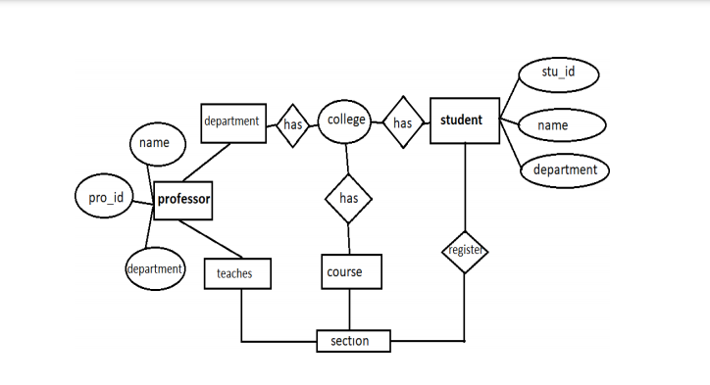
ER - Diagram

Slide 8
ACTIVITY
College circular
Placement details
Hostel details
Faculty details
Admission process
etc...

Slide 9
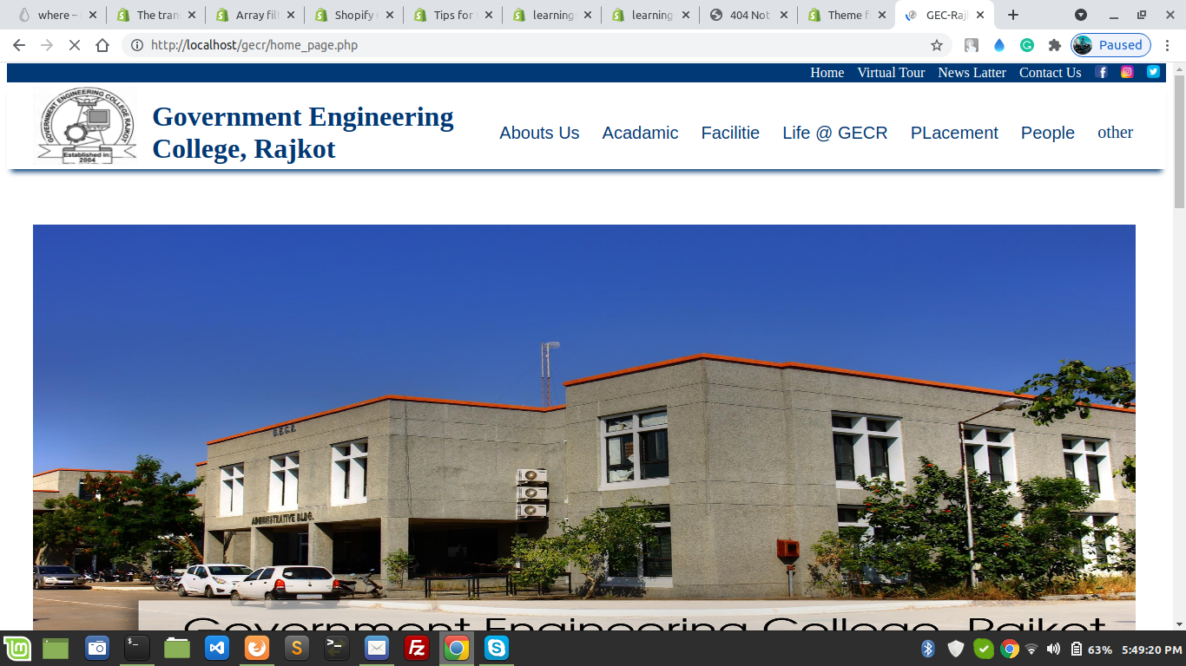
Screenshort of website

Slide 10
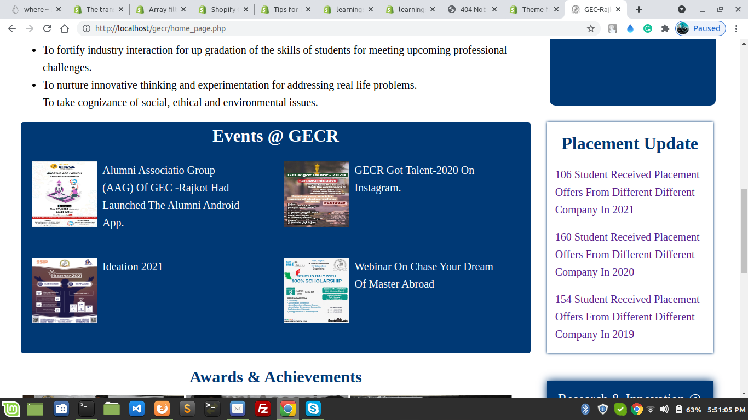
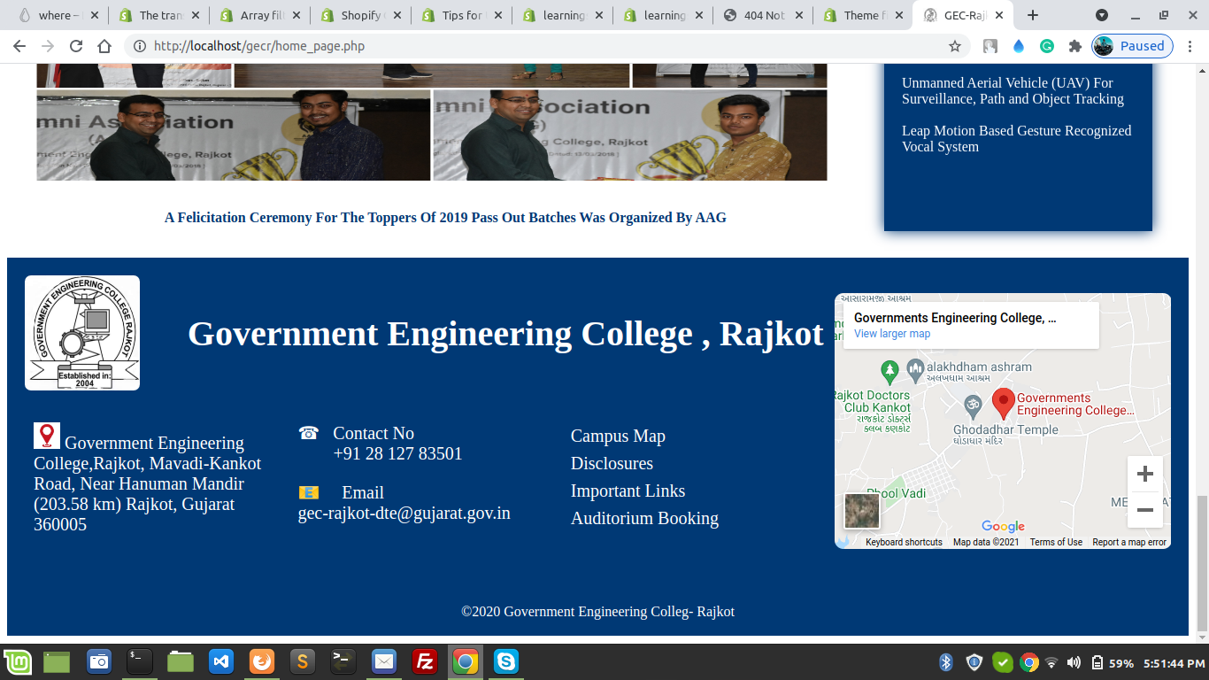

Slide 11
REQURMENT
Hardware Requirement:-
▪ A minimum hard disk space of 20 GB.
▪ RAM size 1 GB.
▪ Pentium 4 dual processor CPU.
▪ A VGA color monitor.
▪ Mouse.
▪ Keyboard.
Software Requirement:-
▪ Any Browser

Slide 12
Limitation
this is web-based application so main required is a good internet and browser.
We can not provided login / sign up.
Any server side issue its main problems in website that not solved in small time.
As soon as possible added the features in over website

Slide 13
Reference
https://www.google.co.in/
https://www.udemy.com/
https://stackoverflow.com/
https://w3school.com/

