Slide 1
BITCOIN Payment System
Instructor Do Huu Vi
Version: 0.0.1

Slide 2
Introduction
What is Bitcoin/Crypto currency
How to pay with Bitcoin
Wallet, HD Wallet
Address
Transaction, Fee
Confirmation
BIPs: 70, 21 (20)
Implementation using NBitcoin lib
Notes:
Introductory notes.

Slide 3
How to Pay with Bitcoin
Get a wallet (an app that lets you receive, hold, and spend bitcoin): BitPay, Copay, Electrum, …
Move bitcoin into your spending wallet
Make a payment
Scan the QR Code
Open the bitcoin URL using the wallet
Manually: enter the payment URL to the wallet
Notes:
Relative vocabulary list.

Slide 4
Bitcoin address
What you share to the world to get paid.
(There is no such thing as a Bitcoin Address), bitcoin address are the map of public key to the corresponding network (MainNet vs TestNet).
To be precise, a bitcoin address is made up of a version byte (which is different on both networks) and your public key’s hash bytes. Both of these bytes are concatenated and then encoded into a Base58Check
Notes:
//mim5ukG6fbWn91dPiuyYPZLqB9pyQTbn61
//0251036303164f6c458e9f7abecb4e55e5ce9ec2b2f1d06d633c9653a07976560c
//Bitcoin Address was the hash of a public key
var publicKeyHash = new Key().PubKey.Hash;
var bitcoinAddress = publicKeyHash.GetAddress(Network.Main);
//there is no such thing as a bitcoin address. The blockchain identifies a receiver with a ScriptPubKey, and that a ScriptPubKey could be generated from the address:
var scriptPubKey = bitcoinAddress.ScriptPubKey;
Console.WriteLine(scriptPubKey); // OP_DUP OP_HASH160 41e0d7ab8af1ba5452b824116a31357dc931cf28 OP_EQUALVERIFY OP_CHECKSIG
var sameBitcoinAddress = scriptPubKey.GetDestinationAddress(Network.Main);

Slide 5
Wallet
An app that lets you receive, hold, and spend bitcoin: BitPay, Copay, Electrum, …
https://bitcoin.org/en/choose-your-wallet
Bitcoin URI Support (BIP 21)
bitcoin:<address>[?amount=<amount>][?label=<label>][?message=<message>]
Users follow a link or scan a QR code
Supporting wallets automatically prepare a payment of the proper amount to the correct address.
Payment Protocol Support (BIP 70, BIP 71, BIP 72 and BIP 73)
enables secure payment requests,
secure payment destinations,
payment experience improvements (payment received notifications, pre-determined refund addresses, and secure proof of payment)
Notes:
bitcoin:mim5ukG6fbWn91dPiuyYPZLqB9pyQTbn61?amount=60.3X8&label=Luke-Jr
bitcoin:?r=http://localhost:35175/?id%3d1%26type%3dRequest

Slide 6
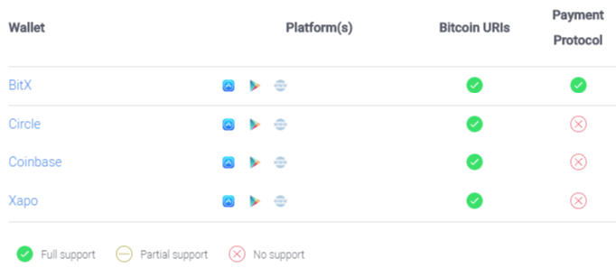
Wallet (cont)
Bitcoin Account Services: manage a bitcoin wallet on behalf of users, much like a bank manages a customer's funds.
Notes:
Account services can be used as bitcoin wallets, though users should keep in mind many of these institutions do not insure consumers from the loss of deposits via theft, fraud, or bankruptcy. It is also not uncommon for account services to delay sending bitcoin, which can slow down purchase experiences and cause unnecessary hassle for users.
https://bitpay.com/docs/wallets

Slide 7
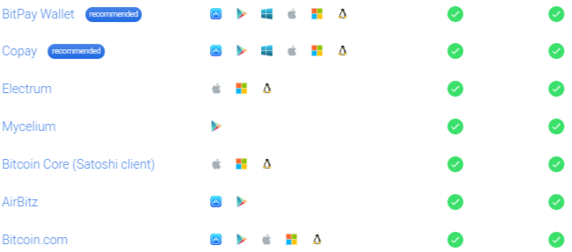
Wallet (cont)
True Wallets: wallets with which users control the keys to their own bitcoin.
Notes:
Relative vocabulary list.

Slide 8
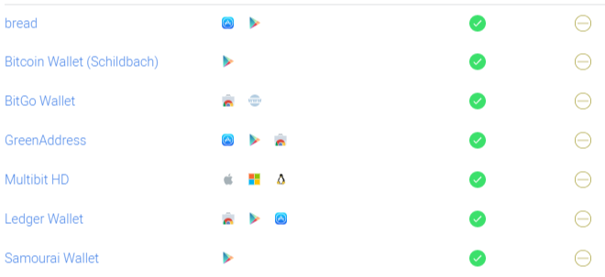
Wallet (cont)
Notes:
Relative vocabulary list.

Slide 9
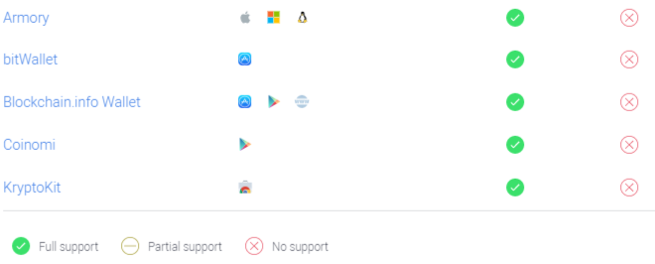
Wallet (cont)
Notes:
Relative vocabulary list.

Slide 10
HD Wallet
Problems with classic address:
need to maintain a mapping between your business transaction and the private key you used
If such database is compromised or private key stolen, you loose money.
A solution is called Hierarchical Deterministic Wallet
Notes:
Prevent outdated backups
Delegating key / address generation to an untrusted peer

Slide 11
HD Wallet
wallets which can be shared partially or entirely with different systems, each with or without the ability to spend coins
you can give your payment server the right to generate public keys, without giving the private key
If the payment database is stolen or compromised, you loose nothing.
In NBitcoin, this feature is implemented with two classes : ExtKey and ExtPubKey.
Notes:
ExtKey will generate a Key for a corresponding ID, ExtPubKey will generate a PubKey for a corresponding ID.
ExtKey masterKey = new ExtKey();
Console.WriteLine("Master key : " + masterKey.ToString(Network.Main));
for (int i = 0; i < 5; i++) {
ExtKey key = masterKey.Derive((uint)i);
Console.WriteLine("Key " + i + " : " + key.ToString(Network.Main));
}
///
ExtPubKey masterPubKey = masterKey.Neuter();
for (int i = 0 ; i < 5 ; i++) {
ExtPubKey pubkey = masterPubKey.Derive((uint)i);
Console.WriteLine("PubKey " + i + " : " + pubkey.ToString(Network.Main));
}

Slide 12
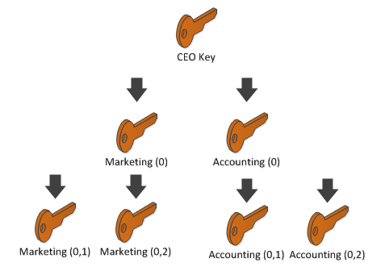
HD Wallet
Notes:
In the previous exercise, we have seen that by combining master key + index we could generate another key. We call this process Derivation, the master key is the parent key, and any generated keys are called child keys.
However, you can also derivate children from the child key. This is what the “hierarchical” stands for.
This is why conceptually more generally you can say: Parent Key + KeyPath => Child Key

Slide 13
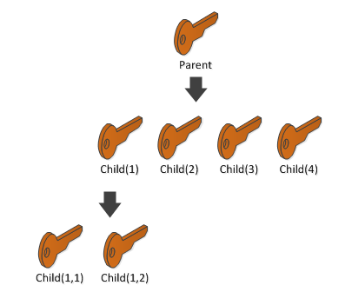
HD Wallet
Notes:
In this diagram, you can derivate Child(1,1) from parent in two different way:
ExtKey parent = new ExtKey();
ExtKey child11 = parent.Derive(1).Derive(1);
Or
ExtKey parent = new ExtKey();
ExtKey child11 = parent.Derive(new KeyPath("1/1"));

Slide 14
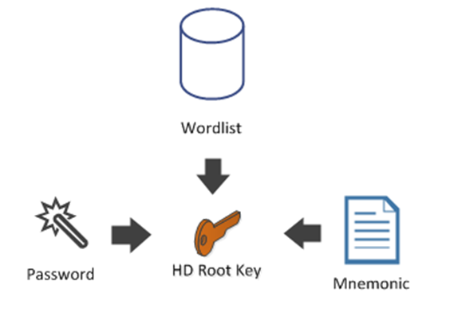
Mnemonic
generate the HD Keys from a sentence that can easily be written down
can eventually be protected by a password or a PIN
Notes:
Mnemonic mnemo = new Mnemonic(Wordlist.English, WordCount.Twelve);
System.Diagnostics.Debug.WriteLine("mnemo: " + mnemo);
ExtKey hdRoot = mnemo.DeriveExtKey("my password");
//recover
mnemo = new Mnemonic("minute put grant neglect anxiety case globe win famous correct turn link", Wordlist.English);

Slide 15
Transaction
a transfer of Bitcoin value that is broadcast to the network and collected into blocks.
typically references previous transaction outputs as new transaction inputs and dedicates all input Bitcoin values to new outputs.
not encrypted
Once transactions are buried under enough confirmations they can be considered irreversible.
Notes:
Relative vocabulary list.

Slide 16
Types of Transaction
Pay-to-PubkeyHash
Pay-to-Script-Hash
Notes:
Bitcoin currently creates two different scriptSig/scriptPubKey pairs. These are described below.
It is possible to design more complex types of transactions, and link them together into cryptographically enforced agreements. These are known as Contracts.

Slide 17
Confirmation
After a transaction is broadcast to the Bitcoin network, it may be included in a block that is published to the network. When that happens it is said that the transaction has been mined at a depth of 1 block. With each subsequent block that is found, the number of blocks deep is increased by one. To be secure against double spending, a transaction should not be considered as confirmed until it is a certain number of blocks deep.
Notes:
https://blockchain.info/tx/9189cb899acd945f818d5d0e188fe0270bae86fdce6c195ad6cd52988e40afa1

Slide 18
Confirmation
How Many Confirmations Is Enough?
6
Transactions with 0/unconfirmed in some cases may still be acceptable especially for low-value goods and services
https://people.xiph.org/~greg/attack_success.html: can be used to calculate the probability of a successful doublespend given a hashrate proportion and number of confirmations
Notes:
The classic bitcoin client will show a transaction as "n/unconfirmed" until the transaction is 6 blocks deep. Merchants and exchanges who accept bitcoins as payment can and should set their own threshold as to how many blocks are required until funds are considered confirmed. When potential loss due to double spending as nominal, as with very inexpensive or non-fungible items, people may choose not to wait for a transaction to be confirmed, and complete the exchange as soon as it is seen on the network. Most exchanges and other merchants who bear the risk from double spending require 6 or more blocks.
There is nothing special about the default, often-cited figure of 6 blocks. It was chosen based on the assumption that an attacker is unlikely to amass more than 10% of the hashrate, and that a negligible risk of less than 0.1% is acceptable. Both these figures are arbitrary, however; 6 blocks are overkill for casual attackers, and at the same time powerless against more dedicated attackers with much more than 10% hashrate.^{[1]}
Freshly-mined coins cannot be spent for 100 blocks. It is advisable to wait some additional time for a better chance that the transaction will be propagated by all nodes. Some older bitcoin clients won't show generated coins as confirmed until they are 120 blocks deep.
https://en.bitcoin.it/wiki/Confirmation

Slide 19
Confirmation
How to get the confirmation?
There are roughly three way to communicate with the Bitcoin network: as a full node, as an SPV SPV(Simplified Payment Verification) node or through an HTTP API.
Notes:
Relative vocabulary list.

Slide 20
QBit Ninja
an open source web service API to query the blockchain and for tracking wallets
Notes:
https://github.com/MetacoSA/QBitNinja

Slide 21
SPV
each block in the blockchain contains two parts, a long list of transactions and a short summary of the block's contents (the header)
Using Merkle tree design, thin wallets can safely confirm that transactions they receive have been included in the blockchain without downloading the full blockchain.
A Bitcoin wallet app that uses SPV can also offer many but not all of the same security guarantees as a full wallet.
Notes:
(the header, contains a hash of all the transactions within that block, structured (Merkle tree) in such a way that any Bitcoin wallet program can easily check whether a transaction belongs to a particular block by considering its hash value)

Slide 22
Fee
The cost your wallet pays for the computing power which confirms bitcoin transactions on the Bitcoin network
Notes:
Relative vocabulary list.

Slide 23
BIP 70: Payment Protocol
This BIP describes a protocol for communication between a merchant and their customer, enabling both a better customer experience and better security against man-in-the-middle attacks on the payment process.
encoded using Google's Protocol Buffers (consists of three messages: PaymentRequest, Payment, and PaymentACK)
authenticated using X.509 certificates
communicated over http/https
Notes:
This BIP extends the above protocol to support several new features:
1) Human-readable, secure payment destinations-- customers will be asked to authorize payment to "example.com" instead of an inscrutable, 34-character bitcoin address.
2) Secure proof of payment, which the customer can use in case of a dispute with the merchant.
3) Resistance from man-in-the-middle attacks that replace a merchant's bitcoin address with an attacker's address before a transaction is authorized with a hardware wallet.
4) Payment received messages, so the customer knows immediately that the merchant has received, and has processed (or is processing) their payment.
5) Refund addresses, automatically given to the merchant by the customer's wallet software, so merchants do not have to contact customers before refunding overpayments or orders that cannot be fulfilled for some reason.

Slide 24
BIP 70: minimal Bitcoin payment protocol operates
Customer adds items to an online shopping basket, and decides to pay using Bitcoin.
Merchant generates a unique payment address, associates it with the customer's order, and asks the customer to pay.
Customer copies the Bitcoin address from the merchant's web page and pastes it into whatever wallet they are using OR follows a bitcoin: link and their wallet is launched with the amount to be paid.
Customer authorizes payment to the merchant's address and broadcasts the transaction through the Bitcoin p2p network.
Merchant's server detects payment and after sufficient transaction confirmations considers the transaction final.
Notes:
Relative vocabulary list.

Slide 25
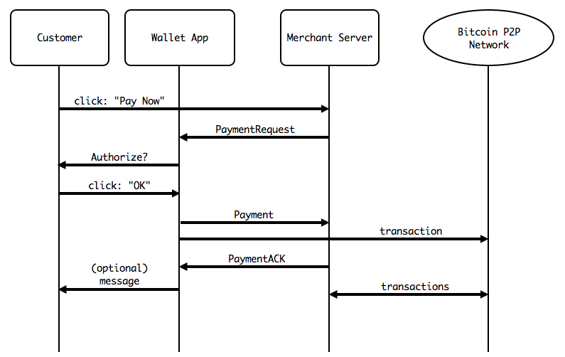
BIP 70: Payment Protocol
Notes:
https://github.com/bitcoin/bips/blob/master/bip-0070.mediawiki

Slide 26
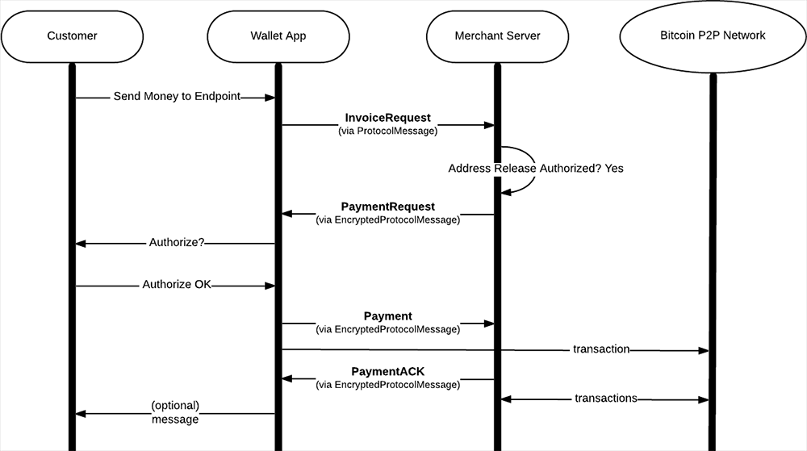
BIP 70: Payment Protocol
Notes:
https://github.com/bitcoin/bips/blob/master/bip-0070.mediawiki

Slide 27
BIP 70: Protocol Buffers messages
message Output {
optional uint64 amount = 1 [default = 0]; optional bytes script = 2;
}
Notes:
https://github.com/bitcoin/bips/blob/master/bip-0070.mediawiki

Slide 28
BIP 70: Protocol Buffers messages
message PaymentDetails {
optional string network = 1 [default = "main"];
repeated Output outputs = 2;
required uint64 time = 3;
optional uint64 expires = 4;
optional string memo = 5;
optional string payment_url = 6;
optional bytes merchant_data = 7;
}
Notes:
https://github.com/bitcoin/bips/blob/master/bip-0070.mediawiki

Slide 29
BIP 70: Protocol Buffers messages
message PaymentRequest {
optional uint32 payment_details_version = 1 [default = 1];
optional string pki_type = 2 [default = "none"];
optional bytes pki_data = 3;
required bytes serialized_payment_details = 4;
optional bytes signature = 5;
}
Notes:
https://github.com/bitcoin/bips/blob/master/bip-0070.mediawiki

Slide 30
BIP 70: Protocol Buffers messages
//sent after the customer has authorized payment:
message Payment {
optional bytes merchant_data = 1;
repeated bytes transactions = 2;
repeated Output refund_to = 3;
optional string memo = 4;
}
Notes:
https://github.com/bitcoin/bips/blob/master/bip-0070.mediawiki

Slide 31
BIP 70: Protocol Buffers messages
//PaymentACK is the final message in the payment protocol; it is sent from the merchant's server to the bitcoin wallet in response to a Payment message:
message PaymentACK {
required Payment payment = 1;
optional string memo = 2;
}
Notes:
https://github.com/bitcoin/bips/blob/master/bip-0070.mediawiki

Slide 32
BIP 70: What wallet do?
When a Bitcoin wallet app receives a PaymentRequest, it must authorize payment by doing:
Validate the merchant's identity and signature using the PKI system, if the pki_type is not "none".
Validate that customer's system unix time (UTC) is before PaymentDetails.expires. If it is not, then the payment request must be rejected.
Display the merchant's identity and ask the customer if they would like to submit payment (e.g. display the "Common Name" in the first X.509 certificate).
Payment messages are sent after the customer has authorized payment
Notes:
https://github.com/bitcoin/bips/blob/master/bip-0070.mediawiki

Slide 33
BIP 70: What wallet do?
If the customer authorizes payment, then the Bitcoin wallet:
Creates and signs one or more transactions that satisfy (pay in full) PaymentDetails.outputs.
Validate that customer's system unix time (UTC) is still before PaymentDetails.expires. If it is not, the payment should be cancelled.
Broadcast the transactions on the Bitcoin p2p network.
If PaymentDetails.payment_url is specified, POST a Payment message to that URL. The Payment message is serialized and sent as the body of the POST request.
When the merchant's server receives the Payment message, it must determine whether or not the transactions satisfy conditions of payment.
Notes:
https://github.com/bitcoin/bips/blob/master/bip-0070.mediawiki

Slide 34
Questions/Discussions
Notes:
An opportunity for questions and discussions.

