Slide 1
BIG DATA
Hung Tran

Slide 2
History
What is Big Data?
How big is Big Data?
Why Big Data?
Value chain & Components
Eco-system
Use case & Applications
Challenges
Hadoop
Spark

Slide 3
History
1960s and 1970s: first data center (US tax, fingerprints)
2005:
Social network: YouTube, Yahoo, Facebook,…
O’Reilly Media coined the term Big Data for the first time
Hadoop
NoSQL
Cloud Computing
2010:
Sparks
IoT
…

Slide 4
What Is Big Data?
Definition | Source
“Big data is high volume, high velocity, and/or high variety information assets that require new forms of processing to enable enhanced decision making, insight discovery and process optimization” | 1 & 2
“When the size of the data itself becomes part of the problem and traditional techniques for working with data run out of steam” | 3
“Big Data technologies [are] a new generation of technologies and architectures designed to extract value economically from very large volumes of a wide variety of data by enabling high-velocity capture, discovery, and/or analysis” | 4
Big data is data sets that are so voluminous and complex that traditional data-processing application software are inadequate to deal with them. | Wiki
“Big data can mean big volume, big velocity, or big variety” | 5
… | …
Notes:
1: Laney, D. (2001). 3D data management: Controlling data volume, velocity, and variety. Technical report, META Group.
2: Manyika, J., Chui, M., Brown, B., Bughin, J., Dobbs, R., Roxburgh, C., & Byers, A. H. (2011). Big data: The next frontier for innovation, competition, and productivity. McKinsey Global Institute, p. 156
3: Loukides, M. (2010). What is data science? O’Reily Radar
4: IDC. (2011). IDC’s worldwide big data taxonomy.
5: Stonebraker, M. (2012). What does ‘big data’ mean. Communications of the ACM, BLOG@ ACM.

Slide 5
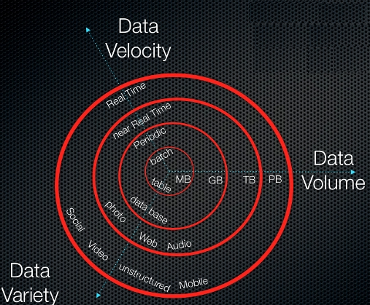
Three Vs
Volume
The amount of data matters.
Velocity
Velocity is the fast rate at which data is received and (perhaps) acted on.
Variety
Variety refers to the many types of data that are available
Source: https://itknowledgeexchange.techtarget.com
Notes:
Volume: With big data, you’ll have to process high volumes of low-density, unstructured data. This can be data of unknown value, such as Twitter data feeds, clickstreams on a webpage or a mobile app, or sensor-enabled equipment. (tens terabytes to hundreds petabytes)
Velocity: the speed at which the data is generated and processed to meet the demands and challenges that lie in the path of growth and development.
Variety: Traditional data types were structured and fit neatly in a relational database. With the rise of big data, data comes in new unstructured data types. Unstructured and semi-structured data types, such as text, audio, and video require additional preprocessing to derive meaning and support metadata.

Slide 6
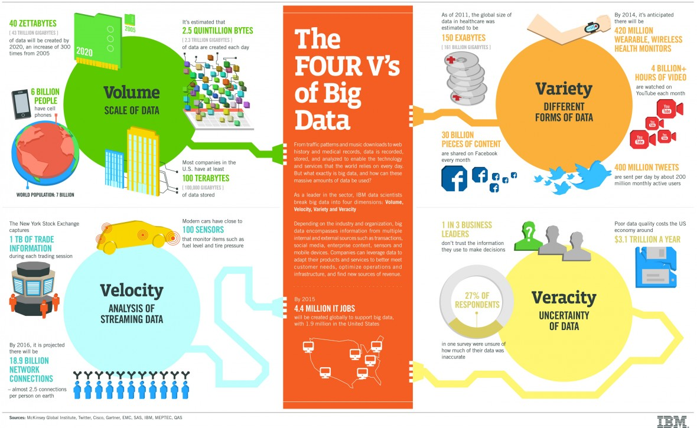
Four Vs
Source: http://www.ibmbigdatahub.com/infographic/four-vs-big-data
Notes:
Veracity: the possible consistency of data is good enough for Big Data.

Slide 7
Other Vs
Value
Variability
How fast is the structure / meaning of your data changing?
Vulnerability
Visualization
Does it trigger a decision?
Vocabulary
Contents that describe the data‘s structure, syntax, content, and provenance
…
Notes:
Value:
Vulnerability:
Volatility: How long does data need to be kept for?
Visualization:
Vocabulary

Slide 8
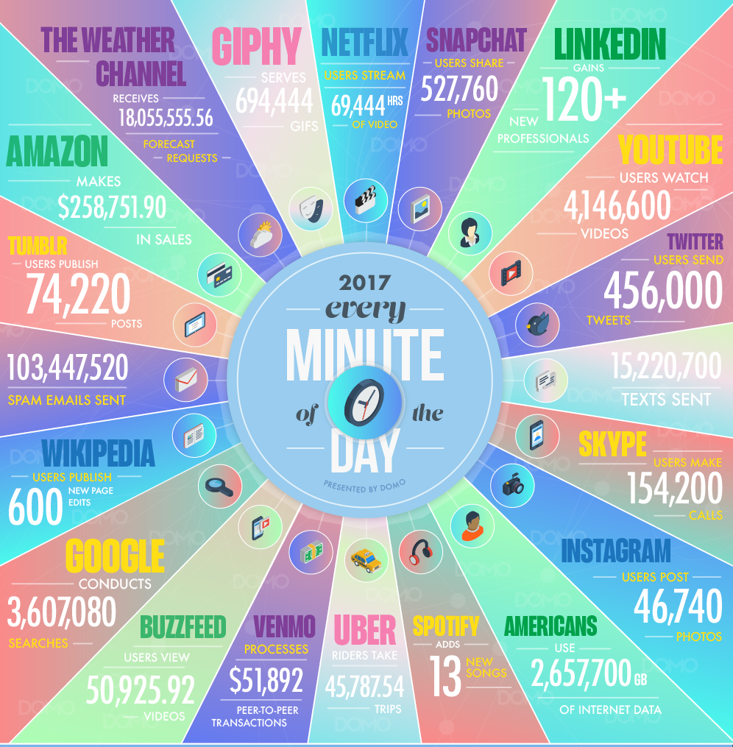
How big is Big Data?
(Source: https://www.domo.com/blog/data-never-sleeps-5/)

Slide 9
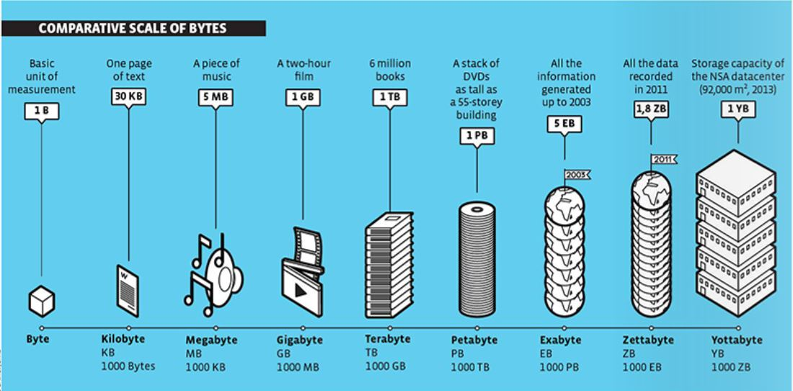
How big is Big Data? (cont.)
(Source: https://www.waterfordtechnologies.com/wp-content/uploads/2018/03/54.jpg)
Notes:
2017: 16.3 ZB (IDC)
2025: 180 ZB (IDC)

Slide 10
How big is Big Data (cont.)
Doubles every 1.5 years [IBM, 2016 / IDC,2014]
50 billion smart device by 2020 [McKinsey,2017]
44 ZB created & copied each year by 2020 [EMC,2014]
37% data is useful [IDC,2014]
0.5% data is analyzed [IDC,2013]
Market grow from $28.65 billion (2016) to $66.79 billion (2021) [Big Data Market]
Revenues for big data and business analytics from 132.1 billion (2016) to 210 billion (2020) [International Data Corporation (IDC)]

Slide 11
Why Big Data?
Cost reduction (storage, processing)
New products and services
New data sources (IoT, Social Network,…)
Smarter and faster decision-making
Advances in Networking
50% more revenue to the companies who have integrated this concept into their processes - Forbes.
Machine Learning, AI
…

Slide 12
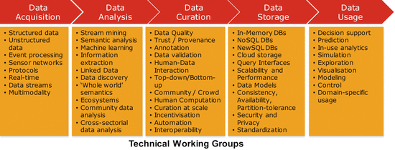
Big Data Value Chain
Source: New Horizons for a Data-Driven Economy (2015)
Notes:
Data Analysis or Data Storage First?!?

Slide 13
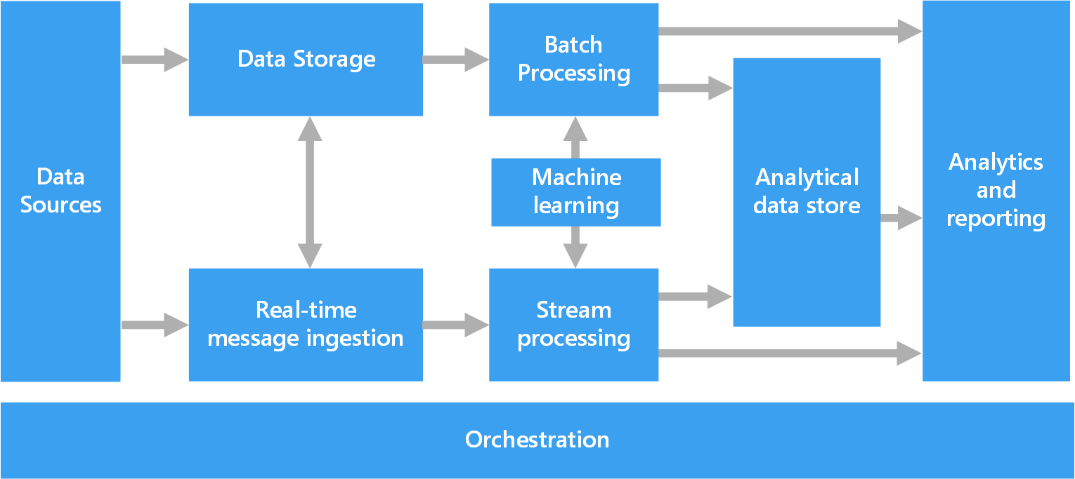
Components of a big data
Source: https://docs.microsoft.com/en-us/azure/architecture/data-guide/big-data/

Slide 14
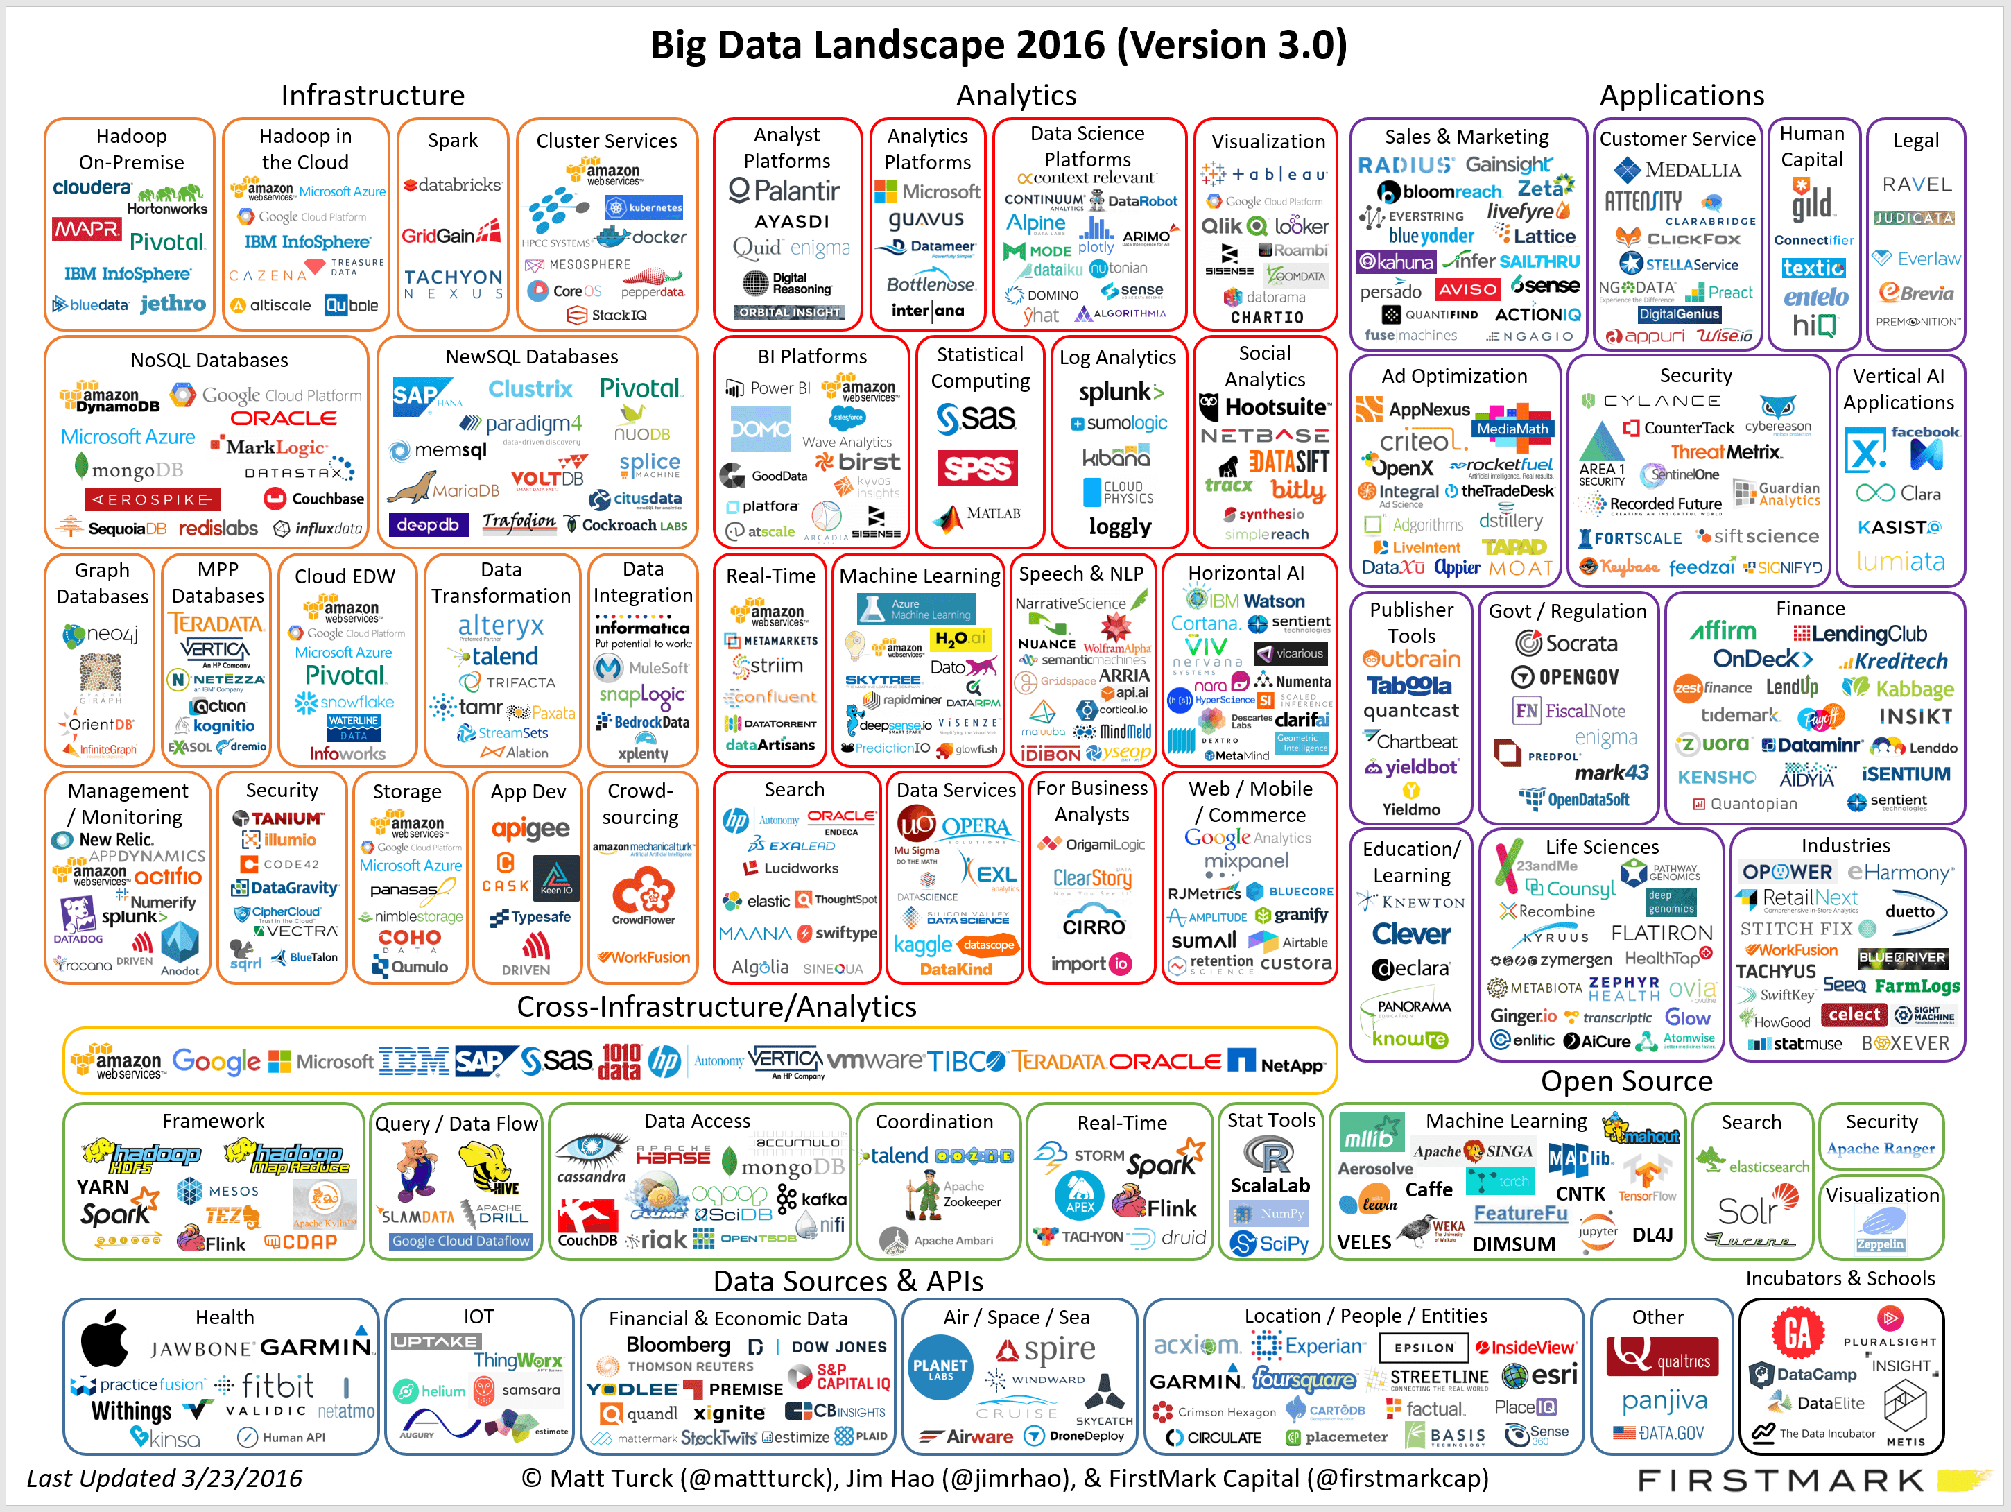
Big Data Ecosystem
Source: https://www.datameer.com/blog/big-data-ecosystem/

Slide 15
Use Cases
Product Development
Predictive Maintenance
Customer Experience
Fraud and Compliance
Machine Learning
Operational Efficiency
Drive Innovation
…
Notes:
Product Development
Netflix and Procter & Gamble build predictive models for new products and services by classifying key attributes of past and current products or services and modeling the relationship between those attributes and the commercial success of the offerings
P&G uses data and analytics from focus groups, social media, test markets, and early store rollouts to plan, produce, and launch new products.
Predictive Maintenance
CERN currently analyzes big data produced by tens of thousands of sensors on the Large Hadron Collider to ensure its particle accelerators are operating at full potential, and if not, that the causes of any fault can be identified and addressed.
An analysis might include data from spreadsheets, databases, social media and even photos, so having the right data preparation processes in places will be crucial to combing all this information in a cohesive way.
Customer Experience
Big data enables you to gather data from social media, web visits, call logs, and other data sources to improve the interaction experience and maximize the value delivered.
Dell, Andoid, iOS, Facebook
Fraud and Compliance
Big data helps you identify patterns in data that indicate fraud and aggregate large volumes of information to make regulatory reporting much faster.
Fraud Credit Card Detection, Cyber Attack Prevention
Machine Learning
Operational Efficiency
With big data, you can analyze and assess production, customer feedback and returns, and other factors to reduce outages and anticipate future demands. Big data can also be used to improve decision-making in line with current market demand.
eBay
Drive Innovation
Big data can help you innovate by studying interdependencies between humans, institutions, entities, and process and then determining new ways to use those insights. Use data insights to improve decisions about financial and planning considerations. Examine trends and what customers want to deliver new products and services.

Slide 16
Applications
Government
Manufacturing & Marketing
Healthcare
Education
Media & Entertainment
IoT
…
Notes:
Government: Traffic Optimization, Tax Compliance, Weather Forecasting, Scientific Research, Pharmaceutical Drug Evaluation, Crime Prediction and Prevention, Cyber security & Intelligence
Manufacturing & Marketing: supply panning, product quality, output forecasting, test, simulation, tracking
Healthcare: predict disease, vaccines, treatments, reduce costs
Education: Customize programs, target recruiting, reduce dropout, career prediction,
Media & Entertainment: Ad targeting, predicting what audience wants, new product development
IoT

Slide 17
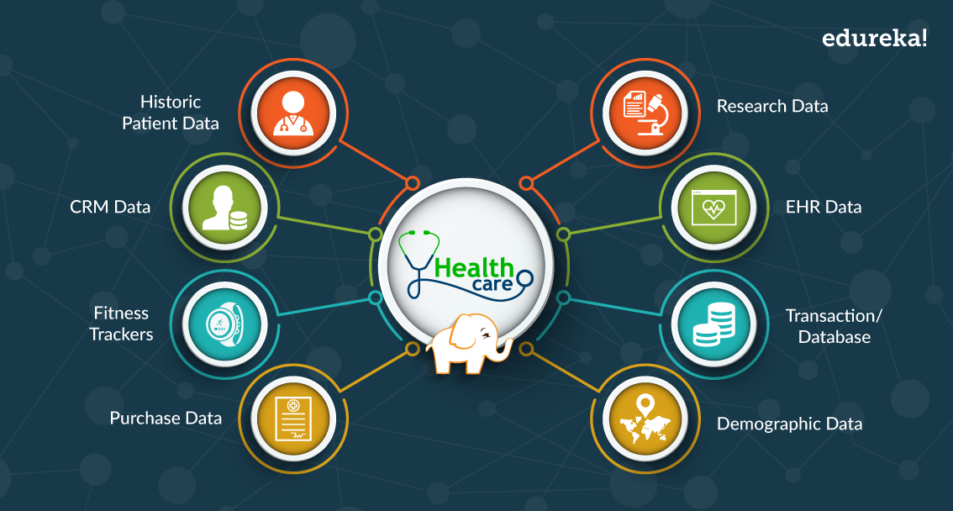
Applications (cont.): Healthcare sample
Source: https://www.edureka.co/blog/big-data-applications-revolutionizing-various-domains/
Notes:
EHR: Electronic Healthcare Record
Researchers: treatments for particular conditions, identify patterns related to drug side effects, reduce costs
Fitness Tracker
Geographical data sets: predict disease that will escalate in specific areas, diagnostics and plan for stocking serums and vaccines

Slide 18
Best Practices
Align Big Data with Specific Business Goals
Ease Skills Shortage with Standards and Governance
Optimize Knowledge Transfer with a Center of Excellence
Top Payoff Is Aligning Unstructured with Structured Data
Plan Your Discovery Lab for Performance
Align with the Cloud Operating Model
…
Notes:
Align Big Data with Specific Business Goals: more data make new discoveries
Ease Skills Shortage with Standards and Governance: add big data to governance program
Optimize Knowledge Transfer with a Center of Excellence: Use a Center of Excellence to share knowledge, control oversight, and manage project communications.
Plan Your Discovery Lab for Performance: Discovering meaning in your data is not always straightforward.

Slide 19
Challenges
Big (doubling in size about every two years)
Clean data (50 - 80 % time for curating and preparing data)
Shortage of Data Scientists
New Skill Profiles and Technologies
Technology is changing at a rapid pace (Apache Hadoop -> Apache Spark -> Combination)
Parallel Processing, Distributed Technology, Data Mining, NoSQL
Data Privacy & Data Security
Getting Real-time Insights
Cost
…
Notes:
Organizational Resistance: 55.9 % of Fortune 1000 companies have hired Chief Data Officers (CDOs) to meet this requirement.

Slide 20
Hadoop
a set of open source programs and procedures which anyone can use as the "backbone" of their big data operations.
Distributed File-System (HDFS)
MapReduce
Hadoop Common
YARN (Yet Another Resource Negotiator)
Notes:
Hadoop Distributed File System
A distributed file system that provides high-throughput access to application data
MapReduce
A YARN-based system for parallel processing of large data sets
Read database and put to a format for analysis (map)
Perform mathematical operations
Hadoop Common
The common utilities that support the other Hadoop modules
YARN
A framework for job scheduling and cluster resource management (manages resources of the systems storing the data and running the analysis)

Slide 21
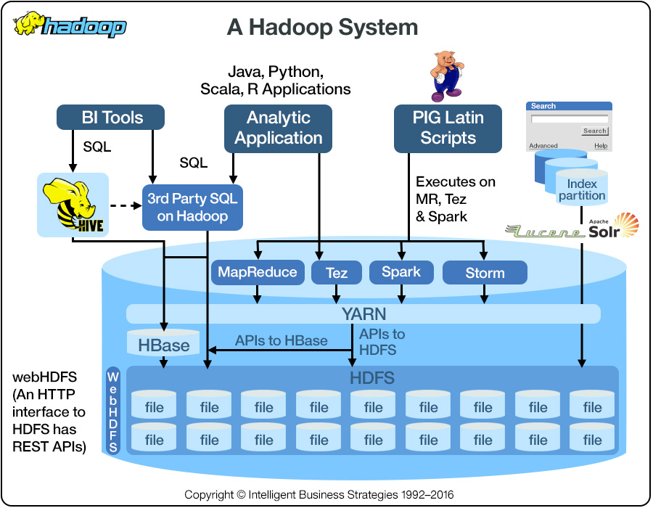
Hadoop (cont.)
Notes:
HBase (Hadoop Database) is a columnar database built on top of the HDFS.
Pig serves the analysis purpose for large data sets.
Hive is new kind of structured query language.
BI (Business Intelligence)
Hadoop execution engines
Apache Spark™ is a unified analytics engine for large-scale data processing.
The Apache TEZ® project is aimed at building an application framework which allows for a complex directed-acyclic-graph of tasks for processing data.
Apache™ Storm adds reliable real-time data processing capabilities to Enterprise Hadoop.
Solr is the popular, blazing-fast, open source enterprise search platform built on Apache Lucene™

Slide 22
Spark (cont)
Apache Spark™ is a unified analytics engine for large-scale data processing.
Combine SQL, streaming, and complex analytics.
Java, Scala, Python, R, and SQL.
Runs on Hadoop, Apache Mesos, Kubernetes, standalone, or in the cloud. It can access diverse data sources.

Slide 23
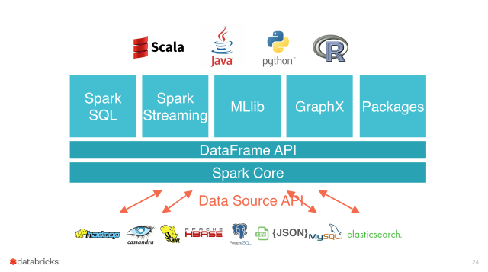
Spark
Source: https://ogirardot.wordpress.com/2015/05/29/rdds-are-the-new-bytecode-of-apache-spark/
Notes:
Spark SQL is Apache Spark's module for working with structured data.
Spark Streaming makes it easy to build scalable fault-tolerant streaming applications.
MLlib is Apache Spark's scalable machine learning library.
GraphX is Apache Spark's API for graphs and graph-parallel computation.

Slide 24
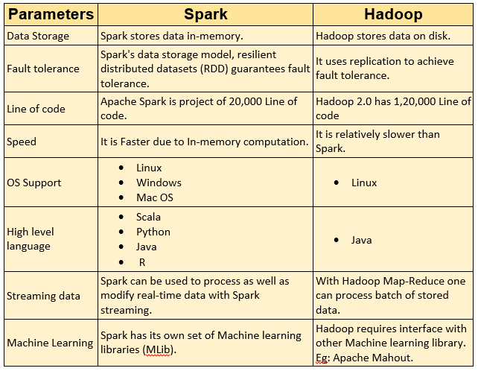
Hadoop vs Spark
Source: https://muniversity.mobi/blog/spark-vs-hadoop/
Notes:
1.200.000 line of code
(2.918.498)

Slide 25
Big Data Testing
?

Slide 26
References
https://www.domo.com/blog/data-never-sleeps-5/
https://en.wikipedia.org/wiki/Big_data
https://www.oracle.com/big-data/guide/what-is-big-data.html
The Big Data Value Chain: Definitions, Concepts, and Theoretical Approaches - Edward Curry
https://spark.apache.org/

Slide 27
THANK YOU!

