Slide 1


4 input XNOR gate using 2X1 MUX
Group Number: 18
Group Members: Abhishek Sethi, 2023030
Devashish Mishra, MT25112 Vishal Kumar Singh, MT25157 Rahul IIITD, 2023417
Guided By: Anuj Grover

Slide 2
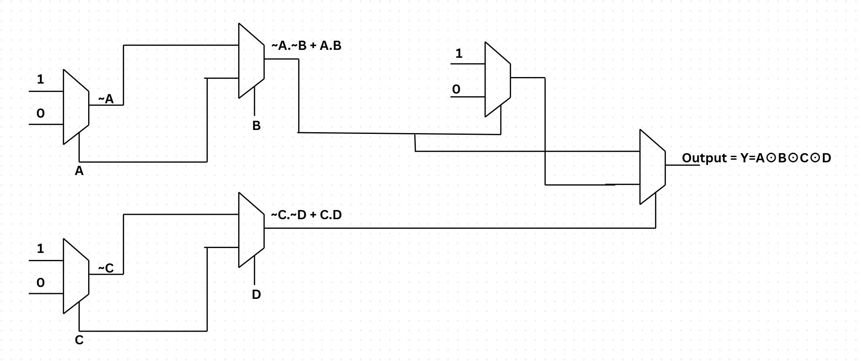
What logic has been used?
4X1 XNOR using 2X1 MUX

Slide 3
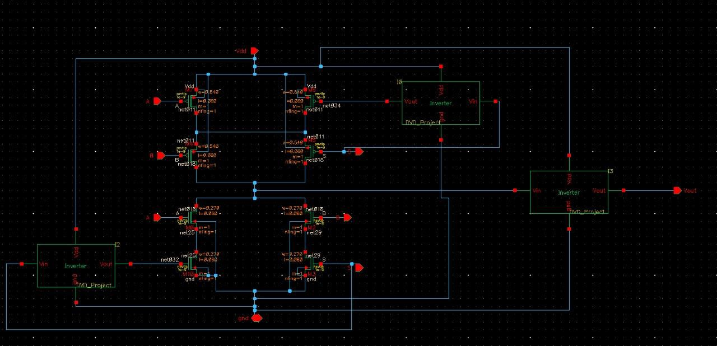
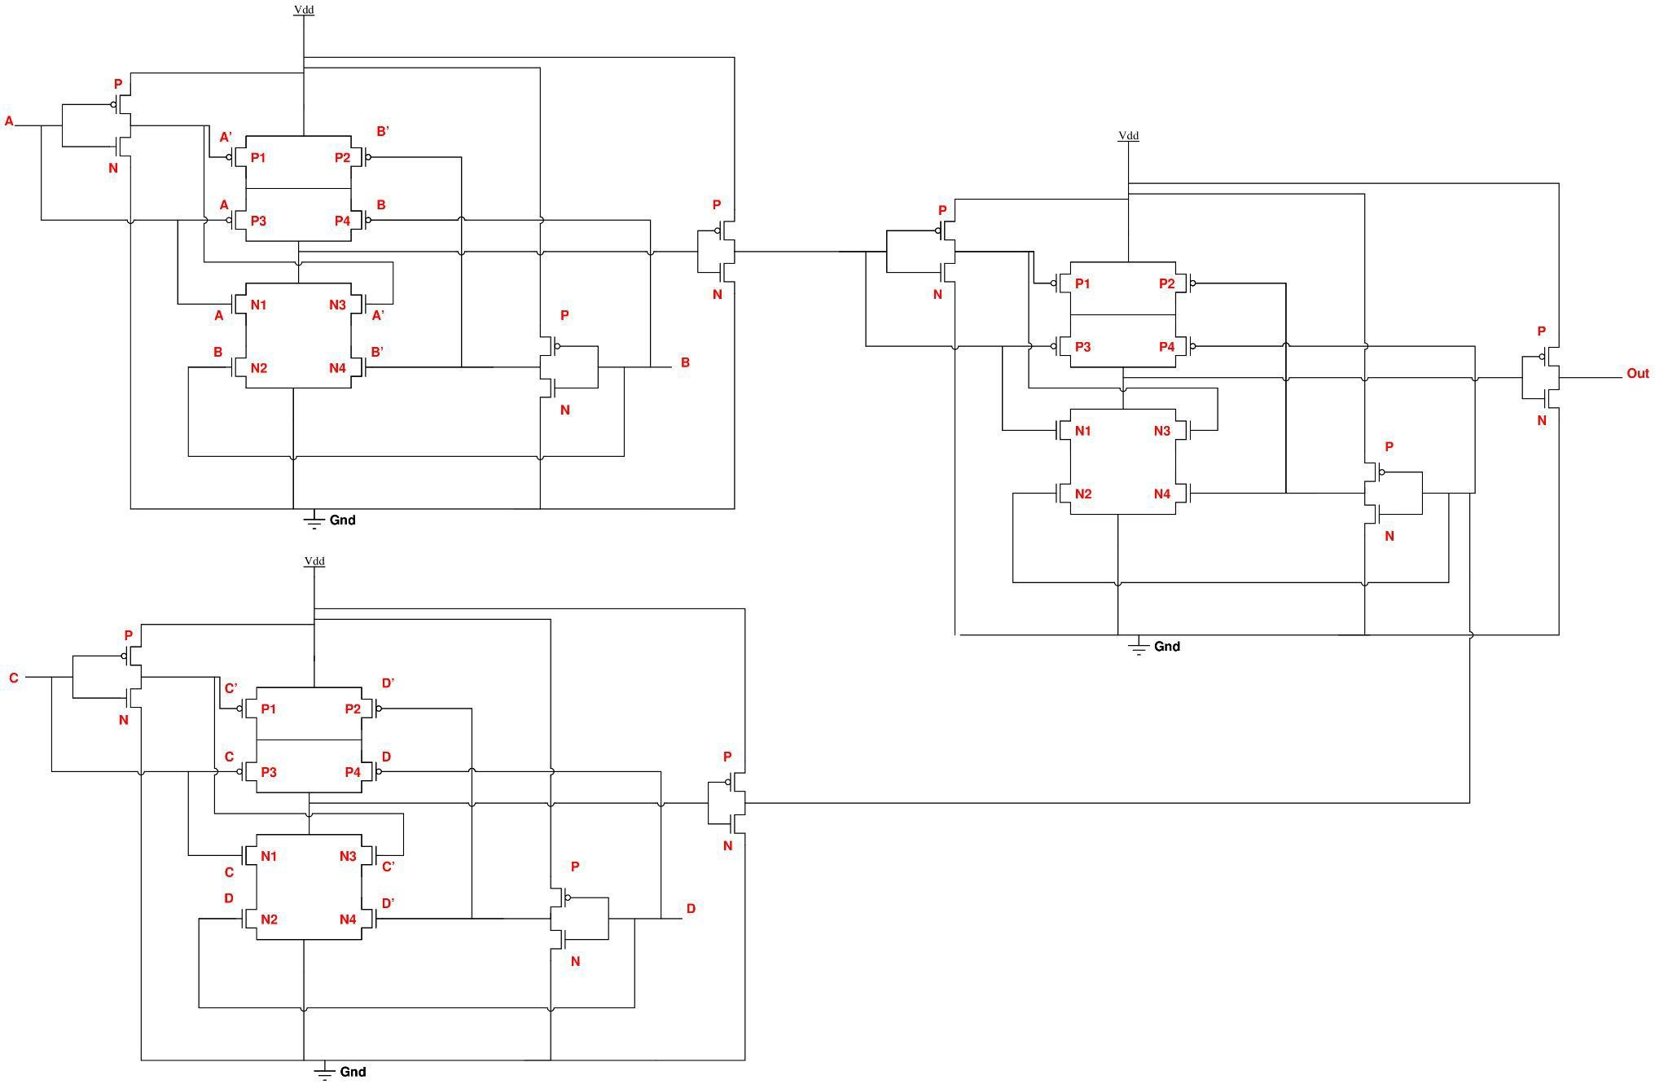
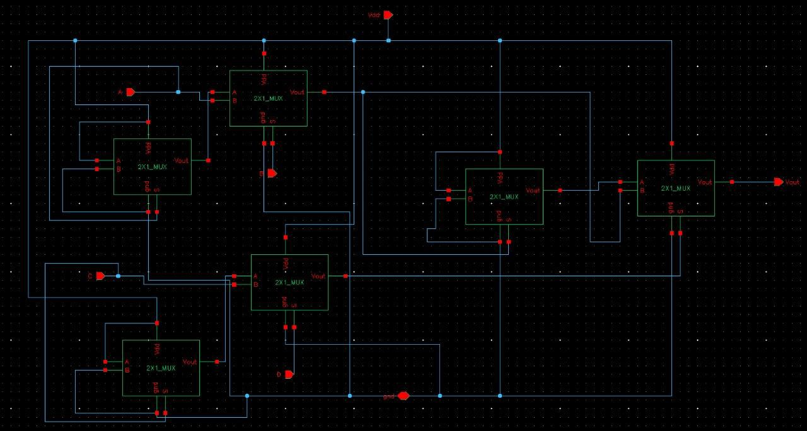
Schematic + Sizing
Transistors Width in MUX with respect to unit inverter PMOS: 0.135 *4 = 0.54 um
NMOS: 0.135 * 2 = 0.27 um
Length: 0.06 um (for all cases)

Slide 4
Stimuli For Verification & Verification Plan
Input | Initial Voltage | Peak Voltage | Rise Time | Fall Time | Pulse Width | Time Period
A | 0 | 1.08 | 20p | 20p | 10n | 20n
B | 0 | 1.08 | 20p | 20p | 5n | 10n
C | 0 | 1.08 | 20p | 20p | 20n | 40n
D | 0 | 1.08 | 20p | 20p | 40n | 80n
Veriﬁcation Plan: We have kept stimuli in such a way all the 16 possible input combination cases are covered (which is shown above) and for the delay calculation the stimuli are little changed in such a way that, for example when Delay for B is calculated, the other input should remain constant at that edge else it will hamper the results and leads to distortion in the output waveform. The above stimuli is example of the same which is used for calculating B input delay and their pulse width and time period has been set in a such a manner that there is no abrupt change in the other inputs (except B) at the rising and falling edge of B. We have used the similar methodology for calculating the delays of other inputs as well.

Slide 5
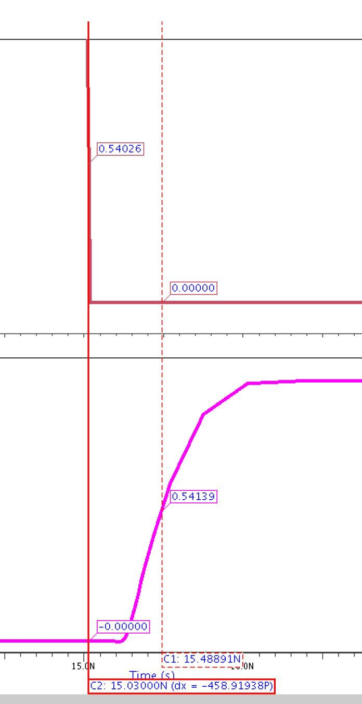
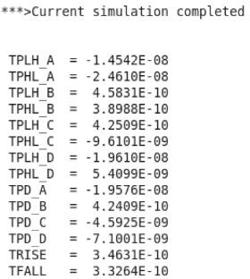
Delay Calculation & Verification
Input | TPLH | TPHL | TPD
A | 567.75 ps | 375.13 ps | 471.44 ps
B | 458.31 ps | 389.88 ps | 420.09 ps
C | 559.50 ps | 597.62 ps | 578.56 ps
D | 394.26 ps | 394.48 ps | 394.37 ps
Veriﬁcation: For delay calculation, we have used a command in the .cir ﬁle. Initially we put RISE and FALL numbers randomly and then veriﬁed it by using ezwave simulation and then update those rise and fall numbers which create problem. After this, we used cursor to verify the propagation delay, we put the ﬁrst cursor at the point on the output waveform which crosses approximately 50% of value which is .54. Same goes for the input waveform and then look for the diﬀerence in the cursor point and it matches with the delay calculated by eldo and hence verifying all our values and method. So as shown in the right side graph, pointers are placed at 50% of their value and when their diﬀerence is as in this case it is tplh (B) which comes out to be 458 ps which matches with the eldo simulation value shown in the table.

Slide 6
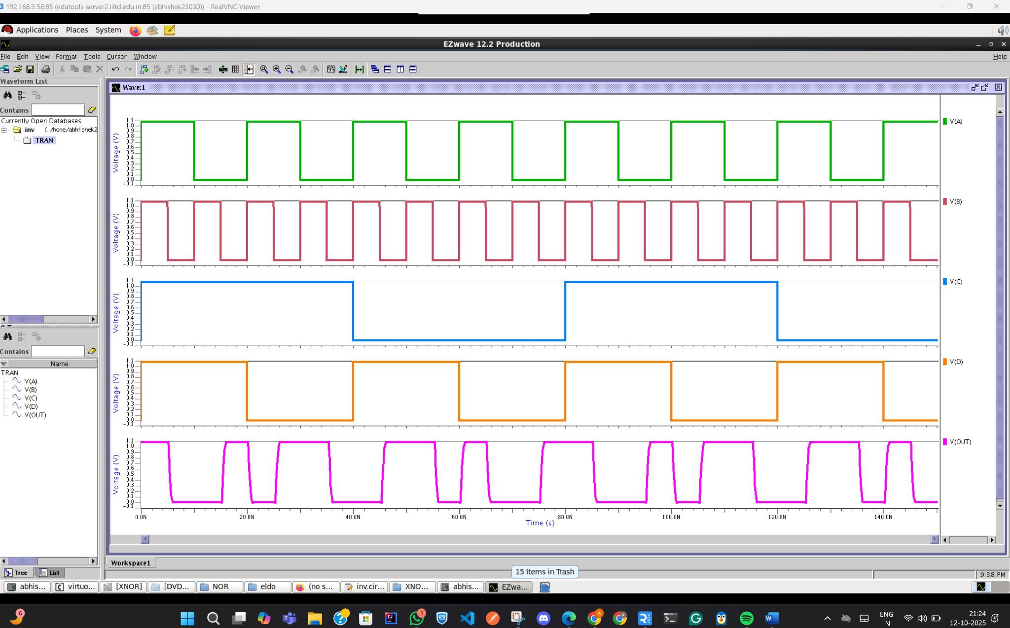
Eldo Waveform

Slide 7
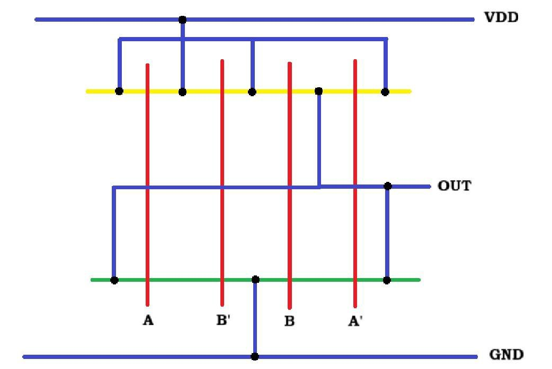
Stick Diagram
Note: As our logic is based upon 2X1 MUX so we have made the stick diagram for 2x1 mux.

Slide 8
Work Distribution
Current Work Distribution
Virtuoso Schematic and ADEL veriﬁcation: Abhishek, Devashish, Vishal
X Circuit Schematic: Rahul
ELDO Simulation: Devashish, Abhishek, Vishal
Veriﬁcation Plan: Abhishek, Rahul
Stick Diagram: Devashish, Vishal
Future Plan
Layout
Power and Current Calculation Post Layout Delays
Testing at other PVT Parameters Monte Carlo Simulation Comparison Pre and Post Layout

