Slide 1
PRE-DECODER
AND
COLUMN DECODER DESIGN
7
Group Number:
Group Members :
MT25111 Charu Singh
MT25130 Neeti Mishra
MT25157 Vishal Kumar Singh
Course:- Memory Design And Test
Prof.: Dr Anuj Grover

Slide 2
Problem Statement
Requirements :
To design a pre-decoder with the following
Input capacitance <10fF
Output loading is for 512 rows,
Hold time to be negative at FF/1.32/-40,
Setup time to be within 500ps at SS/1.08/125
MEMORY SCRAMBLING:
The memory size is 8192 × 32 bits, so a total of 13 address bits (A12–A0) are required.
The higher address bits (A12–A4) are used for row selection through pre-decoding and post-decoding stages.
The pre-decoding is implemented using three 3:8 decoders, which divide the address bits into groups for efficient row decoding.
The lower address bits (A3–A0) are used for column decoding, corresponding to the MUX16 configuration.

Slide 3
Possible pre-decoding stages
Specification / Stages | 2: 3x8 Decoder 1: 2x4 Decoder 1: 1x2 Decoder | 1: 3x8 Decoder 3: 2x4 Decoder | 1: 3x8 Decoder 2: 2x4 Decoder 2: 1x2 Decoder | 3: 3x8 Decoder
 | 22 output lines | 20 output lines | 20 output lines | 24 output lines
 | Total tapping = 512 | Total tapping = 448 | Total tapping = 476 | Total tapping = 192
Area
Power
3:3x8 decoder configuration is selected as it provides the best trade-off between area and power, achieving minimum power consumption with acceptable area overhead.

Slide 4
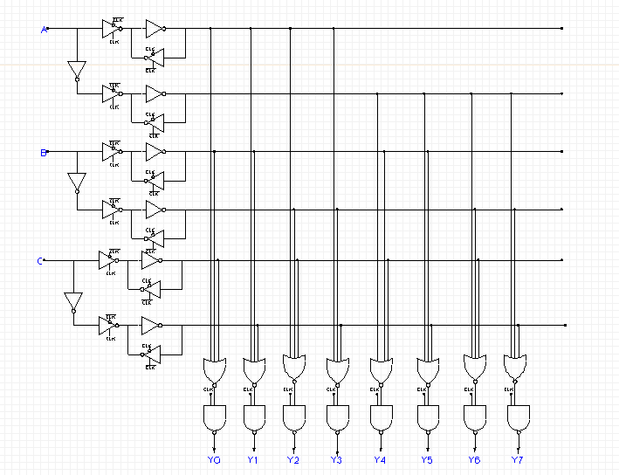
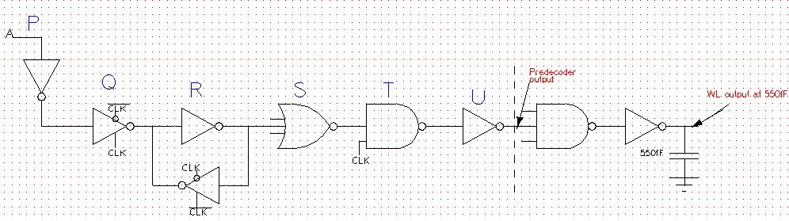
3:8 Pre-Decoder Schematic & Sizing
Sizing Using Logical Effort:
Gates | PMOS | NMOS
P | 0.378u | 0.140u
Q | 0.45u | 0.170u
R | 0.639u | 0.275u
S | 1.169u | 0.167u
T | 1.246u | 1.07u
U | 5.32u | 2.289u

Slide 5
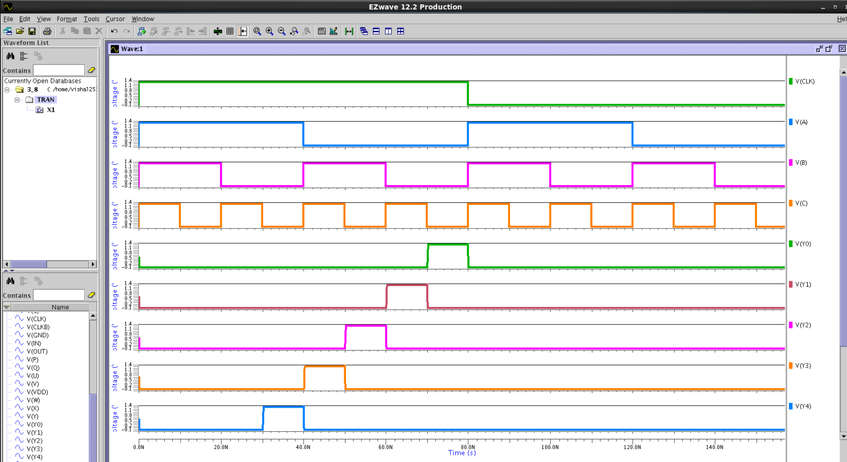
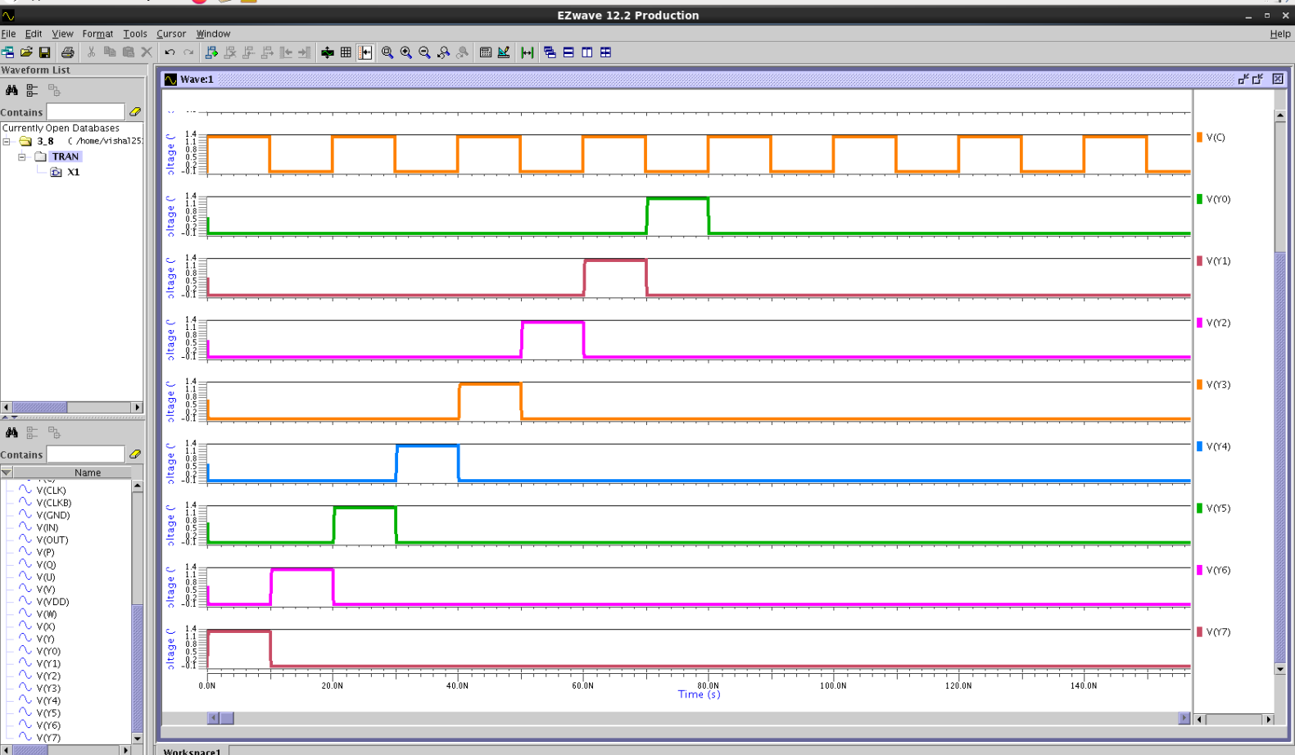
EZ Wave Simulation Results

Slide 6
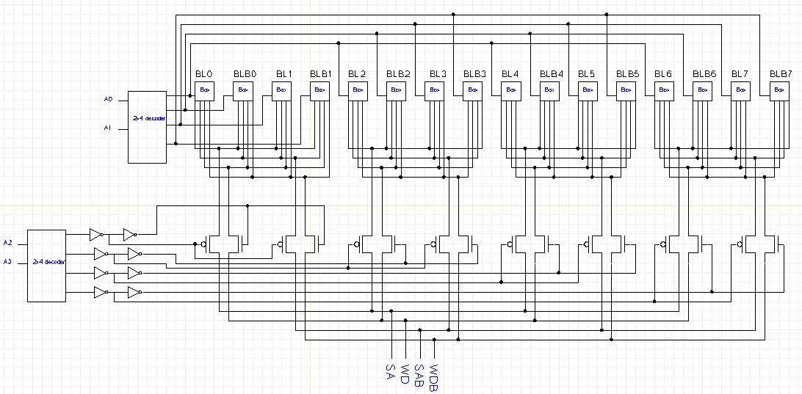
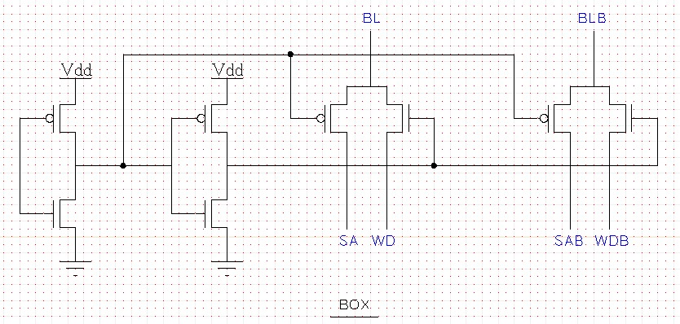
Column Decoder Schematic
BL Selection Box

Slide 7
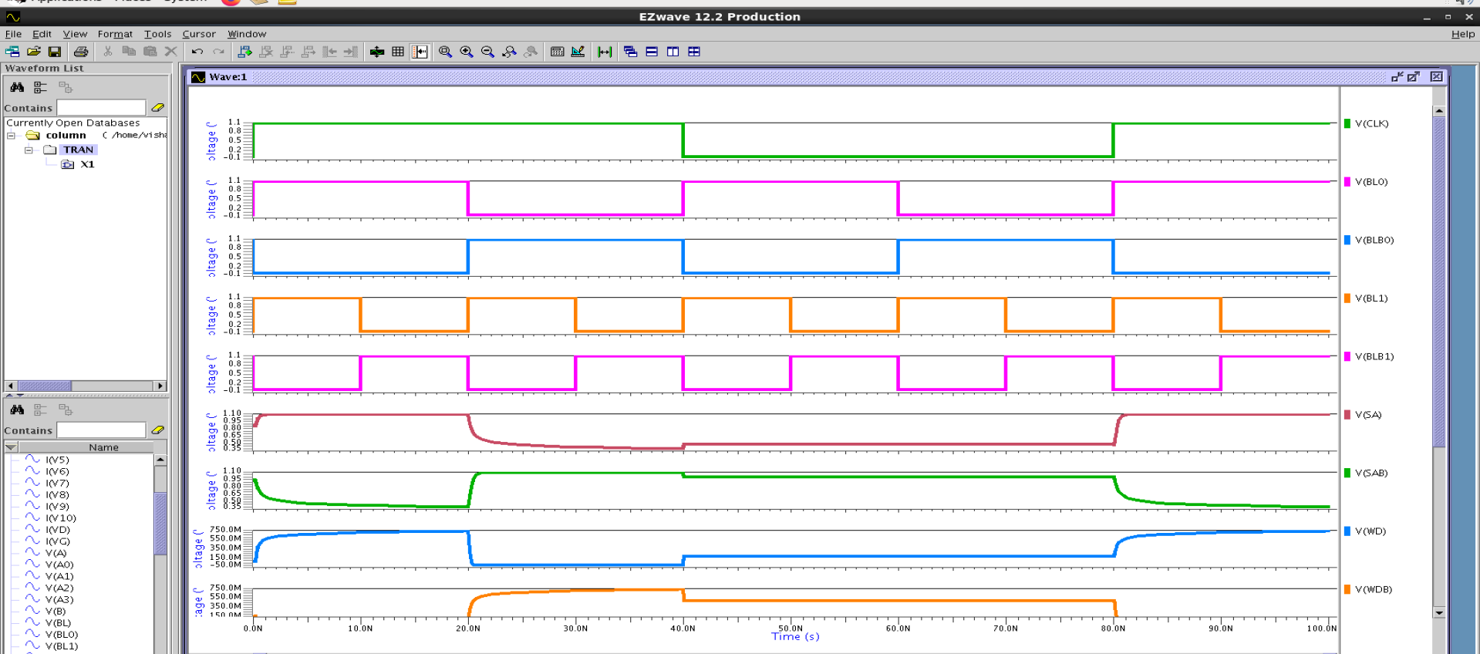
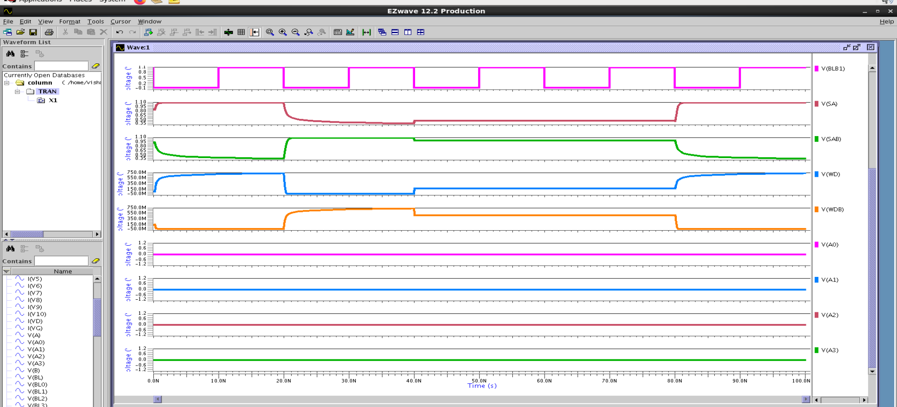
EZ Wave Simulation Results

Slide 8
Challenges,Future Plan And Work Distribution
Challenges:
Multiple design iterations were performed to achieve optimal transistor sizing for the column decoder based on delay and load requirements.
The decoder design was improved by replacing simple inverters with tri-state inverters for better control and efficient decoder operation.
Due to threshold voltage drop in PMOS and NMOS pass transistors, full voltage swing is not achieved; therefore, transmission gates will be implemented in future to ensure full logic level restoration.
Future Plan:
Setup and Hold Time Characterization
Layout Implementation and Parasitic Extraction
PPA (Power, Performance, Area) Analysis
Column Decoder Transistor Sizing Optimization
Work Distributions:
The work completed so far has been carried out with equal contribution and involvement from all 3 team members across all stages of the project.

