Slide 1

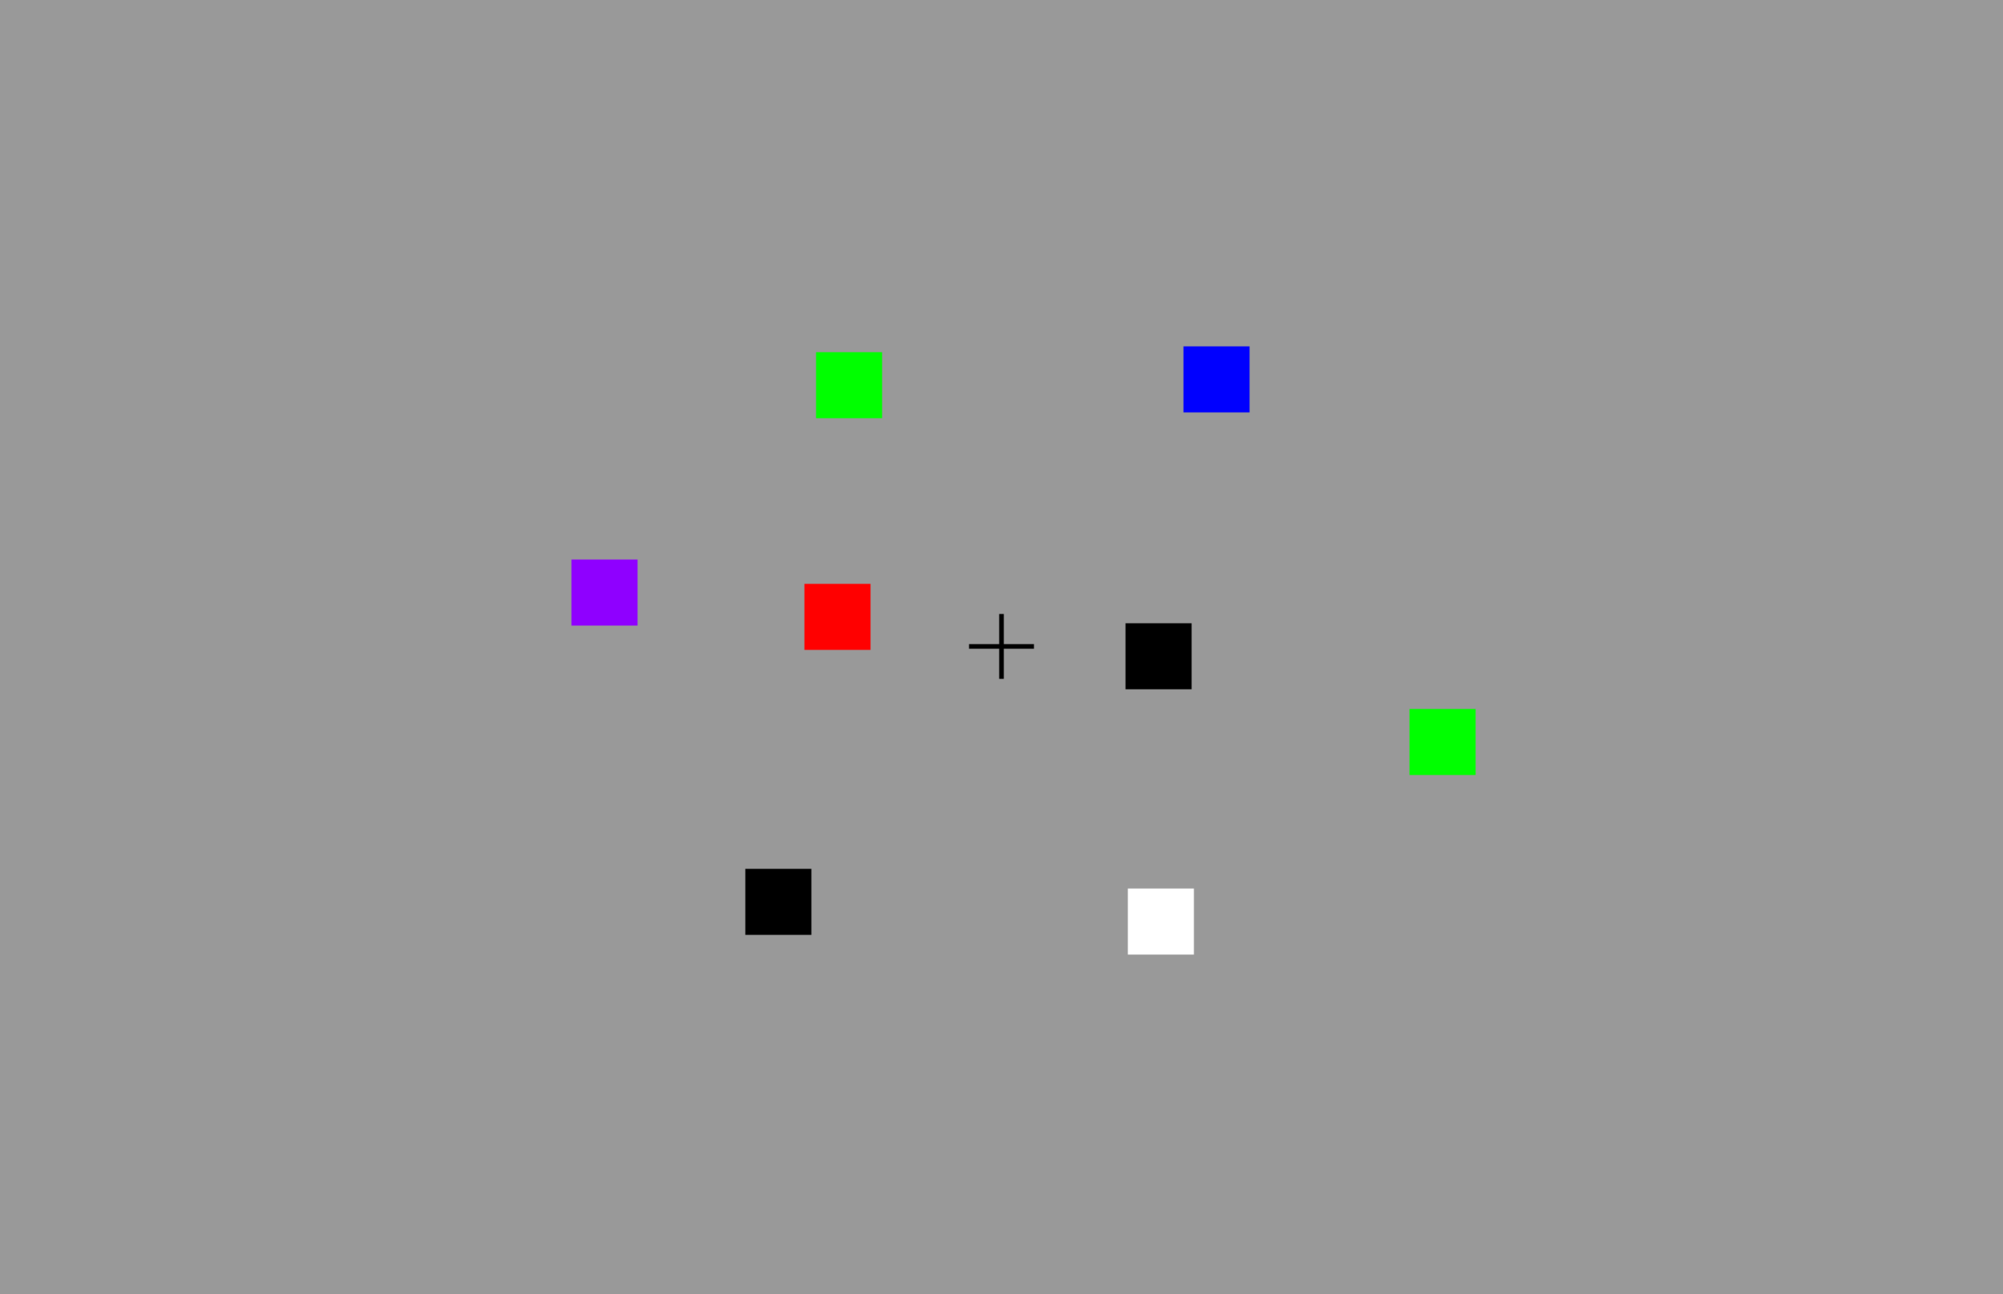

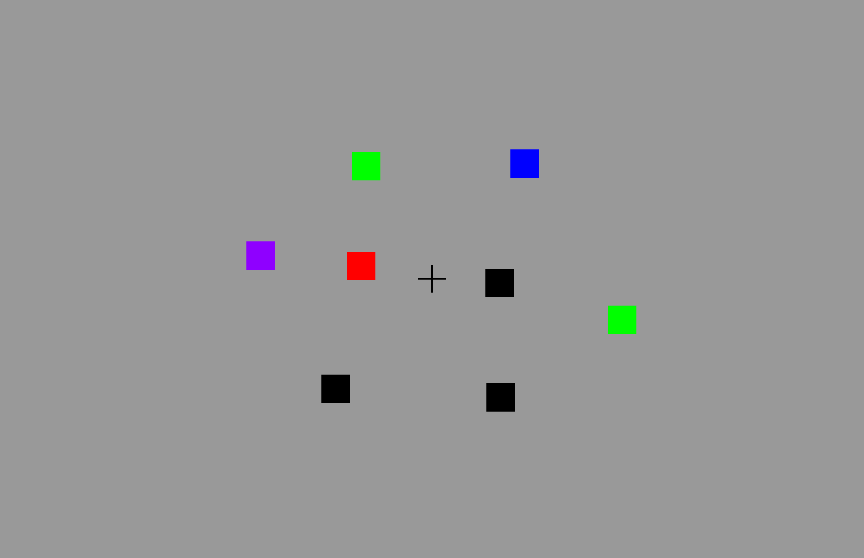
arrow presentation
200 ms
memory array
100 ms
retention interval
900 ms
test array
2,000 ms

