Slide 1
DengueCAD
System Architecture
NMI imputation + NMPrediction (IEEE TITB 2012, Algorithm 1) for computer-aided diagnosis
October 2026
Notes:
DengueCAD is a disease-agnostic CAD stack. This deck walks through its components, the NMPrediction algorithm, data protocols, evaluation and CI/CD.

Slide 2
What DengueCAD does
• Implements NMPrediction (Rao & Kumar, IEEE TITB 2012)
  – NMI imputation → GA wrapper feature selection → stratified 10-fold ADT
  – Reports Accuracy, AUC, Sensitivity (SE), Specificity (SP)
• Compares NM against C4.5, Logistic Regression (LOR) and SVM (RBF)
  – Table I performance · Table II Wilcoxon test · Table III influential features
• Benchmarks imputation: NMI vs MissForest, MICE, kNN, Mean/Median/Mode
  – Hold-out experiment: imputation accuracy and hidden-decision prediction accuracy
• Disease-agnostic: dengue CSVs plus 11 KEEL / Weka ARFF disease datasets
• Reproducible: scripted experiments, generated PDF report, CI on every push
DengueCAD architecture · 2
Notes:
The core library does not assume dengue; any tabular dataset with a decision column can go through the same pipeline.

Slide 3
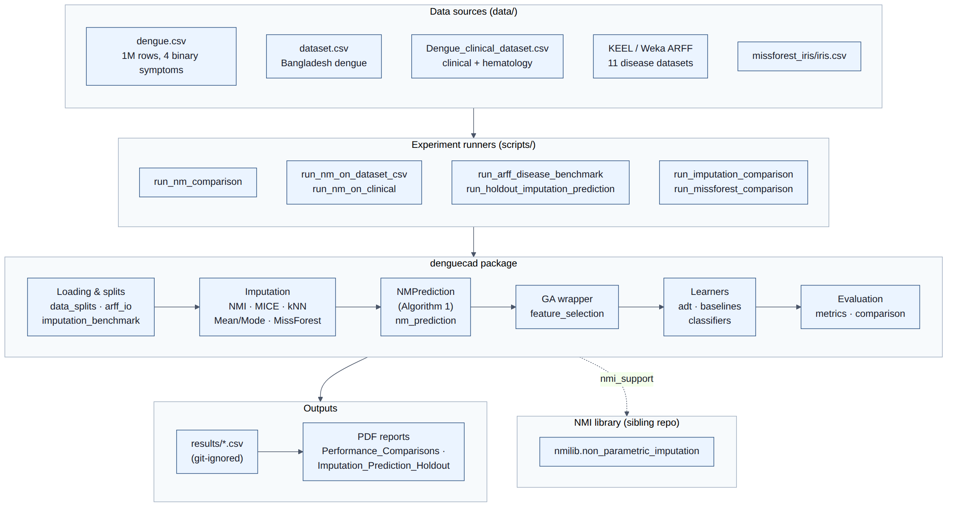
System overview
Data sources → experiment scripts → denguecad package → CSV results and PDF report; imputation delegates to the sibling NMI library.
DengueCAD architecture · 3
Notes:
Left to right: the data folder, the scripts that orchestrate each experiment, the library layers, and outputs. NMI is a separate repository located via NMI_ROOT or ../NMI.

Slide 4
Package components denguecad/
Layer | Modules | Responsibility
Data | data_splits · arff_io · imputation_benchmark | Load, encode, split (70k / 10k / 20k), ARFF with KEEL ranges
Imputation | nmi_support · imputation_benchmark · missforest_impute | NMI, MICE, kNN, Mean/Mode, MissForest
Algorithm | nm_prediction · feature_selection | NMPrediction (Algorithm 1), GA wrapper search
Learners | adt · baselines · classifiers | ADT, C4.5, LOR, SVM (RBF), classifier factory
Evaluation | metrics · comparison · holdout_experiment | Accuracy/AUC/SE/SP, Tables I–III, Wilcoxon, hold-out protocol
Reporting | build_comparison_pdf · build_holdout_comparison_pdf | Performance and hold-out PDF reports with highlighted best results
DengueCAD architecture · 4
Notes:
Each layer only depends on layers below it; the evaluation layer is what the experiment scripts call.

Slide 5
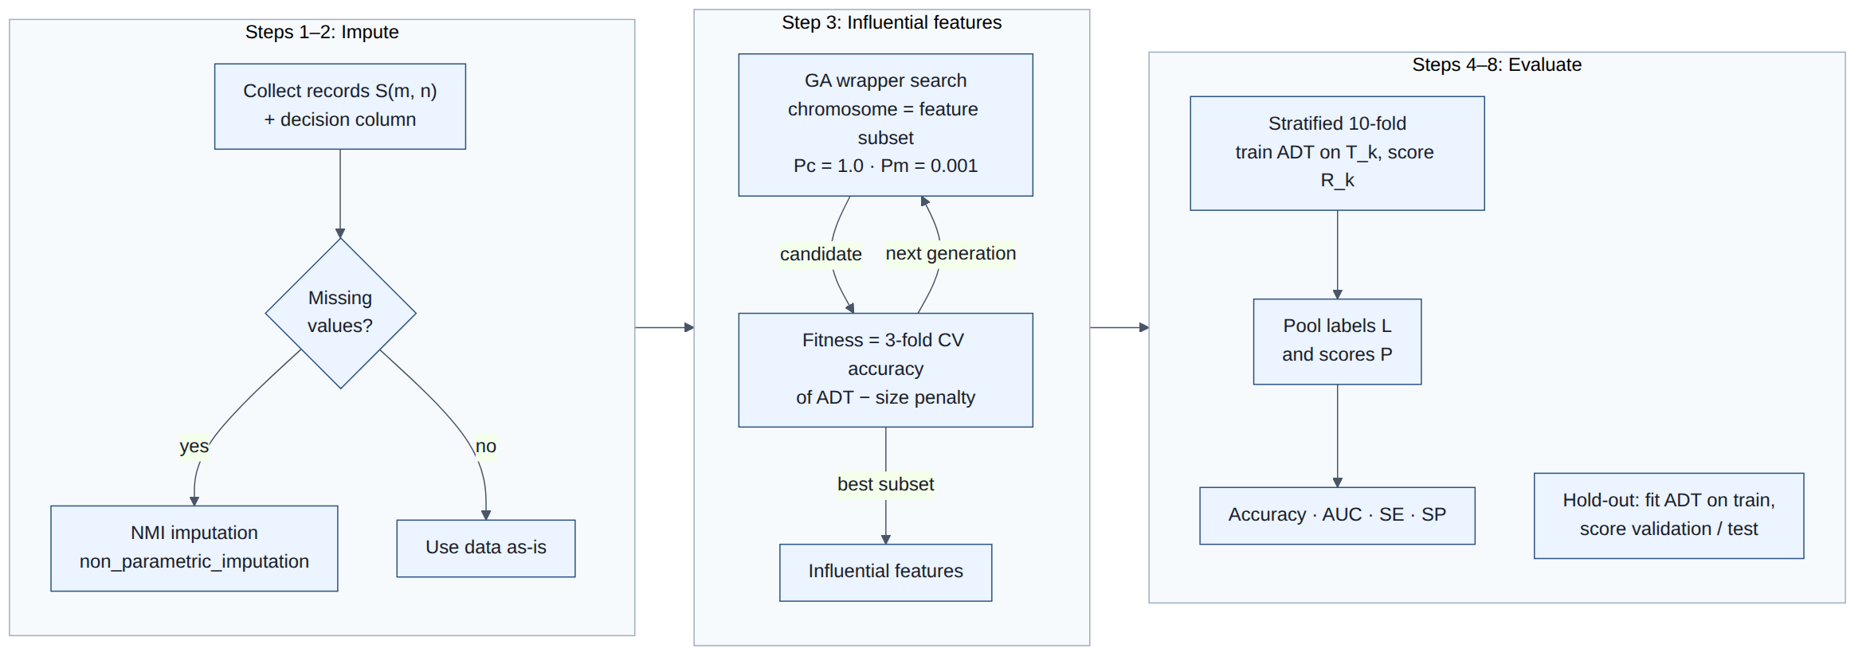
NMPrediction pipeline Algorithm 1
Algorithm 1: impute missing values with NMI, pick influential features with a GA wrapper, then score ADT with stratified 10-fold CV.
DengueCAD architecture · 5
Notes:
Steps 1–2 impute only if values are missing. Step 3 is the GA wrapper. Steps 4–8 pool fold predictions to compute AUC, SE and SP. The selected features are also used for the hold-out validation and test sets.

Slide 6
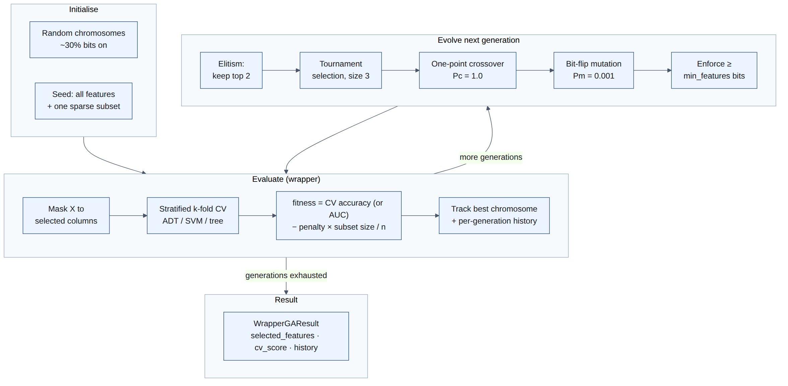
GA wrapper feature selection Section C
Kohavi & John wrapper: the classifier scores each subset. Pc = 1.0, Pm = 0.001, elitism 2, tournament 3, small subset-size penalty.
DengueCAD architecture · 6
Notes:
Chromosomes are bit masks over features. Fitness is cross-validated accuracy minus a penalty proportional to subset size, which favours compact subsets.

Slide 7
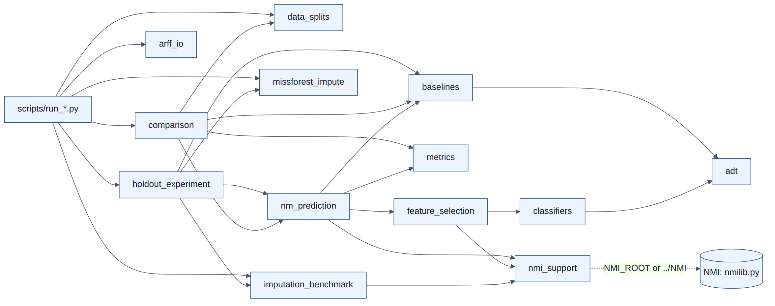
Module dependencies
Arrows point to imported modules. Only nmi_support touches the external NMI library.
DengueCAD architecture · 7
Notes:
comparison orchestrates NM and baselines; holdout_experiment reuses nm_prediction, the imputers and the baselines. nm_prediction depends on feature_selection, baselines, metrics and nmi_support. adt is shared by baselines and the GA classifier factory.

Slide 8
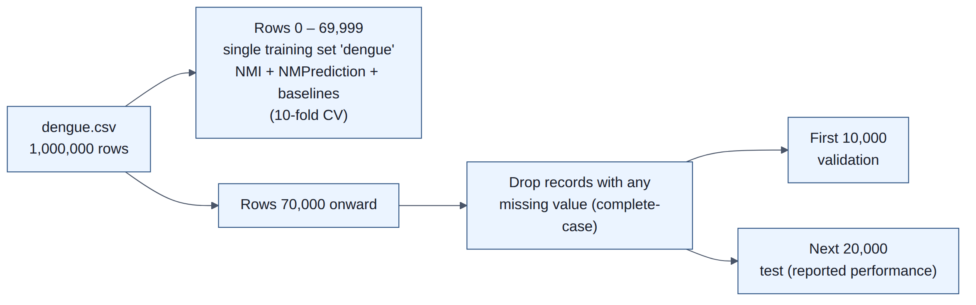
Data protocol: dengue.csv
70,000-row single training set · 10,000 complete-case validation · 20,000 complete-case test.
DengueCAD architecture · 8
Notes:
The first 70k rows go through NMI and NMPrediction as one dataset. From the rest, records with any missing value are dropped; the first 10k complete records are validation and the next 20k are the test set used to report performance.

Slide 9
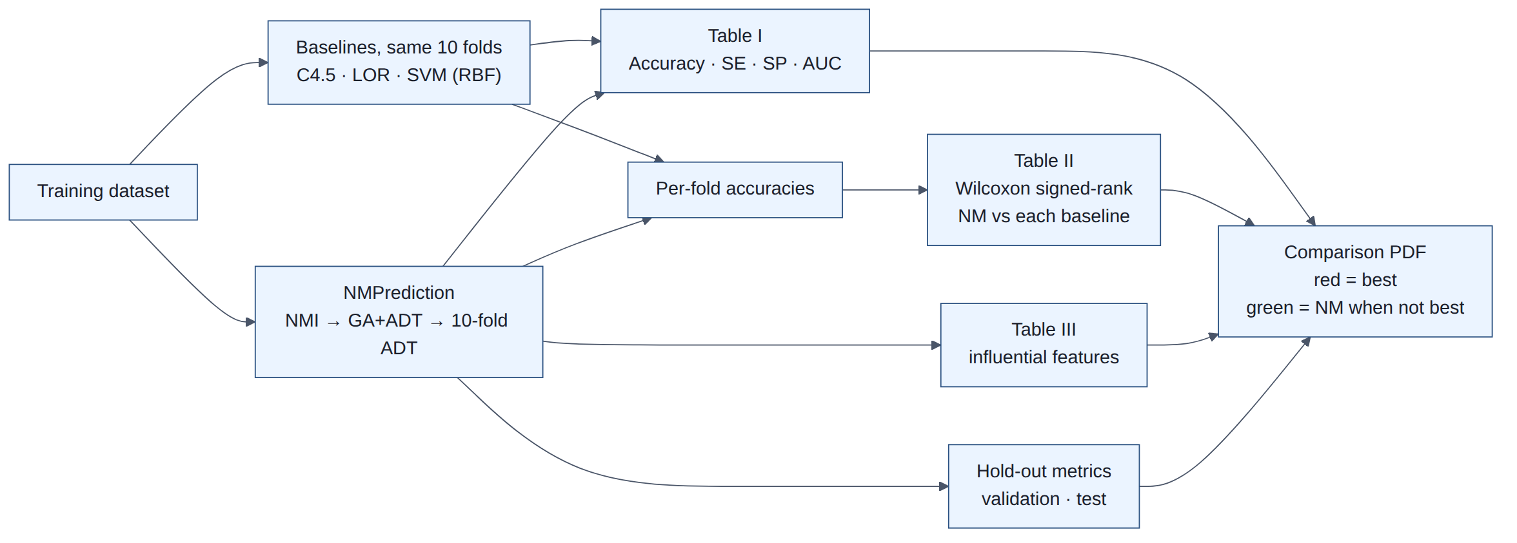
NM vs baselines evaluation
All methods share the same folds; per-fold accuracies feed the Wilcoxon signed-rank test.
DengueCAD architecture · 9
Notes:
Table I reports pooled metrics, Table II the Wilcoxon test of NM against each baseline, Table III the features NM selected. Everything is collected in the comparison PDF.

Slide 10
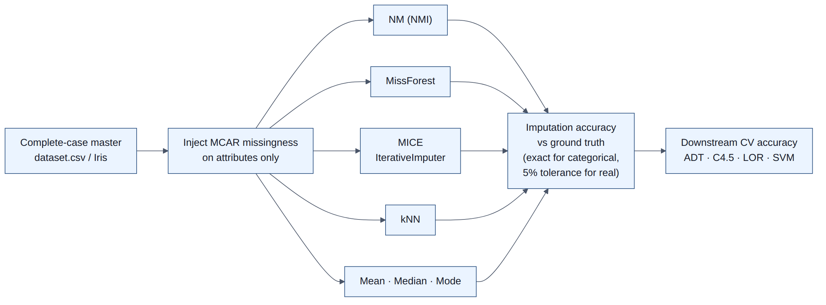
Imputation benchmark
Mask a complete dataset with MCAR missingness, impute with each method, score against ground truth and downstream classifiers.
DengueCAD architecture · 10
Notes:
Used for dataset.csv and the canonical MissForest Iris demo (20% MCAR). Categorical cells must match exactly; real values within 5% relative tolerance.

Slide 11
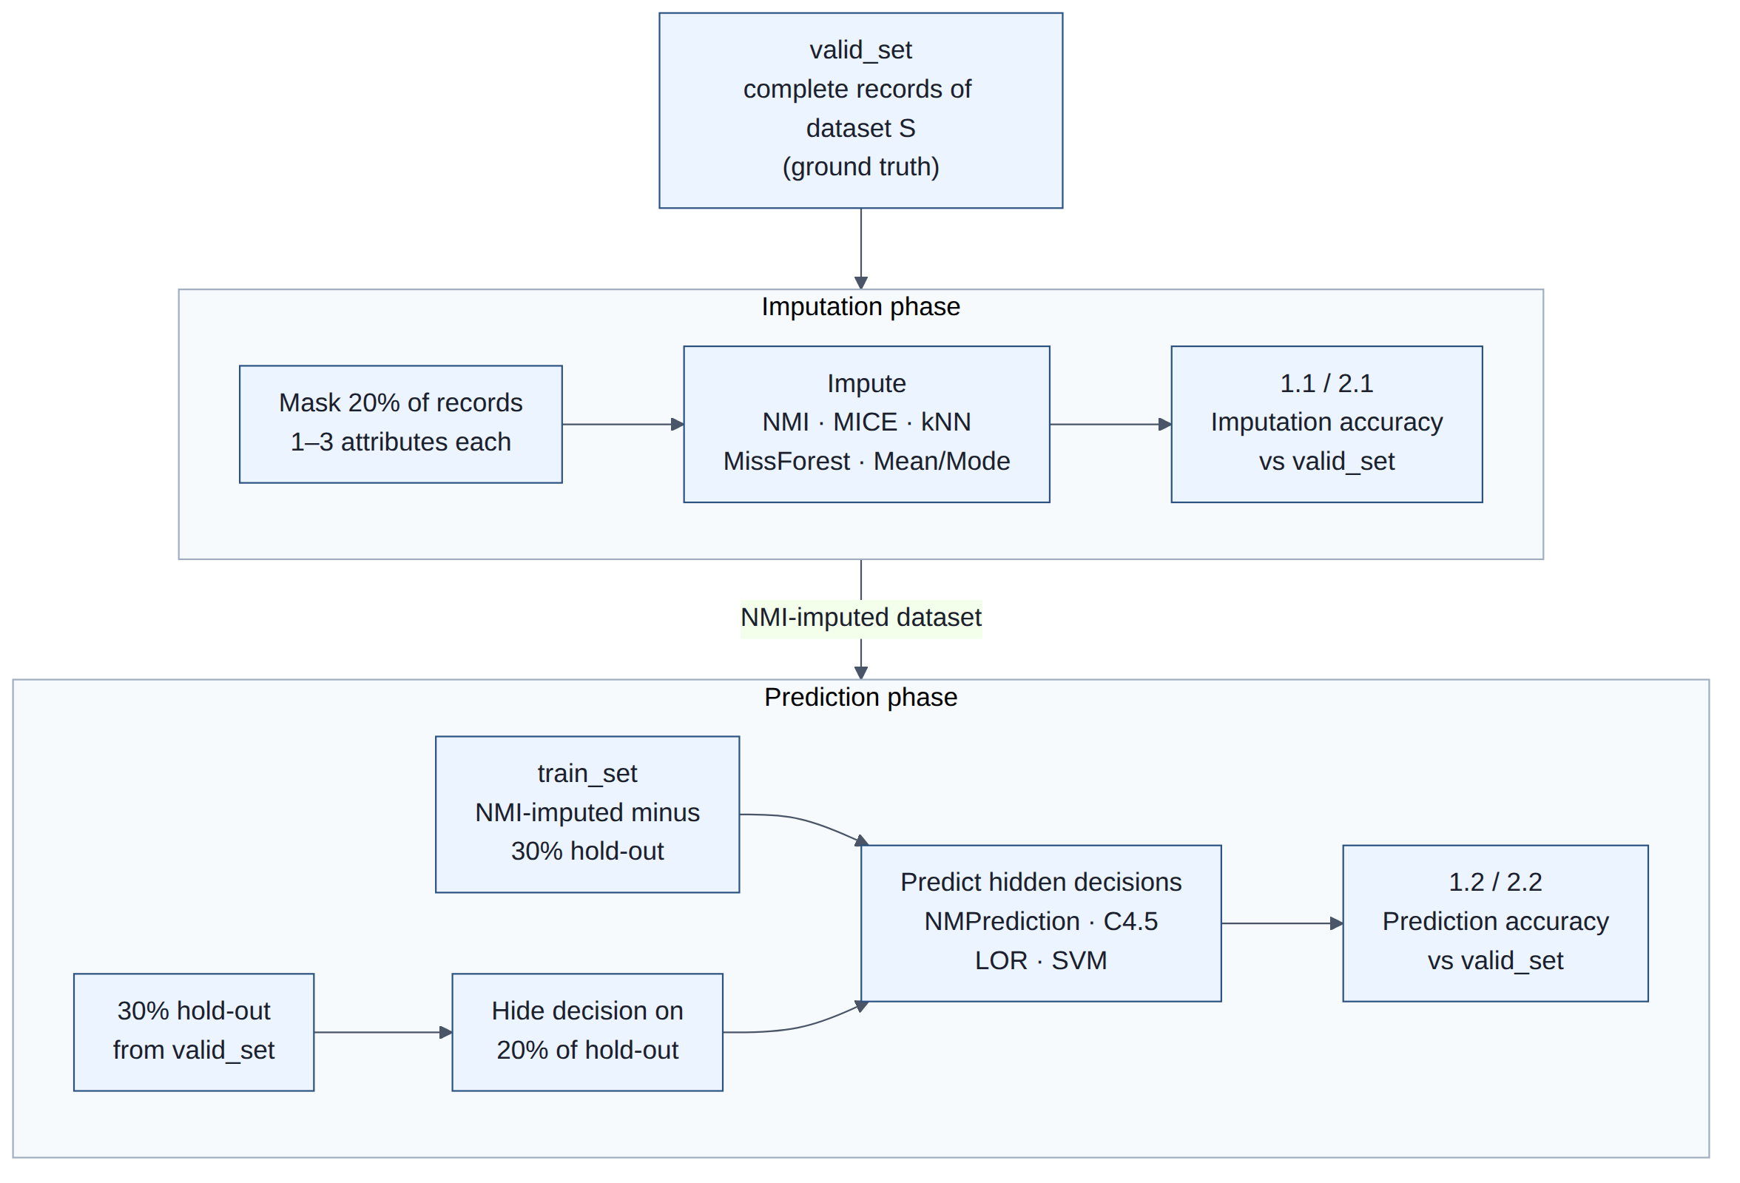
Imputation + prediction hold-out experiment holdout_experiment.py
valid_set kept aside · 20% of records masked and imputed · NMI-imputed train_set · decisions hidden on 20% of a 30% hold-out and predicted.
DengueCAD architecture · 11
Notes:
Run on five dengue datasets and eleven disease ARFFs, 10 seeds each (3 for the 70k dengue.csv sample). Tables 1.1 and 2.1 score imputation of the masked cells, 1.2 and 2.2 score prediction of the hidden decisions. Results are in DengueCAD_Imputation_Prediction_Holdout.pdf.

Slide 12
Experiment runners and outputs scripts/ → results/
Script | Dataset | Output
run_nm_comparison.py | dengue.csv (70k / 10k / 20k) | Tables I–III, hold-out metrics, split summary
run_nm_on_dataset_csv.py | dataset.csv (Bangladesh) | results/nmprediction_dataset_csv/
run_nm_on_clinical.py | Dengue_clinical_dataset.csv | results/nmprediction_clinical/
run_arff_disease_benchmark.py | 11 disease ARFFs | results/arff_disease_comparison/
run_imputation_comparison.py | dataset.csv + MCAR | results/imputation_dataset_csv/
run_missforest_comparison.py | Iris + 20% MCAR | results/missforest_comparison/
run_holdout_imputation_prediction.py | 5 dengue sets + 11 ARFFs | results/holdout_imputation_prediction/
build_comparison_pdf.py | all results | Performance comparison PDF (docs/)
build_holdout_comparison_pdf.py | hold-out results | Imputation / prediction hold-out PDF (docs/)
DengueCAD architecture · 12
Notes:
results/ is git-ignored; the PDF report is the committed record of performance.

Slide 13
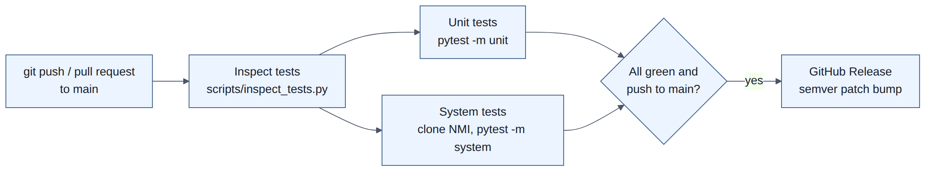
CI/CD GitHub Actions
GitHub Actions on every push and pull request; a green push to main cuts a semver release.
DengueCAD architecture · 13
Notes:
The same gates run locally with scripts/ci_local.sh before pushing. System tests clone the NMI library and use the datasets in data/.

Slide 14
Design decisions and extension points
• NMI kept as an external library behind nmi_support
  – Swap the checkout with NMI_ROOT; no code changes
• Pluggable learners through factories (baselines, classifiers)
  – GA wrapper can evaluate with ADT, SVM or decision tree
• Disease-agnostic data layer
  – New datasets: add a CSV/ARFF loader, reuse run_dataset_comparison
• Reproducibility
  – Fixed random seeds, scripted runs, PDF and diagrams regenerated from source
DengueCAD architecture · 14
Notes:
These are the seams to use when adding a disease dataset, a new imputer or a new classifier.

Slide 15
Running and regenerating
source .venv/bin/activate
python scripts/run_nm_comparison.py # dengue.csv experiment
python scripts/run_arff_disease_benchmark.py # multi-disease ARFFs
python scripts/run_holdout_imputation_prediction.py # hold-out experiment
python scripts/build_comparison_pdf.py # performance report
python scripts/build_holdout_comparison_pdf.py # hold-out report
python scripts/render_architecture_diagrams.py # diagrams
python scripts/build_architecture_slides.py --pdf # this deck
bash scripts/ci_local.sh # CI gates before push
DengueCAD architecture · 15
Notes:
Diagrams live as Mermaid in docs/ARCHITECTURE.md; images and slides are generated.

