Slide 1
Monthly Portfolio Synthesis
Executive Summary · July 2026
Auto-generated by Project Health Agent

Slide 2
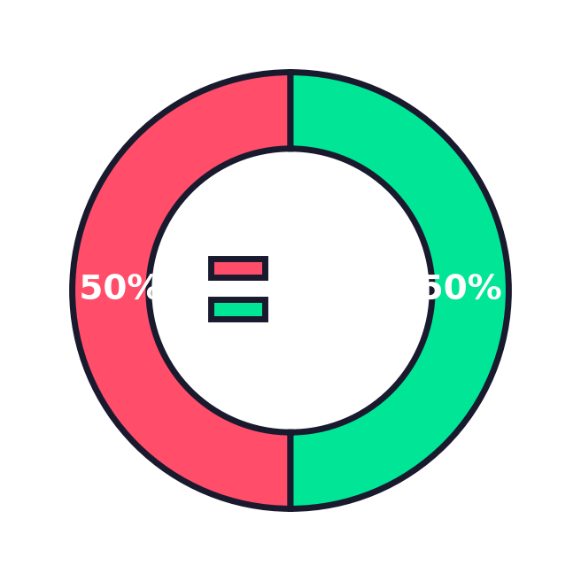
Executive Summary
2
867
12.7%
5
Active Projects
Total Tasks
Overdue Rate
Total Blockers
1
Green Projects
0
Amber Projects
1
Red Projects

Slide 3
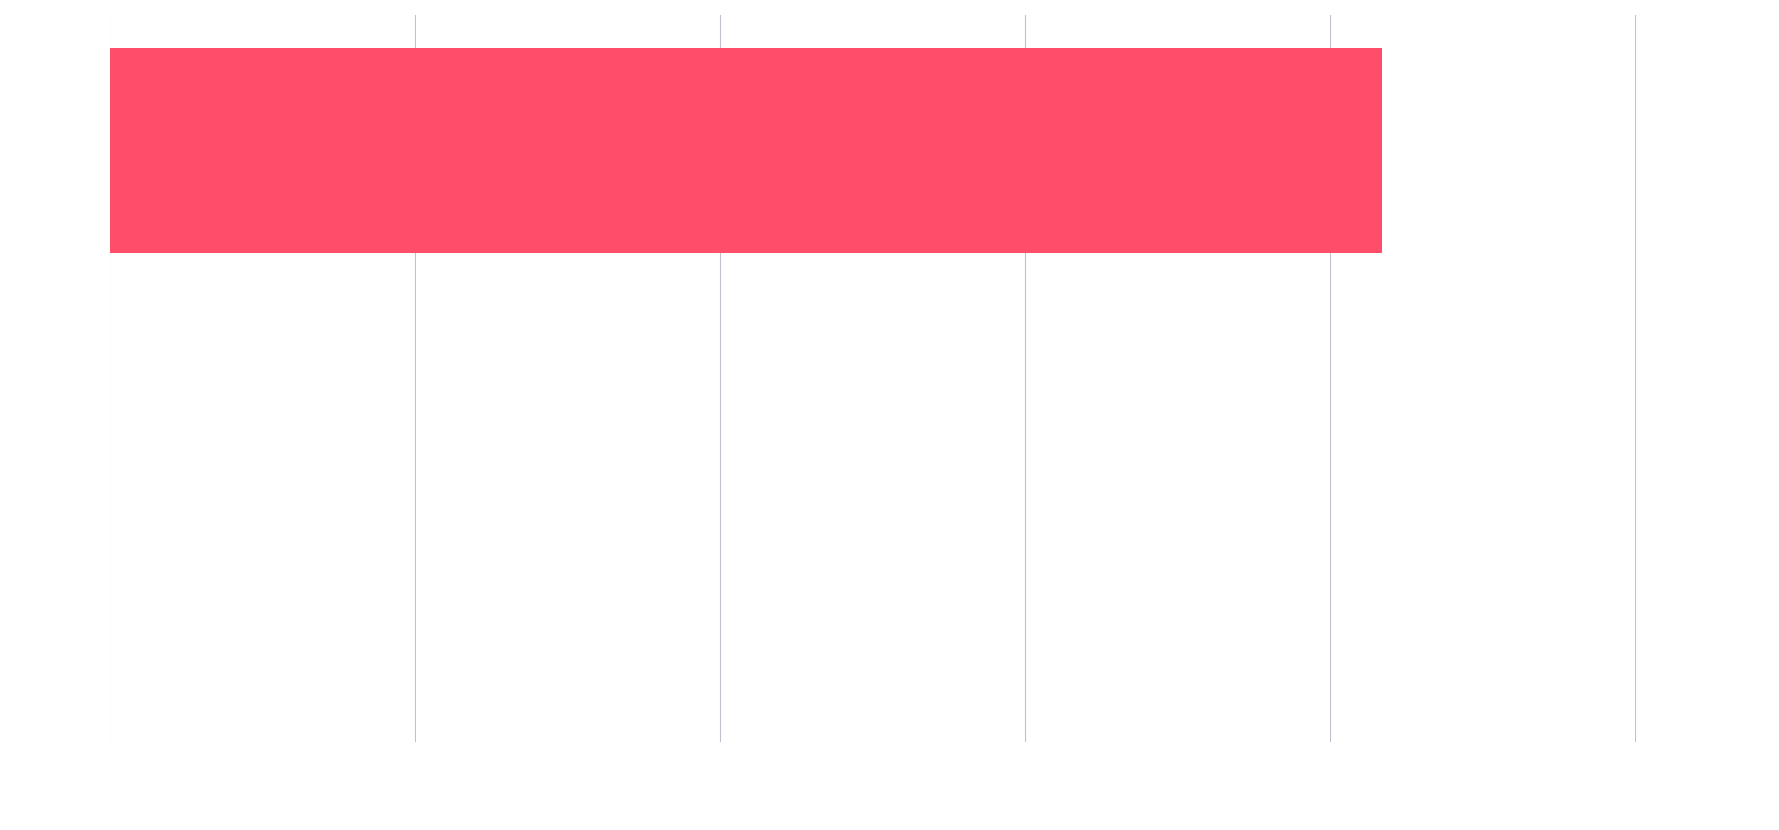
Portfolio Trends: Overdue Tasks

Slide 4
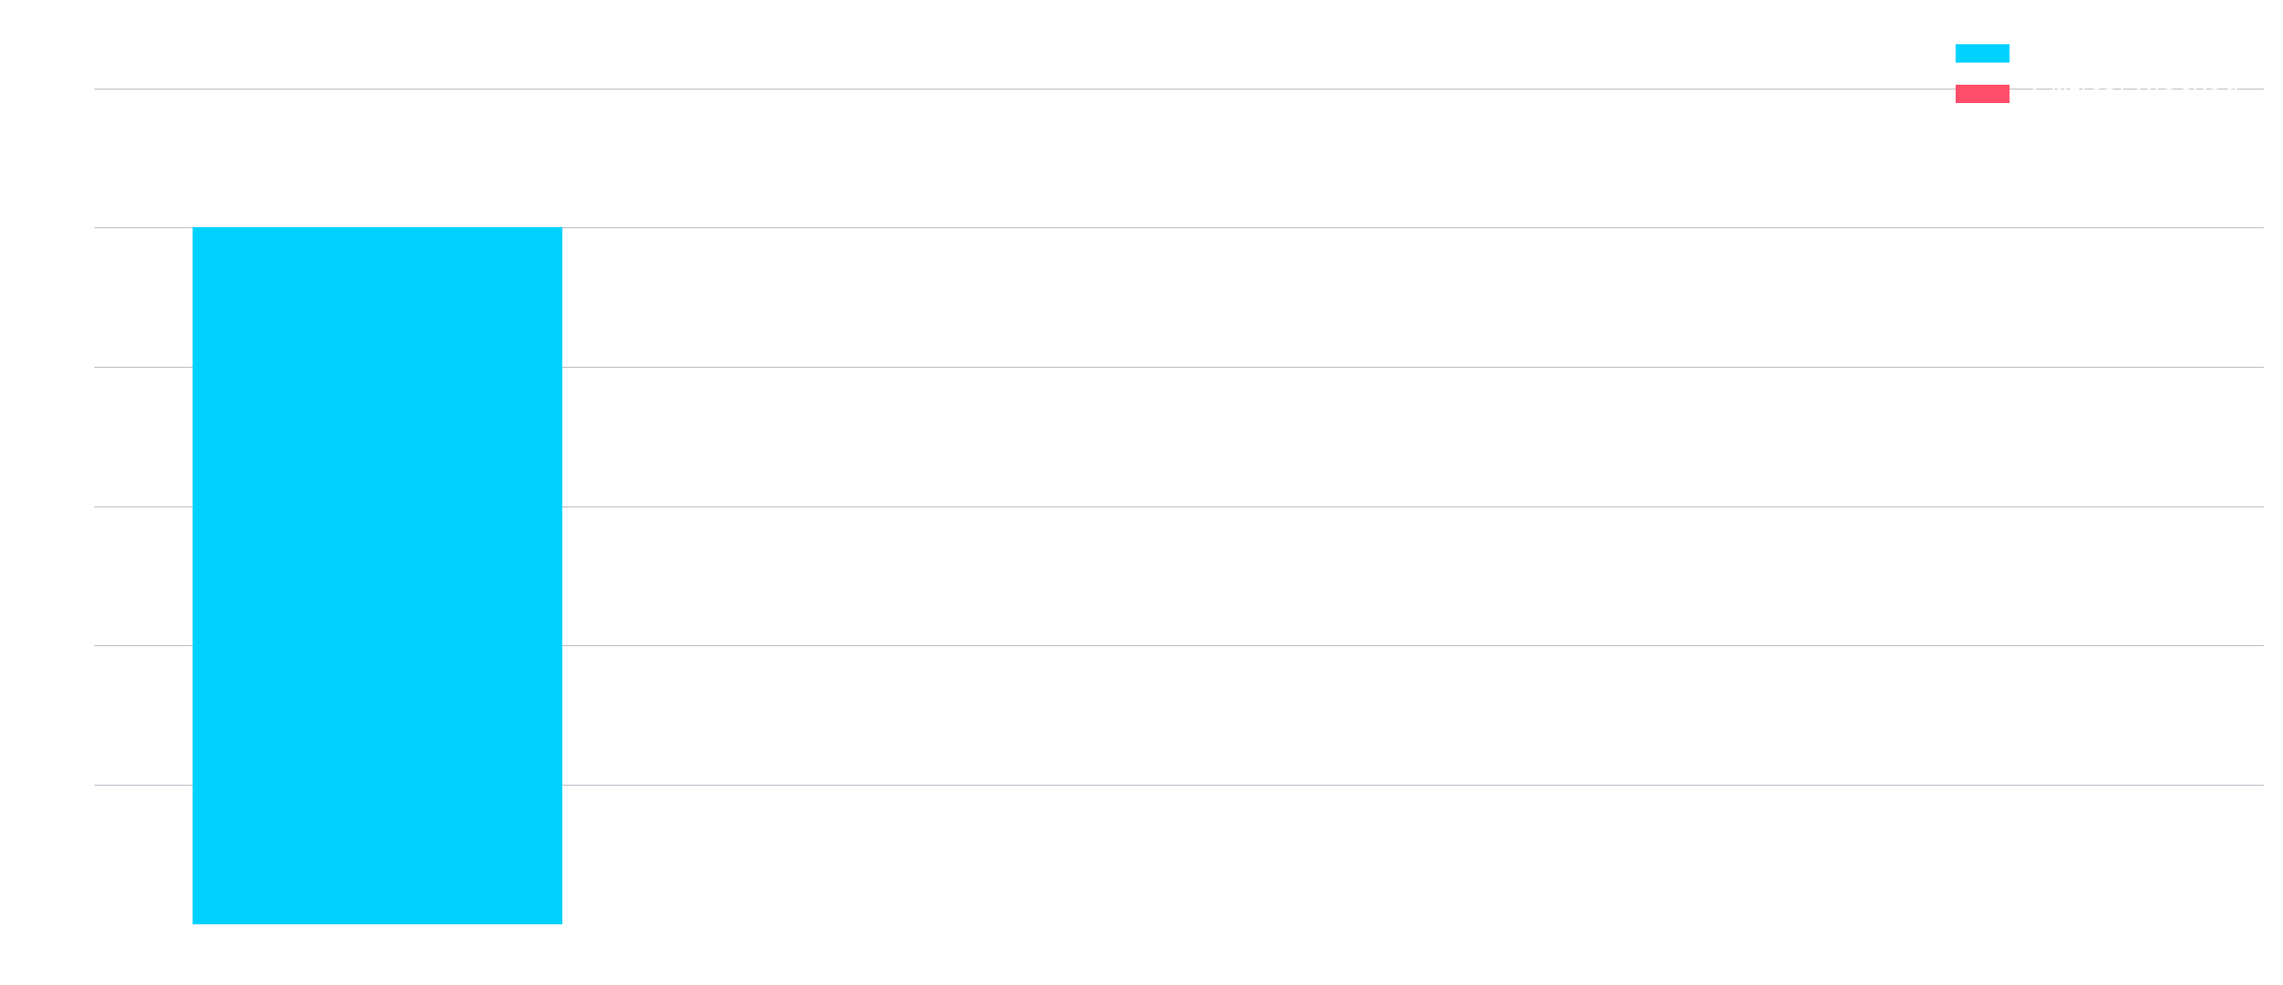
Portfolio Trends: Blockers
Portfolio-wide: 5 blockers, 0 critical blocked

Slide 5
Emerging Risks
Project
RAG
Overdue %
Blockers
Critical
Active Tasks
Titan
Red
41.7%
5
0
484
UniSan
Green
0.0%
0
0
383

Slide 6
Executive Insights
1
Program is heavily polarized with Project Titan (Red) carrying all 5 blockers and 41.7% overdue tasks, while UniSan (Green) shows zero overdue, indicating a single-point-of-failure risk concentrated in one large project.
2
Despite only 12.7% overall overdue, Titan's 484 active tasks represent 55.8% of total portfolio activity, meaning a single project's performance skews the entire portfolio health and delivery risk.
3
Zero critical blocked tasks across both projects is a positive signal, but Titan's 5 blockers and high overdue rate suggest systemic execution issues that could escalate into critical path delays if unaddressed.

Slide 7
Recommendations
1
Immediately dispatch a dedicated SWAT team to Titan to unblock all 5 blockers and conduct a deep-dive into the 41.7% overdue tasks to identify root causes and reprioritize resources.
2
Establish a daily stand-up for Titan leadership to track blocker resolution and overdue reduction, with a mandatory escalation threshold if overdue percentage does not drop below 30% within two weeks.
3
Perform a workload assessment to determine if Titan's 484 active tasks are realistic in scope, and consider shifting non-critical tasks to UniSan to balance portfolio risk and leverage its Green performance capacity.

Slide 8
Thank You
Report generated July 09, 2026 · Project Health Agent

