Slide 1




WakeWise NL
Where should wind turbines go on Newfoundland's west coast so they don't steal each other's wind? Real wind, real terrain, QAOA in Qiskit, and up to 24 qubits on IBM's quantum computer in Quebec
Team AI Entanglers · Mostafa Wasib · Mahmoud Al-Moghrabi · Qiskit Fall Fest 2026 · Memorial University
154 GWh/yr
~345x
24 qubits
14 of 19 years
from the 9-turbine layout we recommend on our flat test parcel: the electricity of ~9,100 NL homes
more often than random guessing, QAOA returns the best layout (flat parcel, 12 qubits, simulation)
real IBM hardware, real terrain: QAOA gets 66% of the way from random guessing to the best layout; the exact best appeared (chance: 1 in 17 million)
real wind years (2007-2025) in which the flat parcel's recommended layout is the best possible; a one-year design: 5 of 19
19 years of real wind
Terrain + PyWake physics
Turn into a qubit problem
QAOA, no tuning loop
Real IBM hardware, up to 24 qubits
Check: exact, greedy, random
Teal = quantum steps. No quantum advantage is claimed: at this size we can check every answer exactly.
Notes:
MOSTAFA: Hi, we're Mostafa Wasib and Mahmoud Al-Moghrabi, team AI Entanglers. Our project is WakeWise NL. The question is simple: where should wind turbines go, so they don't steal each other's wind? Four numbers sum it up. One: the layout we recommend makes 154 gigawatt-hours a year. That's enough for about 9,100 homes. Two: in simulation, our quantum method finds the best layout about 345 times more often than random guessing. Three: on IBM's real quantum computer, on real terrain with 24 qubits, it gets 66% of the way from guessing to the best answer. Four: our layout is the best possible in 14 of 19 real wind years. We start on flat land, then move to real terrain.

Slide 2
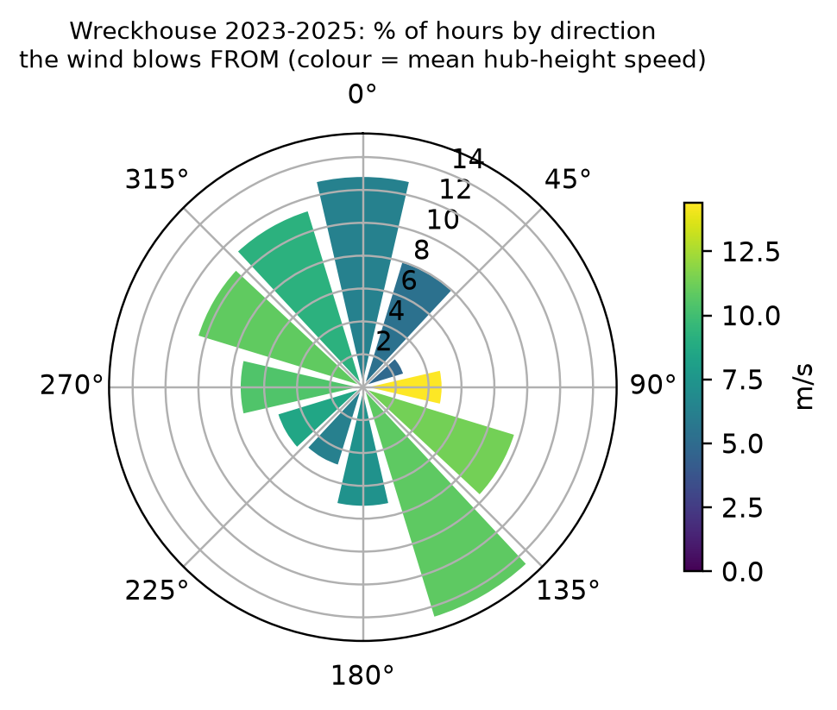




Strong NL wind, and the wakes that waste it
Wreckhouse, southwest Newfoundland
Gales here once blew trains off the tracks. At turbine height (110 m) the wind averaged 9.0 m/s over 2023-2025, so a 4 MW turbine would average 50% of its full output.
Project Nujio'qonik, next door
150+ turbines proposed in the Codroy Valley and on the Port au Port Peninsula to make hydrogen in Stephenville. Released from provincial environmental assessment, with conditions, in April 2024.
MUN's CREATE-SWIFT program asks for this
Compare classical and quantum methods on wind-energy optimization: accuracy, cost, scalability and real-world relevance.
17,600 MWh/yr
up to 2.4%
32% of hours
Design wind: 26,264 hours at Wreckhouse, 2023-2025; we test on all 19 years, 2007-2025. The wind comes mostly from the south-east and north-west, so turbines lined up on that axis shade each other most.
from one 4 MW turbine standing alone (2023-2025 wind, DTU PyWake)
lost to the wake (slower air) of one badly placed neighbour; a block of 12 loses 4.2%
at full power anyway, when a wake costs almost nothing: wakes matter less here than at most sites
Sources: ECCC hourly climate data (Wreckhouse, ID 8404343); NL Government EA bulletin, 9 Apr 2024; CBC News; CREATE-SWIFT talk, Qiskit Fall Fest 2026.
Sustainability benefit: more clean electricity or green hydrogen from the same land and steel. The prototype shows the method; real benefit needs site-specific terrain, turbines and costs.
Notes:
MOSTAFA: Why Newfoundland? Wreckhouse, on the southwest coast, is famous for its wind. Its gales once blew trains off the tracks. At turbine height, the wind averages 9 metres per second. Right next door, Project Nujio'qonik plans more than 150 turbines to make green hydrogen. And MUN's CREATE-SWIFT program asked for exactly this: compare classical and quantum methods on a real wind-energy problem. Here's the problem. A turbine slows the air behind it. That slower air is called a wake. A turbine standing in another's wake makes less power. With real wind and DTU's PyWake simulator, one turbine alone makes about 17,600 megawatt-hours a year. One badly placed neighbour can take up to 2.4% of that. So for each site we decide: build a turbine, or don't. Get it right, and you get more clean energy from the same land.

Slide 3
Inputs, output and scope
Input | What we used | Status
Wind | Wreckhouse weather station, hourly: 2023-2025 to design (26,264 h), 2007-2025 to test (163,068 h); scaled from 10 m up to the 110 m turbine height | Measured (height scaling assumed)
Wake physics | DTU PyWake, an industry-standard simulator; cross-checked with full-farm runs and a second wake model | Industry-standard model
Turbine | Generic 4 MW turbine with a 130 m rotor (PyWake's reference curves) | Illustrative
Costs | Each turbine's yearly cost, counted in energy: 88% of what a lone turbine makes, plus 2% per 650 m of cable; other levels tested | Illustrative, tested
Real-terrain parcel | Satellite elevation (Copernicus) and DTU's Global Wind Atlas; sites picked by a fixed rule | Measured + modelled (screening)
Output and use | One layout: build (1) or don't build (0) at each site. We report the best layouts, the energy at stake and whether the choice holds up year to year; for early screening, not construction advice
Scope | Flat test parcel: 12-16 sites on a 650 m grid, 19 years, a wetland case. Real-terrain parcel: 12-24 sites. Simulation, noise model and real hardware
Notes:
MOSTAFA: What's real, and what's assumed? The wind is real: 19 years of hourly data from Environment Canada. We design on the last three years and test on all 19. The wake physics comes from PyWake, an industry-standard tool. The turbine and the costs are examples, and we label them that way. The answer is a row of ones and zeros: one means build, zero means don't. It's for early screening, not construction.

Slide 4
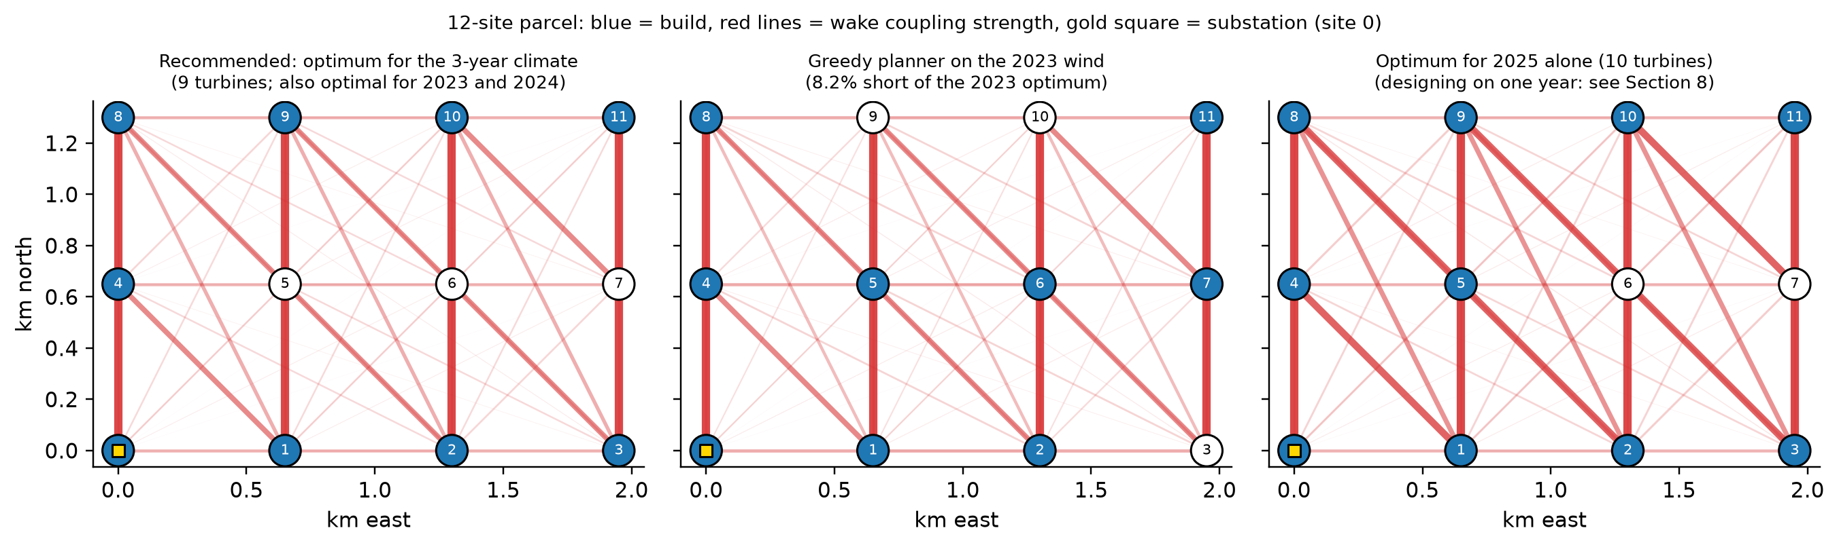
Wakes make this a puzzle, not a checklist
f(x) = −Σ (E − c_{i}) x_{i} + Σ W_{ij} x_{i} x_{j}
Each turbine earns its energy E minus its cost c_{i}; each built pair loses W_{ij} to wakes. A QUBO: yes/no choices with pair terms; lower is better
A simple greedy rule (keep adding the best next turbine) finds the 3-year optimum, but misses the best layout in 16 of 19 single years (up to 8.2% short). We check every answer against all 4,096 possible layouts.
Notes:
MOSTAFA: Why is this hard? Each turbine earns its energy minus its cost. But every pair of turbines also loses some energy to each other's wakes. So you can't judge one site at a time. With 12 sites there are 4,096 possible layouts. We check them all, so we always know the true best. A simple greedy rule, which keeps adding the best next turbine, misses the best layout in 16 of 19 years.

Slide 5
Wake physics maps straight onto qubits
x_{i} = (1 − z_{i}) / 2
H = Σ h_{i} Z_{i} + Σ J_{ij} Z_{i} Z_{j}
Each site is a qubit. A turbine's value acts on its own qubit (a Z field); a wake loss links two qubits (a ZZ coupling). This is an Ising model.
1
Map classical
Wind and PyWake → QUBO → Qiskit QAOA circuit (qaoa_ansatz), 1 to 3 layers
2
Optimize classical
Compile for IBM's chip; drop the weakest wake links to save two-qubit gates
Why QAOA fits
Already yes/no with pair terms: no extra qubits, no penalty tricks
Grows fast: 24 sites give 16.8 million layouts (NP-hard in general)
Tuned on the best 25% of samples (CVaR): a planner needs the best layout, not the average
Small enough to check exactly, so we measure quality instead of assuming it
3
Execute quantum
Angles tuned in simulation, or predicted or reused at 20-24 qubits; run on ibm_quebec
4
Post-process classical
Score every sampled layout; compare with exact, greedy and random
Notes:
MOSTAFA: Here's the key idea. Our problem already has the shape a quantum computer likes. Each site becomes a qubit: one means build, zero means don't. A turbine's value acts on its own qubit. A wake loss links two qubits. Physicists call this an Ising model. We solve it with QAOA, a quantum algorithm for problems like this, built in Qiskit. A normal computer tunes its settings. The quantum computer samples layouts, and we score every one.

Slide 6
QAOA works in simulation and on real hardware
Real hardware: ibm_quebec
Noiseless simulation, 12 qubits
8.4% vs 1 in 4,096
of shots give the best layout: QAOA with 3 layers vs random guessing, about 345 times more often
34 vs 12,269
shots needed to be 95% sure of seeing it (1 layer: 388; 2 layers: 54). One shot = one sampled layout
20%
of QAOA samples (2 layers) beat the greedy rule in the 16 years where greedy misses
ibm_quebec: IBM Quantum System One in Bromont, Quebec, 7 Nov 2026.
Main case, 4 runs: the best layout 23 times more often than random guessing.
2023 wind: 15% of hardware samples beat the greedy rule (random guessing: 2%).
A control circuit with no problem in it scores -0.02, the same as random guessing: the gain is QAOA, not noise.
We found a faulty qubit (101): it misread 1 as 0 in 65% of shots, though IBM's data looked normal. We now keep such qubits out of every run.
Honest caveat: a typical QAOA sample is good but not the best; the value is in its best few dozen shots.
Notes:
MOSTAFA: First, the left side: a simulation with 12 qubits and no noise. Each run of the circuit is a shot, and each shot gives one layout. QAOA works in rounds called layers. Random guessing finds the best layout once in 4,096 shots. QAOA with three layers finds it in 8.4% of shots, about 345 times more often. To be 95% sure of seeing it, guessing needs about 12,000 shots. QAOA needs 34. On the right, Mahmoud will show the real hardware.
MAHMOUD: Thanks, Mostafa. This is the real machine: IBM Quebec, a quantum computer in Bromont, Quebec. The bars show the gap closed. Zero means no better than random guessing. One means the best layout every time. Dark blue and light purple are simulations; teal is the real hardware. On our main case, over 4 runs, the hardware finds the best layout 23 times more often than random. A control circuit with no problem in it stays at random, so the gain is real. We also caught a faulty qubit, number 101. It misread 65% of its ones, even though IBM's data looked normal. Now we keep such qubits out.

Slide 7
Validated: full simulations and 19 years of wind
Layout designed on | Best in | Avg. shortfall | Worst-year shortfall
2023-2025 (recommended) | 14 of 19 | 19 MWh/yr | 167 MWh/yr
2025 wind only | 5 of 19 | 104 MWh/yr | 416 MWh/yr
14 of 19 years
the recommended layout is the best possible; one designed on 2025 alone: 5 of 19
Wind changes from year to year, so we test each design on every year back to 2007. Shortfall = energy lost in a year compared with that year's best layout.
Our pair-by-pair model ranks layouts in nearly the same order as full simulations (rank correlation 0.993; 1 = same order) and as a second wake model (0.992). Its best layout is the best in both.
Notes:
MAHMOUD: Can we trust the model? We ran two checks. On the left: our model adds wake losses pair by pair, but in a real farm all wakes act at once. So we re-scored 192 layouts with full simulations. The order matches almost perfectly: a score of 0.993, where 1 is a perfect match. On the right: wind changes every year, so we tested our layout on every year back to 2007. It is the best possible in 14 of 19 years. A layout designed on 2025 alone manages only 5.

Slide 8
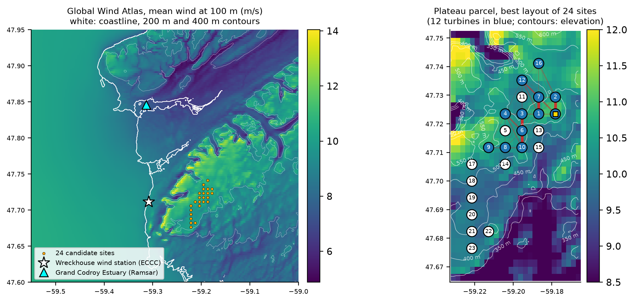
Real-world limits: a wetland and real terrain
Protecting a wetland
519 MWh/yr
9 → 8 turbines
133x random
Illustrative: two sites inside a buffer around the Grand Codroy Estuary, Newfoundland's only wetland of international importance (a Ramsar site).
of net energy: the price of keeping turbines out of the wetland
the optimizer re-plans the whole layout, not just drops two sites
QAOA (3 layers, simulation) finds the new best layout in 3.2% of shots: just a penalty on two qubits
Real terrain: screening level
423-550 m
above sea level: 24 buildable sites on the plateau above Wreckhouse, with 9.7-10.9 m/s average wind in the atlas
12 of 19 years
best possible when designed on all 19 years; a 2023-2025 design: 4 of 19. On terrain, use the long record
804x
more often than random guessing: QAOA (2 layers, simulation) finds the best layout for the first 16 sites
Site rule: on land, slopes up to 10%, terrain like the weather station's (so the wind atlas can be trusted), at least 3 km from the Ramsar estuary, growing out from the windiest spot. Wind: the station's real hours, scaled per site by DTU's Global Wind Atlas.
Notes:
MAHMOUD: Sustainability is not only energy. At the top: next to Wreckhouse is the Grand Codroy Estuary, a wetland of international importance. Suppose two of our sites fall inside its buffer. For the quantum computer, that's just a penalty on two qubits. Protecting the wetland costs 519 megawatt-hours a year, and QAOA still finds the new best layout. Below: so far the land was flat. Now we use real terrain, on the plateau above Wreckhouse. With satellite elevation data and DTU's Global Wind Atlas, a fixed rule picks 24 buildable sites: on land, gentle slopes, and at least 3 kilometres from the estuary. Here the wind record matters more. A layout designed on all 19 years is the best in 12 of them. One designed on three years manages only 4. This is a screening study, not a final design.

Slide 9
Scaling to 24 qubits with no tuning loop
Simulation, unseen years 2020-2025
Real hardware: ibm_quebec
100% / 92%: our AI with 1 / 2 layers, no tuning loop needed
99% / 100%: reusing one good angle set beats our AI, an honest negative result
11%: averaging tuned angles fails at 2 layers; good angles differ, so their average lands in between
0.66 vs 0.76: gap closed at 24 qubits, real hardware vs noiseless simulation
4 in 24,000 shots gave the exact best of 17 million layouts (random guessing: 1 in 17 million)
-0.88: flipped control, the same gates with one sign reversed, lands below random. The machine follows the physics
Notes:
MAHMOUD: On the left: QAOA has tuning knobs called angles. Tuning them for every new problem is slow: hours of computing at 24 qubits. So we built a small AI that predicts good angles straight from the problem. On wind years it never saw, it keeps 100% of the quality with one layer, and 92% with two. But simply reusing one good set of angles did even better: 100% with two layers. So our AI lost. That's an honest negative result, and good news too: no tuning loop is needed. On the right, we scale up on real terrain, from 12 to 24 qubits, on the real machine. Teal is the hardware, light grey is the noiseless simulation. At 24 qubits, the hardware gets 66% of the way from random guessing to the best layout. The perfect simulation gets 76%. There are about 17 million possible layouts. The best one appeared 4 times in 24,000 shots. Random guessing would need about 17 million tries. The red line is our control: the same circuit with one sign flipped. Same gates, same noise, but it steers toward bad layouts, and it lands below random. So the machine is following our problem, not noise.

Slide 10


What the evidence supports, and what it does not
Supports
Does not support
Siting on real NL wind is a real puzzle; our pair-by-pair model matches full simulations
The recommended layout is the best possible in 14 of 19 real wind years
QAOA favours the best layouts: ~345x random in simulation, and a clear signal on real hardware at 24 qubits
No tuning loop needed at 20-24 qubits: our AI works, and reusing one angle set works as well
Control circuits behave as physics predicts: the flipped circuit scores below random
Quantum advantage: a laptop still solves 24 sites exactly
Bankable siting: the terrain parcel is a screening study, and costs are illustrative
That our AI beats simply reusing one good angle set: it does not
That the faulty qubit caused the weaker 2-layer results on the flat parcel: on healthy qubits they were no better
Next: measure wind on the plateau · add spacing and habitat limits · test bigger parcels against strong classical solvers (simulated annealing, MILP) · partner through MUN CREATE-SWIFT and Mitacs
Builds on Hancock et al. (2023) and Nigro et al. (2025), who set out quantum wind-farm layout and compare solvers. New here: a real NL site with 19 years of measured wind and real terrain, a check against full wind-farm simulations, and controlled hardware runs up to 24 qubits.
Resources: notebook about 30 minutes on a laptop; 21 hardware jobs, 174 s of quantum-computer time in total.
Thank you. Questions?
github.com/mrw-soumik/Qiskit-AI-Entanglers-
Credits: QAOA workflow adapted from Tinh Bui's workshop notebook; IBM Qiskit 101 and the Fall Fest hardware example; DTU PyWake; ECCC data (Open Government Licence - Canada); DTU Global Wind Atlas (CC BY 4.0); Copernicus DEM (ESA); prior quantum wind-farm layout studies: Hancock et al. (2023), Nigro et al. (2025). Full credits in the notebook.
Notes:
MAHMOUD: To sum up. The evidence supports three things. Our model matches full simulations. Our layout holds up over 19 years. And QAOA favours the best layouts, in simulation and on real hardware up to 24 qubits. It does not show quantum advantage: a laptop still solves this size exactly. It's not a final siting decision, and our AI did not beat simple reuse. What's new: a real Newfoundland site, 19 years of measured wind, and controlled hardware runs up to 24 qubits. Mostafa will wrap up.
MOSTAFA: Thanks, Mahmoud. To wrap up: real wind, real terrain and industry-standard physics give a model we can trust. Our layout holds up over 19 years. And QAOA finds the best layouts far more often than chance, even on real hardware. Everything is in our public GitHub repo. Thank you. We're happy to take your questions.
Q&A preparation:
Q: Why quantum if greedy finds the long-term optimum? A: At this size the classical method is strong and we say so. Greedy misses the best layout in 16 of 19 single years (up to 8% short), where 20% of QAOA's samples beat it; we claim no advantage, we measure QAOA exactly.
Q: Which inputs are real? A: 19 years of hourly wind from ECCC (2007-2025). Physics from DTU PyWake. Turbine class, parcel and costs are illustrative and labelled.
Q: Is the pairwise QUBO valid? A: Rank correlation 0.993 with full-farm PyWake and 0.992 with a Gaussian wake model; the QUBO optimum is best under both.
Q: Simulator or hardware? A: Noiseless and noise-model results are simulations; the ibm_quebec results are real hardware, 21 jobs in total, job IDs in results/hardware_*.json.
Q: Are the hardware results repeatable? A: The main instances ran 4 times each; the range is in the notebook, Section 6. One run per instance also carried readout calibration, and mitigation changed P(opt) by x1.0 to x3.2.
Q: Why trust one recommended layout? A: Tested on 19 real years: best possible in 14, average loss 19 MWh/yr; a one-year design averages 104.
Q: Is the wetland real? A: The Grand Codroy Estuary is real (Ramsar site 364); placing a buffer on sites 10 and 11 of our idealized parcel is an illustration of how constraints enter the QUBO.
Q: What did your tests prove? A: Ising energies equal the QUBO on every bitstring, Qiskit's bit order is decoded correctly, the fast simulator equals Qiskit's statevector, PyWake pair losses behave physically, CVaR, readout mitigation and scoring are correct.
Q: Why not quantum machine learning for the AI? A: On small classical data sets, standard QML models are generally matched or beaten by classical ones (Bowles, Ahmed and Schuld, 2024); the quantum part belongs where the problem is natively quantum-shaped, the Ising optimization.
Q: Is the terrain wind real? A: The hourly wind is measured at the station; the site-to-site differences come from DTU's Global Wind Atlas, a screening tool. A real project would measure on the plateau.
Q: Why skip tuning the angles? A: Tuning takes about 1,500 circuit runs per instance, hours of simulation at 24 qubits. Our AI was trained once on 195 cases and tested on 90 cases from unseen wind years.
Q: How big is the 24-qubit circuit? A: 213 two-qubit gates for 1 layer after fitting it to the chip.
Q: Do more layers help on hardware? A: Not clearly. On real terrain 2 layers score slightly higher (0.67 against 0.66 at 24 qubits), on the flat parcel lower, so we claim nothing about extra layers.

