Slide 1

CSCA 5642: Introduction To Deep Learning
By Matthew Waleyko
https://github.com/mrwaleyko1/csca_5642_week_6

Slide 2
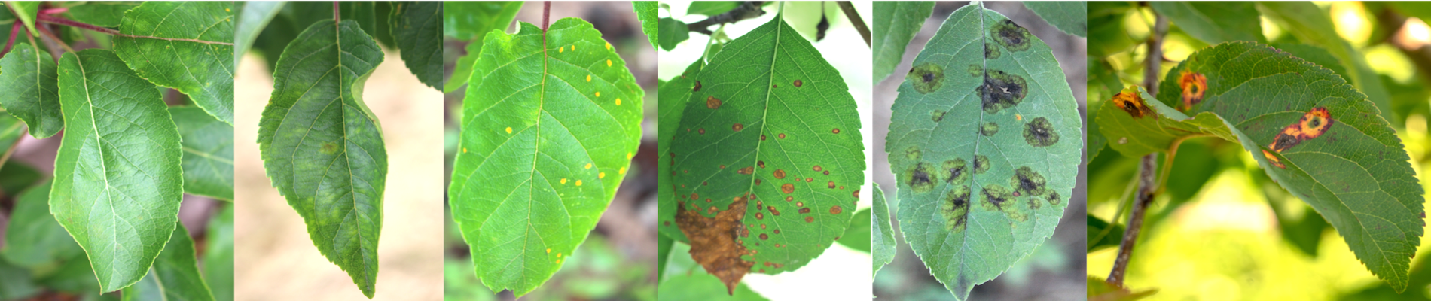
The Problem
Leaf Health Recognition
Agricultural Automation
Plant Monitoring and Diagnostics
Millions of dollars in annual losses
Notes:
usgs nasa
vast wealth of data to comb throught so ther is a benifit to having a ml
model to help with classifiying

Slide 3
The Data
Christine Kaeser-Chen, Fruit Pathology, Maggie, Sohier Dane. (2020). Plant Pathology 2020 - FGVC7. Kaggle. https://kaggle.com/competitions/plant-pathology-2020-fgvc7
Apple Trees

Slide 4
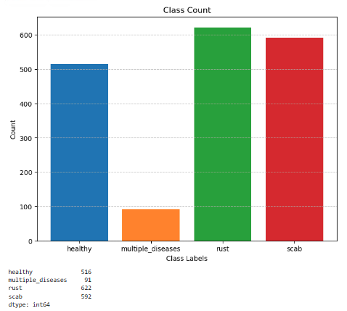
EDA
Feature Histogram
Similar levels of Rust, Scab, Healthy
Categories are imbalanced
1821 Images
2048X1365
Data Augmentation
Notes:
head of the data and datatypes
no null values
or abnormalities indexing at 1
histograms
heatmap

Slide 5
Model Construction
From Scratch Model
~5% accuracy
Extreme Overfitting
https://keras.io/api/applications/
CNN
Accuracy
Training loss

Slide 6
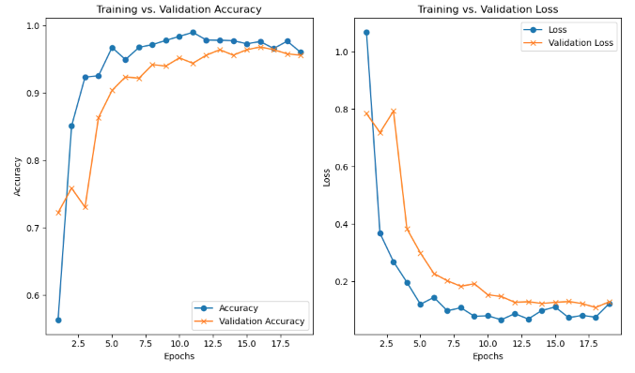
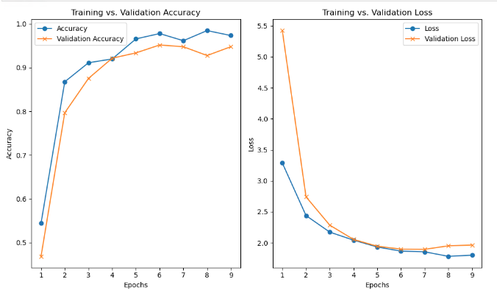
Model Refinement
DenseNet201
96.78% Accuracy
20 Million Parameters
402 Layers
18 Epochs
InceptionResNetV2
95.17% Accuracy
55.9 Million Parameters
449 Layers
9 Epochs

Slide 7
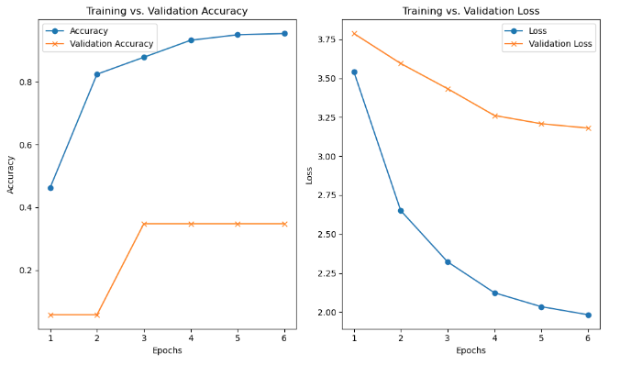
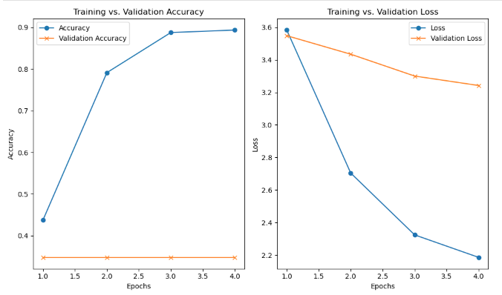
Model Refinement
EfficientNetV2L
34.81% Accuracy
119 Million Parameters
6 Epochs
EfficientNetB5
34.81% Accuracy
30.6 Million Parameters
312 Layers
4 Epochs

Slide 8
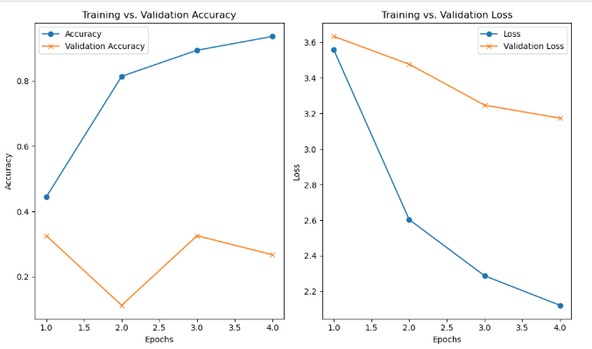
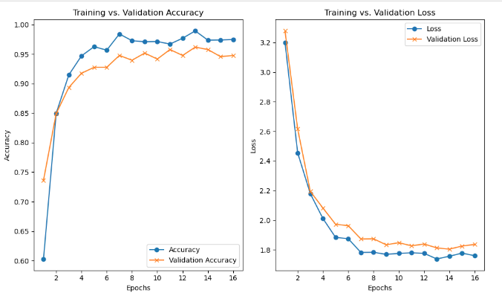
Model Refinement
EfficientNetB5
32.6% Accuracy
4 Epochs
InceptionResNetV2
96.18% Accuracy
16 Epochs

Slide 9
Conclusions
Transfer Learning
>96% accuracy
DenseNet201
InceptionResNetV2

Slide 10
References
Thapa, R., K. Zhang, N. Snavely, S. Belongie, and A. Khan. 2020. “The Plant Pathology Challenge 2020 data set to classify foliar disease of apples.” Applications in Plant Sciences 8(9): e11390. doi:10.1002/aps3.11390.
Christine Kaeser-Chen, Fruit Pathology, Maggie, Sohier Dane. (2020). Plant Pathology 2020 - FGVC7. Kaggle. https://kaggle.com/competitions/plant-pathology-2020-fgvc7
https://keras.io/api/applications/

