Slide 1
Cloud Computing Concepts and Architectures
This chapter covers the following topics:
Cloud Logical Model
Definitions of Cloud Computing
Cloud Service Models
Cloud Deployment Models
Reference and Architecture Models
Cloud Security, Compliance Scope, and the Shared Responsibility Model

Slide 2
Cloud Computing Concepts and Architectures
Although cloud services are presented to the consumer in a user-friendly format, the implementation required to support upwards of 1 million customers behind the scenes is quite different from what we are accustomed to.
The cloud service provider (CSP) creates and manages an offering that consists of pools of resources (Compute, Network, Storage) that are accessed via controllers that communicate using application programming interfaces (APIs).

Slide 3
Cloud Computing Concepts and Architectures
It is through these pools and API access that several essential characteristics of the cloud (such as self-service, elasticity, and resource pooling) are possible.
A very high-level diagram shown in Figure 1-1 demonstrates how the controller is key to serving resources in an abstracted (you don’t access the hardware directly) and orchestrated (coordinates the processes) manner.
In a nutshell, you basically request something (Compute, Network, Storage) from the controller, and the controller takes care of the rest for you.

Slide 4
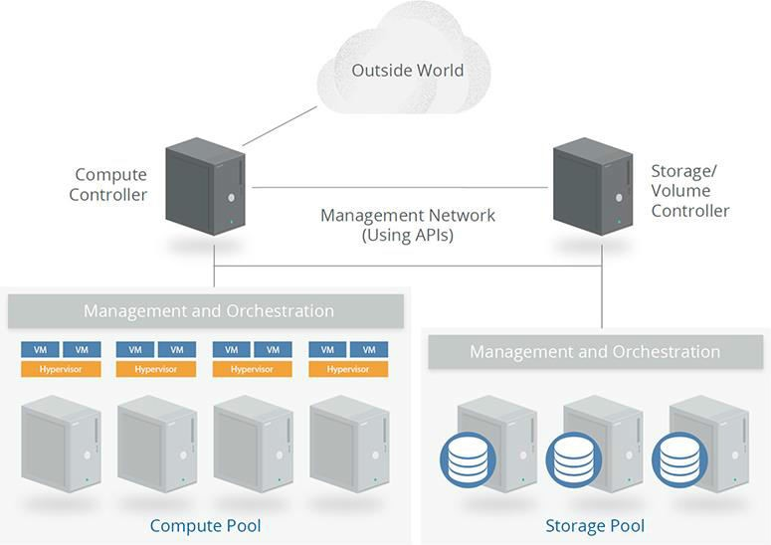
Figure 1-1 Cloud controllers and pools of resources

Slide 5
When most people think of the cloud, they think of how “cheap” it is in comparison to the traditional information technology (IT) structure.
While cloud computing can be (but is not always) cheaper because of economies of scale at the provider’s side, cloud consumers must appreciate that the provider cannot be everything to everyone (that is, the CSP cannot meet everyone’s security policies).
As a result, you need to be very aware of the shared responsibilities that come with any potential cost savings.
The provider will supply you with some security controls, but you will be responsible for implementing other controls.

Slide 6
The bottom line here is this: the idea that a CSP takes care of everything for you is a fallacy that really needs to die.
Although the shared responsibilities are primarily based on the service model consumed (Software as a Service [SaaS], Platform as a Service [PaaS], or Infrastructure as a Service [IaaS]), the deployment model also comes into play when determining what a consumer must do to secure a cloud environment properly.
Cloud computing offers tremendous potential benefits in agility, resiliency, and economy.
As a result, organizations can move faster (no hardware purchases and racking/stacking servers), reduce downtime (if architected to take advantage of elasticity and other cloud characteristics), and save money (no capital expenses, and operational expenditures can be reduced by right-sizing server specs and quantity on the fly to meet actual demand).

Slide 7
As for security at the provider level, the CSP business model requires that extremely strong controls be in place if the provider is to remain in business. (Would you do business with a cloud provider that was successfully hacked three times in the past year?)
CSP generally will spend appropriate time and money to make certain that security is very well architected into everything they do.
The cloud is really what you make of it. You can simply migrate a server in a “like-for-like” fashion by performing a physical-to-virtual (P2V) migration to create that very same system running in a cloud environment.

Slide 8
You might think this would be the easiest way to adopt cloud services, but the thing is, all you’ve really done is take a server that you have physical control over and make a virtual image of it, so that now you are running a single point of failure in someone else’s physical environment over which you have no control.
The real power of the cloud is manifested when you understand and adopt cloud-native models and adjust your architectures and controls to align with the features and capabilities of cloud platforms.
If architected properly, servers can be treated as cattle, not pets. (This expression is often used to describe a pattern where servers are viewed as easily replaceable commodities, not “long-standing” resources, as they are in a traditional environment.)
The focus of workload management moves from “we need X servers” to “we need this application to serve X concurrent connections.”
In fact, you may not even have servers to manage if you are leveraging serverless computing (aka functions).

Slide 9
CLOUD LOGICAL MODEL
The cloud logical model clearly defines four layers of functionality and applicable security requirements that exist in both traditional and cloud environments:
Infrastructure layer Infrastructure security
Metastructure layer Virtual environment security
Infostructure layer Data security
Applistructure layer Application and operating system security

Slide 10
Infrastructure
The servers, networking, and storage pools exist at this layer. Security at this layer involves properly securing the physical world.
Do you run a private cloud that you own? You own this layer.
Have a public cloud? This layer is owned and operated by someone else. In other words, it ’s the provider’s world, and you’re just working in it.

Slide 11
Metastructure
This layer is the game-changing aspect of cloud. In this layer, you both configure and manage a cloud deployment of any type. The single biggest thing you need to understand immediately about the difference between the cloud and traditional IT is the metastructure in your data center. It is within the metastructure logical layer that you build the virtual tools required for a virtual world (the cloud).
You’ll perform configuration in the management plane through a graphical user interface (GUI), a command-line interface (CLI), or an API, depending on what the provider offers to interact with its infrastructure.
If your team knows nothing about the metastructure, they know nothing about securely configuring, managing, or responding to incidents in the cloud. Make no mistake: you are in charge of configuring and managing this layer. Configuration and management mistakes in this layer are why so many companies have been burned in the past when using cloud services (and will likely continue to be burned for the rest of time).

Slide 12
Infostructure
This is where the information and data reside. This could be file storage, databases—whatever. Security in this layer doesn’t really change; how you secure things may change, but the principles of data security remain the same.
Applistructure
Applications and all of the services used to build and support them reside here. Your applications could be running on a Microsoft or Linux server of your own, or they could be running in a wide variety of new technologies such as containers, microservices, or serverless networks. If you take an image of a running system and migrate it into the cloud, nothing changes from a security perspective. In this scenario, operating systems will always need patches, and application security still applies as it always has. As you start to build “cloud-native” applications to take advantage of the new technologies the cloud offers, your security is likely to change dramatically.

Slide 13
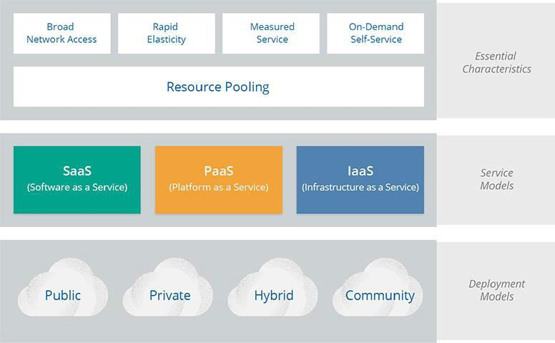
CLOUD COMPUTING DEFINITIONS
You’ll find many definitions for “the cloud” out in the marketplace. NIST states that there are five essential characteristics, three service models, and four deployment models.
Figure 1-2 gives a graphical view of these items.
Figure 1-2 A cloud comprises five essential characteristics, three service models, and four deployment models.

Slide 14
Essential Characteristics
Simply stated, the following essential characteristics determine whether an offering is really a cloud service or not.
If an organization is trying to sell you its “cloud service” and it doesn’t have the five characteristics discussed here, you’re getting “cloudwashed” (a term for trying to sell a non-cloud service as a cloud service) and not really getting the value that the cloud can bring to your company.

Slide 15
1. Resource Pooling
Resources (Compute, Network, Storage) are the most fundamental characteristic of the cloud. Resources are pooled, and consumers are granted access. A consumer’s access to the pools is tightly isolated from that of other consumers, typically based on policies at the provider’s side. NIST 800-145 specifically calls out multitenancy as an aspect of this essential characteristic.
2. Broad Network Access
In this characteristic, the service is available over a network (such as the Internet). There is no special requirement for direct physical connectivity or provider-supplied network connectivity. For example, you could manage an entire IaaS implementation via the browser on your cell phone.

Slide 16
3. Rapid Elasticity
This characteristic is the most powerful aspect of cloud. It enables consumers to scale resources based on demand, often automatically (note that access can be manual and scaling still applies). Scaling can occur in a couple of different ways. Scaling up generally refers to using more powerful servers (such as a four-CPU configuration as opposed to two), whereas scaling out refers to adding more servers (for example, adding servers to a web farm to service requests). Depending on the application and architecture, you want to make sure your provider supports scaling either up or out to meet demand. In addition to having the ability to add capacity when demand increases, you need to be able to scale down when demand drops. This aspect is critical, because you don’t want to scale up to respond to a temporary increase in demand— you’d stay there in perpetuity and be surprised when the provider’s bill is suddenly three times what it was the month before!

Slide 17
4. Measured Service
The measured service essential characteristic makes the cloud a pay-as- you-go model of computing: you’re simply charged for what you use. Another term used is “utility computing,” which is akin to how you consume electricity or water from a utility.
5. On-Demand Self-Service
You have the ability to provision resources on your own without human intervention at the provider’s side. Put another way, if your provider tells you that your ticket for a new server instance is very important to them and they will act on it in 48 to 72 hours, you’re being cloudwashed.

Slide 18
Cloud Service Models
The service model is a portion of the cloud reference architectures from ISO/IEC 17789 and NIST 500-292 documentation.
The service model is presented as a stack to gain a high-level understanding of what is performed by a cloud service provider.
This stack may be referred to as the “SPI” (SaaS, PaaS, IaaS) stack or SPI tiers.
Figure 1-3 depicts the service models and how they are built on top of each other to form the SPI stack.

Slide 19
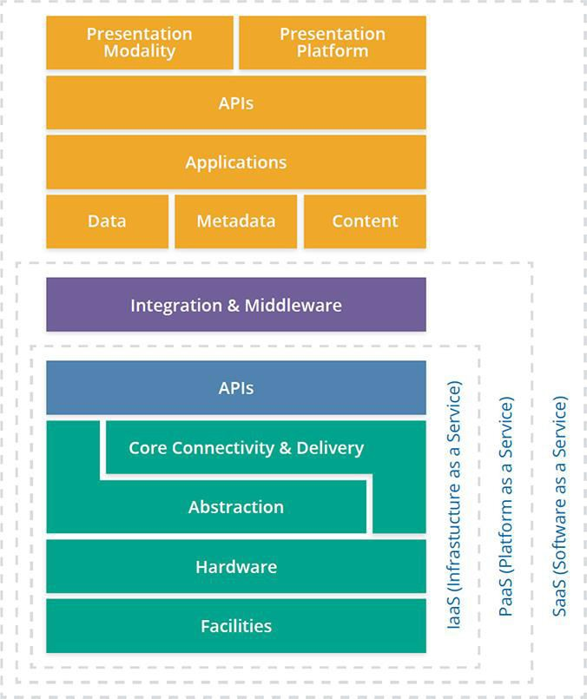
Figure 1-3 Service models are arranged on an SPI stack.

Slide 20
1. Infrastructure as a Service
IaaS is the underlying foundation that consists of the physical facilities and infrastructure hardware. The hardware itself may be customized, proprietary, or standard off the shelf, but it’s still hardware, like you’ll find in any data center. The difference, however, is in the resource pooling, abstraction, automation, and orchestration. Abstraction is usually based on virtualization of servers, networks, and/or storage. It is this abstraction that allows for the pools of resources to be created (for example, a group of hypervisors all working together). The orchestration enables a controller to request resources from the pools of resources, and all this is automated through the use of APIs (mostly RESTful APIs).
Let’s look at a scenario that ties this all together. Say you want to create an Ubuntu Server instance with two CPUs, 12GB of RAM, 2TB of storage, and two network cards. Here’s what happens behind the scenes at the provider side (shown in Figure 1-4):

Slide 21
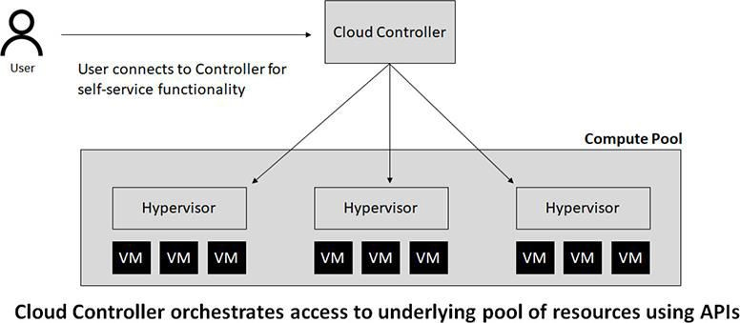
Figure 1-4 Automation and orchestration of cloud components

Slide 22
The cloud controller contacts the compute controller to request that a new server with two CPUs and 12GB of RAM be created.
The cloud controller contacts the storage controller to allocate 2TB of storage. This storage is connected to the new server instance through a storage network.
3. The cloud controller requests two virtual network interface cards from the network controller.
After all of this is performed, the cloud controller takes the requested Ubuntu Server image, copies it to the newly created virtual server, boots it, and configures it. Once this is done (measured in seconds or minutes), the controller makes the connection information available to the consumer.

Slide 23
The IaaS service can usually be accessed via multiple methods—web, CLI, or API. These interfaces are created and made available by the provider for customers to manage their virtual environment, hence the term cloud management plane (and is part of the metastructure logical model covered earlier in this chapter).
In fact, the display of a web interface is mainly for human convenience. The provider will take actions performed graphically and convert them to API calls that are then executed. As a cloud consumer, anything you can do via the web interface can be done via the API calls that are exposed. More mature cloud implementations by consumers are programmatically driven through accessing APIs. In fact, this programmatic-driven virtual infrastructure (referred to as a software defined infrastructure, is something that every cloud consumer should strive for. The less human intervention through a web browser, the better, because there will be less human error and a much higher level of agility.

Slide 24
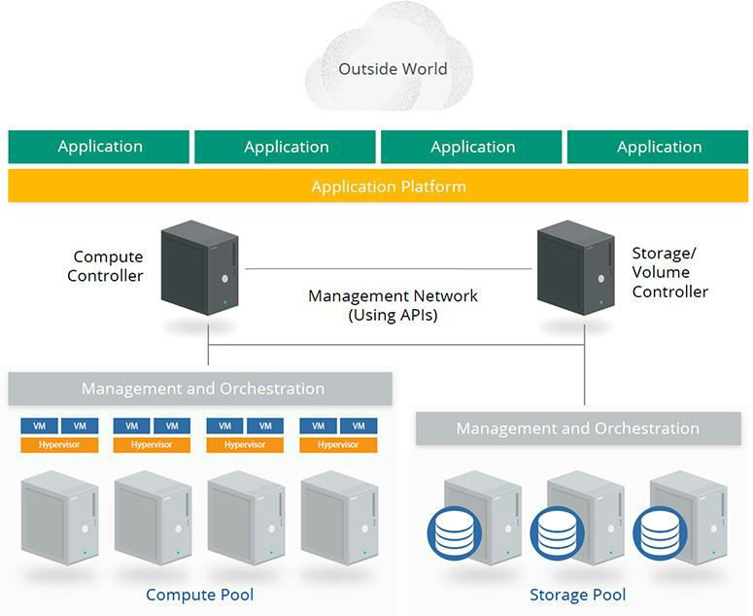
2. Platform as a Service
Of the three service models, PaaS is the blurriest of all of them. PaaS adds a layer of integration with application development frameworks; middleware capabilities; and functions such as databases, messaging, and queuing. Figure 1-5 demonstrates a PaaS offering built on top of IaaS that creates a shared platform on which applications are run.
Figure 1-5 PaaS offering built on top of IaaS.

Slide 25
In the PaaS service model, the provider builds the infrastructure (or leverages IaaS from another provider), creates a shared platform that customers will leverage, and may expose security controls they believe customers want control over. The main benefit of using PaaS is that it removes the overhead associated with building and maintaining servers and shifts that responsibility over to the provider (the service becomes somewhat of a black box). Customers in turn leverage this multitenant platform that is fully managed by the provider.
You can think of PaaS as a development platform that you can use to gain quick access to an environment to build things on, or to leverage for functionality. Take a “Database as a Service” PaaS offering, for example. Rather than launching an instance, configuring the operating system, and then installing and configuring your chosen SQL software, you simply choose the SQL platform you want and answer a few questions, and your database is available within minutes.

Slide 26
The downside to PaaS, as far as security is concerned, is that controls exposed to the customer are restricted compared to those possible in IaaS.
Change management is another issue you can run into with the PaaS provider owning and managing the platform. The provider can, and will, change what platforms will be supported and which ones will be deprecated over time. It is on you not only to be advised of these changes but also to identify potential issues and fix them before your provider makes the change. For example, if you are running application code in a development platform, you may eventually get an e-mail from your vendor announcing the introduction of a change to the platform that will break your application if your code has a dependency on functionality that is being deprecated.
In a way, your provider is now dictating part of your change management. The provider may give you weeks, or they may give you months. It’s up to them, not you, because they own the platform.

Slide 27
3. Software as a Service
The SaaS model can be simply defined as “renting a turnkey application from a provider.” All SaaS applications are considered multitenant in nature and support access by web browsers and mobile applications. In many cases, SaaS applications also support access via API calls. The type of API supported (REST versus SOAP) and capabilities offered via the API are dependent on the provider in question.
The architecture of an SaaS application behind the scenes can range from a single server running both web and SQL services (read: single point of failure), or it can be an extremely complex system that consists of load balancers, redundant server farms, serverless components, and anything else imaginable. There are no rules or regulations as to what an SaaS (or any service model) provider must or must not do.

Slide 28
From a security and due diligence perspective, an important aspect of SaaS services is that the SaaS provider may use a separate provider for IaaS or PaaS purposes.
The biggest issue here has to do with salespeople exaggerating the security of their application because it’s being run in a different provider network. As you already know, the cloud is a shared responsibility, and the SaaS vendor is just another client to the IaaS provider. If the application you are consuming has security issues at the applistructure layer (such as privilege escalation), that is 100 percent on the SaaS vendor.
Along the same lines, the SaaS vendor who says their application is PCI- or HIPAA-compliant because it’s being run in a compliant infrastructure is equally guilty of ignorance or worse.

Slide 29
Cloud Deployment Models
Both NIST and ISO/IEC call out four deployment models, which refer to how the technologies are owned and how they are consumed. Deployment models are separate from the service models; with deployment models, you can have a private PaaS, for example.
1. Public Cloud
This one is pretty simple. Anyone in the world with a credit card (stolen or not) can sign up to use the service. The infrastructure is owned and managed by a third party and is located off premises—somewhere other than your location.
2. Private Cloud
A private cloud is built for a single organization. You can have your own team install and manage a cloud infrastructure in your data center, or you can call a private cloud supplier and they could spin one up for you in their data center. The important fact is that only trusted people (well, people within your organization at least) will be accessing the cloud. Another trick in understanding what constitutes a private cloud is that it is really nothing more than controller software that automates and orchestrates access to pools of resources.

Slide 30
3. Community Cloud
A community cloud is generally built for multiple trusted organizations with similar concerns (such as a risk profile). The community cloud is much like a private cloud in that it can be built and managed by your company, or it can be outsourced. The co-tenants are also contractually bound. The key difference between a private and a community cloud is that the financial risk is shared across multiple contractually trusted organizations in the community cloud.
4. Hybrid Cloud
A hybrid cloud is an interesting model with regard to how its definition has changed over the years. A hybrid cloud has historically been referred to as the connection of two different clouds (such as a public and private cloud) that are bound together by standardized or proprietary technologies that enabled data and application portability. In the past few years, however, this term has been extended to include a non-cloud data center being connected, or bridged, to a cloud provider.

Slide 31
The most important capabilities that are associated with the hybrid deployment model are portability and cloud bursting.
Portability is the ability to shift where a workload is executed—for example, creating a P2V image of a physical server and moving that to a cloud environment. The connectivity between your data center and the cloud environment (hybrid) makes this possible.
Cloud bursting means leveraging a cloud provider to supply additional resources to meet additional load. In this scenario, you could have a load balancer that will direct incoming web traffic either to internal or to cloud-based systems depending on current load.

Slide 32
CLOUD SECURITY SCOPE AND THE SHARED RESPONSIBILITY MODEL
When looking at securing or assessing a cloud environment, you should keep in mind that the CSP is always responsible for implementing and configuring some aspects of the computing environment, and you are responsible for other aspects of the environment.
This split is referred to as the shared responsibility model of the cloud. This shared responsibility model will determine the scope of each party’s cloud security efforts.
Shared Responsibility Model
You know that the cloud has a security responsibility shift. You also know that this responsibility shift is based on the metastructure, because it includes the management plane. All traditional security principles and domains remain the same. The differentiator with the cloud is that the nature of risks, roles and responsibilities, and implementation of controls changes, often dramatically.

Slide 33
When thinking of the responsibility shifts, you should try to remember that the provider is going to supply customers with security that will satisfy most requirements, but you can’t expect miracles. The provider will never know that you recently fired an employee and that the employee’s access should be revoked. That’s on you!
From a risk-tolerance perspective, every company, even the function in every company, will be different, and it’s impossible for the provider to address every risk that every customer may need addressed, even for items the provider is responsible for.
For all the models, you have general risk approaches: accept the risk, mitigate the risk by deploying a control to minimize the impact or likelihood, or avoid the risk.

Slide 34
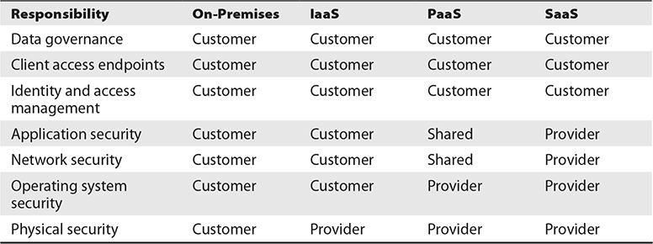
Table 1-1 shows a high-level breakdown of the security responsibility shift that comes with each service model in the SPI stack and how it compares to a traditional (on-premises) data center.
Table 1-1 Security Responsibility for Different Service Models
Notice in the table that in all the models, the customer is never outsourcing everything to the provider. You will always maintain a degree of responsibility, no matter what service model is used.

Slide 35
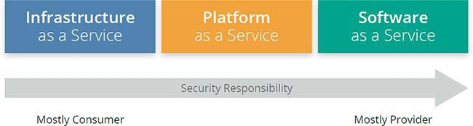
Figure 1-6 shows how the security responsibility shifts based on the service model.
Figure 1-6 Security responsibility shifts based on service model.
The most important security consideration is knowing who is responsible for particular controls in any given cloud workload. In other words, you can’t just assume a provider uses a particular control because they are providing a particular service model (SaaS, PaaS, IaaS).

